Slide 1
Peer Case Managers: Ensuring Continuous Support and Effective Follow-Up in Care
Exploring roles and strategies in healthcare support
Notes:
---
This presentation explores the vital role of peer case managers in healthcare. We will examine their responsibilities, strategies for providing continuous support, effective follow-up practices, and their impact on client well-being and recovery.

Slide 2
Meeting Program
Role and Responsibilities of Peer Case Managers
Continuous Support Strategies
Effective Follow-Up Practices
Impact on Client Well-Being and Recovery
Notes:
We will cover the role and responsibilities of peer case managers, explore continuous support strategies, review effective follow-up practices, and discuss the positive impacts these professionals have on client health and recovery outcomes.

Slide 3
Role and Responsibilities of Peer Case Managers
Notes:
Peer case managers serve as bridges between clients and care teams, leveraging their lived experience to provide empathetic and practical support. Their collaboration with clients and healthcare providers is essential for effective care delivery.

Slide 4

Definition and Core Functions of Peer Case Managers
Lived Experience Support
  Peer case managers use their lived experience to offer empathetic support and guidance to clients.
Outreach and Engagement
  They actively reach out and engage clients to build trust and foster positive relationships.
Care Coordination
  Peer case managers coordinate care by connecting clients with needed services and resources.
Access to Resources
  They facilitate access to community resources to help clients meet their needs and goals.
Notes:
---
Peer case managers are individuals with lived experience who provide support, advocacy, and guidance to clients. Their core functions include outreach, engagement, care coordination, and facilitating access to community resources.
Image source: Microsoft 365 content library

Slide 5

Qualifications and Lived Experience Requirements
Personal Lived Experience
  Peer case managers often have personal experience managing health conditions or recovery, providing authentic understanding.
Training and Certification
  Formal training and certification ensure peer case managers develop necessary professional skills and compassion.
Notes:
---
Effective peer case managers typically have personal experience with recovery or managing health conditions. Training and certification programs help ensure they possess the skills needed to support clients professionally and compassionately.
Image source: Microsoft 365 content library

Slide 6
Collaboration with Care Teams and Clients
Multidisciplinary Teamwork
Peer case managers collaborate with diverse healthcare professionals to coordinate effective care.
Personalized Care Plans
Care plans are tailored to individual client needs through joint decision-making.
Building Trust
Collaboration fosters trust and supports holistic, client-centered healthcare delivery.
Notes:
---
Peer case managers work closely with multidisciplinary care teams and clients to develop personalized care plans. Their collaboration fosters trust and promotes holistic, client-centered care.
Image source: Microsoft 365 content library

Slide 7
Continuous Support Strategies
Notes:
Providing continuous support is key to client success. Peer case managers employ strategies that build strong relationships and offer consistent emotional and practical assistance to clients.

Slide 8
Establishing Trust and Building Relationships
Building Trust with Empathy
Empathy fosters understanding and creates a safe environment for open client communication.
Shared Experiences
Shared experiences strengthen bonds and enhance mutual trust between clients and providers.
Strong Relationships Foundation
Strong relationships enable ongoing support and contribute to positive health and wellbeing outcomes.
Notes:
---
Building trust through empathy and shared experiences encourages clients to engage openly. Strong relationships provide a foundation for ongoing support and positive health outcomes.
Image source: Microsoft 365 content library

Slide 9

Providing Emotional and Practical Assistance
Emotional Support
  Peer case managers provide emotional support and encouragement to help clients cope with challenges.
Appointment Reminders
  Providing timely appointment reminders helps clients stay on track with their healthcare schedules.
Transportation Assistance
  Assisting clients with transportation ensures they can access necessary services and appointments.
Connecting to Community Resources
  Peer case managers connect clients with community resources for additional support and services.
Notes:
---
Peer case managers offer emotional support, encouragement, and practical help such as appointment reminders, transportation assistance, and connecting clients to community resources.
Image source: Microsoft 365 content library

Slide 10

Addressing Barriers to Care and Navigating Resources
Identifying Barriers
  Professionals identify challenges like stigma, financial issues, or information gaps that hinder client care.
Linking to Services
  Clients are connected to appropriate resources and services to address their specific needs effectively.
Overcoming Challenges
  Efforts focus on overcoming stigma and financial difficulties to improve client access to care.
Notes:
---
They help clients overcome challenges such as stigma, financial difficulties, or lack of information by identifying barriers and linking clients to appropriate services and resources.
Image source: Microsoft 365 content library

Slide 11
Effective Follow-Up Practices
Notes:
Regular follow-up ensures clients remain engaged and their care plans are responsive to evolving needs. Peer case managers utilize various tools and methods to maintain ongoing communication and monitor progress.

Slide 12

Tracking Client Progress and Outcomes
Consistent Progress Monitoring
  Regular monitoring helps track client progress effectively and ensures timely intervention adjustments.
Evaluating Intervention Effectiveness
  Evaluating outcomes allows managers to understand what interventions work best for clients.
Adjusting Support Strategies
  Based on monitoring data, support is tailored to better meet individual client goals.
Notes:
---
Tracking progress through consistent monitoring allows peer case managers to evaluate the effectiveness of interventions and adjust support to better meet client goals.
Image source: Microsoft 365 content library

Slide 13
Using Technology for Regular Check-Ins
Phone Calls for Support
Phone calls provide a direct and personal way to check in with clients regularly and offer real-time support.
Text Message Check-Ins
Text messages facilitate quick and convenient client check-ins, helping maintain engagement between meetings.
Digital Platforms Usage
Using digital platforms enables seamless scheduling and messaging, supporting continuous client communication.
Notes:
---
Utilizing phone calls, text messages, and digital platforms facilitates timely check-ins, ensuring clients feel supported even between in-person meetings.
Image source: Microsoft 365 content library

Slide 14

Adjusting Care Plans Based on Client Feedback
Importance of Client Feedback
  Client feedback guides the customization of care plans to better meet individual needs and preferences.
Role of Peer Case Managers
  Peer case managers advocate for clients to ensure care plans reflect their unique needs and improve satisfaction.
Notes:
---
Feedback from clients is essential for tailoring care plans. Peer case managers advocate for clients’ needs and preferences to improve care effectiveness and satisfaction.
Image source: Microsoft 365 content library

Slide 15
Impact on Client Well-Being and Recovery
Notes:
Peer case managers contribute significantly to improved client engagement, reduced relapse and hospitalization rates, and the empowerment of clients in managing their own health.

Slide 16

Improved Engagement and Retention in Services
Peer Support Impact
  Peer case managers enhance client engagement by providing relatable support and encouragement.
Sustained Client Engagement
  Clients stay connected with their care plans longer when supported by peers, improving adherence.
Better Health Outcomes
  Increased engagement leads to improved health outcomes and sustained recovery for clients.
Notes:
---
Clients supported by peer case managers tend to stay engaged with their care plans longer, resulting in better health outcomes and sustained recovery.
Image source: Microsoft 365 content library

Slide 17
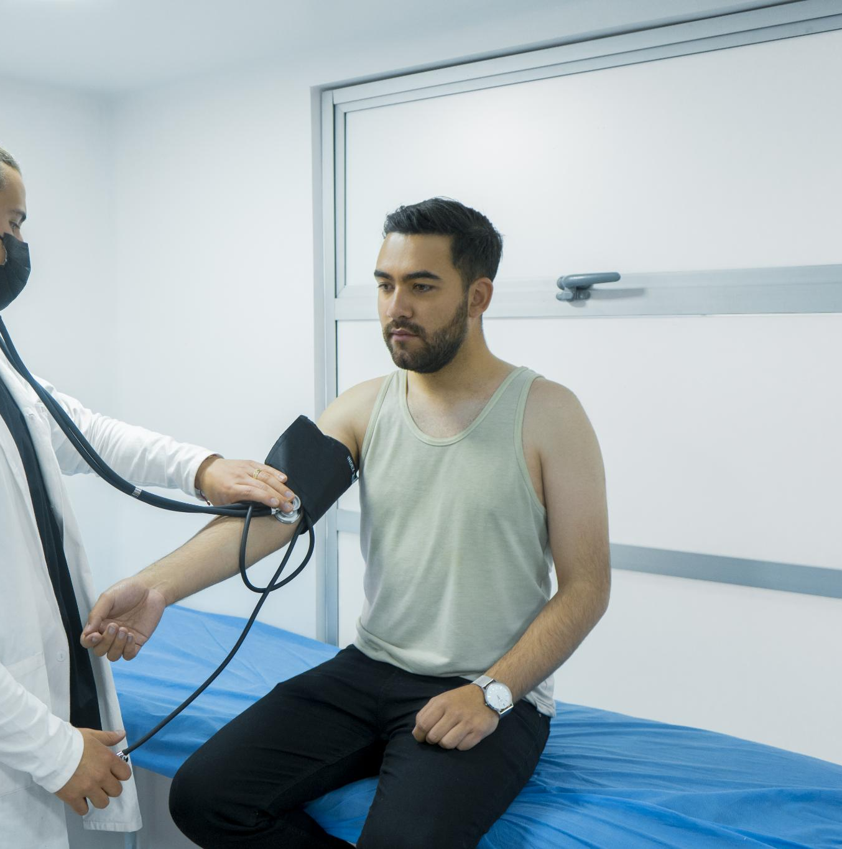
Reduction in Relapse and Hospitalization Rates
Continuous Support Importance
  Ongoing support helps identify and manage issues early, preventing setbacks before they escalate.
Early Issue Detection
  Timely follow-ups enable quick intervention, reducing chances of relapse and hospital stays.
Notes:
---
Continuous support and follow-up help prevent setbacks by addressing issues early, reducing the likelihood of relapse and unnecessary hospitalizations.
Image source: Microsoft 365 content library

Slide 18

Empowerment and Self-Advocacy Among Clients
Modeling Lived Experience
  Peer case managers share their own experiences to inspire and guide clients in their healthcare journey.
Encouragement for Active Role
  Encouragement helps clients actively participate in their care decisions and build confidence.
Effective Self-Advocacy
  Clients learn skills to advocate for their needs and communicate effectively with healthcare providers.
Notes:
---
By modeling lived experience and providing encouragement, peer case managers empower clients to take an active role in their care and advocate for themselves effectively.
Image source: Microsoft 365 content library

Slide 19
Conclusion
Role of Peer Case Managers
Peer case managers provide essential continuous support, ensuring clients receive consistent care throughout recovery.
Unique Perspective
Their lived experience brings unique insights that improve client engagement and trust.
Improved Client Outcomes
Dedicated follow-up by peer case managers promotes better health outcomes and long-term recovery.
Notes:
Peer case managers play a critical role in healthcare by providing continuous support and effective follow-up. Their unique perspective and dedication foster improved client outcomes and promote long-term recovery.

