Slide 1
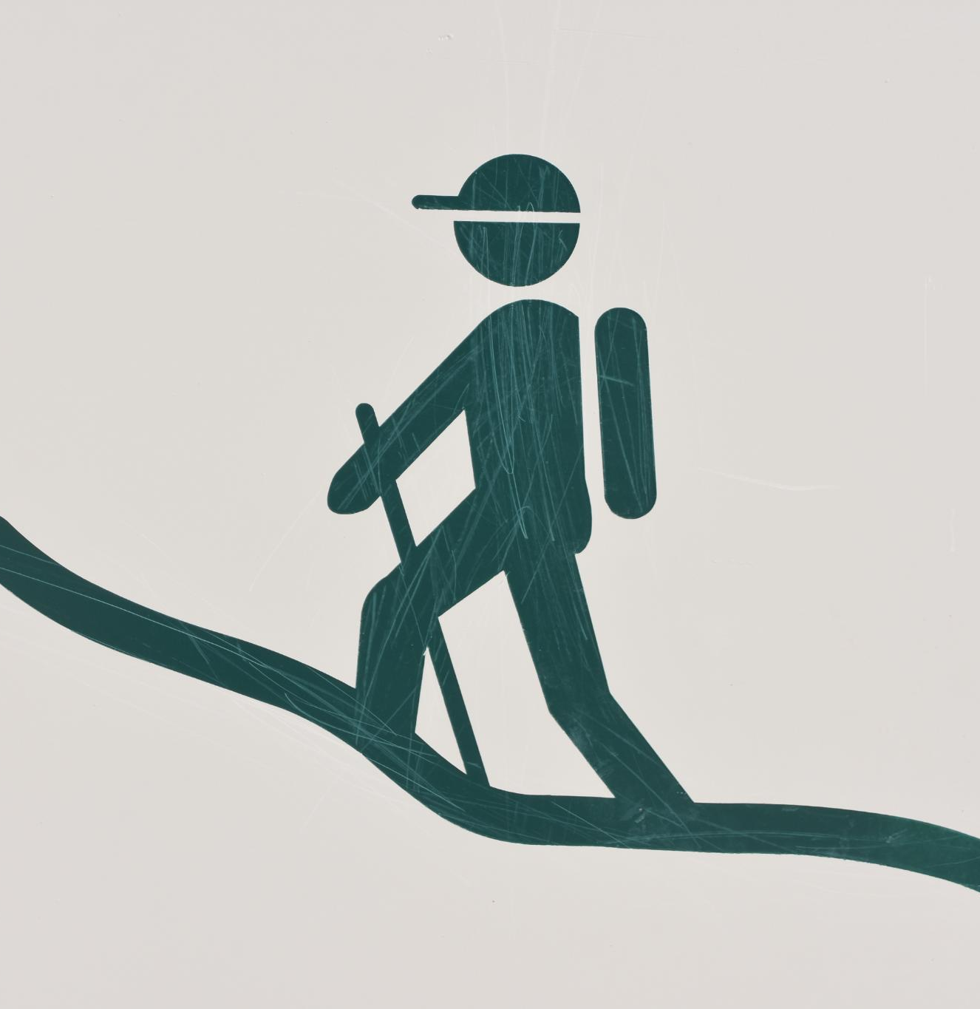
Building Self-Esteem with Wellness Recovery Action Plan (WRAP)
Empowering individuals through structured recovery strategies
Notes:
---
This presentation focuses on how the Wellness Recovery Action Plan (WRAP) can be a powerful tool in building self-esteem. We will explore WRAP's principles, its relation to self-esteem, and strategies to create a personalized plan for recovery and self-improvement.

Slide 2
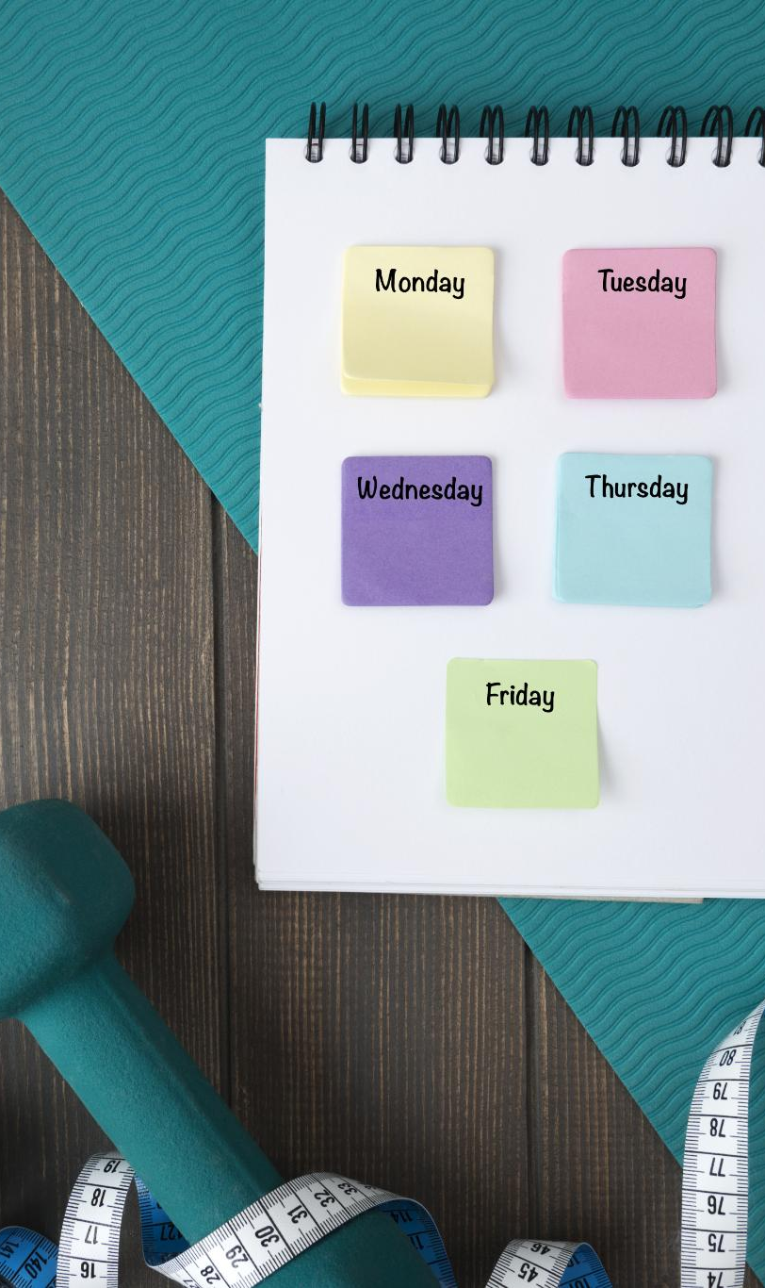
Agenda for Today's Presentation
Introduction to Wellness Recovery Action Plan
Understanding Self-Esteem
WRAP and Self-Esteem Building Strategies
Creating a Personalized WRAP for Self-Esteem
Support Systems and Maintaining Self-Esteem
Notes:
We will begin with an introduction to the Wellness Recovery Action Plan, including its overview, purpose, principles, and benefits. Next, we will delve into self-esteem, discussing its definition, influencing factors, and significance in recovery. We will then present strategies for building self-esteem through WRAP, followed by guidance on creating a personalized WRAP and maintaining support systems.

Slide 3
Introduction to Wellness Recovery Action Plan
Notes:
The Wellness Recovery Action Plan (WRAP) is a structured system for monitoring and managing your wellness. It emphasizes personal responsibility, education, and self-advocacy, making it a powerful tool for recovery.

Slide 4
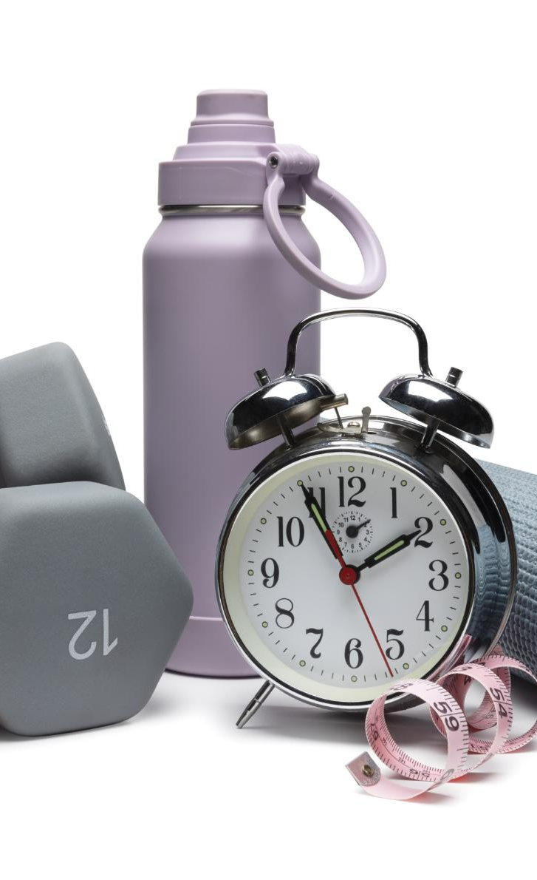
Overview of WRAP
Self-Designed Program
  WRAP allows individuals to create personalized wellness plans tailored to their unique goals and needs.
Identifying Wellness Goals
  The program emphasizes the importance of identifying specific wellness goals to guide one's mental health journey effectively.
Proactive Engagement
  WRAP encourages individuals to take proactive steps in their mental health journey, fostering a sense of ownership and empowerment.
Notes:
WRAP is a self-designed program that helps individuals identify their wellness goals and actionable steps to achieve them. It encourages proactive engagement in one's mental health journey.

Slide 5

Purpose and Principles of WRAP
Empowerment through Self-Management
  WRAP aims to empower individuals by providing tools for effective self-management and personal growth.
Principle of Hope
  Hope is a foundational principle of WRAP, encouraging individuals to envision a positive future and work towards it.
Support and Education
  Support and education are crucial aspects of WRAP, fostering resilience and equipping individuals with knowledge for recovery.
Notes:
The primary purpose of WRAP is to empower individuals through self-management. Its principles include hope, personal responsibility, education, and support, which together foster resilience and recovery.

Slide 6

Benefits of Using WRAP
Increased Self-Awareness
  WRAP fosters increased self-awareness, helping individuals understand their thoughts and emotions better.
Improved Coping Skills
  It promotes the development of effective coping skills to handle stress and challenges in daily life.
Greater Life Control
  Using WRAP empowers individuals to take greater control over their lives and decisions, leading to better outcomes.
Enhanced Well-Being
  WRAP has been linked to enhanced overall well-being and supports sustainable recovery from mental health challenges.
Notes:
Using WRAP can lead to increased self-awareness, improved coping skills, and greater control over one's life. It has been shown to enhance overall well-being and support sustainable recovery.

Slide 7
Understanding Self-Esteem
Notes:
Self-esteem plays a crucial role in one's mental health and recovery journey. Understanding what self-esteem is and how it can be influenced is vital for personal growth.

Slide 8
Definition of Self-Esteem
Valuation of Self
Self-esteem is fundamentally about how we value ourselves in various aspects of life, impacting our overall well-being.
Confidence Levels
It includes confidence, which plays a crucial role in how we approach challenges and interact with others.
Belief in Abilities
Self-esteem involves believing in our abilities to navigate life's challenges effectively, which fosters resilience.
Notes:
Self-esteem refers to how we value and perceive ourselves. It encompasses self-worth, confidence, and the belief in our abilities to navigate challenges.

Slide 9

Factors Influencing Self-Esteem
Upbringing
  A person's upbringing plays a crucial role in shaping their self-esteem and self-worth from an early age.
Life Experiences
  Positive and negative life experiences significantly impact self-esteem, influencing how individuals view themselves.
Social Interactions
  Interactions with peers and society contribute to self-esteem, as acceptance and feedback shape self-perception.
Cultural Norms
  Cultural norms and values can influence self-esteem by dictating standards for success and acceptance.
Notes:
Numerous factors influence self-esteem, including upbringing, life experiences, social interactions, and cultural norms. Recognizing these can help in understanding one's self-perception.

Slide 10

Importance of Self-Esteem in Recovery
Role of Self-Esteem
  Healthy self-esteem is crucial for individuals in recovery, as it supports their confidence and self-worth.
Fostering Resilience
  A strong sense of self-esteem fosters resilience, enabling individuals to face challenges during their recovery journeys.
Active Participation
  With healthy self-esteem, individuals are more likely to engage actively in their healing processes and pursue their goals.
Notes:
A healthy level of self-esteem is essential in the recovery process. It fosters resilience and encourages individuals to actively participate in their healing journeys and pursue their goals.

Slide 11
WRAP and Self-Esteem Building Strategies
Notes:
WRAP provides concrete strategies for enhancing self-esteem. By focusing on strengths and achievements, individuals can foster a positive self-image.

Slide 12
Identifying Personal Strengths and Achievements
Recognizing Personal Strengths
Identifying your personal strengths is crucial for personal development and enhancing self-esteem.
Celebrating Achievements
Celebrating achievements, no matter how small, helps to reinforce a positive self-view and motivation.
List of Accomplishments
Creating a list of accomplishments can serve as a reminder of your capabilities and boost confidence.
Notes:
A key strategy in WRAP is recognizing personal strengths and celebrating achievements. Making a list of accomplishments can help reinforce a positive self-view.

Slide 13

Setting Realistic Goals and Celebrating Progress
Achievable Goals
  Setting achievable goals is crucial for personal growth and helps individuals navigate their progress effectively.
Boosting Self-Esteem
  Celebrating small victories plays a significant role in boosting self-esteem and maintaining motivation on the journey.
Personal Growth
  Focusing on realistic goals encourages continuous personal growth and leads to greater overall satisfaction in life.
Notes:
Setting achievable goals within WRAP encourages personal growth. Celebrating even small victories can significantly boost self-esteem and motivation.

Slide 14

Incorporating Positive Affirmations and Self-Talk
Building Self-Esteem
  Positive affirmations boost self-esteem by fostering a mindset of self-acceptance and confidence.
Countering Negative Thoughts
  Constructive self-talk helps to counter negative thoughts, enabling a more positive and resilient mindset.
Reinforcing Positive Self-Image
  Regularly practicing affirmations reinforces a positive self-image and encourages personal growth.
Notes:
Positive affirmations and constructive self-talk are essential in building self-esteem. They help counter negative thoughts and reinforce a positive self-image.

Slide 15
Creating a Personalized WRAP for Self-Esteem
Notes:
Developing a personalized WRAP is crucial for individual recovery. It includes tools and strategies tailored to one’s unique needs and circumstances.

Slide 16
Developing a Wellness Toolbox
Coping Mechanisms
Coping mechanisms are essential strategies that help individuals manage stress and anxiety effectively.
Supportive Contacts
Having a list of supportive contacts is crucial for mental health, providing a network for encouragement and assistance.
Well-being Activities
Engaging in activities that promote well-being can enhance mental health and overall happiness.
Notes:
A wellness toolbox is a collection of resources and strategies that support mental health. This includes coping mechanisms, supportive contacts, and activities that promote well-being.

Slide 17
Building a Daily Maintenance Plan
Establishing Routines
A daily maintenance plan helps create consistent routines that foster overall wellness in daily life.
Self-Care Activities
Incorporating self-care activities into your daily plan enhances mental and physical health, promoting a balanced lifestyle.
Time for Reflection
Allocating time for reflection in your daily maintenance plan supports self-awareness and boosts self-esteem.
Notes:
Creating a daily maintenance plan helps establish routines that promote wellness. This plan should include self-care activities and time for reflection to maintain self-esteem.

Slide 18
Recognizing Triggers and Early Warning Signs
Importance of Awareness
Being aware of personal triggers is essential for managing mental health effectively. This awareness helps in recognizing emotions and reactions.
Identifying Triggers
Identifying specific triggers can empower individuals to avoid situations that negatively impact their mental health, fostering better self-management.
Proactive Steps
Taking proactive steps to address triggers and early warning signs can significantly improve self-esteem and overall well-being.
Notes:
Understanding personal triggers and recognizing early warning signs are vital in managing mental health. This awareness allows individuals to take proactive steps to maintain self-esteem.

Slide 19
Support Systems and Maintaining Self-Esteem
Notes:
Support systems play a vital role in maintaining self-esteem. Engaging with peers and professionals can provide encouragement and accountability in one's recovery journey.

Slide 20

Seeking Support From Peers and Professionals
Value of Peer Support
  Connecting with peers can offer a sense of belonging and understanding during challenging times, enhancing emotional well-being.
Professional Guidance
  Engaging with mental health professionals provides expert insights and strategies to manage challenges effectively.
Sharing Experiences
  Sharing personal experiences and challenges fosters validation and creates a supportive community where individuals feel understood.
Notes:
Connecting with peers and mental health professionals can provide valuable support. Sharing experiences and challenges can enhance feelings of belonging and validation.

Slide 21

Engaging in Supportive Communities and Activities
Fostering Connection
  Engaging in community activities enhances social connections among individuals, creating a supportive network.
Reinforcing Self-Esteem
  Participation in supportive communities boosts self-esteem by providing positive feedback and encouragement.
Sense of Purpose
  Being part of a community offers individuals a sense of purpose, contributing to overall well-being.
Belonging
  Engagement in community activities creates feelings of belonging, essential for mental health and happiness.
Notes:
Participating in supportive communities and engaging in activities fosters connection and reinforces self-esteem. These experiences contribute to a sense of purpose and belonging.

Slide 22

Continuous Self-Monitoring and Adjusting the Plan
Importance of Monitoring Progress
  Regular progress monitoring allows individuals to identify areas for improvement and maintain effectiveness in their plans.
Adjusting the WRAP
  Adjusting the WRAP as needed helps individuals stay aligned with their goals and respond to changing circumstances.
Long-term Self-Esteem
  Adaptability in plans is essential for maintaining long-term self-esteem and overall wellness in life.
Notes:
Regularly monitoring one’s progress and adjusting the WRAP as needed ensures it remains effective. This adaptability is crucial for long-term self-esteem and wellness.

Slide 23
Conclusion
Personal Empowerment
The Wellness Recovery Action Plan fosters personal empowerment, allowing individuals to take charge of their mental well-being.
Supportive Structure
WRAP helps individuals establish a supportive framework that enhances their mental health and well-being.
Mental Health Promotion
By utilizing WRAP, individuals can actively promote their mental health and resilience in daily life.
Notes:
Building self-esteem through the Wellness Recovery Action Plan is a powerful journey toward personal empowerment. By utilizing WRAP, individuals can create a supportive structure that promotes their mental health and well-being.

