Slide 1

WRAP at the Action Stage of Change
WELLNESS RECOVERY ACTION PLAN
Turning the decision to change into daily, repeatable practice
Notes:
Purpose: show how WRAP supports someone actively doing the work of recovery.
Action stage = change is underway; the risk is losing momentum.
WRAP gives that momentum a written, personal structure.
WRAP is self-created, self-directed, and owned by the person.

Slide 2

Where the Action Stage Fits
The person is actively changing behavior — and needs structure to sustain it
Action means new behaviors are already in motion, not just planned
Motivation is high, but so is vulnerability to relapse and burnout
Success depends on repetition, self-monitoring, and quick course-correction
Vague goals fail here; specific, written routines hold up
WRAP converts intention into a concrete, personal daily plan
Notes:
Stages of change: precontemplation, contemplation, preparation, action, maintenance.
Action = doing, not deciding — behavior has visibly changed.
Biggest threats: fatigue, stress, unnoticed early warning signs.
WRAP meets this stage by making the work visible and routine.
Ask the group: what does 'action' look like in your week right now?

Slide 3
What WRAP Is
A personal, written self-management plan built and owned by the individual
Developed by and for people in recovery — peer-based, not prescribed
Grounded in hope, personal responsibility, education, self-advocacy, and support
Six plans covering everyday wellness through crisis and recovery
Built around a Wellness Toolbox of tools that already work for that person
Living document — reviewed and revised as recovery progresses
The six plans of WRAP
Daily Maintenance
Triggers
Early Warning Signs
When Things Break Down
Crisis Plan
Post-Crisis Plan
Notes:
WRAP was developed by Mary Ellen Copeland with people in recovery.
Five key concepts: hope, personal responsibility, education, self-advocacy, support.
Six plans cover everyday wellness through crisis and recovery afterward.
The person writes it themselves — ownership is what makes it work.
Emphasize: no one else can write someone's WRAP for them.

Slide 4
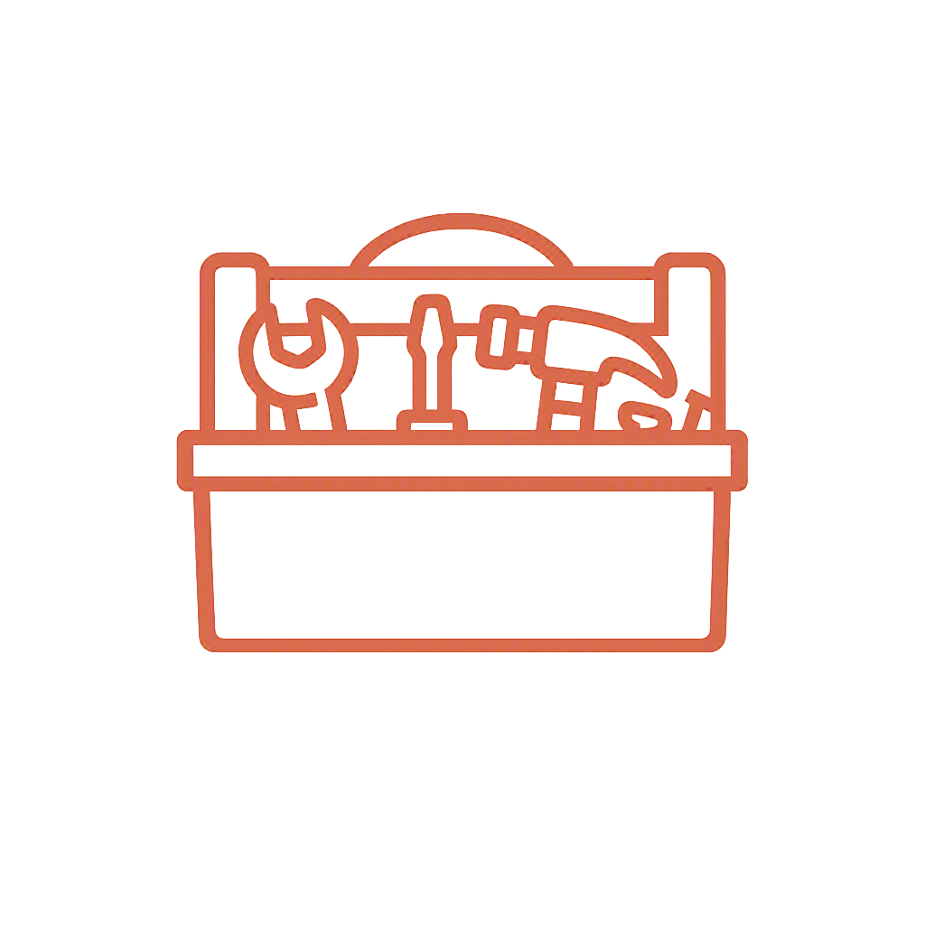

Building the Foundation
The two pieces that give the Action stage its daily structure
Wellness Toolbox
Daily Maintenance Plan
A personal list of what keeps this person well: sleep and nutrition routines, exercise, peer support calls, journaling, medication routines, grounding and breathing skills, time outdoors, creative outlets. Drawn from lived experience — things already proven to help.
Three short lists: what I'm like when I'm well, what I must do every day to stay well, and what I may need to do some days. It turns recovery from an abstract goal into a checklist that can be completed today.
Notes:
Toolbox first — it feeds every other plan in WRAP.
Keep tools simple, low-cost, and realistically available.
Daily maintenance makes wellness a repeatable action, not a mood.
Daily wins build the self-efficacy the Action stage depends on.
Suggest starting with 3-5 non-negotiable daily items.

Slide 5



Catching Problems Early
Triggers, early warning signs, and when things are breaking down
Triggers
Early Warning Signs
When Things Break Down
External events that can set back recovery: conflict, anniversaries, financial stress, certain people or places. Each trigger is paired with a written response plan.
Subtle internal shifts — poor sleep, isolating, irritability, skipped routines. Noticing them early allows small, quick adjustments.
Signs that things are getting serious, with clear steps and named supporters to contact before a crisis develops.
Notes:
This is relapse prevention made specific and personal.
Triggers are external; early warning signs are internal.
Write the response next to each sign — decisions get harder under stress.
Name real people and real actions, not general intentions.
Invite participants to identify their top three warning signs.

Slide 6

Crisis and Post-Crisis Planning
Deciding in advance, while thinking clearly, what happens if control is lost
Crisis plan: written while well, describing symptoms that show others need to step in
Names trusted supporters, treatments and facilities that help — and those that don't
Protects choice and dignity when the person can't advocate for themselves
Post-crisis plan: how to resume routines, responsibilities, and daily maintenance
Reduces fear of setbacks, which keeps the person engaged in the action work
A crisis plan is written by the person, for the people who may need to help them.
Notes:
Crisis planning is empowerment, not pessimism.
Written in advance so choices reflect the person's real preferences.
Share copies with named supporters — a plan no one has can't work.
Post-crisis focus: returning to daily maintenance step by step.
Setbacks are part of recovery, not proof of failure.

Slide 7
Summary: How WRAP Benefits Recovery
The lasting value of the plan beyond the Action stage
WRAP gives a person in recovery a practical, self-authored structure for staying well. It turns daily effort into a routine that can be followed, tracked, and adjusted; it makes triggers and early warning signs visible while they are still manageable; and it prepares clear responses for crisis and the return to daily life. Because the plan is written by the person, it strengthens hope, personal responsibility, and self-advocacy — the qualities that carry recovery from active change into long-term maintenance.
Structure
Awareness
Ownership
Daily routines that hold
Early signs caught sooner
The person leads the plan
Notes:
Close by tying benefits back to the Action stage.
Structure sustains momentum; awareness prevents setbacks.
Ownership builds confidence and self-advocacy.
WRAP is revised over time — it grows with the person.
Next step: help each person start a Wellness Toolbox this week.

