Slide 1

Wellness Recovery Action Plan: Navigating Challenges When Things Are Breaking Down
Empowering individuals to manage mental health effectively
Notes:
---
This presentation focuses on the Wellness Recovery Action Plan (WRAP), a structured framework designed to help individuals manage their mental health challenges. We will explore its key components, how to identify moments of breakdown, and strategies to develop and implement personalized action plans.

Slide 2

Agenda for Wellness Recovery
Understanding Wellness Recovery Action Plan (WRAP)
Identifying Signs of Breakdown
Developing Effective Action Plans
Implementing Your WRAP During Breakdowns
Reflecting and Refining Your Plan
Notes:
We will begin by defining what a Wellness Recovery Action Plan (WRAP) is, including its core principles and benefits. Next, we will discuss how to identify signs of breakdown in one's mental health, develop effective action plans to address these challenges, and implement WRAP during difficult times. Finally, we will reflect on refining the plan for ongoing wellness.

Slide 3
Understanding Wellness Recovery Action Plan (WRAP)
Notes:
The Wellness Recovery Action Plan (WRAP) empowers individuals to take charge of their mental health recovery. It is a proactive approach that emphasizes self-awareness, planning, and utilizing support systems.

Slide 4

Introduction to WRAP
Development of WRAP
  WRAP was developed in the 1990s as a tool for individuals to create personalized wellness strategies to enhance their mental health.
Empowerment in Wellness
  The WRAP program emphasizes that individuals can take responsibility for their own wellness and make positive changes in their lives.
Notes:
WRAP was developed by Mary Ellen Copeland in the 1990s as a way for individuals to create personalized strategies for maintaining wellness. It is grounded in the belief that everyone can take responsibility for their own wellness.

Slide 5

Core Principles and Objectives
Personal Responsibility
  Taking personal responsibility is a core principle that encourages individuals to manage their own recovery journey actively.
Education and Awareness
  Education is vital in empowering individuals with knowledge and skills to navigate their recovery effectively.
Self-Advocacy
  Self-advocacy involves individuals effectively expressing their needs and preferences to ensure their recovery is prioritized.
Support Systems
  Support from peers and professionals is essential in facilitating recovery and promoting mental health resilience.
Notes:
Core principles of WRAP include personal responsibility, education, self-advocacy, and support. The objective is to create a plan that addresses recovery needs and promotes mental health resilience.

Slide 6

Benefits of Having a WRAP
Increased Self-Awareness
  A WRAP promotes greater self-awareness, allowing individuals to understand their mental health and triggers better.
Improved Coping Skills
  With WRAP, individuals develop better coping skills that can help manage stress and emotional challenges effectively.
Enhanced Support Networks
  Having a WRAP helps individuals build and strengthen their support networks, enhancing connections with family and friends.
Structured Stress Management
  WRAP provides a structured approach to managing stress and crises, ensuring effective responses to challenges.
Notes:
Having a WRAP offers numerous benefits, including increased self-awareness, improved coping skills, enhanced support networks, and a structured approach for managing stress and crises effectively.

Slide 7
Identifying Signs of Breakdown
Notes:
Recognizing breakdowns in mental health is crucial for timely intervention. This section will outline how to identify early warning signs and triggers that signal a decline in wellness.

Slide 8

Recognizing Early Warning Signs
Changes in Mood
  Sudden shifts in mood can indicate underlying issues. Recognizing these changes is crucial for timely intervention.
Energy Level Fluctuations
  Variations in energy levels can signal the need for attention. Monitoring these fluctuations helps in early detection.
Behavioral Changes
  Notable changes in behavior can serve as critical warning signs. Identifying these can prevent further complications.
Notes:
Early warning signs can include changes in mood, energy levels, or behavior. By identifying these signs, individuals can take proactive steps to address potential breakdowns before they escalate.

Slide 9

Understanding Personal Triggers
Variety of Triggers
  Personal triggers can differ widely among individuals, encompassing stressful events, conflicts, or environmental factors.
Stressful Life Events
  Stressful life events are significant triggers that can impact an individual's emotional and mental well-being.
Interpersonal Conflicts
  Interpersonal conflicts are another common trigger that can lead to heightened emotional responses and stress.
Environmental Changes
  Changes in one's environment, such as relocation or changes in routine, can also serve as significant triggers.
Notes:
Triggers can vary from person to person and may include stressful life events, interpersonal conflicts, or environmental changes. Understanding these triggers is essential for effective planning and response.

Slide 10
Assessing the Severity of the Situation
Impact of Warning Signs
Evaluating warning signs is crucial for understanding their impact on mental health and overall well-being.
Triggers Evaluation
Identifying triggers is essential for assessing how they affect mental health and daily functioning.
Determining Support Needs
The assessment helps determine the necessary level of intervention and support for effective mental health management.
Notes:
Assessing the severity involves evaluating the impact of the warning signs and triggers on one's mental health. This assessment helps in determining the appropriate level of intervention and support needed.

Slide 11
Developing Effective Action Plans
Notes:
Creating effective action plans is a core component of WRAP. This section will guide you on how to personalize your WRAP to fit your unique needs and circumstances.

Slide 12
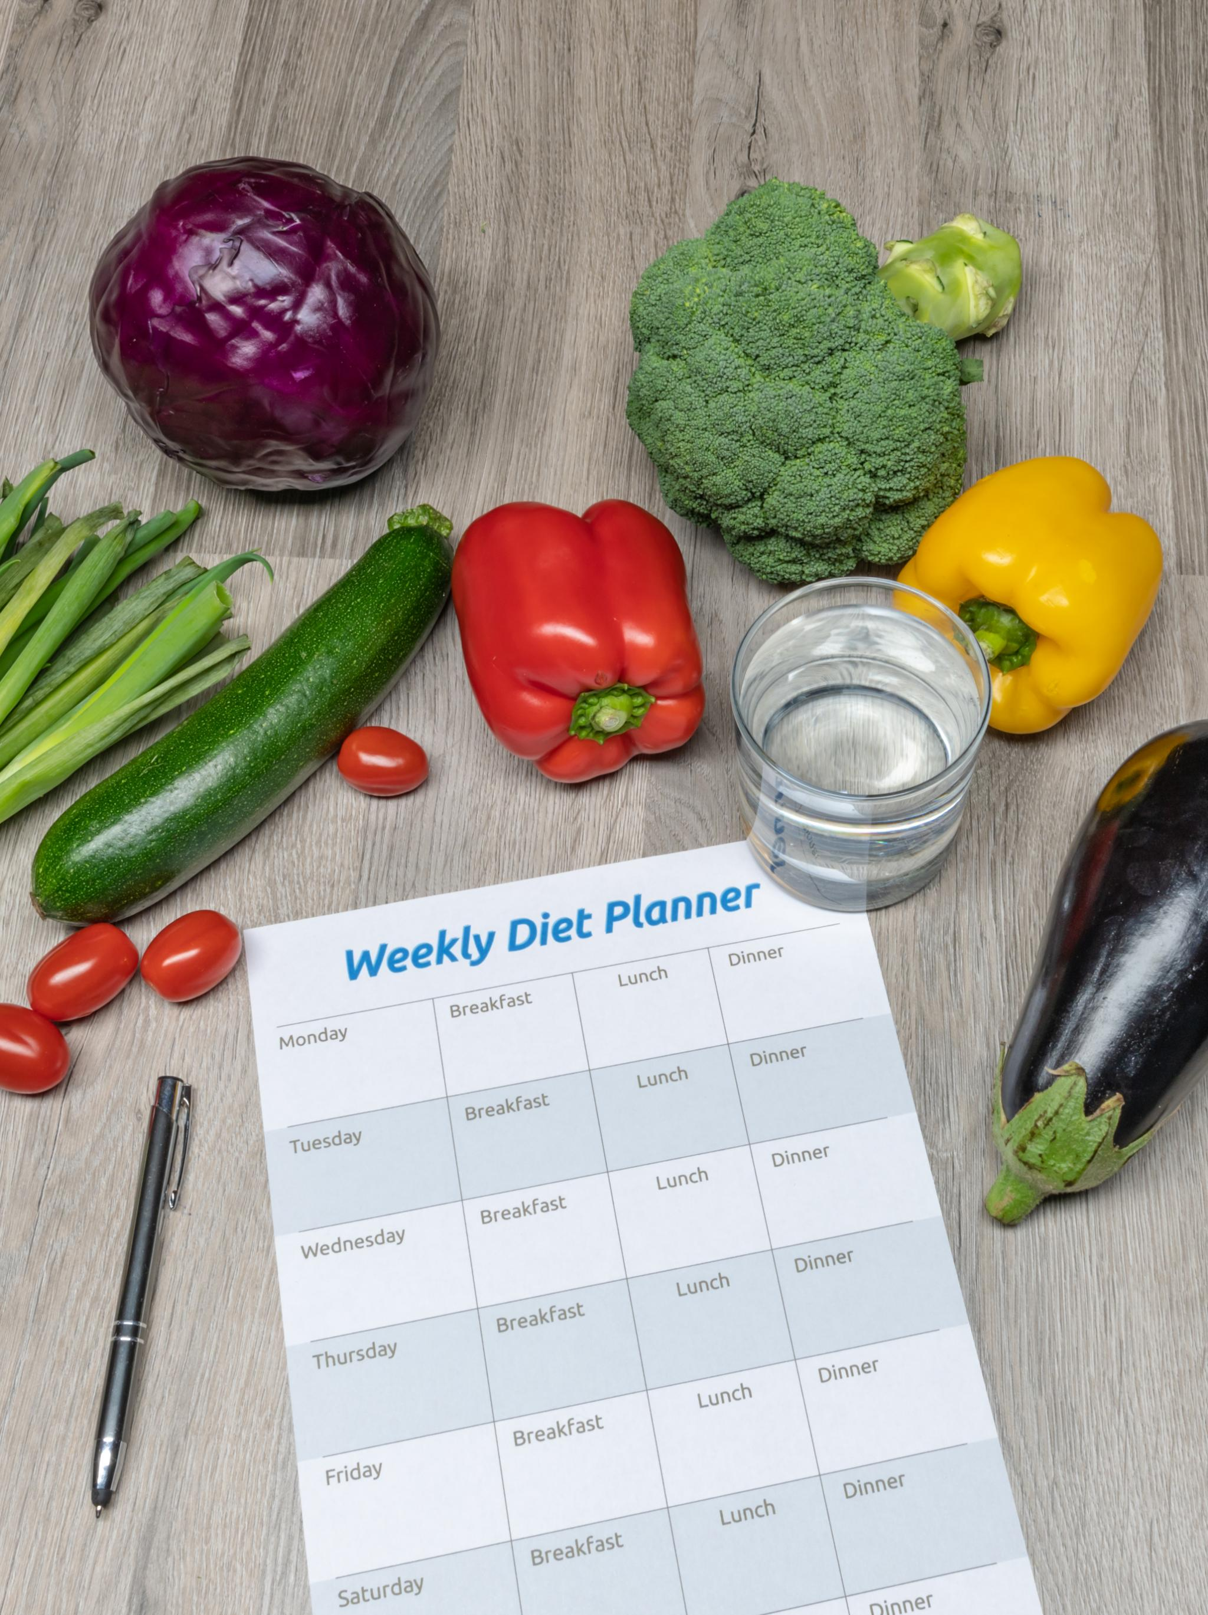
Creating a Personalized WRAP
Tailored Strategies
  A personalized WRAP includes specific strategies tailored to individual experiences and wellness needs.
Identifying Triggers
  Recognizing personal triggers is essential for effective crisis management and maintaining overall wellness.
Crisis Action Steps
  Outlining clear action steps for crisis situations helps individuals respond effectively and maintain stability.
Notes:
A personalized WRAP is tailored to individual experiences and needs. It should include specific strategies for maintaining wellness, identifying triggers, and outlining action steps for crisis situations.

Slide 13
Incorporating Coping Strategies
Mindfulness Practices
Mindfulness practices, such as meditation and deep breathing, are crucial for managing stress and enhancing emotional well-being.
Physical Activity
Engaging in physical activity helps reduce stress, improve mood, and support overall mental health and recovery.
Creative Outlets
Creative outlets, such as art, writing, or music, can significantly aid in stress management and emotional expression.
Notes:
Coping strategies are essential tools in a WRAP. These may include mindfulness practices, physical activity, or creative outlets that help individuals manage stress and promote recovery.

Slide 14

Planning for Support and Resources
Importance of Support
  Identifying reliable support networks is crucial for individuals during their recovery journey, providing essential assistance when needed.
Resources for Recovery
  Utilizing available resources can enhance the recovery process, ensuring individuals receive the help they need effectively.
Planning Ahead
  Effective planning for support involves mapping out resources and networks that can be accessed during challenging times.
Notes:
A key element of WRAP is planning for support. Identifying reliable support networks and resources can provide essential assistance during times of need and enhance one's recovery journey.

Slide 15
Implementing Your WRAP During Breakdowns
Notes:
Implementing your WRAP effectively during breakdowns is crucial for recovery. This section will cover actionable steps to take and how to leverage your support network.

Slide 16
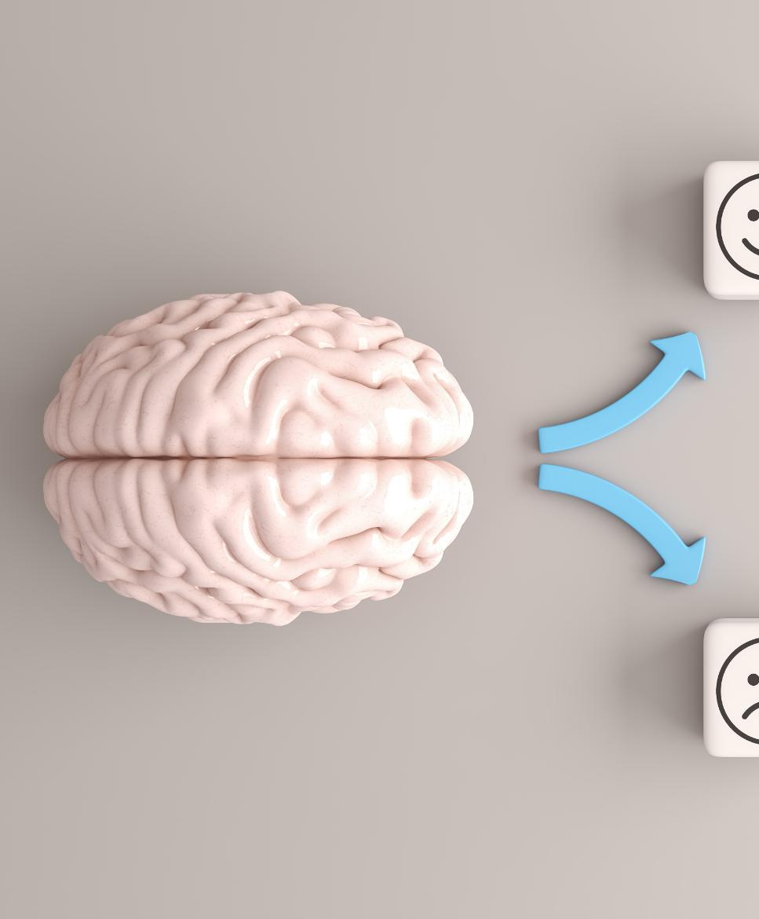
Immediate Steps to Take
Reach Out for Support
  Connecting with friends, family, or professionals is crucial when experiencing a breakdown. Support can provide comfort and guidance.
Utilize Coping Strategies
  Implementing coping strategies like mindfulness or relaxation techniques can help manage stress and anxiety during difficult times.
Follow Action Plan
  Adhering to your pre-determined action plan can provide structure and clarity on the steps to take when feeling overwhelmed.
Notes:
When experiencing a breakdown, it's important to take immediate steps outlined in your WRAP. This may include reaching out for support, utilizing coping strategies, or following your pre-determined action plan.

Slide 17

Utilizing Your Support Network
Importance of Support Networks
  Having a strong support network is crucial during challenging times, providing emotional and practical assistance.
Effective Communication
  Communicating your needs clearly to your support network can lead to better understanding and assistance.
Seeking Help
  Don't hesitate to seek help from trusted individuals; they can provide valuable insights and support.
Notes:
Effective use of your support network can make a significant difference during challenging times. Communicating needs and seeking help from trusted individuals can aid in the recovery process.

Slide 18

Adjusting the Plan as Needed
Importance of Flexibility
  Flexibility allows for effective WRAP implementation by adapting to changing circumstances and needs.
Evolving Needs
  Recognizing that your needs may evolve over time is crucial for successful plan adjustments.
Adjusting Plans
  Being open to adjusting your plan is essential to meet the challenges and opportunities that arise.
Notes:
Flexibility is key to effective WRAP implementation. As circumstances change, be open to adjusting your plan to better meet your evolving needs and experiences.

Slide 19
Reflecting and Refining Your Plan
Notes:
Continuous reflection and refinement of your WRAP ensure its effectiveness. This final section will guide you on evaluating your experiences and making necessary adjustments.

Slide 20

Evaluating What Worked and What Didn't
Reflecting on Effectiveness
  Reflecting on strategies helps to identify what worked well and what needs adjustment for future plans.
Understanding Needs
  Evaluating your WRAP provides insight into your current needs and how to better address them moving forward.
Continuous Improvement
  This evaluation fosters continuous improvement and adaptation of your plan to achieve better results over time.
Notes:
Evaluating your WRAP involves reflecting on which strategies were effective and which were not. This evaluation helps in understanding your needs and improving your plan over time.

Slide 21

Incorporating Feedback for Improvement
Value of Feedback
  Feedback from your support network can provide crucial insights to help identify areas for improvement.
Strengthening WRAP
  Incorporating feedback can significantly enhance your WRAP, allowing for more effective coping strategies.
Coping Strategies
  Utilizing insights gained from feedback leads to improved coping strategies tailored to individual needs.
Notes:
Feedback from your support network and personal experiences can provide valuable insights. Incorporating this feedback allows you to strengthen your WRAP and enhance your coping strategies.

Slide 22

Maintaining and Updating Your WRAP Regularly
Importance of Regular Updates
  Regular updates to your WRAP are crucial to ensure it aligns with your current circumstances and goals.
Schedule Periodic Reviews
  Scheduling periodic reviews helps identify necessary adjustments and keeps your plan effective over time.
Long-term Success
  Consistent maintenance of your WRAP leads to long-term success and better adaptation to life changes.
Notes:
Regular maintenance and updates to your WRAP are essential for long-term success. Schedule periodic reviews to ensure your plan remains relevant and effective as your circumstances change.

Slide 23
Conclusion
Understanding WRAP Components
Understanding the components of the Wellness Recovery Action Plan is crucial for effective mental health management.
Identifying Breakdown Signs
Recognizing signs of breakdown is essential to intervene early and adjust your wellness plan accordingly.
Developing Effective Plans
Creating effective plans helps you navigate through challenges and promotes overall wellness.
Reflecting on Experiences
Reflection on your experiences fosters growth and understanding in your wellness journey.
Notes:
The Wellness Recovery Action Plan is a vital tool for managing mental health challenges. By understanding its components, identifying breakdown signs, developing effective plans, and reflecting on your experiences, you can navigate challenges and promote your wellness journey.

