Slide 1

Wellness Recovery Action Plan (WRAP) Facilitator Training: Empowering Wellness and Recovery
Training for support in personal wellness journeys
Notes:
---
Welcome to the WRAP Facilitator Training! This presentation will guide you through the key elements of WRAP, focusing on how facilitators can empower individuals on their wellness and recovery journey.

Slide 2

Agenda for WRAP Training
Introduction to WRAP
Role of a WRAP Facilitator
Training Components and Curriculum
Facilitation Techniques and Strategies
Implementing WRAP in Diverse Settings
Notes:
This training will cover various aspects of WRAP, including its history, core concepts, and benefits. We will explore the role of facilitators, training components, facilitation techniques, and implementation strategies across diverse settings.

Slide 3
Introduction to WRAP
Notes:
The Wellness Recovery Action Plan (WRAP) is a personalized system for self-management and recovery. It is essential to understand its origins and core elements to effectively facilitate its use.

Slide 4

History and Development of WRAP
Origin of WRAP
  WRAP was developed in the 1990s to help individuals with mental health challenges create personalized wellness plans.
Evolution as a Recovery Tool
  Over the years, WRAP has evolved into a widely recognized recovery tool that supports mental health and well-being.
Notes:
WRAP was developed in the 1990s by Mary Ellen Copeland as a way for individuals experiencing mental health challenges to create a plan for their own wellness. It has since evolved into a widely recognized and used recovery tool.

Slide 5
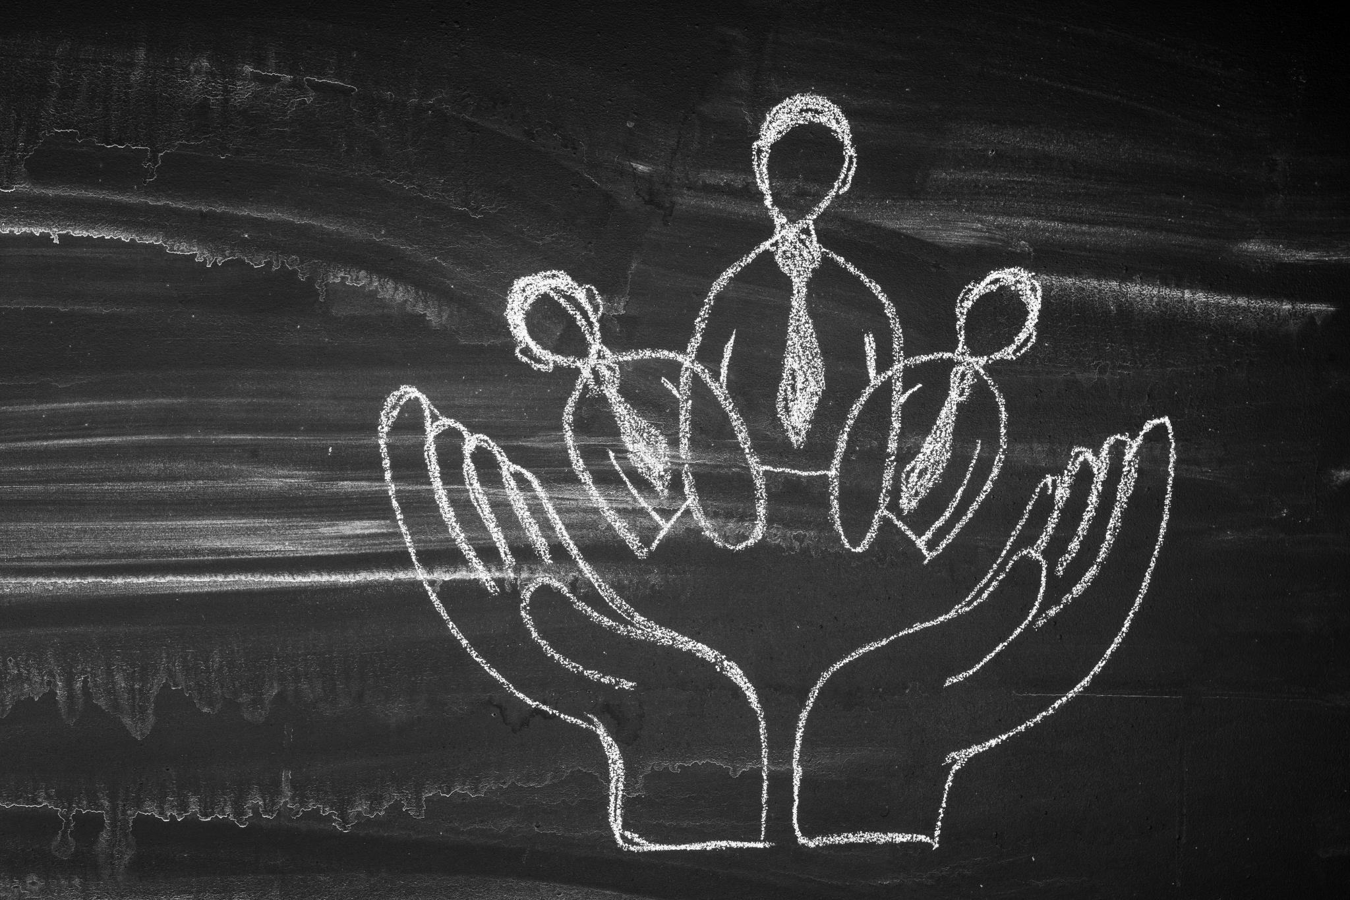
Core Concepts and Principles
Personal Responsibility
  Personal responsibility empowers individuals to take control of their recovery journey and make informed choices.
Education
  Education is vital for understanding recovery concepts and equipping individuals with the knowledge they need.
Self-Advocacy
  Self-advocacy encourages individuals to express their needs and concerns, promoting autonomy in the recovery process.
Support
  Support from peers and facilitators is essential in fostering a positive recovery environment and building resilience.
Notes:
WRAP is based on key principles such as personal responsibility, education, self-advocacy, and support. Understanding these concepts is crucial for effective facilitation and supporting the recovery process.

Slide 6

Benefits of WRAP for Individuals and Communities
Improved Mental Health Outcomes
  WRAP implementation can significantly enhance mental health outcomes, fostering better emotional well-being and stability.
Increased Resilience
  The WRAP approach empowers individuals, helping them develop resilience and cope with life's challenges effectively.
Community Engagement
  WRAP promotes greater community engagement, fostering connections and support among individuals in the community.
Notes:
Implementing WRAP can lead to improved mental health outcomes, increased resilience, and greater community engagement. It empowers individuals to take control of their recovery and promotes a culture of support and understanding.

Slide 7
Role of a WRAP Facilitator
Notes:
Facilitators play a crucial role in guiding participants through their WRAP journey. Understanding their responsibilities and the qualities that make an effective facilitator is vital for success.

Slide 8

Responsibilities and Expectations
Creating a Supportive Environment
  Facilitators must create an atmosphere where participants feel safe and comfortable sharing their thoughts and experiences.
Guiding Discussions
  Effective facilitators guide discussions thoughtfully, encouraging participation while keeping the group's focus on relevant topics.
Ensuring Safety and Respect
  Facilitators are responsible for maintaining a respectful environment where all participants feel valued and heard.
Focusing on Group Needs
  Facilitators must remain attentive to the needs and experiences of the group, adapting their approach as necessary.
Notes:
A WRAP facilitator's primary responsibilities include creating a supportive environment, guiding discussions, and ensuring that participants feel safe and respected. Facilitators must remain focused on the needs and experiences of the group.

Slide 9

Qualities and Skills of an Effective Facilitator
Empathy and Patience
  Empathy and patience are essential qualities for facilitators, allowing them to understand participants' perspectives and create a supportive environment.
Active Listening Skills
  Effective facilitators demonstrate active listening skills, ensuring that all participants feel heard and valued during discussions.
Knowledge of WRAP Principles
  A knowledgeable facilitator understands WRAP principles, which helps guide the group through structured and effective discussions.
Fostering Engaging Discussions
  Facilitators must be skilled in fostering engaging discussions, encouraging participation and collaboration among group members.
Notes:
Effective facilitators possess qualities such as empathy, patience, and active listening skills. They should also be knowledgeable about WRAP principles and adept at fostering engaging discussions.

Slide 10
Ethical Considerations and Confidentiality
Upholding Ethical Standards
Facilitators must adhere to ethical standards to foster trust and respect in group settings.
Maintaining Confidentiality
Confidentiality is crucial for creating a safe space where participants feel secure sharing personal stories.
Creating a Safe Space
A non-judgmental atmosphere encourages open communication and support among participants.
Notes:
Facilitators must uphold ethical standards and maintain confidentiality to create a safe space for participants. This includes respecting personal stories and ensuring a non-judgmental atmosphere.

Slide 11
Training Components and Curriculum
Notes:
The WRAP facilitator training program consists of various components designed to equip facilitators with the necessary skills and knowledge. This section will outline the curriculum's structure and learning objectives.

Slide 12

Overview of the Training Program
Comprehensive Understanding of WRAP
  The program offers in-depth knowledge of WRAP concepts and their application in real-world scenarios.
Practical Skills Development
  Participants will gain hands-on experience through practical activities that reinforce theoretical knowledge.
Experiential Learning Opportunities
  The training includes experiential learning to enhance engagement and application of skills in real-life situations.
Notes:
The training program is designed to provide a comprehensive understanding of WRAP, including theoretical knowledge, practical skills, and experiential learning opportunities. Participants will engage in various activities to enhance their learning.

Slide 13

Key Modules and Learning Objectives
Understanding WRAP Concepts
  The first module focuses on WRAP concepts, providing foundational knowledge essential for effective implementation.
Facilitation Techniques
  This module covers various facilitation techniques that enhance group dynamics and engagement during learning sessions.
Implementation Strategies
  Learn effective implementation strategies that help translate knowledge into actionable skills and practices.
Notes:
Key modules include understanding WRAP concepts, facilitation techniques, and implementation strategies. Each module has specific learning objectives that facilitate skill development and knowledge acquisition.

Slide 14

Experiential Learning Activities and Exercises
Role-Playing Activities
  Role-playing allows participants to practice facilitation skills in a safe and supportive environment, enhancing learning through active engagement.
Group Discussions
  Group discussions facilitate collaboration among participants, encouraging sharing of ideas and experiences to deepen understanding of concepts.
Case Studies
  Analyzing case studies helps participants apply WRAP principles to real-world scenarios, bridging theory and practice effectively.
Notes:
Experiential learning is a core component of the training. Participants will engage in role-playing, group discussions, and case studies to practice facilitation skills and apply WRAP principles in real-world scenarios.

Slide 15
Facilitation Techniques and Strategies
Notes:
Successful facilitation requires specific techniques and strategies. This section will explore ways to create a supportive environment, engage participants, and manage challenges during sessions.

Slide 16

Creating a Safe and Supportive Environment
Safe Space Importance
  Creating a safe space ensures participants feel comfortable and respected while sharing their experiences and ideas.
Establishing Ground Rules
  Setting ground rules is essential for maintaining a respectful and inclusive environment where everyone can contribute.
Fostering Trust
  Fostering trust among participants encourages open communication and strengthens the group dynamics, enhancing participation.
Notes:
Facilitators should prioritize creating a safe space where participants feel comfortable sharing their experiences. Establishing ground rules and fostering trust are essential components of this environment.

Slide 17

Engaging and Motivating Participants
Interactive Techniques
  Using interactive techniques like group activities fosters participant engagement and makes the learning experience enjoyable.
Commitment to WRAP Process
  Motivating participants enhances their commitment to the WRAP process, leading to a more fruitful recovery journey.
Support in Recovery
  Engagement and motivation are critical in supporting participants' recovery journeys and fostering a positive environment.
Notes:
Engaging participants involves using interactive techniques, such as group activities and discussions. Motivating participants can enhance their commitment to the WRAP process and support their recovery journey.

Slide 18

Handling Challenges and Conflicts
Identifying Challenges
  Facilitators should recognize different opinions and emotional conflicts as common challenges that arise during discussions.
Calm Resolution Techniques
  Employing calm and respectful communication is essential in addressing conflicts to ensure productive discussions.
Maintaining Group Harmony
  Utilizing effective conflict resolution strategies helps maintain group harmony and fosters a collaborative environment.
Notes:
Facilitators may encounter challenges, such as differing opinions or emotional conflicts. It is important to address these issues calmly and respectfully, using conflict resolution strategies to maintain group harmony.

Slide 19
Implementing WRAP in Diverse Settings
Notes:
WRAP can be adapted for various populations and settings. Understanding how to tailor the approach ensures that it meets the unique needs of different groups.

Slide 20

Adapting WRAP for Different Populations
Understanding Diverse Needs
  Facilitators need to understand the specific needs of different age groups and cultural backgrounds when implementing WRAP.
Cultural Considerations
  Cultural background plays a crucial role in how individuals relate to mental health and wellness practices. Customization ensures relevance and effectiveness.
Mental Health Challenges
  Different populations may face unique mental health challenges, and adapting WRAP can help address these effectively.
Notes:
When implementing WRAP, facilitators must consider the specific needs of diverse populations, including age, cultural background, and mental health challenges. Customizing the approach can enhance its effectiveness.

Slide 21

Incorporating Cultural Sensitivity
Importance of Cultural Sensitivity
  Cultural sensitivity is crucial for effective facilitation, ensuring that all participants feel respected and valued.
Awareness of Cultural Differences
  Facilitators should recognize and appreciate cultural differences to create an inclusive environment for all participants.
Respecting Participants' Values
  It is essential to honor the beliefs and values of participants, fostering trust and open communication.
Notes:
Cultural sensitivity is vital in facilitating WRAP. Facilitators should be aware of cultural differences and ensure that the program respects and honors the values and beliefs of participants.

Slide 22

Case Studies and Success Stories
Insights from Case Studies
  Analyzing case studies can reveal significant insights into the practical applications of WRAP.
Community Impact
  Success stories demonstrate the positive impact of WRAP on various communities, showcasing real-life benefits.
Individual Transformations
  Highlighting individual success stories shows how WRAP can change lives and promote well-being.
Notes:
Examining case studies and success stories can provide valuable insights into the practical application of WRAP. These examples highlight the impact of WRAP on individuals and communities.

Slide 23
Conclusion
Empowering Others
As a facilitator, your role is to empower others to take charge of their wellness and recovery journey.
Understanding WRAP
A solid understanding of WRAP is essential for effective facilitation and guiding others in their recovery.
Facilitation Skills
Honing your facilitation skills will enhance your ability to support participants on their path to wellness.
Notes:
Thank you for participating in the WRAP Facilitator Training. By understanding WRAP and honing your facilitation skills, you are now equipped to empower others on their path to wellness and recovery.

