Slide 1

Creating a Wellness Recovery Action Plan for Your Living Space
Designing environments that enhance mental well-being
Notes:
---
In this presentation, we will explore how to create a Wellness Recovery Action Plan (WRAP) that focuses on enhancing your living space. This plan will help you create an environment that supports your mental well-being and recovery.

Slide 2

Agenda for Our Session
Understanding Wellness Recovery Action Plans (WRAP)
Assessing Your Living Space
Designing a Supportive Environment
Developing Daily Maintenance Plans
Planning for Crisis Situations
Reviewing and Revising Your WRAP Living Space
Notes:
We will begin by understanding what a Wellness Recovery Action Plan (WRAP) is and its purpose. Next, we will assess your living space to identify stressors and areas for improvement. We will then design a supportive environment, develop daily maintenance plans, and prepare for crisis situations. Finally, we will discuss how to review and revise your plan regularly.

Slide 3
Understanding Wellness Recovery Action Plans (WRAP)
Notes:
WRAP is a structured system for developing personalized strategies to maintain and enhance wellness. It empowers individuals to take control of their recovery process by creating a plan that addresses their unique needs.

Slide 4

Definition and Purpose of WRAP
Self-Designed Wellness Plan
  A WRAP is a personalized plan that allows individuals to take charge of their wellness journey by outlining specific steps.
Recognizing Triggers
  The WRAP framework encourages individuals to identify their triggers to better manage their mental health effectively.
Proactive Strategies
  Developing proactive strategies is essential for maintaining mental health and wellness under the WRAP framework.
Notes:
A WRAP is a self-designed plan that outlines the steps one can take to manage their wellness. Its purpose is to provide a framework for individuals to recognize their triggers and develop proactive strategies to maintain their mental health.

Slide 5

Key Components of WRAP
Daily Maintenance Plans
  Daily maintenance plans ensure consistent self-care and help individuals manage their well-being on a daily basis.
Triggers and Early Warning Signs
  Identifying triggers and early warning signs is crucial for anticipating and managing potential crises effectively.
Crisis Planning
  Crisis planning involves preparing strategies and resources to address potential crises as they arise.
Post-Crisis Planning
  Post-crisis planning focuses on recovery and learning from experiences to improve future strategies and resilience.
Notes:
The key components of WRAP include daily maintenance plans, triggers, early warning signs, crisis planning, and post-crisis planning. Each component works together to ensure a comprehensive approach to recovery.

Slide 6

Benefits of Implementing a WRAP
Increased Self-Awareness
  Implementing a WRAP enhances self-awareness, enabling individuals to understand their thoughts and feelings better.
Empowerment
  WRAP fosters empowerment, allowing individuals to take charge of their lives and make informed decisions.
Improved Coping Skills
  The program enhances coping skills, providing strategies to manage challenges effectively.
Enhanced Communication
  WRAP improves communication with support systems, fostering stronger relationships and support networks.
Notes:
Implementing a WRAP can lead to increased self-awareness, empowerment, and improved coping skills. It also fosters a sense of control over one’s life and enhances communication with support systems.

Slide 7
Assessing Your Living Space
Notes:
An effective WRAP requires a thorough assessment of your living space to identify stressors and recognize areas for improvement. This step sets the foundation for creating a supportive environment.

Slide 8
Identifying Stressors and Triggers in Your Environment
Observation of Surroundings
Take time to observe your environment and identify areas that contribute to stress, enhancing awareness of your surroundings.
Identifying Specific Stressors
Recognize specific stressors like clutter, noise, and lack of privacy that can affect your mental state and well-being.
Developing Management Strategies
Understanding your triggers is essential for developing effective strategies to manage stress and improve your environment.
Notes:
Take time to observe your surroundings and identify specific stressors, such as cluttered spaces, noise, or lack of privacy. Recognizing these triggers is crucial for developing strategies to manage them.

Slide 9

Evaluating the Functionality and Comfort of Your Space
Assess Living Space Functionality
  Evaluate if your living space meets your needs for relaxation, focus, and daily activities.
Comfort and Relaxation
  Identify elements that promote comfort, such as soft furnishings and inviting decor for a relaxing environment.
Lighting Evaluation
  Consider natural and artificial lighting to create a pleasant atmosphere that enhances comfort and focus.
Notes:
Consider the functionality of your living space. Is it comfortable and conducive to relaxation and focus? Evaluate furniture arrangements, lighting, and overall aesthetics to enhance comfort.

Slide 10

Recognizing Areas for Improvement
Identifying Stressors
  Recognizing stressors in your environment is the first step toward creating a more peaceful space. Evaluate what aspects contribute to feelings of tension.
Decluttering Your Space
  Decluttering is crucial in fostering a serene environment. Removing unnecessary items can greatly enhance your space's tranquility.
Reorganizing Furniture
  Reorganizing furniture can optimize flow and improve comfort within your space. Consider layouts that encourage ease of movement.
Adding Tranquil Elements
  Incorporating elements like plants, soft lighting, and calming colors can foster tranquility and enhance well-being in your space.
Notes:
After identifying stressors and evaluating your space, pinpoint specific areas needing improvement. This may include decluttering, reorganizing furniture, or adding elements that foster tranquility.

Slide 11
Designing a Supportive Environment
Notes:
A supportive environment is essential for wellness. Designing your living space thoughtfully can help reduce stress and promote mental well-being.

Slide 12

Creating a Calming and Soothing Atmosphere
Calming Colors
  Incorporating calming colors such as soft blues and greens can create a serene environment that promotes relaxation.
Soft Lighting
  Using soft lighting, such as lamps with warm bulbs, can enhance the calming effect of a space and create a welcoming atmosphere.
Nature Elements
  Incorporating nature elements like plants or natural materials can help bring a sense of tranquility and connection to the outdoors.
Notes:
Incorporate calming colors, soft lighting, and nature elements into your decor. A soothing atmosphere can significantly impact your mood and help you feel more at ease.

Slide 13
Organizing Your Space for Ease and Accessibility
Facilitate Easy Movement
Organizing your space ensures free movement, allowing you to access items without hassle.
Access to Necessary Items
Organizing items within reach minimizes time spent searching for essentials and enhances productivity.
Promote Sense of Control
A well-organized space leads to a feeling of control, reducing stress and frustration throughout your day.
Notes:
Ensure that your space is organized to facilitate easy movement and access to necessary items. A well-organized space promotes a sense of control and reduces frustration.

Slide 14
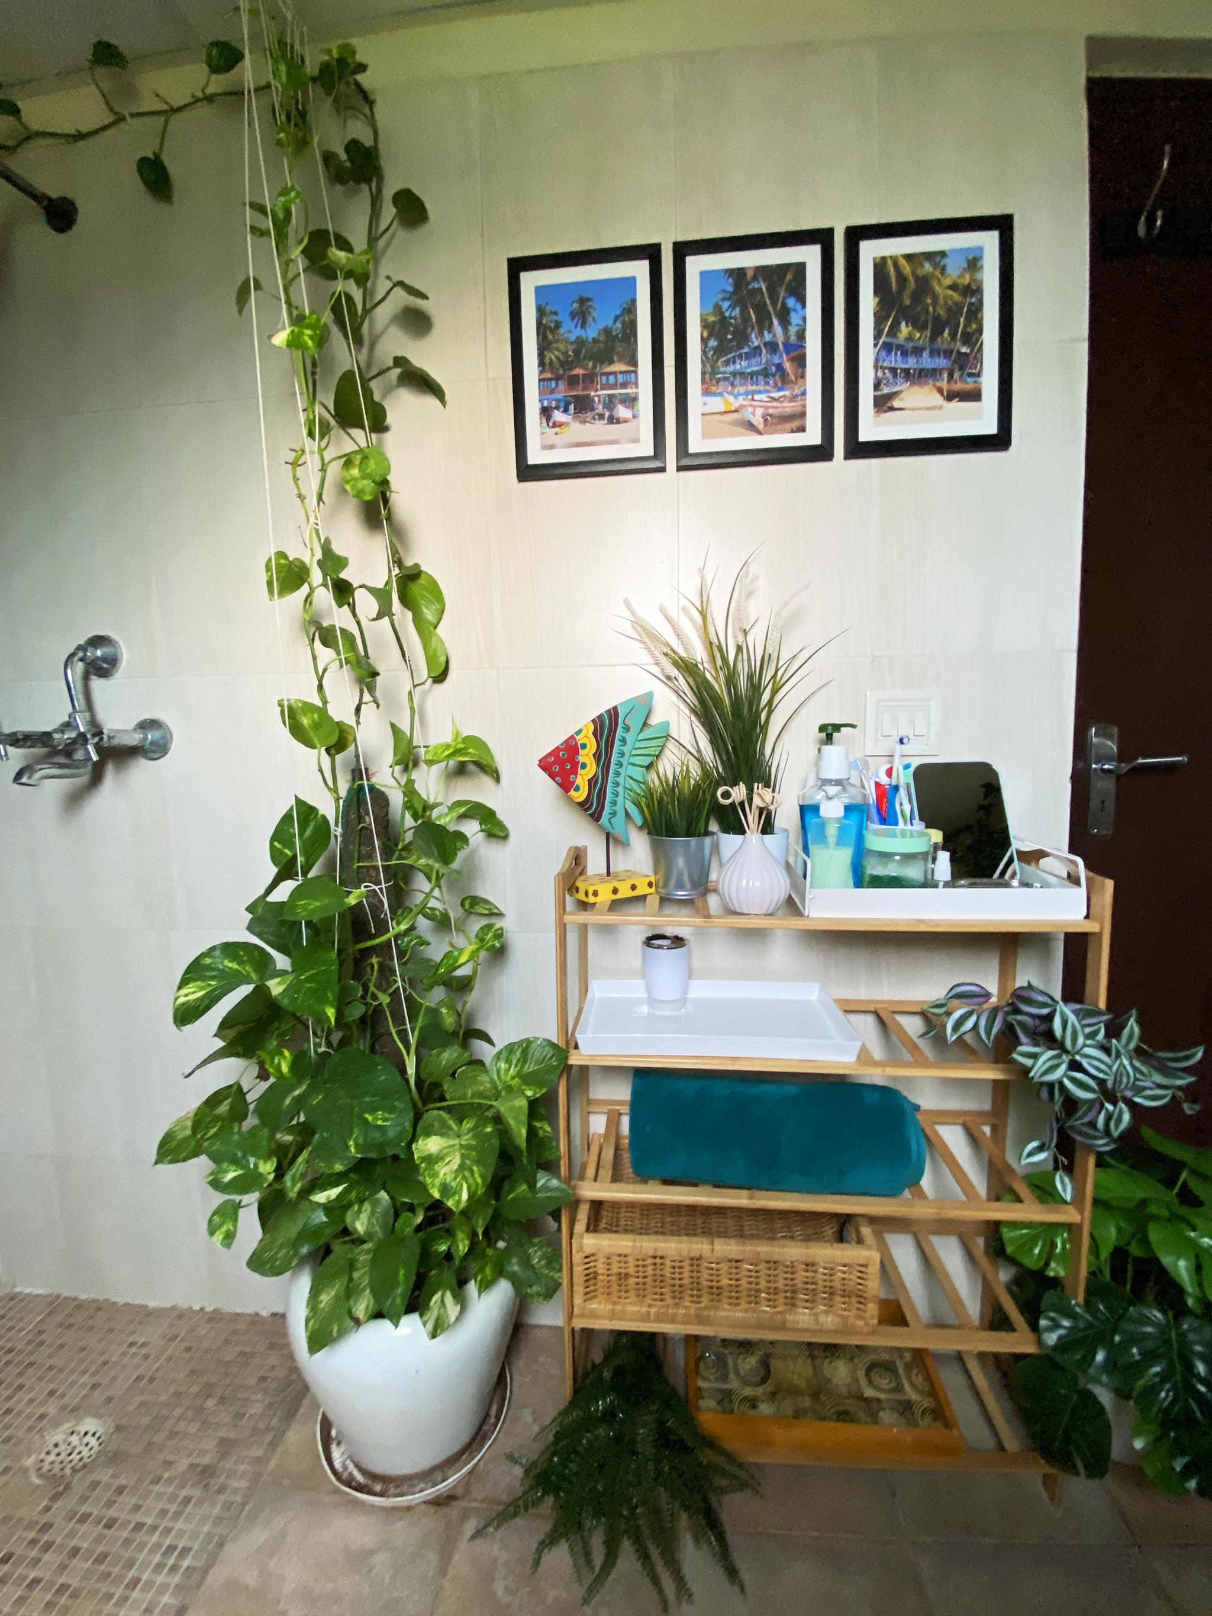
Incorporating Elements that Promote Mental Well-Being
Importance of Plants
  Incorporating plants into living spaces can improve air quality and boost mood, fostering a sense of tranquility.
Impact of Artwork
  Displaying inspiring artwork can uplift spirits and spark creativity, contributing to a more positive environment.
Value of Personal Mementos
  Personal mementos remind us of cherished memories and loved ones, promoting feelings of happiness and belonging.
Notes:
Include elements that contribute to mental well-being, such as plants, inspiring artwork, or personal mementos. These items can enhance positivity and create a more inviting environment.

Slide 15
Developing Daily Maintenance Plans
Notes:
Establishing daily routines is crucial for maintaining a supportive living environment. Consistent practices contribute to a sense of stability and well-being.

Slide 16

Establishing Routines and Daily Practices
Incorporate Self-Care
  Daily routines should include self-care activities that promote mental and physical well-being for a balanced life.
Daily Meditation Practice
  Engaging in regular meditation can help reduce stress, improve focus, and enhance overall well-being.
Regular Exercise
  Incorporating exercise into daily routines supports physical health and boosts mood and energy levels.
Journaling Benefits
  Journaling can provide clarity, promote emotional well-being, and serve as a valuable tool for self-reflection.
Notes:
Create daily routines that incorporate self-care and wellness activities. Regular practices such as meditation, exercise, or journaling can be beneficial.

Slide 17

Incorporating Wellness Activities and Hobbies
Joyful Activities
  Engaging in activities you love can significantly boost your mood and overall happiness.
Stress Relief
  Hobbies can serve as a healthy outlet for stress, helping to promote mental clarity and relaxation.
Promoting Relaxation
  Incorporating hobbies into your routine encourages relaxation and provides a break from daily tasks.
Notes:
Make time for activities that bring you joy and enhance your wellness. Engaging in hobbies can provide a healthy outlet for stress and promote relaxation.

Slide 18

Maintaining a Clean and Clutter-Free Environment
Importance of Cleanliness
  A clean living space fosters mental clarity and enhances overall wellbeing. It contributes to a positive atmosphere and productivity.
Regular Decluttering
  Regularly decluttering your space is key to maintaining an organized environment. It helps to remove distractions and unnecessary items.
Creating Calming Atmosphere
  An organized and clean environment promotes a calming atmosphere. This can lead to improved focus and relaxation.
Notes:
A clean and organized living space is essential for mental clarity. Regularly declutter and clean your environment to create a refreshing and calming atmosphere.

Slide 19
Planning for Crisis Situations
Notes:
It is vital to prepare for potential crises by having a crisis plan in place. This preparation can minimize the impact of unexpected events on your mental well-being.

Slide 20

Identifying and Preparing for Potential Crises
Reflect on Past Crises
  Evaluating past crises helps in understanding the challenges faced and the effectiveness of your response strategies.
Anticipate Future Challenges
  Identifying potential future challenges is crucial for proactive crisis management and effective planning.
Effective Response Planning
  Creating a response plan involves outlining steps to take during a crisis to mitigate impacts and recover efficiently.
Notes:
Reflect on past crises you’ve experienced and anticipate potential future challenges. Plan how to respond to these situations effectively.

Slide 21
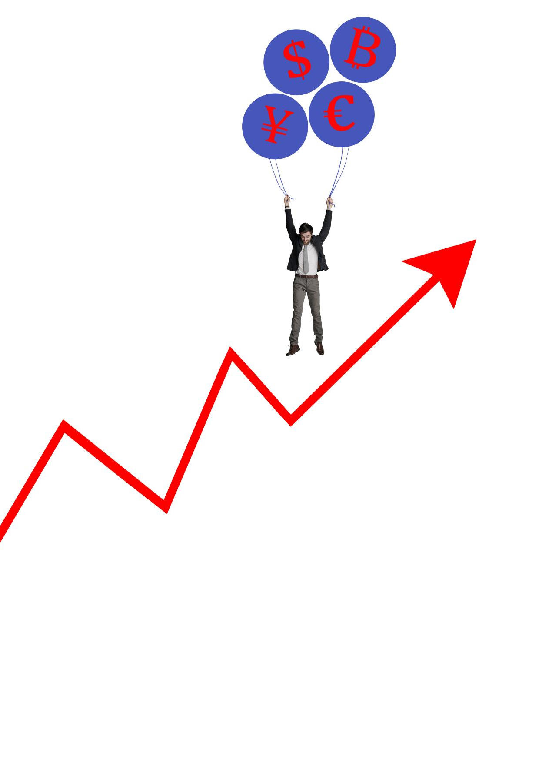
Creating a Crisis Plan for Your Living Space
Emergency Contacts
  Include a list of emergency contacts in your crisis plan for quick access during difficult times.
Coping Strategies
  Develop coping strategies to manage anxiety and stress during crises, ensuring emotional well-being.
Safe Spaces
  Identify safe spaces within your home where you can retreat during a crisis for comfort and security.
Notes:
Develop a clear crisis plan that outlines steps to take during difficult times. This may include emergency contacts, coping strategies, and safe spaces within your home.

Slide 22

Resources and Support Systems to Have in Place
Friends and Family Support
  Friends and family can provide emotional support during crises and help you navigate difficult situations.
Support Groups
  Support groups offer a safe space to share experiences and receive encouragement from others facing similar challenges.
Mental Health Professionals
  Mental health professionals can provide expert guidance and support, helping you develop coping strategies during crises.
Notes:
Identify resources and support systems that can assist you during crises. This may include friends, family, support groups, or mental health professionals.

Slide 23
Reviewing and Revising Your WRAP Living Space
Notes:
Regularly reviewing and revising your WRAP ensures its effectiveness. Adapting to changes in your life and seeking feedback can enhance your recovery process.

Slide 24

Regularly Assessing the Effectiveness of Your Plan
Evaluate Your WRAP
  Regularly assess the effectiveness of your WRAP to understand its impact on your environment and well-being.
Make Necessary Adjustments
  Be open to making adjustments based on your evaluations to ensure a supportive and productive environment.
Maintain Supportive Environment
  Continuously cultivate an environment that supports your goals and enhances your overall well-being.
Notes:
Set aside time to evaluate the effectiveness of your WRAP and its impact on your living space. Make adjustments as necessary to maintain a supportive environment.

Slide 25

Adjusting and Updating as Needed
Embrace Change
  Adapting to life changes is crucial for personal growth and effective planning. Embrace the inevitability of change.
Flexibility in Planning
  Maintaining flexibility in your plan allows for adjustments that better meet your needs. Stay open to revising your approach.
Reflect Current Needs
  Regularly assess your situation and update your plan to align with your current circumstances and aspirations.
Notes:
Life changes, and so should your WRAP. Stay flexible and willing to make updates to your plan to reflect your current needs and circumstances.

Slide 26

Seeking Feedback and Support From Others
Engage with Trusted Individuals
  Reach out to friends or professionals who can provide constructive feedback on your WRAP, ensuring you gain valuable perspectives.
Collaboration for New Insights
  Collaborating with others can reveal new insights that you might not have considered, enhancing the effectiveness of your plan.
Enhancing Effectiveness
  By integrating feedback from trusted sources, you can refine your approach, making your plan more effective and actionable.
Notes:
Engage with trusted friends or professionals for feedback on your WRAP. Collaborating with others can provide new insights and enhance your plan's effectiveness.

Slide 27
Conclusion
Understanding WRAP
Wellness Recovery Action Plan (WRAP) provides a framework for mental health recovery. Understanding it is crucial for effective implementation.
Assessing Your Environment
Evaluate your living space to identify factors that affect your mental well-being. This assessment is a key step in the WRAP process.
Designing a Supportive Atmosphere
Create a nurturing environment that promotes mental health through organization, comfort, and positive elements in your space.
Planning for Maintenance and Crises
Establish strategies and routines for maintaining well-being and addressing potential crises to enhance resilience.
Notes:
Creating a Wellness Recovery Action Plan for your living space involves understanding WRAP, assessing your environment, designing a supportive atmosphere, and planning for maintenance and crises. By implementing these steps, you can enhance your mental well-being and foster a nurturing living environment.

