Slide 1
Peer Case Managers: Harnessing Strengths-Based Planning for Empowerment and Recovery
Exploring methods to support client recovery effectively
Notes:
---
This presentation explores the vital role of peer case managers and how strengths-based planning empowers clients on their recovery journey. We will cover core responsibilities, principles, implementation strategies, outcomes, and challenges to enhance understanding and practice.

Slide 2
Agenda Items
Understanding the Role of Peer Case Managers
Principles of Strengths-Based Planning
Implementing Strengths-Based Planning in Case Management
Advantages and Outcomes of Strengths-Based Planning
Challenges and Best Practices for Peer Case Managers
Notes:
We will first understand the role of peer case managers, then examine the principles of strengths-based planning. Next, we will discuss how to implement these approaches effectively, review their advantages, and conclude with challenges and best practices.

Slide 3
Understanding the Role of Peer Case Managers
Notes:
Peer case managers bring lived experience to case management, offering unique support. This section clarifies their definition, core responsibilities, and distinguishes them from traditional case managers.

Slide 4
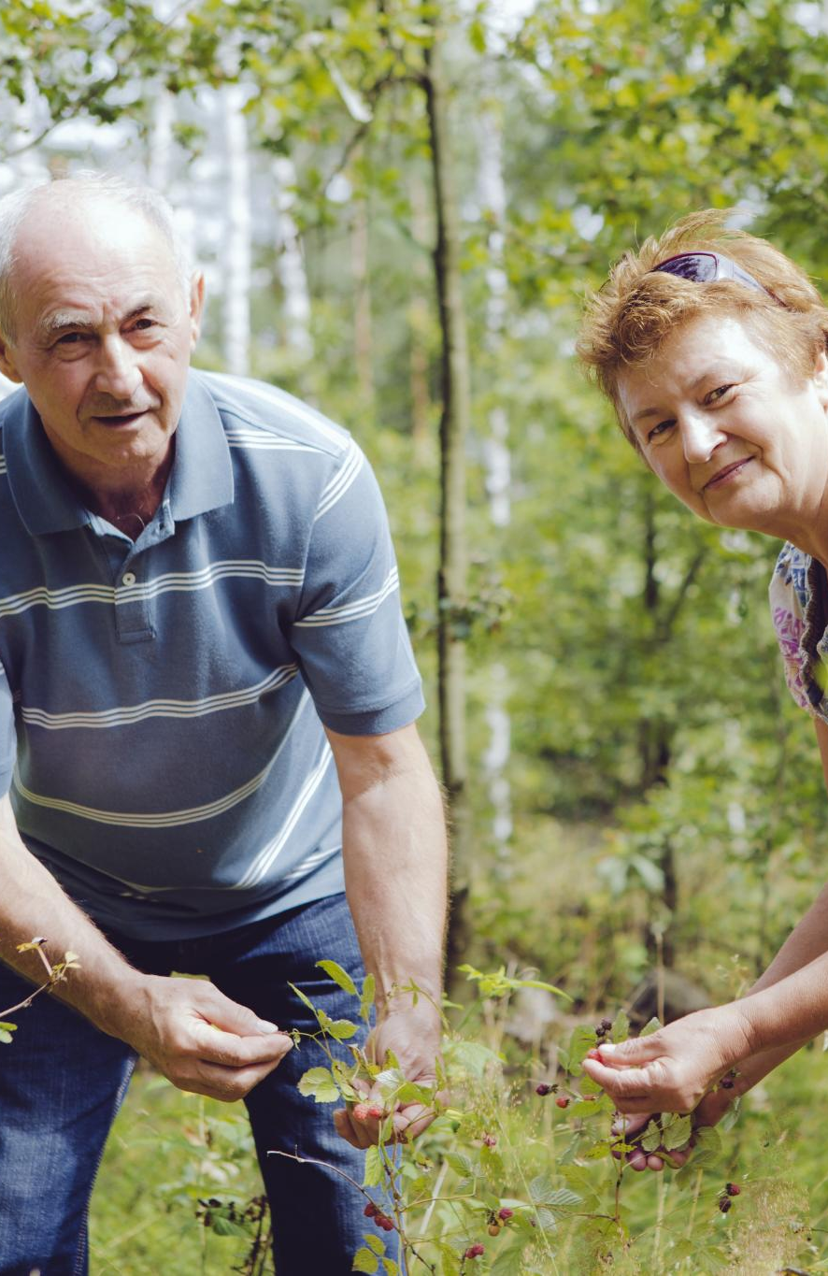
Definition and Core Responsibilities
Peer Case Manager Role
  Peer case managers use lived experience to provide empathetic support and guidance to clients.
Building Trust
  Establishing trust is essential for effective client relationships and successful recovery outcomes.
Facilitating Recovery
  Peer case managers assist clients in navigating recovery pathways and overcoming challenges.
Resource Linking and Empowerment
  They connect clients to vital resources and promote self-empowerment for lasting change.
Notes:
---
Peer case managers are individuals with lived experience who provide support, advocacy, and guidance. Their responsibilities include building trust, facilitating recovery, linking clients to resources, and promoting empowerment.
Image source: Microsoft 365 content library

Slide 5
Difference Between Peer Case Managers and Traditional Case Managers
Personal Recovery Experience
Peer case managers draw from their lived recovery experience to guide and support clients effectively.
Empathy and Connection
This shared experience fosters deeper empathy and stronger emotional connections between peer managers and clients.
Mutual Empowerment
Peer case management emphasizes mutual understanding and empowerment, promoting collaborative growth and healing.
Notes:
---
Unlike traditional case managers, peer case managers use their personal recovery experience as a foundation. This fosters deeper empathy and connection, emphasizing shared understanding and mutual empowerment.
Image source: Microsoft 365 content library

Slide 6
Principles of Strengths-Based Planning
Notes:
Strengths-based planning focuses on clients' capabilities rather than deficits. This section reviews its overview, key values, guiding principles, and advantages over deficit-focused models.

Slide 7

Overview of Strengths-Based Approach
Focus on Individual Strengths
  The approach emphasizes recognizing unique talents and resources each individual possesses to foster growth.
Empowerment to Overcome Challenges
  Clients are encouraged to use their inherent abilities to face challenges and achieve personal goals successfully.
Notes:
---
This approach recognizes and builds on individual strengths, talents, and resources. It encourages clients to identify and use their inherent abilities to overcome challenges and achieve goals.
Image source: Microsoft 365 content library

Slide 8
Key Values and Guiding Principles
Core Values Overview
Respect, empowerment, collaboration, and hope form the foundation of core values guiding positive actions.
Client Autonomy
Focusing on client autonomy encourages self-direction and independent decision-making processes.
Fostering Resilience
Building resilience through positive relationships supports growth and overcoming challenges.
Notes:
---
Core values include respect, empowerment, collaboration, and hope. Guiding principles emphasize client autonomy, focusing on potential, and fostering resilience through positive relationships.
Image source: Microsoft 365 content library

Slide 9
Benefits over Deficit-Focused Models
Promotes Positive Identity
Strengths-based models encourage a positive self-view and boost motivation in individuals.
Reduces Stigma
These models help reduce stigma by focusing on abilities rather than limitations.
Enhances Engagement and Outcomes
Strengths-based approaches result in better engagement and sustainable positive outcomes.
Notes:
---
Strengths-based models promote positive identity and motivation, reducing stigma. They tend to yield better engagement and sustainable outcomes compared to approaches centered on problems and deficits.
Image source: Microsoft 365 content library

Slide 10
Implementing Strengths-Based Planning in Case Management
Notes:
Effective implementation involves identifying client strengths, setting collaborative goals, and using appropriate tools. This section covers practical strategies and techniques.

Slide 11

Identifying Client Strengths and Resources
Uncovering Client Skills
  Peer case managers help identify clients’ unique skills that can support their growth and recovery.
Recognizing Support Systems
  Identifying available social supports is essential for creating effective client-centered plans.
Building on Personal Qualities
  Acknowledging clients’ strengths and qualities fosters confidence and empowerment.
Notes:
---
Peer case managers work with clients to uncover skills, supports, and personal qualities. This asset mapping lays the foundation for tailored planning.
Image source: Microsoft 365 content library

Slide 12

Collaborative Goal Setting and Action Plans
Co-Creation of Goals
  Clients and case managers work together to set goals that reflect strengths and personal aspirations.
Action Plans Development
  Focus on creating achievable steps that empower clients and facilitate steady progress.
Notes:
---
Clients and case managers co-create goals that align with strengths and aspirations. Action plans focus on achievable steps to foster empowerment and progress.
Image source: Microsoft 365 content library

Slide 13

Tools and Techniques for Strengths-Based Assessment
Strengths Questionnaires
  Strengths questionnaires help systematically identify clients' abilities and positive traits for a comprehensive assessment.
Narrative Methods
  Narrative methods engage clients by encouraging storytelling to reveal personal strengths and experiences.
Motivational Interviewing
  Motivational interviewing fosters client engagement, enhancing motivation to recognize and build on their strengths.
Notes:
---
Utilizing tools such as strengths questionnaires, narrative methods, and motivational interviewing enhances assessment. These techniques support client engagement and accurate strength identification.
Image source: Microsoft 365 content library

Slide 14
Advantages and Outcomes of Strengths-Based Planning
Notes:
This section highlights how strengths-based planning improves client engagement, recovery outcomes, and resilience, leading to meaningful empowerment.

Slide 15

Enhanced Client Engagement and Motivation
Strength-Based Focus
  Emphasizing client strengths builds confidence and motivates active participation in recovery.
Client Confidence
  Increased confidence leads to greater willingness to engage in recovery processes.
Notes:
---
Focusing on strengths increases client confidence and willingness to participate actively in their recovery journey.
Image source: Microsoft 365 content library

Slide 16

Improved Recovery and Empowerment Outcomes
Client Empowerment
  Focusing on clients' strengths promotes empowerment and builds confidence for lasting recovery.
Independence and Self-Determination
  Encouraging self-determination helps clients gain independence and take control of their own recovery journey.
Sustained Recovery Success
  Strength-based approaches support long-term recovery and wellbeing for clients.
Notes:
---
Empowering clients through their strengths fosters greater independence, self-determination, and sustained recovery success.
Image source: Microsoft 365 content library

Slide 17

Building Resilience and Self-Efficacy
Strengths-Based Planning
  Focusing on individual strengths helps develop effective coping skills and problem-solving abilities.
Coping Skills Development
  Building resilience involves learning to manage stress and bounce back from adversity effectively.
Self-Efficacy Belief
  Belief in one’s ability to overcome obstacles boosts motivation and persistence in facing challenges.
Notes:
---
Strengths-based planning supports the development of coping skills and belief in personal ability to overcome challenges.
Image source: Microsoft 365 content library

Slide 18
Challenges and Best Practices for Peer Case Managers
Notes:
Peer case managers face unique challenges such as boundary setting and self-care needs. This section reviews common barriers and strategies for effective practice and professional growth.

Slide 19

Common Barriers and Solutions
Role Confusion Barrier
  Role confusion causes inefficiencies and misunderstandings in workplace responsibilities.
Stigma Barrier
  Stigma negatively impacts collaboration and openness within teams or communities.
Resource Limitations
  Limited resources hinder effective implementation of programs and support.
Effective Solutions
  Clear roles, ongoing training, and supportive supervision improve outcomes and reduce barriers.
Notes:
---
Barriers include role confusion, stigma, and resource limitations. Solutions involve clear role definitions, ongoing training, and supportive supervision.
Image source: Microsoft 365 content library

Slide 20
Professional Boundaries and Self-Care
Importance of Boundaries
Establishing clear professional boundaries helps protect emotional well-being and maintain healthy relationships.
Prioritizing Self-Care
Regular self-care practices reduce stress and increase resilience, supporting long-term peer support effectiveness.
Preventing Burnout
Maintaining boundaries and self-care prevents burnout and promotes sustainable professional engagement.
Notes:
---
Maintaining boundaries and prioritizing self-care are essential to prevent burnout and ensure sustainable peer support provision.
Image source: Microsoft 365 content library

Slide 21

Continuous Learning and Supervision
Ongoing Education Importance
  Continuous education enhances skills and knowledge for peer case managers, improving service quality over time.
Reflective Supervision Benefits
  Reflective supervision supports accountability and professional growth through regular feedback and self-assessment.
Quality Service Delivery
  Skill development and supervision together ensure high-quality, accountable service delivery by peer case managers.
Notes:
---
Ongoing education and reflective supervision promote skill development, accountability, and quality service delivery among peer case managers.
Image source: Microsoft 365 content library

Slide 22
Conclusion
Transformative Role of Case Managers
Peer case managers empower clients by focusing on their strengths and supporting recovery journeys effectively.
Overcoming Challenges
Using best practices helps peer case managers to navigate challenges and deliver compassionate care.
Fostering Lasting Growth
Compassionate support from case managers fosters sustainable growth and improved well-being for clients.
Notes:
Peer case managers play a transformative role through strengths-based planning, empowering clients and enhancing recovery. Overcoming challenges with best practices ensures effective, compassionate support that fosters lasting growth.

