Slide 1
WRAP Seminar I: Developing a Wellness Recovery Action Plan
Session II
Wellness Toolbox

Slide 2
Four Parts of Mental Health Recovery and WRAP®
Recovery Concepts and Issues that Need Attention
Wellness Toolbox
Wellness Recovery Action Planning® (WRAP®)
Recovery Topics
104
Notes:
2

Slide 3
WRAP®
To develop your own Wellness Recovery Action Plan® begin by developing a list of personal
WELLNESS TOOLS
105

Slide 4
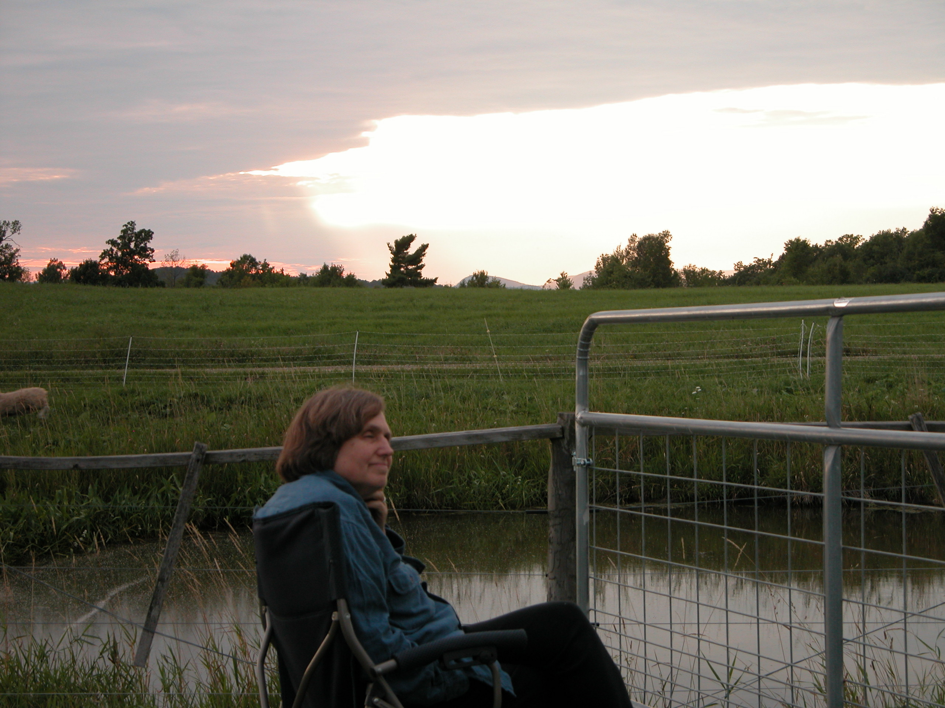
Wellness Tools
Wellness tools are things you do to keep yourself well, and the things you do to help yourself feel better when you are not feeling well.
106

Slide 5
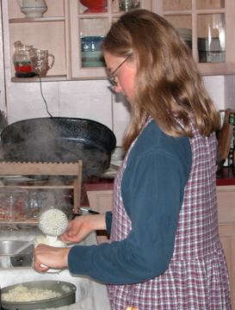
Wellness Tools
  You may have discovered them yourself or learned about them from others.
  Most of them are simple, safe, free and non-invasive.
107

Slide 6
Wellness Tools
List the Wellness Tools you can think of, including things that help you to feel better when you are not feeling well.
  Get ideas for your toolbox from the Wellness Tools discovered by others.
108

Slide 7
Wellness Tools
  Support from others
  Medical or alternative health care
  Peer counseling (exchange listening)
  Focusing exercises
109

Slide 8
Wellness Tools
  Stress reduction and relaxation techniques
  Doing things that divert your attention, things you enjoy
  Diet issues
110

Slide 9
Wellness Tools
Exercise
Light
Sleeping well
111

Slide 10
Wellness Tools
Modifying your daily life
Keeping yourself safe
Daily planning
Spiritual beliefs
112

Slide 11
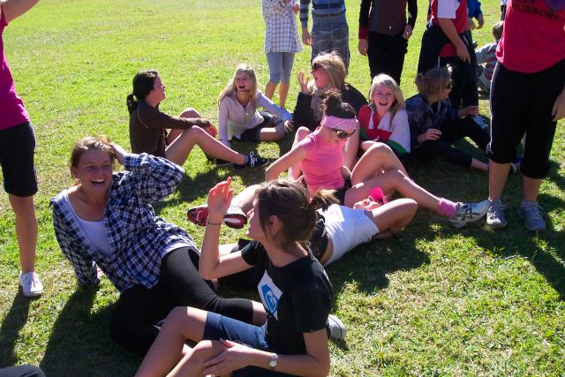
Support
Call or get together with a peer or friend. Talk, listen, share, laugh, cry, or do something fun together.
113

Slide 12
Medical or
Alternative Health Care
Call or arrange an appointment with a medical or alternative health care professional to discuss your situation and to possibly take some action that will keep you well or help you to feel better.
114

Slide 13
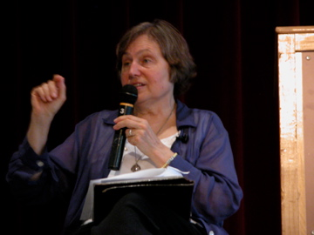
Medical or
Alternative Health Care
If you need immediate attention, ask for it.
115

Slide 14
Medical or
Alternative Health Care
You may want counseling to be one of your Wellness Tools.
If you are already in counseling, you may want to arrange for an extra session to talk things over, address any issues that might be causing you to feel badly, and get support.
116

Slide 15
Peer Counseling
It Really Helps, and It is Free!
Two people agree to spend time together, dividing the time in half, taking turns listening and paying attention to each other.
117

Slide 16
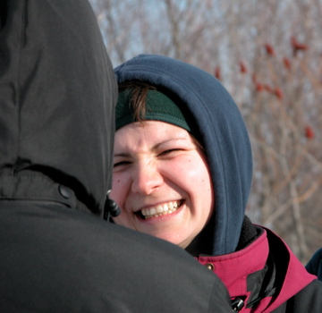
Peer Counseling
Each person has a chance to share while being supported by someone they trust.
118

Slide 17
Peer Counseling
The person who is sharing can do it any safe way that feels good to them—talking, crying, laughing, hitting a pillow, or ranting.
119

Slide 18
Peer Counseling
The person who is listening gives positive support only. They do not judge, criticize or give advice to the person who is sharing.
120

Slide 19
Peer Counseling
The two people who are peer counseling decide how much time they want to spend.
People often divide an hour—each person getting half an hour to share and the other half to pay attention.
121

Slide 20
Peer Counseling
You may find it is useful to focus on one issue and keep coming back to it, even though you want to avoid it. At other times you may feel like talking about many different things.
122

Slide 21
Peer Counseling
You may never have had anyone pay attention to you in this way. Although it may feel uncomfortable at first, many people find it to be very helpful.
123

Slide 22
Peer Counseling
If you are having a really hard time, or if it just feels like the right thing to do, arrange to do peer counseling more often.
124

Slide 23
Peer Counseling
You may want to have several people you peer counsel with so that there is always one available when needed.
They can be the same people that are on your list of supporters.
125

Slide 24

Peer Counseling
Hold peer counseling sessions in a comfortable, quiet place where there will be no interruption or distraction, and where you cannot be heard by others.
126

Slide 25


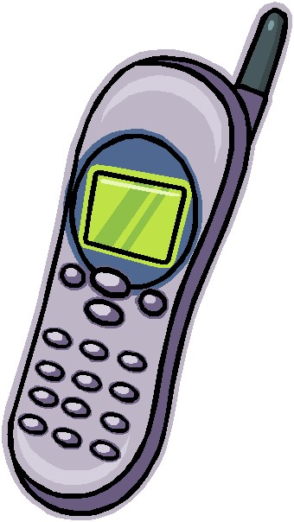
Peer Counseling
Disconnect the phone, turn off the radio and television, and do whatever else is necessary to avoid distraction.
127

Slide 26
Peer Counseling
Begin the session by sharing several good things that have happened in the last week (or day, or month, etc..)
128

Slide 27
Peer Counseling
At the end of the session the person who is listening can ask the person who is sharing to tell them something they are looking forward to.
129

Slide 28

Peer Counseling
Peer counseling sessions can be held over the phone.
130

Slide 29
Steps for
Peer Counseling
Ask someone you feel comfortable with to peer counsel with you.
Agree on how often you will share time together and the amount of time you will be together. Find a place where you will not be disturbed.
131

Slide 30
Steps for
Peer Counseling
As listener, give your complete attention to the person who is sharing, letting them know by nodding your head and other body language that you are paying close attention.
Do not interrupt them.
132

Slide 31
Steps for
Peer Counseling
Start your time by sharing something that happened in the past week that you enjoyed.
End your time by sharing something you are looking forward to.
133

Slide 32
Steps for
Peer Counseling
Some people say that peer counseling is the most important part of their wellness program. They find that when they peer counsel often, it helps them to feel better.
134

Slide 33
Focusing
Focusing is a simple, safe, free, tool that may help you to feel better. Give it a try and see if it is helpful to you.
135

Slide 34

Focusing
Try it several times, as you may not notice any change in the way you feel the first time you do this.
136

Slide 35
Focusing
In focusing, you respond to questions or steps that help you focus on the “real” issue, the one that is most important at the time.
137

Slide 36
Focusing
It may not be the issue you thought was most important. Focusing can connect you with the feelings caused by that issue.
138

Slide 37
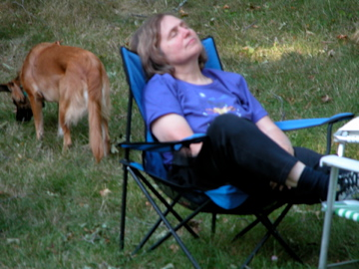
Focusing
When you connect with the feelings and explore them, you may notice that you feel relieved or better.
139

Slide 38
Focusing
Ask a friend to read you the instructions as you focus.
After a while you will know them without having them read to you. You could also make a tape of the instructions.
140

Slide 39
Focusing
Most people just “feel” the answers to the questions. You may choose to write the answers or feelings that come to you.
141

Slide 40

Focusing
Get ready for a focusing exercise by settling down in a comfortable space and asking yourself, “How does it feel inside my body right now?”
142

Slide 41
Focusing
  Notice any feelings of uneasiness or discomfort in your body. Focus your attention on these feelings for a few moments.
143

Slide 42

Focusing
Ask yourself, “What's between me and feeling fine?”
144

Slide 43
Focusing
  Don't answer; let the feeling that comes in your body do the answering.
  As each concern comes up, put it aside, like making a list in your head.
145

Slide 44

Focusing
Review the list. See which problem stands out, seems to be begging for your attention.
146

Slide 45
Focusing
  It may be different from the one you thought was most important.
147

Slide 46
Focusing
  Ask yourself if it’s okay to focus on the problem.
  If the answer is yes, notice what you sense in your body when you recall the whole of that problem.
148

Slide 47
Focusing
  If the answer is no, choose another problem that stands out and let the other alone for the time being.
149

Slide 48

Focusing
  Sense all the feeling of the problem. Really feel it in your body for several minutes.
150

Slide 49

Focusing
Let a word, phrase, or image that matches the feeling of this problem come into your mind.
151

Slide 50
Focusing
Go back and forth between the word, phrase or image and the felt sense.
152

Slide 51

Focusing
  Do they really match? If they don't match, find another word, phrase or image to work with that does feel like a match.
153

Slide 52
Focusing
    When they match, go back and forth several times between the word, phrase or image and the feeling in your body.
154

Slide 53
Focusing
  If the feeling in your body changes, follow it with your attention – notice it. Be with the feeling for several moments.
155

Slide 54

Focusing
If you want, ask yourself some or all of the following questions about the problem to help yourself change the way you feel:
156

Slide 55
Focusing
    How does the worst of this feel in my body?
    What needs to happen inside me for this whole thing to change?
157

Slide 56
Focusing
    What would feel like a small step forward with all this?
    What would feel like a breath of fresh air in this whole thing?
158

Slide 57
Focusing
  How would it feel inside if this were all okay?
  What needs to change inside me for this to feel better?
159

Slide 58
Focusing
Again, when they match, go back and forth several times between the word, phrase or image and the feeling in your body.
160

Slide 59

Focusing
If the feeling in your body changes, follow it with your attention – notice it.
Be with the feeling for several moments.
161

Slide 60
Focusing
  Be with the feelings that came up for a few moments. Then ask yourself, “Am I ready to stop or should I do another round of focusing?”
162

Slide 61
Focusing
  If you are going to stop, before resuming your regular activities, relax for a few minutes and notice how your feelings have changed.
163

Slide 62
Relaxation and Stress Reduction Exercises
When used consistently, relaxation and stress reduction exercises are useful tools in achieving wellness.
They can help you feel better by helping you to relax.
164

Slide 63

Relaxation and Stress Reduction Exercises
They relieve feelings like anxiety, agitation, and stress.
They help you feel better about yourself.
165

Slide 64
Relaxation and Stress Reduction Exercises
Learn and practice these techniques when you are feeling well so they are easy for you to do when you are not feeling well.
166

Slide 65
Learn How to Relax
  Take a relaxation course
  Rent instructional videos
  Listen to audio CDs
  Review self-help books
167

Slide 66
Learn How to Relax
When you are not feeling well or when your life is more stressful, spend more time relaxing and repeat the exercises more often during the day.
168

Slide 67

Learn How to Relax
Use a CD or DVD with a guided relaxation exercise when you are easily distractible.
169

Slide 68
Learn How to Relax
Try different relaxation exercises to discover which work best for you:
progressive relaxation
body scan
guided imagery
focusing on detail
checking in
170

Slide 69
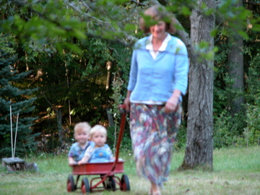
Self-Esteem
You are a special, unique person who deserves to be alive and to be treated with dignity, compassion and respect.
336

Slide 70
Self-Esteem
Like many others, you may have low self-esteem. You may feel that you have little value as a person. Remind yourself that this is not true.
337

Slide 71
Self-Esteem
Low self esteem can keep you from being the kind of person you want to be and living the kind of life you want to live.
338

Slide 72
Self-Esteem
You may make poor choices for yourself and avoid doing some things you really want to do and can do. This can worsen your self-esteem and affect the quality of your life.
339

Slide 73
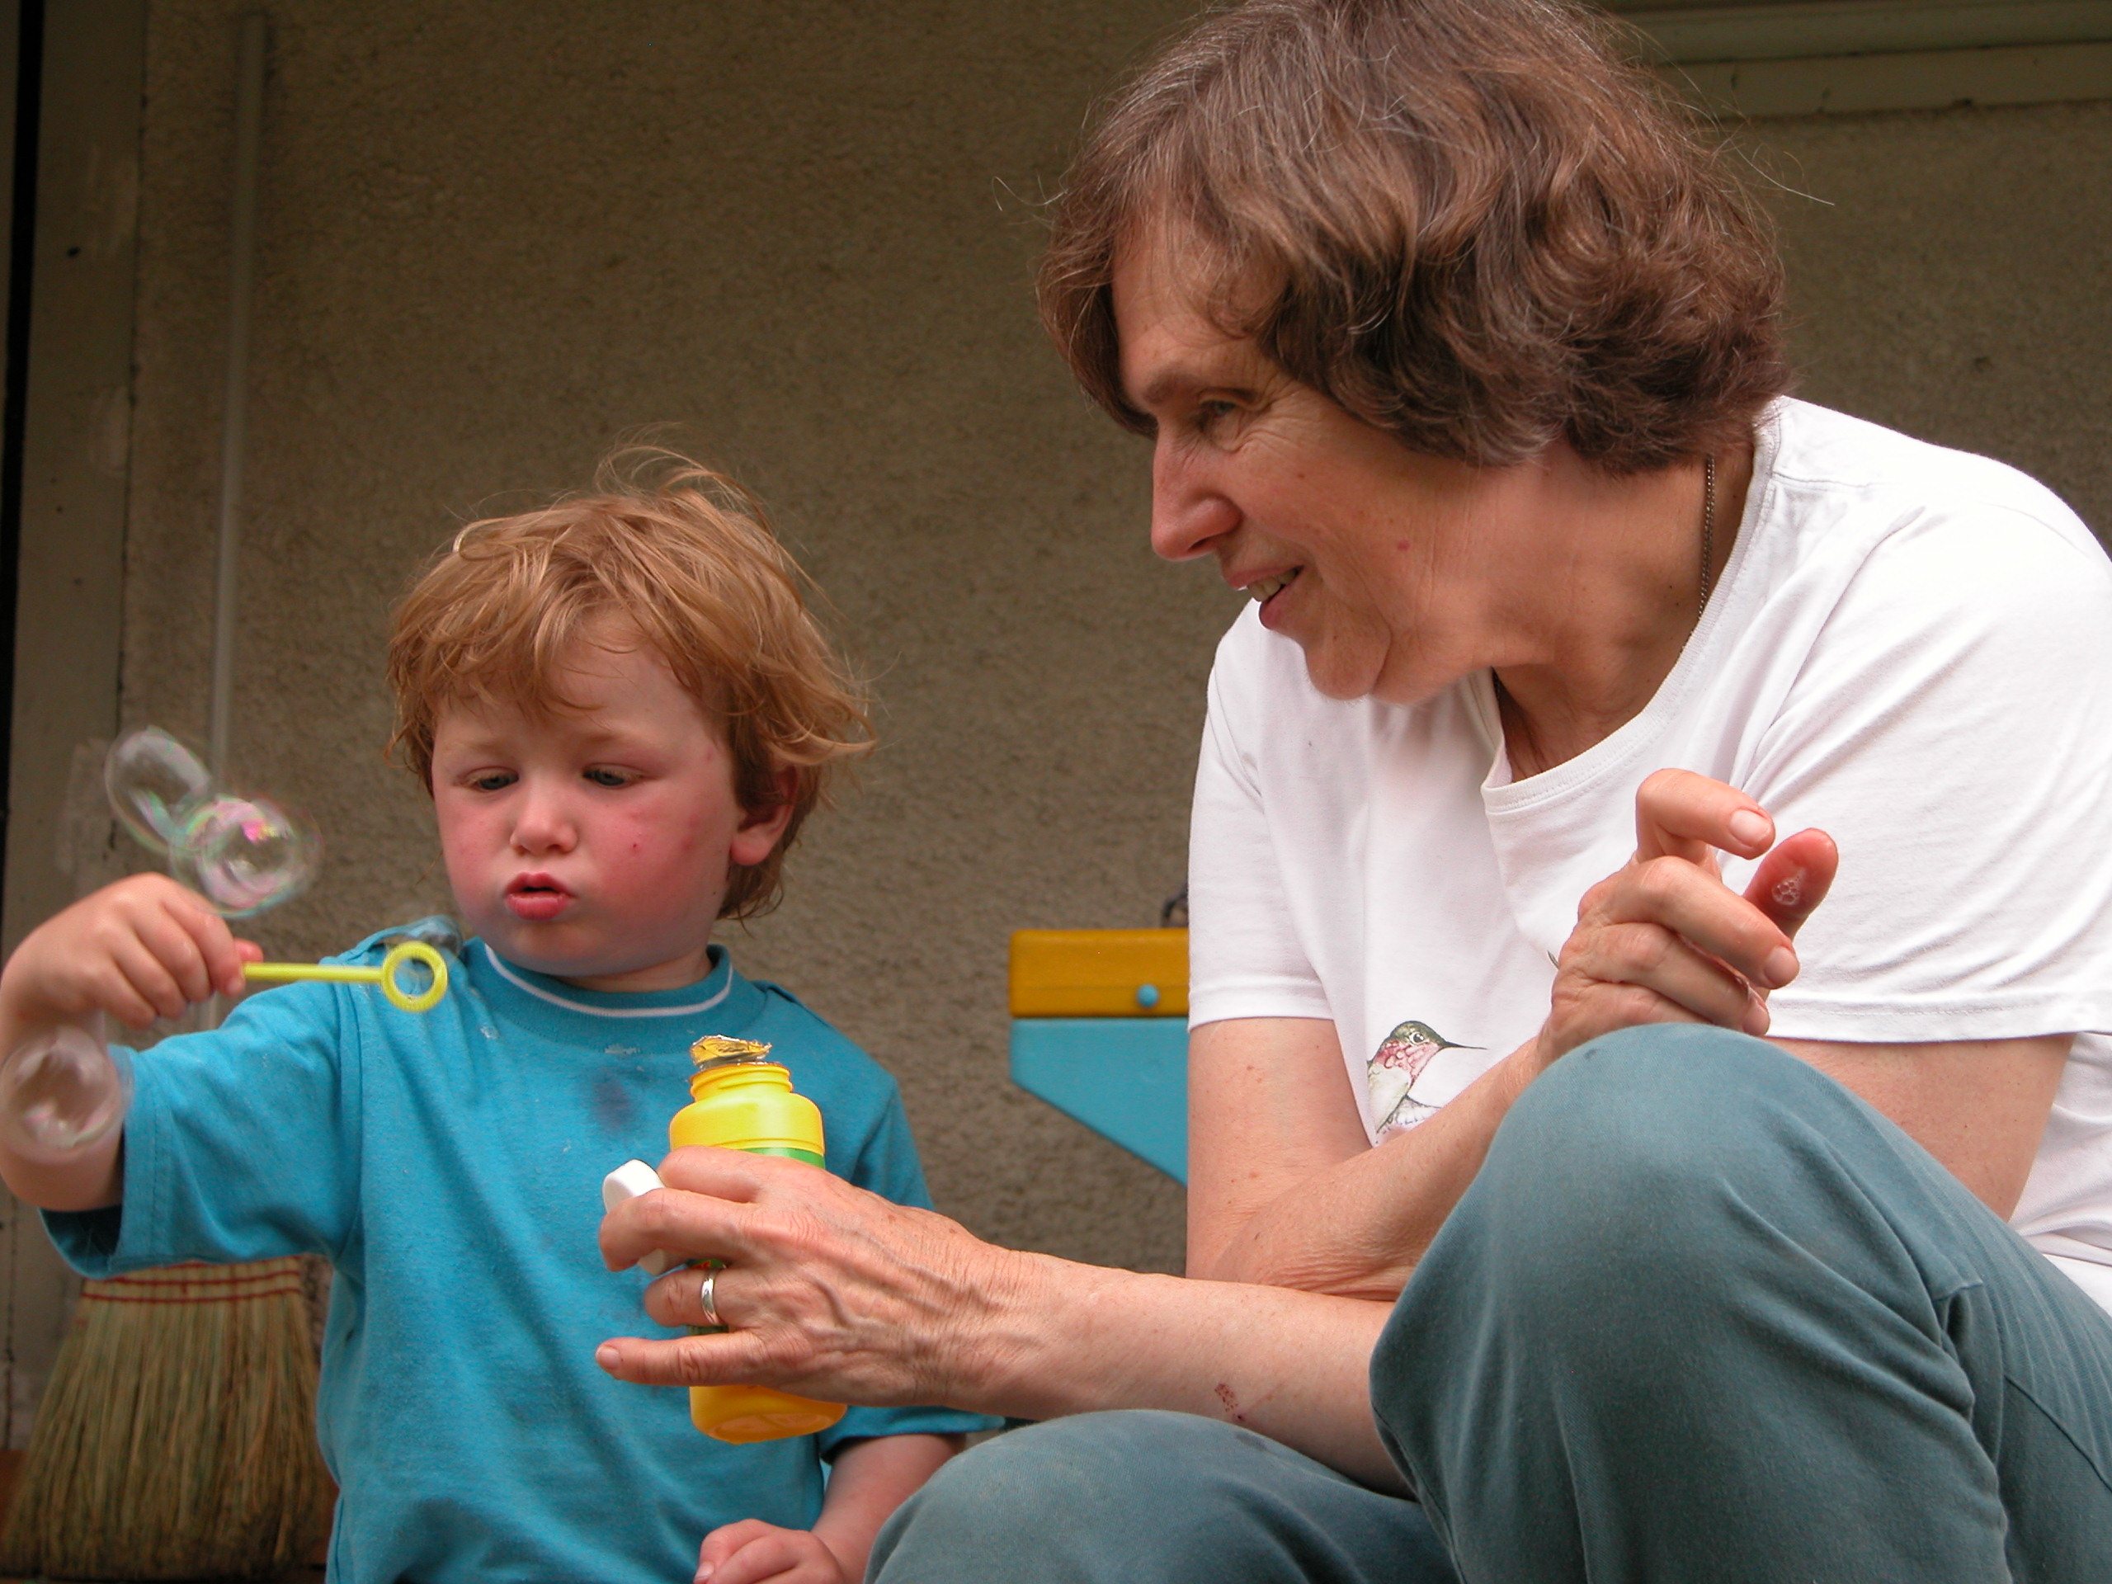
Self-Esteem
There are many things you can do to help yourself feel better about yourself and raise your self-esteem.
340

Slide 74
Self-Esteem
  Develop a Statement of Your Positive Value – carry it with you and read it over and over, every chance you get. Make signs with this message and hang them in prominent places around your home.
341

Slide 75
Self-Esteem
  Make an Appreciation Paper-
  At the top of a sheet of paper write
  “Things I Like About ______(Your Name)”.
  Have friends, acquaintances, family members, etc., write an appreciative statement about you on it. When you read it, just accept it!
  Read it over and over. Keep it in a prominent place where you will see it often.
342

Slide 76
Self-Esteem
Take a risk or make some change in your life that you have wanted.
Now may be the right time to begin taking some small or big steps toward making your life the way you want it to be.
343

Slide 77
Self-Esteem
Decide what it is you want to do. Maybe you want to get a job, change jobs, find a new living space or lose weight.
Next, write the first step or steps you plan to take to do it. For instance, if you want to get a job, your first step might be to arrange an appointment with a vocational counselor.
344

Slide 78
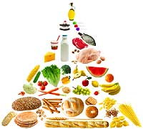
Self-Esteem
If you want to lose weight, your first steps might be to set up an appointment with a nutritionist and to stop eating foods that contain sugar.
345

Slide 79

Self-Esteem
  Make a collage of your life combining pictures, words, and colors that show how great you are.
346

Slide 80

Self-Esteem
  Make a scrapbook of all your achievements, even things that may seem small, like learning to tie your shoes or training a pet.
347

Slide 81
Self-Esteem
  Hang flattering pictures of yourself all around your living space.
  Tell a friend you want to compliment them for five minutes. Then ask them to compliment you for five minutes.
348

Slide 82
Self-Esteem
  Arrange to spend time with people who like you and treat you well.
  Take good care of yourself in every way – treat yourself like your own best friend.
349

Slide 83
Self-Esteem
  Work on changing negative thoughts about yourself to positive ones.
  Read and do the activities in a self-help book on raising your self-esteem. You can find plenty of these at your local library.
350

Slide 84
Self-Esteem
Quick and Easy Ways to Raise Self-Esteem:
  Give yourself a pat on the back because you are great.
  Do something you enjoy.
  Do something that makes you laugh.
351

Slide 85
Self-Esteem
  Do something special for someone else.
  Ask for what you want and need for yourself. You deserve it!
352

