Slide 1

Wellness Recovery Action Plan (WRAP) Peer Support: A Path to Wellness
Exploring WRAP and the benefits of peer support
Notes:
---
This presentation focuses on the Wellness Recovery Action Plan (WRAP) and the integral role of peer support in promoting wellness. We will explore the concept of WRAP, its components, and how peer support enhances the recovery process.

Slide 2

Agenda Overview
Introduction to WRAP
Components of a WRAP
Role of Peer Support in WRAP
Steps to Creating a WRAP with Peer Support
Success Stories and Case Studies
Resources and Further Learning
Notes:
In this presentation, we will cover the introduction to WRAP, its components, the role of peer support, steps to create a WRAP with peer involvement, success stories, and additional resources for further learning. Each section will provide insights into how WRAP can facilitate recovery.

Slide 3
Introduction to WRAP
Notes:
The Wellness Recovery Action Plan (WRAP) is a structured system for monitoring and managing one's wellness. It encourages individuals to develop personalized plans to enhance their recovery and wellness journey.

Slide 4

What Is WRAP?
Self-Designed Wellness System
  WRAP is a personalized wellness system that enables individuals to craft their own path to mental well-being.
Empowerment Through Planning
  The WRAP system empowers users by providing tools to plan proactively for their mental health and recovery.
Identifying Wellness Resources
  WRAP helps individuals identify and utilize their wellness resources and strategies effectively for better mental health.
Notes:
WRAP is a self-designed wellness system that helps individuals identify their wellness resources and strategies. It empowers users to take control of their mental health and recovery process through proactive planning.

Slide 5
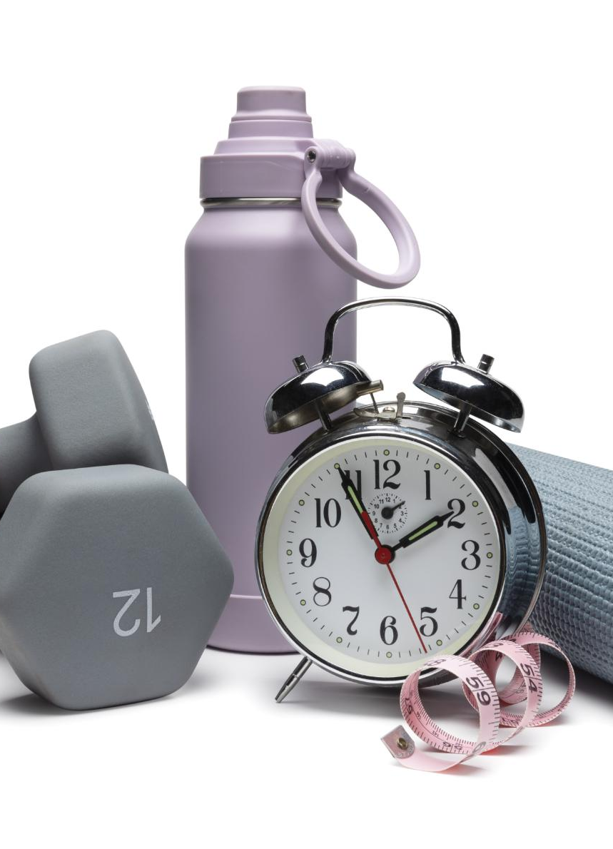
History and Development of WRAP
Origins in the 1990s
  WRAP was developed in the 1990s based on the experiences of individuals facing mental health challenges, showcasing their needs and insights.
Promoting Wellness
  WRAP has evolved into a recognized tool that promotes wellness and recovery, helping individuals take charge of their mental health.
Adaptation Across Populations
  The versatility of WRAP has allowed it to be adapted for various populations, making it accessible for diverse communities.
Notes:
Developed in the 1990s by Mary Ellen Copeland, WRAP originated from the experiences of individuals with mental health challenges. It has evolved into a widely recognized tool for promoting wellness and recovery across various populations.

Slide 6

Core Principles and Values
Principles of Hope
  Hope is foundational in WRAP, driving individuals to envision and work towards brighter futures.
Personal Responsibility
  Personal responsibility empowers individuals to take charge of their lives and decisions, fostering independence.
Education and Self-Advocacy
  Education and self-advocacy are essential for individuals to articulate their needs and advocate for themselves.
Support Systems
  Support from others is crucial, as it provides encouragement and resources for achieving personal goals.
Notes:
WRAP is rooted in principles of hope, personal responsibility, education, self-advocacy, and support. These values guide individuals to create a plan that reflects their unique needs and goals.

Slide 7
Components of a WRAP
Notes:
A WRAP consists of several key components that work together to support an individual’s wellness journey. Each component is designed to help people identify their goals and strategies for maintaining wellness.

Slide 8

Wellness Toolbox
Coping Techniques
  Coping techniques are strategies designed to help individuals manage stress and life's challenges effectively, promoting emotional resilience.
Relaxation Practices
  Relaxation practices, such as mindfulness and meditation, are essential for reducing stress and enhancing overall wellbeing.
Supportive Activities
  Supportive activities help individuals connect with others and foster a sense of belonging, contributing to improved mental health.
Notes:
The Wellness Toolbox is a collection of resources and strategies that individuals can use to manage their wellbeing. This toolbox may include coping techniques, relaxation practices, and supportive activities.

Slide 9

Daily Maintenance Plan
Wellness Routines
  Daily actions and routines are essential for maintaining wellness and mental clarity. Consistency in self-care practices leads to improved health.
Structure and Stability
  A consistent structure in daily life promotes stability, helping individuals to navigate challenges more effectively.
Self-Care Practices
  Incorporating self-care practices into the daily routine is crucial for mental and emotional well-being.
Notes:
The Daily Maintenance Plan outlines the daily actions and routines that support wellness. It helps individuals establish a consistent structure in their lives that promotes stability and self-care.

Slide 10

Identifying Triggers and Action Plans
Recognizing Personal Triggers
  Identifying personal triggers is vital for understanding their impact on mental health and developing coping mechanisms.
Creating Action Plans
  Developing action plans provides a structured way to address triggers and enhance mental well-being effectively.
Effective Strategies for Wellness
  Implementing effective strategies can help individuals manage challenges, promoting resilience and sustaining wellness.
Notes:
This component involves recognizing personal triggers that may impact mental health and creating action plans to address them. Effective strategies can help individuals navigate challenges and maintain their wellness.

Slide 11
Role of Peer Support in WRAP
Notes:
Peer support is a vital aspect of the WRAP process, providing individuals with shared experiences and understanding. It fosters a sense of community and connection among participants.

Slide 12

Definition and Importance of Peer Support
Understanding Peer Support
  Peer support is about individuals sharing their experiences to provide mutual understanding and assistance in challenging times.
Encouraging Hope
  Peer support plays a crucial role in recovery by instilling hope and motivation among individuals facing similar challenges.
Fostering Resilience
  Through shared experiences, peer support helps individuals develop resilience, empowering them to overcome obstacles.
Reducing Isolation
  Peer support significantly reduces feelings of isolation by creating a community of support and understanding.
Notes:
Peer support involves individuals sharing their experiences and providing mutual support. It is essential in recovery as it encourages hope, fosters resilience, and reduces feelings of isolation.

Slide 13

Benefits of Peer Support in Recovery
Enhanced Recovery Outcomes
  Peer support has been shown to significantly enhance recovery outcomes, helping individuals overcome challenges in their journey.
Improved Mental Health
  Engaging with peers in recovery can lead to improved mental health by providing emotional support and understanding.
Increased Motivation
  Peer support fosters increased motivation through shared experiences and encouragement from others facing similar challenges.
Coping Skills Development
  Through shared experiences, individuals develop effective coping skills that aid in their recovery process.
Notes:
Research shows that peer support significantly enhances recovery outcomes. Benefits include improved mental health, increased motivation, and the development of coping skills through shared experiences.

Slide 14

Examples of Effective Peer Support Strategies
Group Discussions
  Group discussions provide a platform for individuals to share experiences, fostering a sense of community and belonging.
One-on-One Mentoring
  One-on-one mentoring allows for personalized support and guidance tailored to individual needs, enhancing personal growth.
Skills Training
  Skills training equips individuals with practical tools and coping mechanisms to navigate challenges effectively.
Notes:
Effective peer support strategies include group discussions, one-on-one mentoring, and skills training. These strategies help individuals build confidence and learn new coping mechanisms in a supportive environment.

Slide 15
Steps to Creating a WRAP with Peer Support
Notes:
Creating a WRAP with peer support involves collaboration and engagement. By working together, peers can effectively develop personalized plans that reflect their individual wellness goals.

Slide 16

Engaging Peers in the WRAP Process
Open Communication
  Fostering open communication is essential for engaging peers effectively in the WRAP process and building trust among participants.
Encouraging Participation
  Encouraging participation from all peers ensures that everyone has a voice and contributes to the process, leading to better outcomes.
Valuing Insights
  Recognizing and valuing each individual's insights fosters a sense of belonging and collaboration within the group.
Notes:
Engaging peers in the WRAP process involves fostering open communication and encouraging participation. This collaborative approach ensures that each individual's insights and preferences are valued.

Slide 17
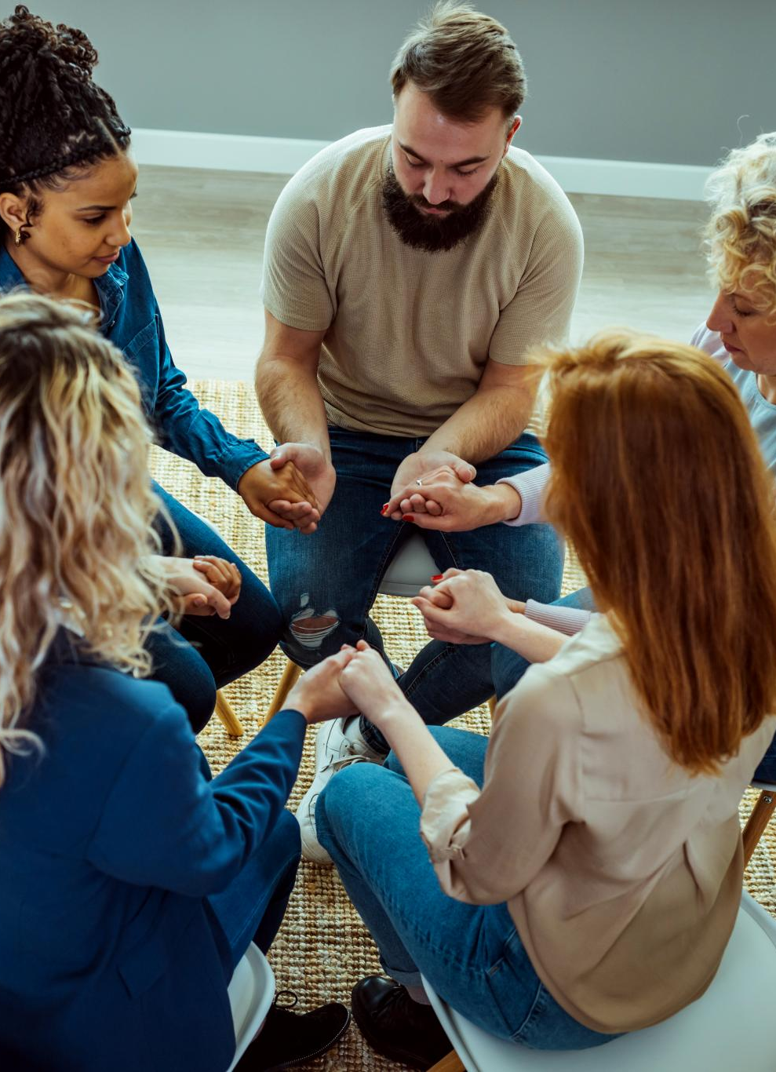
Collaborative Development of Wellness Tools
Sense of Ownership
  Collaborative development fosters a sense of ownership among participants, increasing their commitment to wellness initiatives.
Shared Strategies and Resources
  Participants can share successful strategies and resources they have discovered, enriching the collaborative wellness experience.
Enhanced WRAP Experience
  Through collaboration, participants enhance their WRAP experiences, leading to more effective wellness tools and practices.
Notes:
Developing wellness tools collaboratively helps create a sense of ownership and commitment. Participants can share strategies and resources that have worked for them, leading to a richer WRAP experience.

Slide 18

Monitoring Progress and Making Adjustments
Importance of Monitoring
  Regularly monitoring progress is essential to identify areas that require adjustments for effective wellness promotion.
Iterative Approach
  Adopting an iterative approach enables individuals to refine their plans based on ongoing feedback and results.
Adapting Plans
  Making timely adjustments to the WRAP ensures it remains relevant and effectively supports individual wellness goals.
Notes:
Regularly monitoring progress and making adjustments to the WRAP is crucial. This iterative approach allows individuals to adapt their plans as needed to ensure they remain effective in promoting wellness.

Slide 19
Success Stories and Case Studies
Notes:
Real-life success stories and case studies demonstrate the effectiveness of WRAP and peer support. These examples provide inspiration and practical insights into how WRAP can facilitate recovery.

Slide 20

Personal Testimonials
Transformative Impact
  Testimonials illustrate how WRAP has transformed lives by promoting mental and emotional well-being.
Resilience and Empowerment
  Personal stories highlight the resilience developed through WRAP, empowering individuals on their wellness journeys.
Wellness Journey
  The narratives reflect the importance of embracing a wellness journey in achieving personal growth and resilience.
Notes:
Personal testimonials from individuals who have utilized WRAP highlight its transformative impact. These narratives showcase the resilience and empowerment that come from embracing a wellness journey.

Slide 21

Case Studies of WRAP Implementation
Diverse Implementation Settings
  Case studies showcase a range of environments where WRAP has been successfully adopted, highlighting its versatility.
Best Practices Insights
  These case studies provide valuable insights into best practices for implementing WRAP effectively in various contexts.
Adapting WRAP
  Insights from these studies reveal how WRAP can be tailored to meet the unique needs of different sectors.
Notes:
Case studies illustrate various settings where WRAP has been effectively implemented. They offer insights into best practices and the diverse contexts in which WRAP can thrive.

Slide 22

Lessons Learned and Best Practices
Importance of Flexibility
  Flexibility in the implementation of WRAP allows for adjustments based on real-time feedback and changing needs.
Peer Involvement
  Engaging peers in the process fosters support and enhances the effectiveness of peer support frameworks.
Ongoing Evaluation
  Continuous evaluation is crucial for identifying what works well and what needs improvement in support frameworks.
Notes:
Lessons learned from the implementation of WRAP emphasize the importance of flexibility, peer involvement, and ongoing evaluation. Best practices can guide future efforts to enhance peer support frameworks.

Slide 23
Resources and Further Learning
Notes:
To continue learning about WRAP and peer support, various resources are available. These include training programs, online communities, and publications that provide valuable information.

Slide 24
Training Programs and Workshops
Diverse Training Programs
Various training programs are designed to cater to different learning needs and objectives, ensuring effective implementation of WRAP.
Skill Development
Participants gain essential skills through hands-on exercises and expert guidance, preparing them for successful facilitation.
Effective Facilitation Techniques
Workshops focus on teaching effective facilitation techniques, enabling participants to lead discussions and activities successfully.
Notes:
Numerous training programs and workshops are available to help individuals and organizations learn how to implement WRAP effectively. These programs equip participants with the skills needed for successful facilitation.

Slide 25
Online Resources and Communities
Access to Information
Online resources provide valuable information about WRAP, enhancing understanding and support for users.
Peer Support Networks
Communities offer opportunities for peer support, allowing individuals to connect and share experiences with others.
Building Connections
Engaging with online platforms fosters meaningful connections that can lead to ongoing support and collaboration.
Notes:
Online resources and communities offer access to a wealth of information about WRAP and peer support. Engaging with these platforms can foster connections and provide ongoing support.

Slide 26

Books and Publications on WRAP and Peer Support
In-depth Knowledge
  Books on WRAP and peer support offer comprehensive knowledge about recovery and mental wellness.
Practical Guidance
  These publications provide practical guidance and strategies to implement WRAP and peer support effectively.
Valuable Resources
  The various resources are invaluable for individuals seeking to improve their understanding of mental health support.
Notes:
There are various books and publications dedicated to WRAP and peer support that provide in-depth knowledge and practical guidance. These resources are invaluable for anyone looking to deepen their understanding.

Slide 27
Conclusion
Wellness Recovery Action Plan
The Wellness Recovery Action Plan serves as a structured approach to individual recovery, empowering people to take charge of their wellness.
Role of Peer Support
Peer support plays a crucial role in recovery by providing encouragement and shared experiences that foster empowerment and resilience.
Collaborative Efforts
Collaborative efforts among individuals enhance the recovery process, leading to meaningful progress towards personal wellness goals.
Notes:
In conclusion, the Wellness Recovery Action Plan and peer support together create a powerful framework for promoting recovery and wellness. By leveraging personal experiences and collaborative efforts, individuals can achieve meaningful progress on their wellness journeys.

