Slide 1
Peer Case Manager Skills: Core Competencies and Best Practices for Effective Support
Essential abilities and strategies for impactful case management
Notes:
---
This presentation explores the essential skills and best practices for peer case managers. We will cover the role and responsibilities, core competencies, best practices, professional development, and evaluating success to help enhance effective support.

Slide 2
Presentation Agenda Overview
Understanding the Role of a Peer Case Manager
Core Competencies Required for Peer Case Managers
Best Practices in Peer Case Management
Professional Development and Self-Care
Evaluating Success and Outcomes
Notes:
We will begin by understanding the role of peer case managers, then examine core competencies required. Next, we'll discuss best practices, followed by professional development and self-care strategies. Finally, we'll look at evaluating success and outcomes in peer case management.

Slide 3
Understanding the Role of a Peer Case Manager
Notes:
A peer case manager plays a unique role in providing support by leveraging lived experiences to guide and advocate for clients. This section outlines the definition, key responsibilities, and the distinct value peer perspectives bring.

Slide 4

Defining Peer Case Management
Lived Experience Support
  Peer case managers use their own lived experiences to offer authentic guidance and support to clients.
Trust and Relatability
  Building trust through shared experiences enhances client engagement and fosters meaningful connections.
Advocacy in Complex Systems
  Peers help clients navigate complex systems by advocating and providing practical support.
Notes:
---
Peer case management involves individuals with lived experience offering guidance, support, and advocacy to clients navigating complex systems. This approach fosters trust and relatability, enhancing client engagement and recovery.
Image source: Microsoft 365 content library

Slide 5

Key Responsibilities and Functions
Service Coordination
  Peer case managers organize and coordinate various services to meet clients' diverse needs effectively.
Emotional Support
  Providing empathetic emotional support helps clients feel understood and motivated throughout their journey.
Resource Connection
  Connecting clients to community resources ensures they access necessary healthcare and social services.
Advocacy and Navigation
  Peer case managers assist in navigating complex systems and advocate for clients' rights and needs.
Notes:
---
Peer case managers coordinate services, provide emotional support, help clients set goals, and connect them with community resources. They also assist in navigating healthcare, social services, and advocate for client needs.
Image source: Microsoft 365 content library

Slide 6
Unique Value of Lived Experience
Empathy Through Experience
Lived experience provides peer case managers with empathy that enhances client relationships beyond traditional approaches.
Building Authentic Connections
Shared experiences foster authentic connections that help reduce stigma and create trust with clients.
Empowerment Through Understanding
Peer case managers empower clients by using shared understanding to encourage growth and healing.
Notes:
---
Lived experience equips peer case managers with empathy and insight that traditional professionals may lack. It helps build authentic connections, reduces stigma, and empowers clients through shared understanding.
Image source: Microsoft 365 content library

Slide 7
Core Competencies Required for Peer Case Managers
Notes:
Successful peer case managers must develop strong communication, empathy, cultural competence, advocacy, and resource navigation skills. These competencies enable effective client support and collaboration.

Slide 8

Effective Communication and Active Listening
Trust and Understanding
  Clear communication and active listening build trust and enhance mutual understanding between peers and clients.
Non-Judgmental Listening
  Peer case managers listen without judgment to fully understand clients’ needs and perspectives.
Compassionate Communication
  Communicating information clearly and compassionately helps clients feel supported and valued.
Notes:
---
Clear communication and active listening foster trust and understanding. Peer case managers must listen without judgment, clarify client needs, and communicate information compassionately and clearly.
Image source: Microsoft 365 content library

Slide 9

Empathy, Respect, and Cultural Competence
Empathy and Respect
  Showing empathy and respect to clients' diverse backgrounds encourages trust and inclusivity in care.
Cultural Competence
  Cultural competence involves understanding and valuing individual differences to improve client interactions.
Reducing Barriers
  Respect and cultural competence reduce barriers, ensuring effective and client-centered care delivery.
Notes:
---
Demonstrating empathy and respect while honoring clients’ diverse backgrounds promotes inclusivity and client-centered care. Cultural competence ensures sensitivity to individual differences and reduces barriers.
Image source: Microsoft 365 content library

Slide 10
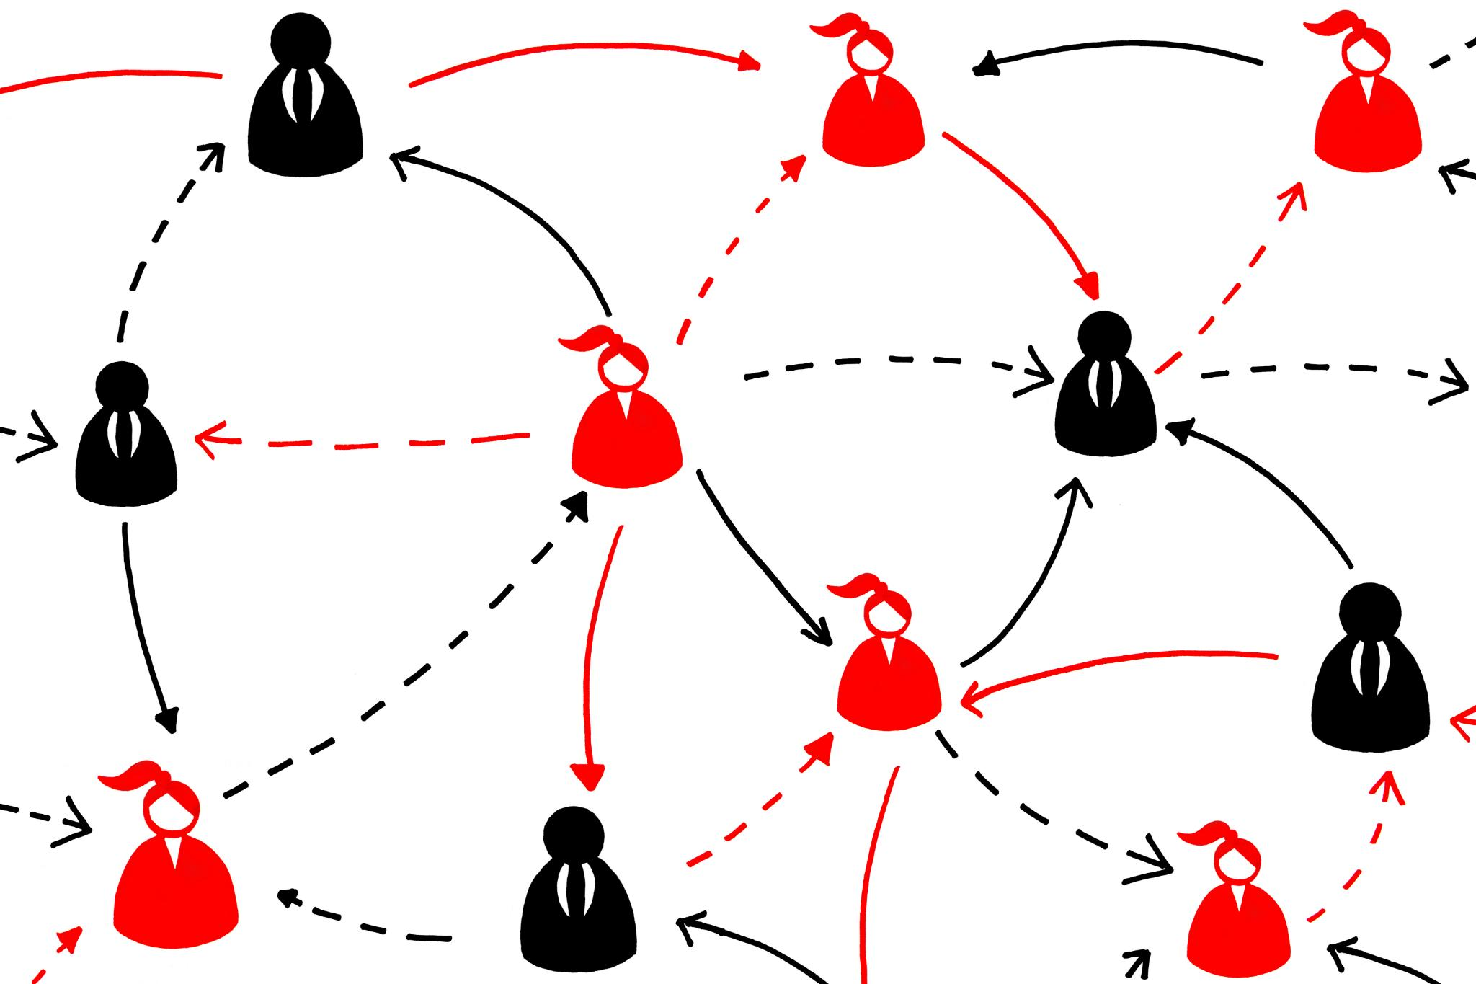
Advocacy and Resource Navigation Skills
Advocating for Client Rights
  Peer case managers actively support client rights to ensure fair access to needed services and resources.
Navigating Complex Systems
  They skillfully navigate healthcare and social service systems to connect clients with appropriate resources efficiently.
Ensuring Timely Support
  Timely connection to services ensures clients receive effective support when it is most needed.
Notes:
---
Peer case managers advocate for client rights and access to services. They navigate complex systems to connect clients with appropriate resources, ensuring timely and effective support.
Image source: Microsoft 365 content library

Slide 11
Best Practices in Peer Case Management
Notes:
Implementing best practices such as building trust, maintaining boundaries, and collaborating with interdisciplinary teams improves outcomes and sustains professional relationships.

Slide 12

Building Trust-Based Relationships
Importance of Trust
  Trust is the foundation for strong client engagement and long-lasting relationships.
Authenticity and Consistency
  Being authentic and consistent builds credibility and deepens client rapport.
Confidentiality Matters
  Maintaining confidentiality ensures client privacy and strengthens commitment.
Notes:
---
Establishing trust is foundational for engaging clients. Being authentic, consistent, and maintaining confidentiality strengthens rapport and client commitment.
Image source: Microsoft 365 content library

Slide 13

Maintaining Professional Boundaries
Protecting Clients and Case Managers
  Clear professional boundaries safeguard the wellbeing of both clients and peer case managers.
Preventing Conflicts of Interest
  Maintaining professionalism helps avoid conflicts of interest in client support services.
Promoting Ethical Support
  Ethical guidelines ensure effective and respectful support for clients in peer case management.
Notes:
---
Clear boundaries protect both clients and peer case managers. Maintaining professionalism prevents conflicts of interest and promotes ethical, effective support.
Image source: Microsoft 365 content library

Slide 14

Collaborative Care and Interdisciplinary Teamwork
Holistic Care Approach
  Collaboration among healthcare providers and social workers ensures comprehensive and holistic client care.
Resource Sharing Benefits
  Interdisciplinary teamwork promotes resource sharing, improving efficiency and client support.
Coordinated Client Support
  Coordinated efforts among professionals enhance support and outcomes for clients.
Notes:
---
Working alongside healthcare providers, social workers, and other professionals ensures holistic care. Collaboration enhances resource sharing and coordinated support for clients.
Image source: Microsoft 365 content library

Slide 15
Professional Development and Self-Care
Notes:
Ongoing training, stress management, and support networks are essential for sustaining peer case managers’ effectiveness and well-being over time.

Slide 16

Continuous Training and Skill Enhancement
Importance of Skill Development
  Ongoing training ensures peer case managers stay current with best practices and policies.
Improved Client Outcomes
  Enhanced skills and knowledge lead to better support and services for clients.
Notes:
---
Regular skill development keeps peer case managers updated on best practices, policies, and emerging resources, improving client outcomes.
Image source: Microsoft 365 content library

Slide 17
Stress Management and Burnout Prevention
Importance of Self-Care
Practicing self-care helps peer case managers maintain mental and emotional resilience daily.
Recognizing Burnout Signs
Identifying early signs of burnout allows timely intervention to prevent compassion fatigue.
Building Resilience
Developing coping strategies strengthens resilience and supports sustained caregiving performance.
Notes:
---
Self-care techniques and recognizing burnout signs help peer case managers maintain resilience and avoid compassion fatigue.
Image source: Microsoft 365 content library

Slide 18

Supervision, Mentorship, and Support Networks
Guidance Through Mentorship
  Mentorship offers crucial guidance to navigate professional challenges and achieve career goals effectively.
Accountability Benefits
  Supervision ensures accountability, helping individuals maintain focus and meet their professional responsibilities.
Emotional Support
  Support networks provide emotional encouragement, fostering resilience and professional sustainability.
Notes:
---
Receiving supervision and mentorship provides guidance, accountability, and emotional support, fostering professional growth and sustainability.
Image source: Microsoft 365 content library

Slide 19
Evaluating Success and Outcomes
Notes:
Measuring progress and satisfaction, utilizing feedback, and thorough documentation enable continuous improvement and demonstrate the impact of peer case management.

Slide 20
Measuring Client Progress and Satisfaction
Tracking Client Goals
Monitoring client goals ensures progress is aligned with their needs and objectives for effective support.
Monitoring Milestones
Recording milestones helps in evaluating achievements and adjusting strategies for continued success.
Assessing Satisfaction Levels
Measuring client satisfaction provides feedback to improve services and personalize support effectively.
Notes:
---
Tracking client goals, milestones, and satisfaction levels helps evaluate effectiveness and tailor support to individual needs.
Image source: Microsoft 365 content library

Slide 21

Utilizing Feedback for Improvement
Feedback Collection
  Gathering feedback from clients and team members is essential for identifying areas for improvement.
Data Analysis
  Analyzing the collected feedback helps uncover trends and insights to guide improvements.
Enhancing Service Delivery
  Implementing feedback-driven changes leads to better quality and improved customer satisfaction.
Notes:
---
Collecting and analyzing client and team feedback guides quality improvement and enhances service delivery.
Image source: Microsoft 365 content library

Slide 22

Documenting and Reporting Case Management Efforts
Ensuring Accountability
  Accurate documentation maintains transparency and accountability in case management processes.
Continuity of Care
  Well-maintained records support seamless care transitions and ongoing client support.
Data for Evaluation and Funding
  Collected data from documentation aids evaluation, planning, and securing funding.
Notes:
---
Accurate documentation ensures accountability, continuity of care, and provides data for evaluation and funding purposes.
Image source: Microsoft 365 content library

Slide 23
Conclusion
Role of Peer Case Managers
Peer case managers leverage lived experience and key skills to effectively support clients.
Mastering Core Competencies
Developing essential skills ensures peer case managers deliver high-quality, compassionate care.
Continuous Professional Growth
Ongoing learning and outcome evaluation improve effectiveness and client outcomes.
Notes:
Peer case managers play a vital role in supporting clients through lived experience and essential skills. By mastering core competencies, following best practices, prioritizing professional development, and evaluating outcomes, they provide effective, compassionate care.

