Slide 1
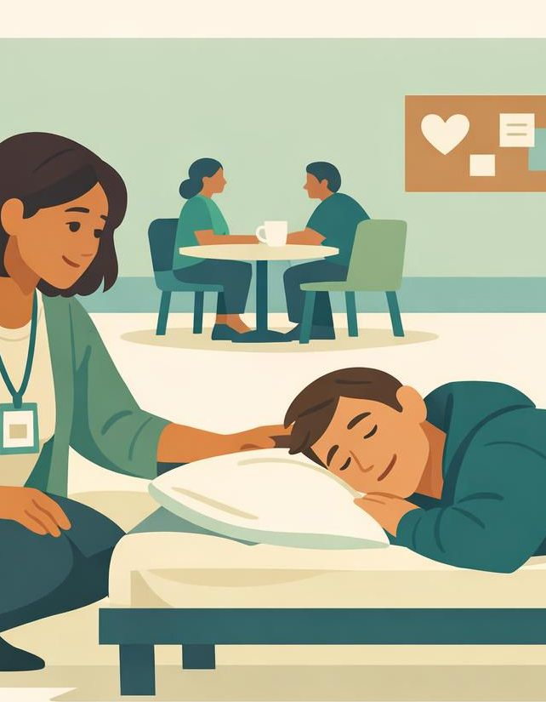
STAFF BRIEFING
Stronger
Together
How guest use of WRAP supports Low Barrier Shelter staff
When guests in the Isolation & Quarantine (ISAQ) Program use the Wellness Recovery Action Plan (WRAP), the whole shelter feels it — starting with the people who staff the floor.
Audience: Frontline staff & program leadership · Prepared June 2026
Notes:
Purpose of this briefing: show, in plain terms, why it helps shelter staff when ISAQ guests are working a WRAP. WRAP is the Wellness Recovery Action Plan — a voluntary, evidence-based self-management tool. ISAQ is our Isolation and Quarantine Program for guests who have been exposed to or are recovering from a communicable illness. Frame the session as practical, not clinical: this is about a calmer floor, safer interactions, and a guest who can tell us what they need. Encourage questions throughout.

Slide 2

SETTING THE SCENE
Two programs, one shared goal
Both programs meet people where they are. WRAP gives a guest the tools to stay steady while they are with us.
ISAQ Program
Low Barrier Shelter
ISOLATION & QUARANTINE
FEW REQUIREMENTS TO ENTER OR STAY
Short-stay space for guests experiencing homelessness who are exposed to, symptomatic for, or recovering from a communicable illness — keeping the wider shelter safe.
No sobriety, ID, or program-participation requirements for entry. Staff keep people safe and housed while honoring autonomy and choice.
Separated, supervised rooms
Health monitoring & basic needs
Higher stress, more confinement
Meets people where they are
Harm-reduction mindset
Discharge only as a last resort
WRAP × ISAQ · Low Barrier Shelter Staff
02
Notes:
Quick grounding so everyone shares the same vocabulary. ISAQ guests are often more stressed than usual — they are isolated, possibly unwell, and cut off from their normal routines and supports. Low Barrier means we deliberately keep the bar to enter and stay low; we don't require sobriety, ID, or program participation. The tension staff feel: how do we keep a confined, stressed guest steady without piling on requirements? WRAP fits because it is the guest's own plan, fully voluntary — it adds support without adding barriers.

Slide 3
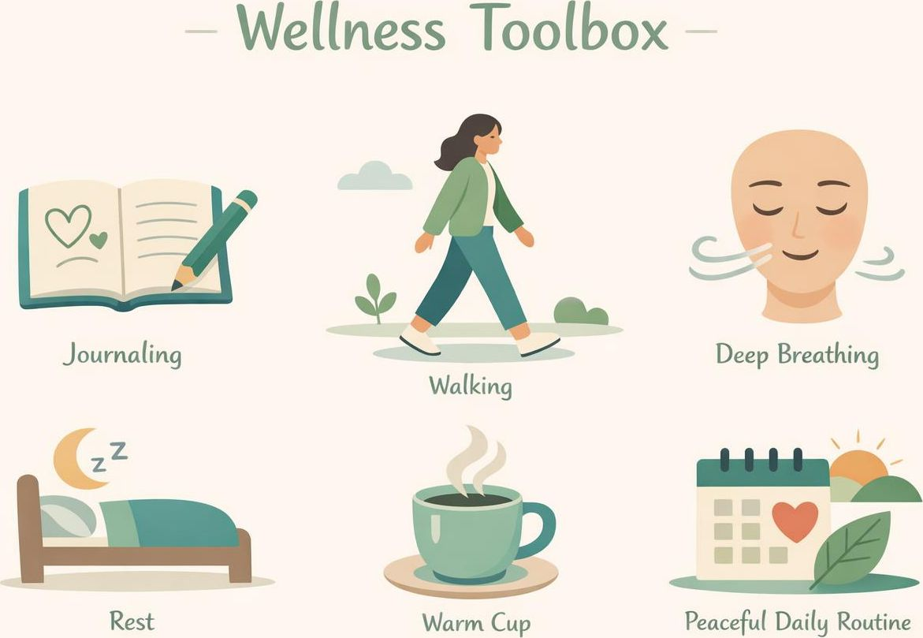
THE TOOL
What is WRAP?
The Wellness Recovery Action Plan is a voluntary, self-directed plan a guest builds for staying well — recognized by SAMHSA as an evidence-based practice. The guest owns it, chooses what goes in it, and decides who sees it.
1
Wellness Toolbox Simple things that help — rest, a walk, a call, music.
2
Daily Maintenance Plan What to do each day to stay grounded and well.
3
Triggers Outside events that cause stress, plus how to respond.
4
Early Warning Signs Subtle signs to catch and act on before they grow.
5
When Things Break Down Steps for harder moments, before a full crisis.
6
Crisis & Post-Crisis Plan Who to call, what helps, and how to recover after.
WRAP × ISAQ · Low Barrier Shelter Staff
03
Notes:
Walk the six parts at a high level — staff don't need to be facilitators, just familiar. Key points: (1) WRAP is voluntary; if it's required, it isn't WRAP. (2) The guest owns it and controls who sees it, which is exactly why it works in a low-barrier setting. (3) It was designed as a peer-facilitated group practice and is SAMHSA-recognized. For our purposes, the parts staff will hear about most are the Wellness Toolbox, Triggers, Early Warning Signs, and the Crisis Plan — those are the ones a guest may choose to share so we can back them up.

Slide 4

THE CHALLENGE
The daily reality on the floor
Isolation magnifies stress. Without a plan, staff absorb every spike — often with little warning and few clues about what helps.
01
02
03
04
Confinement adds pressure
Crises arrive unannounced
Guessing what helps
Thin staffing, high stakes
Being isolated and unwell heightens anxiety, boredom, and conflict.
Staff often see distress only once it has already escalated.
Without insight into a guest's needs, support is trial and error.
Every avoidable incident pulls staff away from everyone else.
WRAP × ISAQ · Low Barrier Shelter Staff
04
Notes:
Name the problem honestly so the benefits land. In ISAQ, the very thing that keeps the building safe — separation — also ramps up stress for the guest. Staff are frequently reacting after a situation has already boiled over, and without knowing the person well, support becomes guesswork. With lean staffing, a single avoidable crisis can consume the attention the rest of the floor needs. This is the gap WRAP helps close: it moves us from reacting blindly to responding early with the guest's own playbook.

Slide 5

STAFF BENEFITS
How WRAP lightens the load for staff
A guest working a WRAP does more of the steadying — so staff spend less time firefighting and more time supporting.
1
2
3
4
Guests self-manage
Early signals, not surprises
A ready response plan
Fewer interruptions
Daily Maintenance and Toolbox give guests their own routines, so they handle more of the day independently.
Shared early-warning signs let staff step in sooner — small check-ins instead of big interventions.
When a guest names what helps, staff act with confidence instead of guessing under pressure.
Steadier guests mean fewer incidents pulling staff away from the rest of the floor.
WRAP × ISAQ · Low Barrier Shelter Staff
05
Notes:
This is the heart of the briefing — four concrete ways staff benefit. (1) Self-management: the guest's daily plan and toolbox mean they carry more of their own day. (2) Early signals: if a guest has shared early warning signs, we can do a two-minute check-in before things escalate. (3) Ready response: instead of guessing, we use what the guest already told us helps them. (4) Fewer interruptions: a steadier guest means fewer incidents stealing attention from everyone else. Emphasize the shift from reactive to proactive — that's where staff feel the relief.

Slide 6
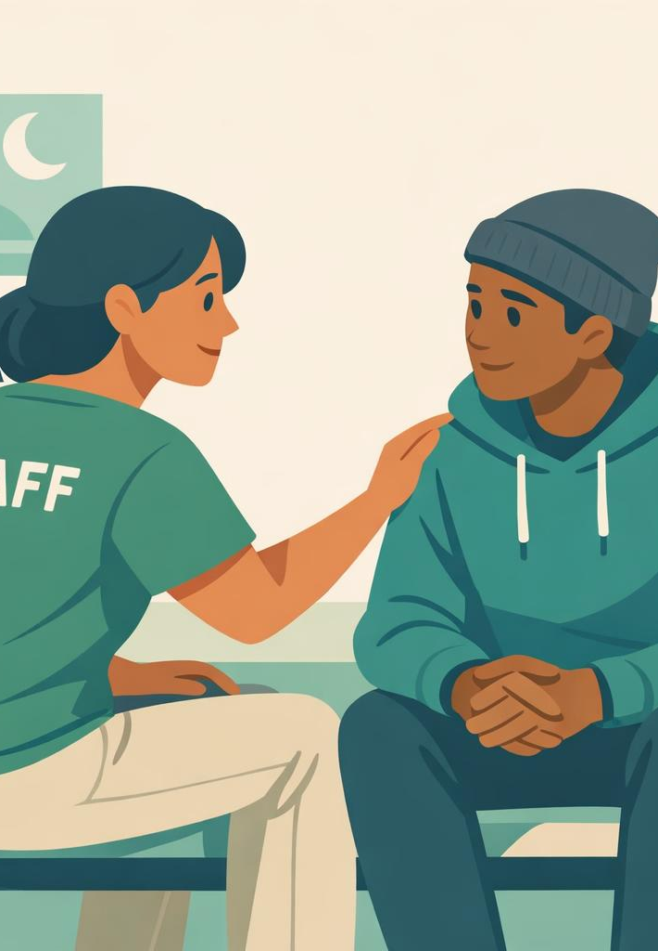
SAFETY & DE-ESCALATION
Fewer crises, calmer interventions
WRAP gives staff and guests a shared roadmap for hard moments — so escalation is rarer and de-escalation is safer for everyone.
Crisis plan
The guest's own instructions for what helps and who to call when things get hard.
Lower distress
WRAP is linked to reduced anxiety and depression — fewer flashpoints to manage.
Consent in advance
Preferences are agreed when the guest is well, not negotiated mid-crisis.
WRAP × ISAQ · Low Barrier Shelter Staff
06
Notes:
Safety is the benefit leadership cares about most and frontline staff feel most. A crisis plan is the guest telling us, in advance and while calm, what helps and what doesn't — so we are not improvising during the worst moment. Because WRAP is associated with lower anxiety and depression, there are simply fewer flashpoints to manage. And because preferences are agreed ahead of time, de-escalation becomes collaborative rather than confrontational. Note: WRAP supports our response; it never replaces emergency or medical protocols.

Slide 7

COMMUNICATION
A shared language between staff and guests
WRAP gives everyone the same words for wellness — making hand-offs faster, support more consistent, and trust easier to build.
✓
Common vocabulary
✓
Smoother shift hand-offs
"Triggers," "early warning signs," and "toolbox" mean the same thing to every staff member and guest.
A guest's shared plan travels across shifts, so the next staff member starts informed, not blind.
✓
Guest-led, not staff-imposed
✓
Stronger rapport & trust
Direction comes from the guest's own plan, which lowers defensiveness and builds cooperation.
Honoring a guest's plan signals respect — the foundation of a low-barrier relationship.
WRAP × ISAQ · Low Barrier Shelter Staff
07
Notes:
Communication is an underrated win. When the whole team shares WRAP language, a note like 'guest is showing early warning signs' instantly tells the next shift what to watch for and what to do. Plans travel across hand-offs, so staff aren't starting from zero every shift. Because direction comes from the guest's own plan rather than a staff order, guests are less defensive and more cooperative — which is exactly the trust-based dynamic a low-barrier shelter depends on. Remind staff: a guest chooses what to share; we never require it.

Slide 8

WHY IT WORKS
Guest outcomes that make staff's job easier
WRAP's benefits to staff are downstream of real, evidence-based gains for guests. When guests do better, the floor runs better.
Lower anxiety & depression
Fewer acute episodes for staff to manage.
More hope & empowerment
Engaged guests participate instead of resist.
Stronger self-advocacy
Guests state needs clearly and early.
Greater independence
Less reliance on staff for routine support.
WRAP × ISAQ · Low Barrier Shelter Staff
08
Notes:
Connect the dots between guest outcomes and staff experience. Research on the facilitated WRAP model shows reduced anxiety and depression, increased hope, empowerment, and self-advocacy. Translate each into floor terms: lower distress means fewer acute episodes; more hope means guests engage rather than resist; stronger self-advocacy means a guest tells us what they need before it becomes a crisis; greater independence means less constant staff prompting. The staff benefit is real precisely because the guest benefit is real — they are two sides of the same coin.

Slide 9

PRACTICAL HOW-TO
How staff can support WRAP use
You don't need to be a facilitator. Small, respectful actions help guests keep their plan working.
1
Invite, never require
2
Make room for the routine
Offer WRAP as an option and connect interested guests to peer facilitators. It only works when it's voluntary.
Protect quiet time and small choices so guests can use their Daily Maintenance Plan and toolbox.
3
Ask what helps
4
Honor the plan
If a guest is willing to share, learn their triggers, early warning signs, and preferred supports.
Follow the guest's stated preferences in tense moments — and keep what they share confidential.
WRAP × ISAQ · Low Barrier Shelter Staff
09
Notes:
Give staff four concrete, do-it-tomorrow actions. (1) Invite, never require — point interested guests toward certified peer facilitators; pressure breaks WRAP. (2) Make room for the routine — in ISAQ, even small choices and a little quiet time let guests run their daily plan. (3) Ask what helps — only if the guest is willing — and listen for triggers, warning signs, and preferred supports. (4) Honor the plan and protect privacy — following stated preferences in tense moments is what builds the trust that makes all the other benefits possible. Keep it low-pressure and guest-led.

Slide 10

THE BOTTOM LINE
When guests use WRAP, staff win too
A voluntary tool for the guest becomes a calmer, safer, more predictable floor for the staff who support them.
Calmer floor
Safer response
Shared language
Stronger trust
Self-management and early warning signs mean fewer crises to absorb.
A guest's crisis plan turns chaotic moments into guided ones.
Consistent words and smoother hand-offs across every shift.
Honoring the guest's plan deepens the low-barrier relationship.
WRAP supports — it never replaces — emergency, medical, or clinical protocols.
Notes:
Close by tying it together: WRAP is the guest's voluntary tool, but its ripple effects land squarely on staff — a calmer floor with fewer crises, a safer and more collaborative response when things get hard, a shared language that smooths every hand-off, and deeper trust that strengthens the whole low-barrier relationship. Leave staff with one ask: support guests who want to use WRAP, stay curious about what helps each person, and always treat it as voluntary and confidential. Final caveat: WRAP complements but never replaces emergency or clinical protocols.

