Slide 1
Peer Case Managers: Advocacy and Resource Navigation for Empowered Communities
Supporting clients through advocacy and resource guidance
Notes:
---
This presentation explores the vital role of peer case managers in advocating for clients and navigating resources to empower communities. We will examine their responsibilities, strategies, resource navigation, and impact on individuals and communities.

Slide 2
Agenda Overview
Understanding the Role of Peer Case Managers
Advocacy Strategies in Peer Case Management
Resource Navigation for Clients
Impact of Peer Case Managers on Individuals and Communities
Notes:
We will cover the role and qualifications of peer case managers, advocacy strategies they employ, how they navigate resources for clients, and the overall impact they have on individuals and communities.

Slide 3
Understanding the Role of Peer Case Managers
Notes:
Peer case managers bring lived experience to their core responsibilities, offering unique support to clients. This section outlines their definition, qualifications, and how they differ from traditional case managers.

Slide 4

Definition and Core Responsibilities
Role of Peer Case Managers
  Peer case managers use shared experiences to build trust and provide meaningful support to clients.
Assisting Access to Services
  They help clients navigate and access essential services that meet their individual needs.
Advocacy and Empowerment
  Peer case managers advocate for client needs and help create personalized plans to promote empowerment and well-being.
Notes:
---
Peer case managers provide support by leveraging shared experiences, assisting clients in accessing services, advocating for their needs, and helping develop individualized plans to promote well-being and empowerment.
Image source: Microsoft 365 content library

Slide 5

Qualifications and Lived Experience
Peer Case Manager Experience
  Peer case managers bring firsthand lived experience of client challenges, fostering deeper understanding and connection.
Building Client Trust
  Shared experiences enhance trust between case managers and clients, facilitating more effective support.
Notes:
---
Unlike traditional case managers, peer case managers have lived experience related to the challenges clients face. This experience enhances empathy and trust, enabling stronger client connections and effective support.
Image source: Microsoft 365 content library

Slide 6

Difference Between Peer and Traditional Case Managers
Traditional Case Managers
  Traditional case managers typically have formal education and clinical training, delivering expert care based on professional knowledge.
Peer Case Managers
  Peer case managers blend professional skills with personal experience, focusing on empowerment and mutual understanding.
Notes:
---
While traditional case managers often have formal education and clinical training, peer case managers combine professional skills with personal experience, offering a distinctive approach focused on empowerment and shared understanding.
Image source: Microsoft 365 content library

Slide 7
Advocacy Strategies in Peer Case Management
Notes:
Advocacy is central to peer case management. This section highlights strategies to empower clients, overcome access barriers, and build partnerships with stakeholders to support client needs.

Slide 8

Empowering Clients Through Self-Advocacy
Building Client Confidence
  Peer case managers help clients develop confidence by encouraging self-advocacy skills and independence.
Expressing Needs Clearly
  Clients learn to express their needs effectively to ensure their voices are heard in decision-making.
Making Informed Decisions
  Empowered clients make informed decisions about their care with guidance from peer case managers.
Notes:
---
Peer case managers encourage clients to develop self-advocacy skills, fostering confidence and independence. This empowers clients to express their needs and make informed decisions about their care.
Image source: Microsoft 365 content library

Slide 9

Navigating Barriers to Accessing Services
Common Client Barriers
  Clients often encounter stigma, complicated systems, and lack of information when accessing services.
Role of Peer Case Managers
  Peer case managers provide guidance, emotional support, and practical help to navigate these barriers effectively.
Notes:
---
Clients often face obstacles such as stigma, complex systems, or lack of information. Peer case managers guide clients through these barriers by providing knowledge, emotional support, and practical assistance.
Image source: Microsoft 365 content library

Slide 10

Building Collaborative Relationships with Stakeholders
Importance of Collaboration
  Collaboration with service providers, community groups, and policymakers strengthens advocacy efforts and client support.
Role of Peer Case Managers
  Peer case managers build and nurture relationships to create effective support networks for clients.
Notes:
---
Effective advocacy involves collaboration with service providers, community organizations, and policymakers. Peer case managers foster these relationships to create supportive networks for clients.
Image source: Microsoft 365 content library

Slide 11
Resource Navigation for Clients
Notes:
Navigating community resources is a key function. This section discusses identifying supports, tailoring service plans, and managing referrals and follow-ups to ensure clients receive comprehensive care.

Slide 12

Identifying Community Resources and Support Networks
Role of Peer Case Managers
  Peer case managers stay informed about community resources to effectively assist clients with access to support services.
Local Resource Categories
  Important local resources include housing, healthcare, employment, and social services vital for client support.
Connecting Clients to Services
  Connecting clients with appropriate community supports improves their well-being and access to necessary services.
Notes:
---
Peer case managers maintain up-to-date knowledge of local resources such as housing, healthcare, employment, and social services to connect clients with appropriate supports.
Image source: Microsoft 365 content library

Slide 13

Creating Individualized Service Plans
Client Collaboration
  Peer case managers work closely with clients to understand their unique goals and needs.
Personalized Planning
  Service plans are tailored to each individual's strengths and circumstances for maximum effectiveness.
Effective Support Strategies
  Individualized plans ensure relevant and practical support for client success and growth.
Notes:
---
By collaborating with clients, peer case managers develop personalized plans that reflect unique goals, needs, and strengths, ensuring relevant and effective support strategies.
Image source: Microsoft 365 content library

Slide 14
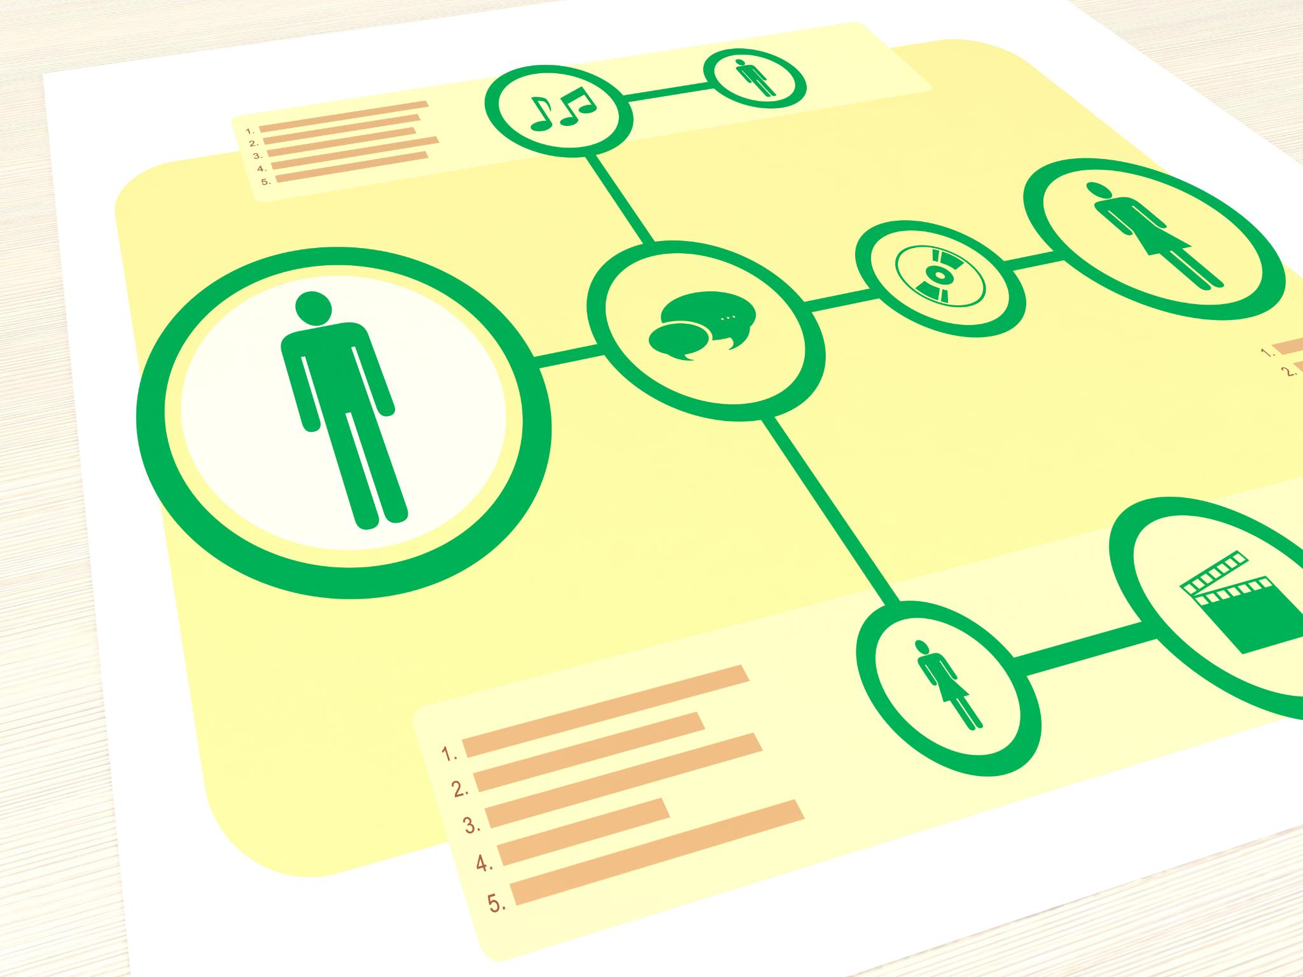
Facilitating Referrals and Follow-Ups
Coordinating Referrals
  Peer case managers connect clients to appropriate services by managing a network of referral resources effectively.
Tracking Follow-Ups
  Regular follow-ups allow case managers to monitor client progress and identify challenges for timely intervention.
Adjusting Client Plans
  Adjustments in client plans are made based on follow-up insights to ensure sustained success and address emerging needs.
Notes:
---
Peer case managers coordinate referrals to services and track follow-ups to monitor progress, address challenges, and adjust plans as necessary to promote sustained client success.
Image source: Microsoft 365 content library

Slide 15
Impact of Peer Case Managers on Individuals and Communities
Notes:
This section explores the positive outcomes peer case managers contribute to marginalized individuals and the broader community, including challenges and solutions in practice.

Slide 16

Improved Outcomes for Marginalized Populations
Role of Peer Case Managers
  Peer case managers provide culturally relevant support, improving trust and engagement among marginalized populations.
Reducing Disparities
  Their work reduces disparities by enhancing access to health and social services for underserved groups.
Improved Health Outcomes
  Improved engagement leads to better health and social outcomes for marginalized populations.
Notes:
---
Peer case managers help reduce disparities by improving access, engagement, and health and social outcomes for populations often underserved by traditional systems.
Image source: Microsoft 365 content library

Slide 17
Strengthening Community Engagement
Building Trust and Connection
Peer case managers build trust that strengthens bonds within communities, encouraging greater participation.
Enhancing Community Cohesion
Fostering connections leads to increased cohesion, helping communities work together effectively.
Empowering Active Participation
Community members are empowered to take active roles through supportive peer engagement.
Notes:
---
By fostering trust and connection, peer case managers enhance community cohesion and participation, empowering individuals to take active roles in their communities.
Image source: Microsoft 365 content library

Slide 18

Challenges and Solutions in Peer Case Management
Role Ambiguity
  Unclear role definitions create confusion and hinder peer case management effectiveness.
Burnout and Stress
  Burnout among peers can reduce productivity and impact care quality negatively.
Systemic Barriers
  Organizational challenges and systemic barriers obstruct efficient peer case management.
Effective Solutions
  Ongoing training, clear roles, and organizational support sustain successful peer case management.
Notes:
---
Challenges include role ambiguity, burnout, and systemic barriers. Solutions involve ongoing training, clear role definitions, and organizational support to sustain effective peer case management.
Image source: Microsoft 365 content library

Slide 19
Conclusion
Role in Advocacy
Peer case managers advocate effectively for clients to access essential services and resources.
Lived Experience Impact
Their lived experience enables unique strategies that empower individuals on their recovery journeys.
Strengthening Communities
Peer case managers help build stronger, more connected communities through supportive care.
Notes:
Peer case managers play a crucial role in advocating for clients and navigating resources. Their lived experience and unique strategies empower individuals and strengthen communities, making them invaluable in supportive care systems.

