Slide 1

Wellness Recovery Action Plan for Trauma: A Comprehensive Approach to Healing
Strategies for effective trauma recovery and support
Notes:
---
Trauma can have lasting effects on individuals, but with the right strategies, recovery is possible. This presentation explores the Wellness Recovery Action Plan (WRAP) as an effective framework for healing from trauma.

Slide 2

Agenda for Today's Presentation
Understanding Trauma and Its Effects
Introduction to Wellness Recovery Action Plan (WRAP)
Creating a Personalized WRAP for Trauma Recovery
Implementing and Adjusting Your WRAP
Long-Term Recovery and Growth
Notes:
Today, we will first explore the nature of trauma and its effects on individuals. Next, we will introduce the Wellness Recovery Action Plan (WRAP) and discuss its core principles. Then, we will focus on creating a personalized WRAP for trauma recovery, implementing it effectively, and finally, discuss long-term recovery and personal growth.

Slide 3
Understanding Trauma and Its Effects
Notes:
Trauma is a complex experience that can significantly impact mental and physical health. Understanding its definition and various types is crucial for effective recovery.

Slide 4
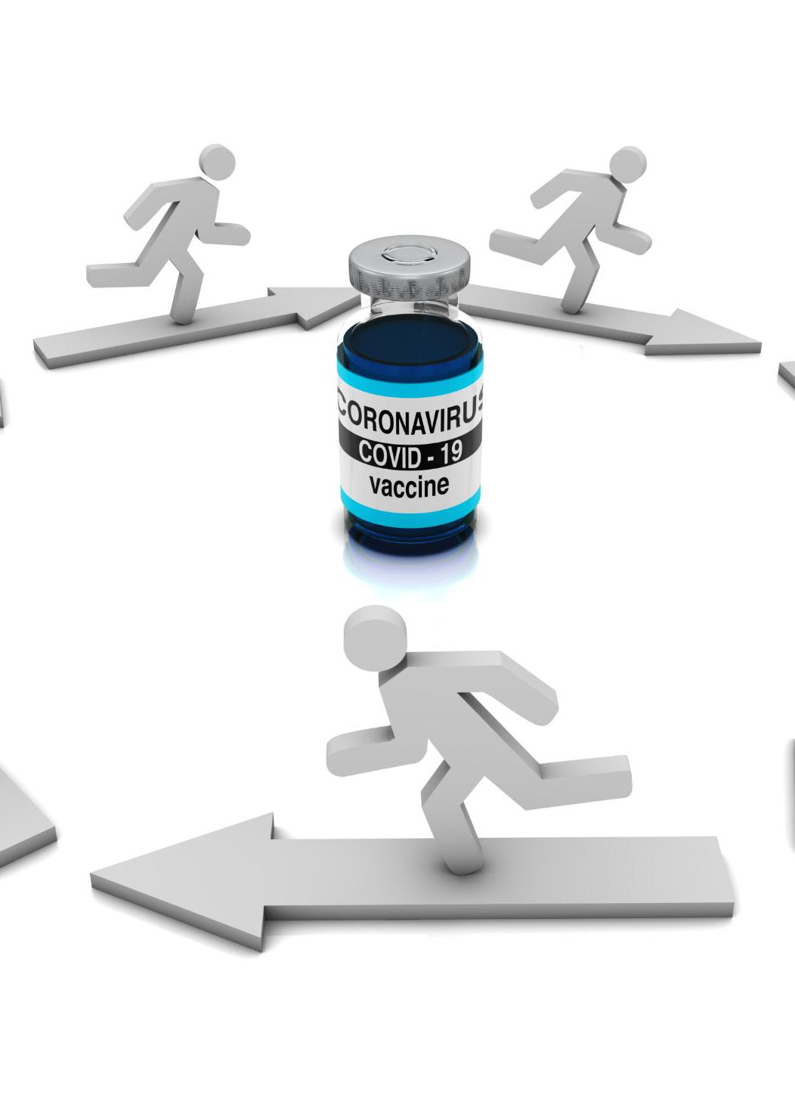
Definition and Types of Trauma
Acute Trauma
  Acute trauma results from a single distressing event that causes immediate shock and emotional distress.
Chronic Trauma
  Chronic trauma stems from prolonged exposure to distressing situations, leading to ongoing emotional and psychological challenges.
Complex Trauma
  Complex trauma involves multiple traumatic events, often in interpersonal relationships, leading to deep-seated emotional issues.
Notes:
Trauma can be categorized into different types, including acute, chronic, and complex trauma. Each type has unique characteristics and requires tailored approaches for recovery.

Slide 5

Psychological and Physical Impact
Psychological Effects of Trauma
  Trauma can manifest in various psychological effects, including anxiety, depression, and emotional distress.
Physical Symptoms of Trauma
  Physical symptoms such as fatigue and chronic pain often accompany psychological trauma, affecting overall well-being.
Recovery Strategies
  Understanding the psychological and physical impacts of trauma is crucial for developing effective recovery strategies.
Notes:
Trauma can lead to both psychological effects, such as anxiety and depression, as well as physical symptoms like fatigue and chronic pain. Understanding these impacts is vital for effective recovery strategies.

Slide 6

Common Symptoms and Responses
Emotional Dysregulation
  People may struggle with managing their emotions after experiencing trauma, leading to mood swings and intense feelings.
Avoidance Behaviors
  Individuals might engage in avoidance behaviors to cope with reminders of trauma, such as staying away from certain places or situations.
Hyperarousal
  Hyperarousal is characterized by heightened alertness and anxiety, making individuals easily startled or irritable after trauma.
Notes:
Individuals may exhibit a range of symptoms in response to trauma, including emotional dysregulation, avoidance behaviors, and hyperarousal. Recognizing these responses is essential for developing support mechanisms.

Slide 7
Introduction to Wellness Recovery Action Plan (WRAP)
Notes:
WRAP is a self-designed prevention and wellness tool that helps individuals manage their health and well-being, especially following traumatic experiences. It serves as a structured approach to recovery.

Slide 8

What Is WRAP?
Personalized Wellness Plan
  WRAP is tailored to individual needs, empowering people to create their own wellness strategies and tools.
Proactive Mental Health Management
  The plan encourages proactive management of mental health, promoting self-advocacy and resilience in recovery.
Identifying Wellness Tools
  WRAP helps individuals identify wellness tools that work best for them, fostering personal growth and recovery.
Notes:
The Wellness Recovery Action Plan (WRAP) is a personalized plan created by individuals to help them identify their wellness tools and strategies. It is a proactive approach to managing mental health and recovery.

Slide 9
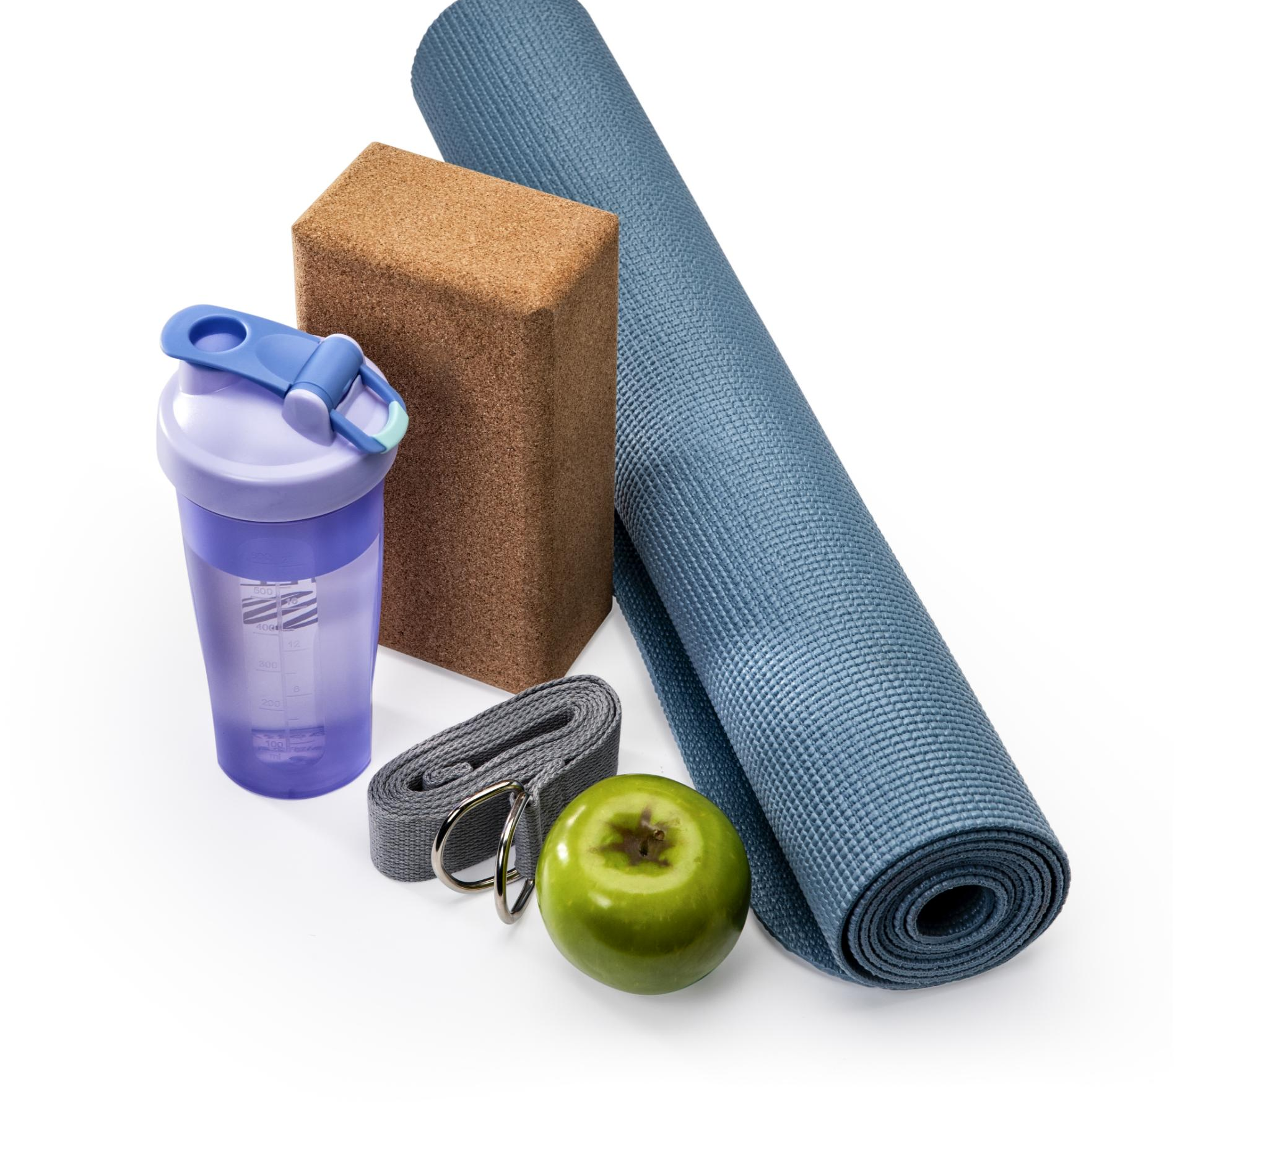
Core Principles and Components
Core Principles
  WRAP emphasizes core principles such as hope, personal responsibility, education, and self-advocacy, promoting individual growth and recovery.
Wellness Tools
  The wellness tools in WRAP provide strategies for individuals to manage their well-being effectively and promote a healthy lifestyle.
Daily Maintenance Plans
  Daily maintenance plans help individuals stay on track with their wellness goals and maintain a balanced life.
Crisis Plans
  Crisis plans provide essential steps for individuals to take during challenging times, ensuring they receive the necessary support.
Notes:
WRAP is built on core principles such as hope, personal responsibility, education, self-advocacy, and support. Its components include wellness tools, daily maintenance plans, and crisis plans.

Slide 10

Benefits and Applications for Trauma Recovery
Increased Self-Awareness
  WRAP promotes increased self-awareness, helping individuals better understand their thoughts and feelings in the recovery process.
Empowerment in Recovery
  The program empowers individuals to take charge of their recovery journey, fostering a sense of control and ownership over their healing process.
Supportive Group Settings
  WRAP is effective in both individual therapy and group settings, providing support through shared experiences and community connections.
Notes:
WRAP offers various benefits, including increased self-awareness, empowerment in managing recovery, and support in building resilience. It can be applied in various contexts, including individual therapy and group settings.

Slide 11
Creating a Personalized WRAP for Trauma Recovery
Notes:
Developing a WRAP tailored to individual needs is crucial for effective trauma recovery. This involves recognizing personal strengths and identifying specific wellness strategies.

Slide 12

Identifying Wellness Tools and Strategies
Mindfulness Practices
  Mindfulness practices help individuals focus on the present moment, reducing stress and enhancing mental clarity.
Physical Activity
  Regular physical activity is essential for maintaining physical health and improving overall well-being.
Creative Expression
  Engaging in creative expression can significantly enhance emotional health and personal fulfillment.
Notes:
Individuals can explore various wellness tools such as mindfulness, physical activity, and creative expression. Identifying effective strategies is key to personalizing a WRAP.

Slide 13
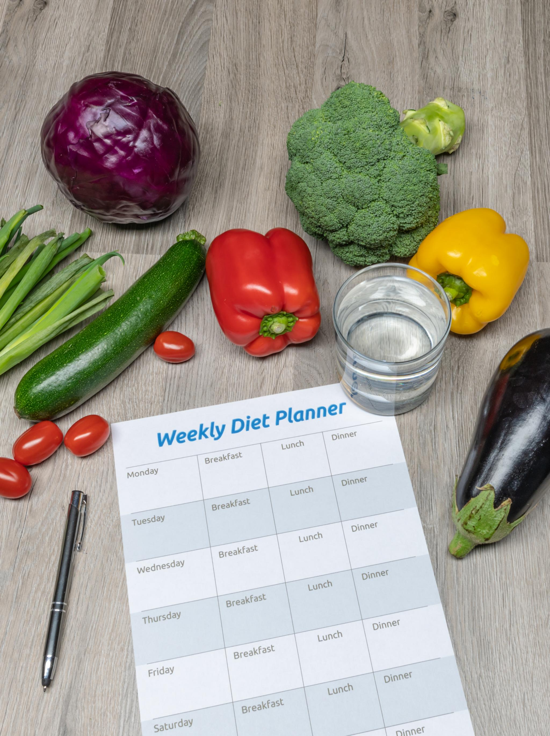
Developing a Daily Maintenance Plan
Wellness Activities
  Incorporating specific activities into a daily routine helps promote overall wellness and recovery.
Stability and Health
  A solid daily maintenance plan provides a foundation for maintaining stability and health during recovery.
Roadmap to Recovery
  The daily maintenance plan serves as a roadmap guiding individuals through their recovery journey.
Notes:
A daily maintenance plan includes specific activities and practices that promote wellness. This plan serves as a roadmap to maintain stability and health throughout the recovery process.

Slide 14

Creating a Crisis Plan
Importance of a Crisis Plan
  A well-structured crisis plan is essential for ensuring safety and providing support during emergencies, helping individuals respond effectively.
Coping Strategies
  Including coping strategies in the crisis plan helps individuals manage stress and anxiety during difficult times, promoting mental well-being.
Emergency Contacts
  Listing emergency contacts in the crisis plan ensures quick access to support and resources when they are most needed.
Notes:
A crisis plan outlines steps to take during challenging times, including coping strategies and emergency contacts. This plan is essential for ensuring safety and support during crises.

Slide 15
Implementing and Adjusting Your WRAP
Notes:
Once a WRAP is created, implementing it effectively is crucial for recovery. Regular monitoring and adjustments can enhance its effectiveness.

Slide 16

Putting the Plan Into Action
Integrating Wellness Strategies
  To implement the WRAP, wellness strategies must be integrated into daily routines, promoting healthier lifestyles.
Commitment to Success
  A strong commitment to the wellness plan is crucial for achieving long-term success and maintaining motivation.
Consistency is Key
  Regular practice of wellness strategies is essential to see the benefits and ensure sustainability in health improvements.
Notes:
Taking actionable steps to implement the WRAP involves integrating wellness strategies into daily life. Commitment and consistency are vital for success.

Slide 17

Monitoring Progress and Making Adjustments
Regular Progress Reviews
  Regularly reviewing progress helps identify successful strategies and areas that require modifications to achieve goals.
Importance of Flexibility
  Being flexible in the planning process is crucial for adapting to changing circumstances and evolving needs effectively.
Notes:
Regularly reviewing progress allows individuals to assess what is working and what needs adjustment. Flexibility in the plan is important to meet evolving needs.

Slide 18

Seeking Support and Resources
Importance of Support
  Connecting with supportive individuals is crucial for implementing WRAP successfully, enhancing motivation and resilience.
Community Resources
  Utilizing community resources can provide varied perspectives and enhance the WRAP implementation process.
Motivation Through Support
  Support from individuals and groups boosts motivation, making the journey of WRAP implementation more effective.
Notes:
Connecting with supportive individuals, groups, and resources is essential for successful implementation of WRAP. Support enhances motivation and provides additional perspectives.

Slide 19
Long-Term Recovery and Growth
Notes:
Recovery from trauma is a long-term process that involves continual growth and resilience. By focusing on long-term wellness, individuals can sustain their recovery journey.

Slide 20
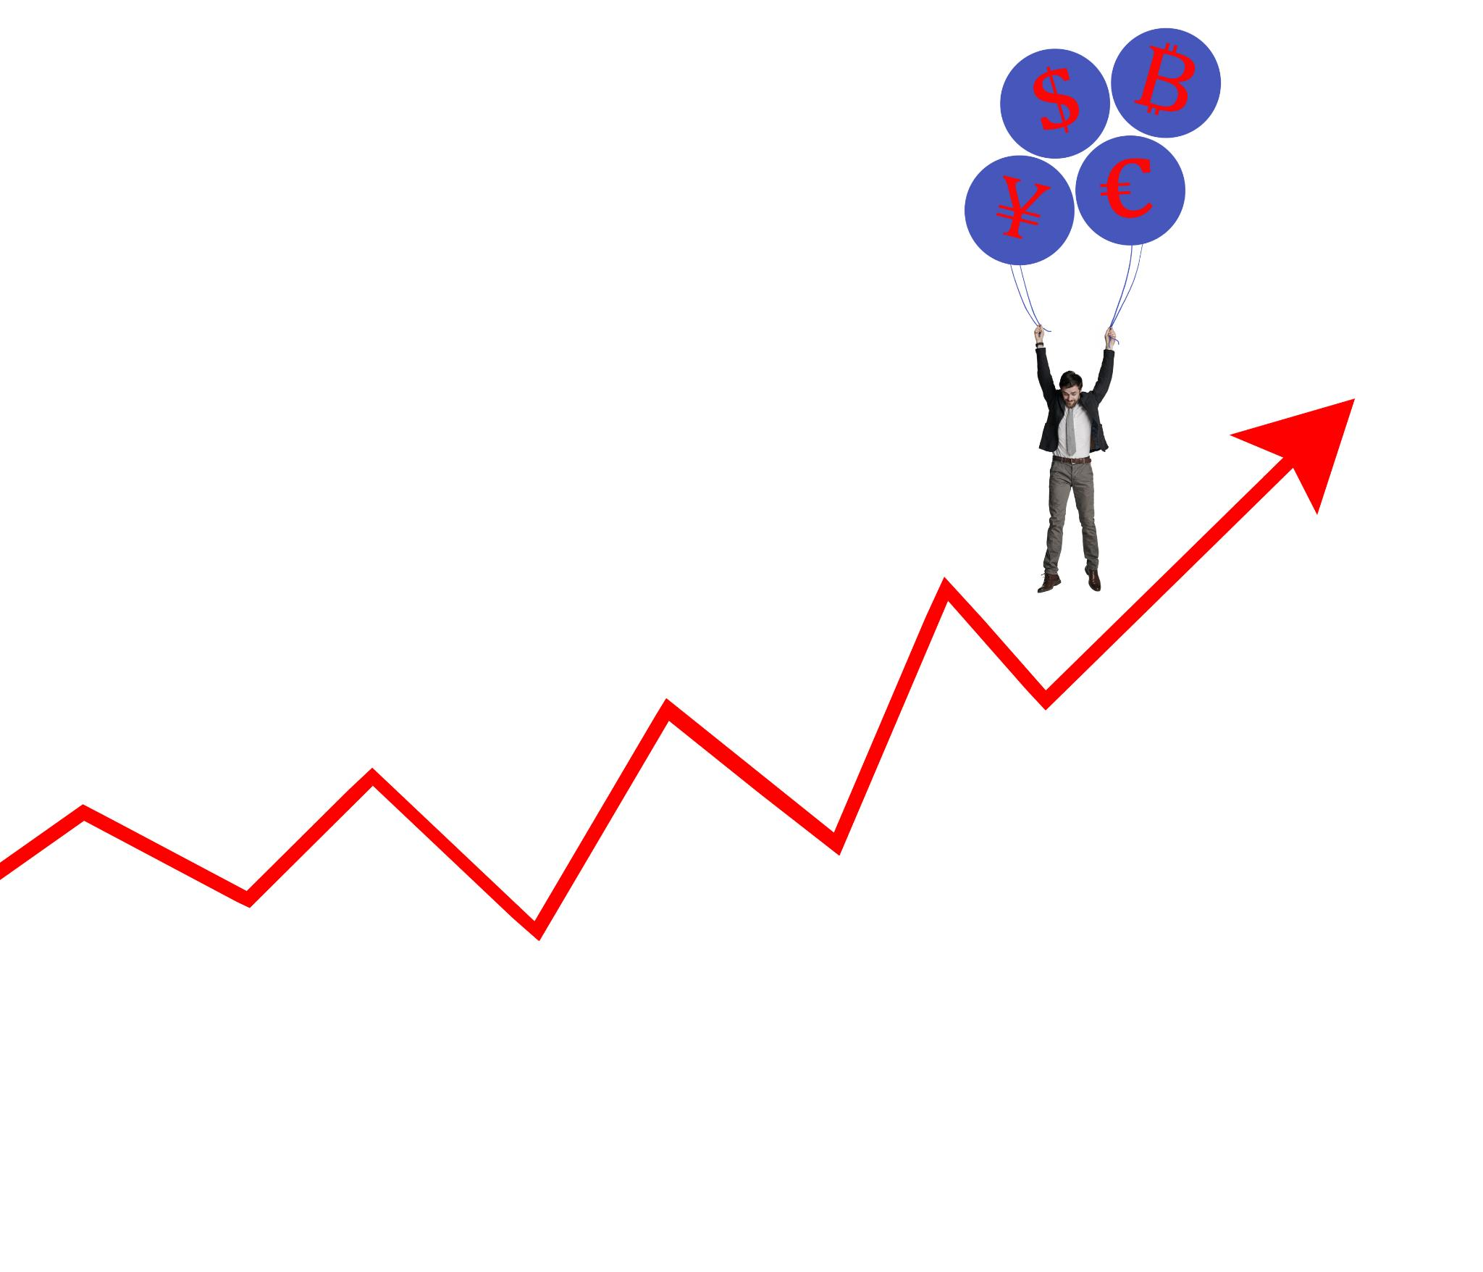
Building Resilience and Coping Skills
Understanding Resilience
  Resilience is the ability to bounce back from adversity. It involves adapting to challenges and maintaining mental well-being.
Coping Skills Development
  Developing coping skills is crucial for managing stress and emotions during challenging times. These skills help individuals navigate life's difficulties.
Stress Management Techniques
  Effective stress management techniques, such as deep breathing and meditation, play an essential role in building resilience.
Positive Thinking
  Cultivating a positive mindset fosters resilience. Positive thinking can improve overall mental health and enhance coping abilities.
Notes:
Developing resilience involves cultivating coping skills that help individuals navigate challenges. Techniques such as stress management and positive thinking are essential.

Slide 21

Sustaining Wellness and Preventing Relapse
Ongoing Wellness Efforts
  Sustaining long-term wellness requires continuous effort and commitment to personal health strategies.
Preventive Strategies
  Implementing preventive strategies is essential for maintaining wellness and reducing the risk of relapse.
Support Systems
  Maintaining strong support systems, including friends, family, and professionals, is vital for recovery and wellness.
Updating WRAP
  Regularly updating the Wellness Recovery Action Plan (WRAP) is crucial for adapting to changing needs and situations.
Notes:
Long-term wellness requires ongoing effort. Implementing preventive strategies, maintaining support systems, and regularly updating the WRAP are critical to avoiding relapse.

Slide 22

Achieving Personal Growth and Empowerment
Trauma Recovery Journey
  Healing from trauma can pave the way for profound personal growth and self-discovery, transforming pain into strength.
Strengthening Identity
  Individuals can use their experiences to form a stronger sense of self, leading to greater confidence and resilience.
Pursuing Goals
  With newfound confidence, individuals are empowered to pursue their goals and aspirations with determination and clarity.
Notes:
Trauma recovery can lead to personal growth and empowerment. Individuals can harness their experiences to strengthen their identities, build confidence, and pursue their goals.

Slide 23
Conclusion
Understanding Trauma
Understanding trauma is essential for effective recovery. It empowers individuals to acknowledge their experiences and begin the healing process.
Personalized Recovery Plans
Creating personalized plans is crucial for an effective recovery journey. These plans are tailored to meet individual needs and goals.
Focus on Long-term Growth
Focusing on long-term growth allows individuals to develop resilience and maintain wellness beyond immediate recovery.
Notes:
The Wellness Recovery Action Plan offers a comprehensive approach to healing from trauma. By understanding trauma, creating personalized plans, and focusing on long-term growth, individuals can navigate their recovery journey towards wellness and empowerment.

