Slide 1
Peer Case Manager: Client Empowerment Through Education and Skill Building
Strategies to foster independence and growth in clients
Notes:
---
This presentation explores the vital role of peer case managers in empowering clients through education and skill development. We will discuss the principles of empowerment, effective education strategies, and methods to build sustainable independence for clients.

Slide 2
Presentation Agenda
Introduction to Peer Case Management
Client Empowerment Principles
Education Strategies for Clients
Skill Building for Sustainable Independence
Measuring Outcomes and Continuous Improvement
Notes:
We will begin by defining peer case management and the importance of lived experience. Next, we cover client empowerment principles, followed by education strategies tailored for clients. Then, we discuss skill building approaches to foster independence. Finally, we look at measuring outcomes and continuous improvement.

Slide 3
Introduction to Peer Case Management
Notes:
Peer case management involves individuals with lived experience supporting clients through guidance, education, and advocacy. This foundation builds trust and relatability essential for effective support.

Slide 4

Definition and Role of Peer Case Managers
Definition of Peer Case Managers
  Peer case managers use their own experiences to guide clients through challenges and resource access.
Role as Role Models
  They serve as positive examples, inspiring clients by sharing relatable experiences.
Advocacy within Support Systems
  Peer case managers advocate to help clients access resources and achieve personal goals.
Notes:
---
Peer case managers are individuals who use their personal experience to assist clients in navigating challenges, accessing resources, and achieving goals. They serve as role models and advocates within the support system.
Image source: Microsoft 365 content library

Slide 5
Importance of Lived Experience in Peer Support
Empathy Through Shared Experience
Lived experience enables peer managers to empathize deeply with clients, strengthening trust and rapport.
Enhancing Credibility
Sharing personal recovery stories builds credibility and authenticity in the peer support relationship.
Boosting Motivation and Engagement
Shared experiences motivate clients and encourage active engagement in their recovery journey.
Notes:
---
Lived experience fosters empathy and credibility, enabling peer case managers to connect authentically with clients. This shared understanding enhances motivation and engagement in the recovery process.
Image source: Microsoft 365 content library

Slide 6
Client Empowerment Principles
Notes:
Empowerment centers on fostering clients’ confidence and ability to advocate for themselves. Building trust and setting client-driven goals are key components of this approach.

Slide 7

Understanding Empowerment and Self-Advocacy
Concept of Empowerment
  Empowerment enables clients to gain control over their personal decisions and life direction.
Self-Advocacy Skills
  Self-advocacy helps clients effectively communicate their needs and assert their rights.
Notes:
---
Empowerment encourages clients to take control of their lives and decisions. Self-advocacy skills support clients in expressing their needs and rights effectively.
Image source: Microsoft 365 content library

Slide 8

Building Trust and Respectful Relationships
Creating Safe Spaces
  Trust and mutual respect establish a safe environment for open client communication and engagement.
Demonstrating Reliability
  Peer case managers must be dependable to foster trust throughout the client relationship.
Empathy and Cultural Sensitivity
  Showing empathy and cultural awareness strengthens respectful relationships with clients.
Notes:
---
Trust and mutual respect create a safe space for clients to share openly and engage in the process. Peer case managers must demonstrate reliability, empathy, and cultural sensitivity.
Image source: Microsoft 365 content library

Slide 9

Client-Centered Goal Setting
Collaboration with Clients
  Working together with clients promotes shared understanding and commitment to set meaningful goals.
Achievable Goals
  Setting achievable goals keeps clients motivated and ensures progress is realistic and measurable.
Values and Aspirations
  Goals should align with the client’s personal values and future aspirations for effectiveness.
Notes:
---
Collaborating with clients to set meaningful, achievable goals ensures the support remains relevant and motivating. Goals should reflect the client’s values and aspirations.
Image source: Microsoft 365 content library

Slide 10
Education Strategies for Clients
Notes:
Effective education equips clients with knowledge and resources to make informed choices. Tailored approaches help address diverse learning needs and promote autonomy.

Slide 11

Health Literacy and Information Sharing
Empowering Clients
  Enhancing health literacy helps clients better understand their medical conditions and treatment choices.
Clear Communication
  Providing accessible and understandable health information builds patient confidence and encourages active engagement.
Notes:
---
Improving health literacy empowers clients to understand their conditions and treatment options. Clear, accessible information fosters confidence and engagement.
Image source: Microsoft 365 content library

Slide 12
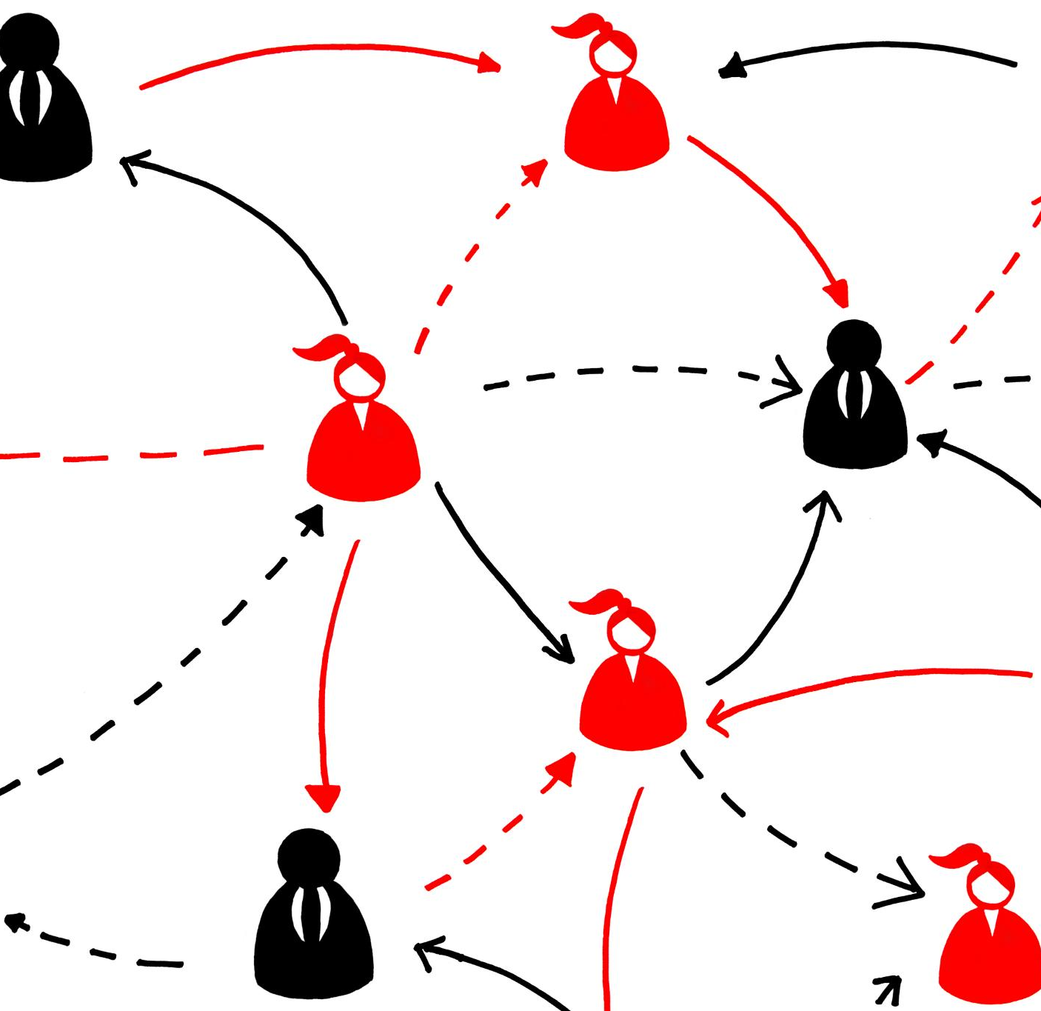
Navigating Community Resources
Client Education on Resources
  Educating clients about community services empowers them to find essential help effectively.
Accessing Necessary Help
  Knowledge of resources helps clients obtain needed assistance and improve well-being.
Building Social Networks
  Community resources foster social connections that strengthen clients’ support systems.
Notes:
---
Educating clients about available community services and supports enhances their ability to access necessary help and build social networks.
Image source: Microsoft 365 content library

Slide 13
Promoting Informed Decision-Making
Weighing Options
Clients learn to evaluate different choices carefully before making decisions.
Considering Consequences
Understanding the potential outcomes of each option helps in responsible decision-making.
Aligning with Goals
Ensuring decisions support personal goals fosters autonomy and responsibility.
Notes:
---
Teaching clients to weigh options and consider consequences supports autonomous, responsible decision-making aligned with their goals.
Image source: Microsoft 365 content library

Slide 14
Skill Building for Sustainable Independence
Notes:
Developing practical skills enables clients to manage challenges and maintain progress beyond formal support. This fosters lasting empowerment.

Slide 15

Developing Problem-Solving Abilities
Identifying Issues
  Structured methods help to clearly recognize and define problems before seeking solutions.
Generating Solutions
  Creative thinking techniques guide the development of multiple potential solutions to challenges.
Evaluating Outcomes
  Assessing and reviewing results ensures the effectiveness of the chosen solutions and guides improvements.
Notes:
---
Teaching structured approaches to identify issues, generate solutions, and evaluate outcomes equips clients to handle obstacles effectively.
Image source: Microsoft 365 content library

Slide 16
Enhancing Communication and Interpersonal Skills
Building Strong Relationships
Effective communication fosters trust and connection, essential for building strong relationships during recovery.
Self-Advocacy Skills
Clients learn to express their needs and rights clearly to advocate for themselves effectively.
Collaborative Partnerships
Collaborating with others enhances recovery by sharing ideas and working towards common goals.
Notes:
---
Effective communication skills help clients build relationships, advocate for themselves, and collaborate with others in their recovery journeys.
Image source: Microsoft 365 content library

Slide 17

Strengthening Coping Mechanisms and Resilience
Emotional Resilience
  Developing emotional resilience helps individuals recover quickly from stress and adversity.
Adaptive Coping Strategies
  Adaptive coping strategies enable clients to manage setbacks effectively and maintain mental well-being.
Notes:
---
Building emotional resilience and adaptive coping strategies supports clients in managing stress and setbacks constructively.
Image source: Microsoft 365 content library

Slide 18
Measuring Outcomes and Continuous Improvement
Notes:
Ongoing evaluation and feedback ensure programs meet client needs effectively and support professional growth of peer case managers.

Slide 19

Tracking Client Progress and Success Stories
Identifying Achievements
  Tracking client progress helps recognize key accomplishments and milestones effectively.
Highlighting Areas for Support
  Monitoring progress reveals areas where additional guidance or resources are needed.
Motivating Clients
  Showcasing progress and success stories inspires and motivates clients to continue their efforts.
Notes:
---
Monitoring progress allows identification of achievements and areas for further support, highlighting positive impacts and motivating clients.
Image source: Microsoft 365 content library

Slide 20

Utilizing Feedback for Program Refinement
Client Feedback Importance
  Client feedback provides valuable insights that help tailor programs to meet user needs effectively.
Staff Feedback Role
  Staff feedback identifies operational challenges and opportunities for enhancing program delivery.
Continuous Improvement
  Regularly incorporating feedback ensures ongoing refinement and relevance of strategies.
Notes:
---
Incorporating client and staff feedback drives continuous improvement, ensuring strategies stay relevant and effective.
Image source: Microsoft 365 content library

Slide 21
Ensuring Ongoing Professional Development for Peer Case Managers
Skill Enhancement
Ongoing training improves peer case managers' practical skills for better client support.
Knowledge Expansion
Learning opportunities update peer case managers on latest practices and resources.
Empowering Clients
Well-trained peer case managers effectively empower and guide their clients.
Notes:
---
Providing training and learning opportunities for peer case managers enhances their skills, knowledge, and ability to empower clients.
Image source: Microsoft 365 content library

Slide 22
Conclusion
Empowering through Education
Peer case managers empower clients by providing education and developing essential skills.
Building Trust
Fostering trust strengthens the client-case manager relationship and promotes open communication.
Promoting Autonomy
Encouraging client autonomy supports sustainable independence and self-management.
Continuous Improvement
Ongoing practice improvements enhance service effectiveness and client well-being.
Notes:
Peer case managers play a crucial role in empowering clients through education and skill development. By fostering trust, promoting autonomy, and continuously improving practices, they contribute to sustainable client independence and well-being.

