Slide 1

How WRAP Helps at the Precontemplation Stage
MEETING PEOPLE WHERE THEY ARE
Using the Wellness Recovery Action Plan to plant seeds of change before someone is ready to change
Notes:
• Frame the session: WRAP is useful even before someone wants to change.
• Precontemplation = no intention to act in the next 6 months.
• Goal today: practical, low-pressure ways to introduce WRAP.
• Emphasize: WRAP is self-directed — the person owns it, we don't.

Slide 2

Where the Person Is: Precontemplation
No intention to change in the next six months
Often unaware, or unconvinced, that there is a problem
May feel demoralized by past attempts that didn't hold
Resists advice, information, and pressure to act
Defensiveness is protective, not a character flaw
Pushing a plan here usually creates resistance, not readiness.
Notes:
• Describe the stage in plain language, no jargon.
• Ambivalence and denial are normal, not resistance to fight.
• Past failed attempts often drive the 'not interested' response.
• Our job: keep the relationship open, not win the argument.

Slide 3

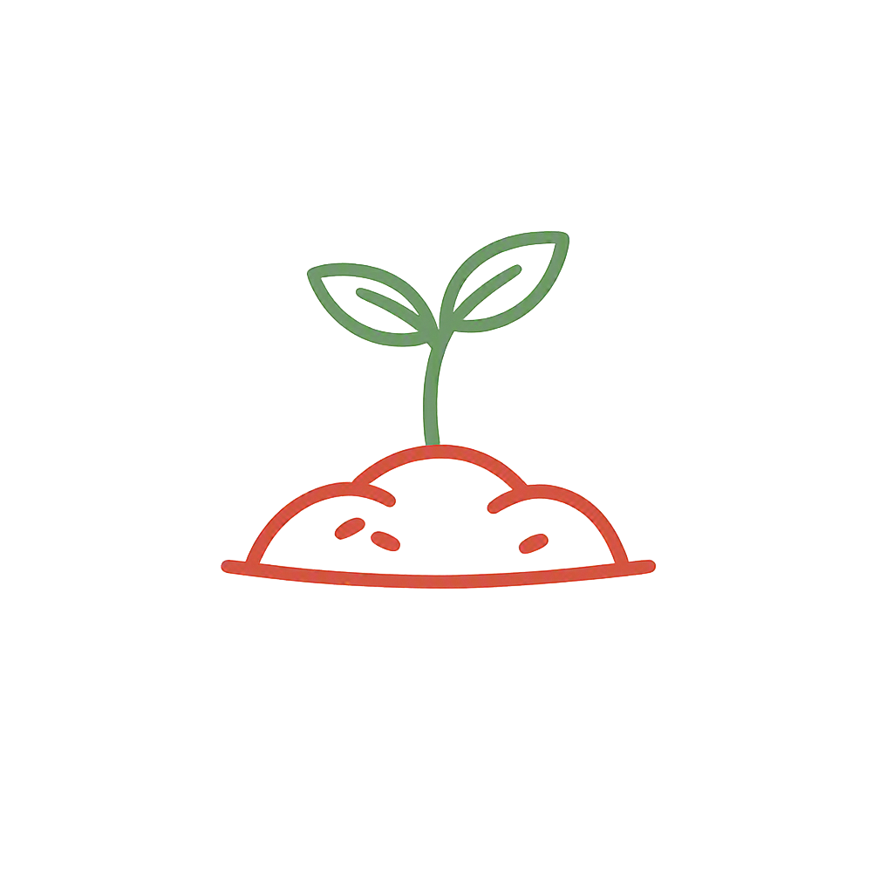
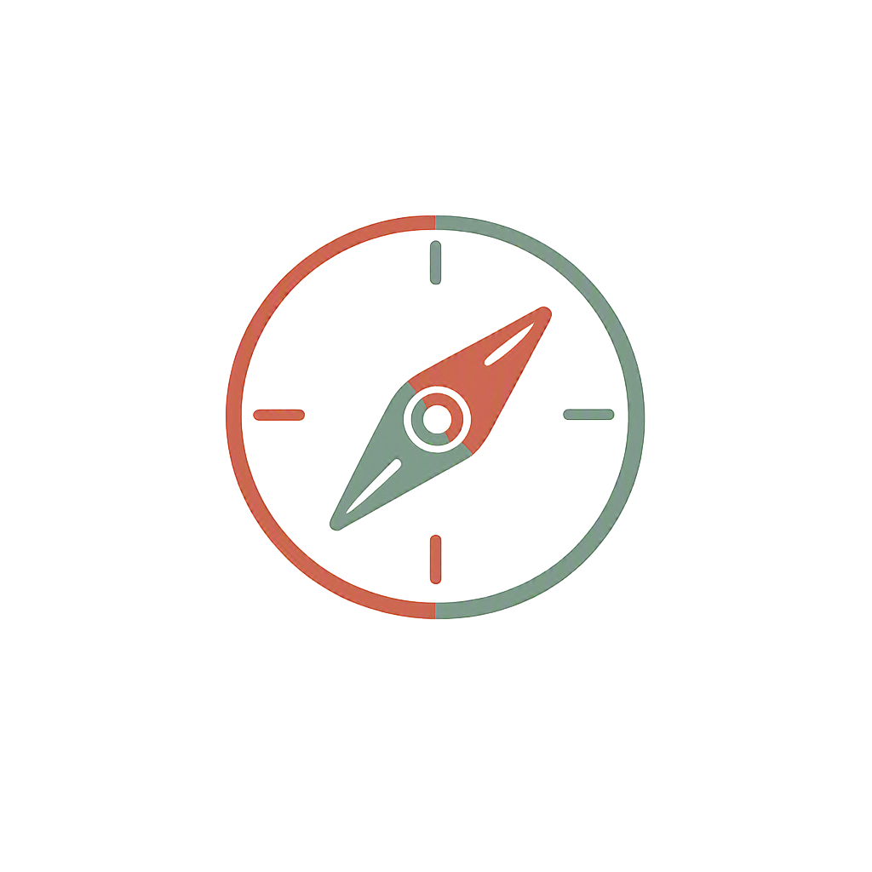
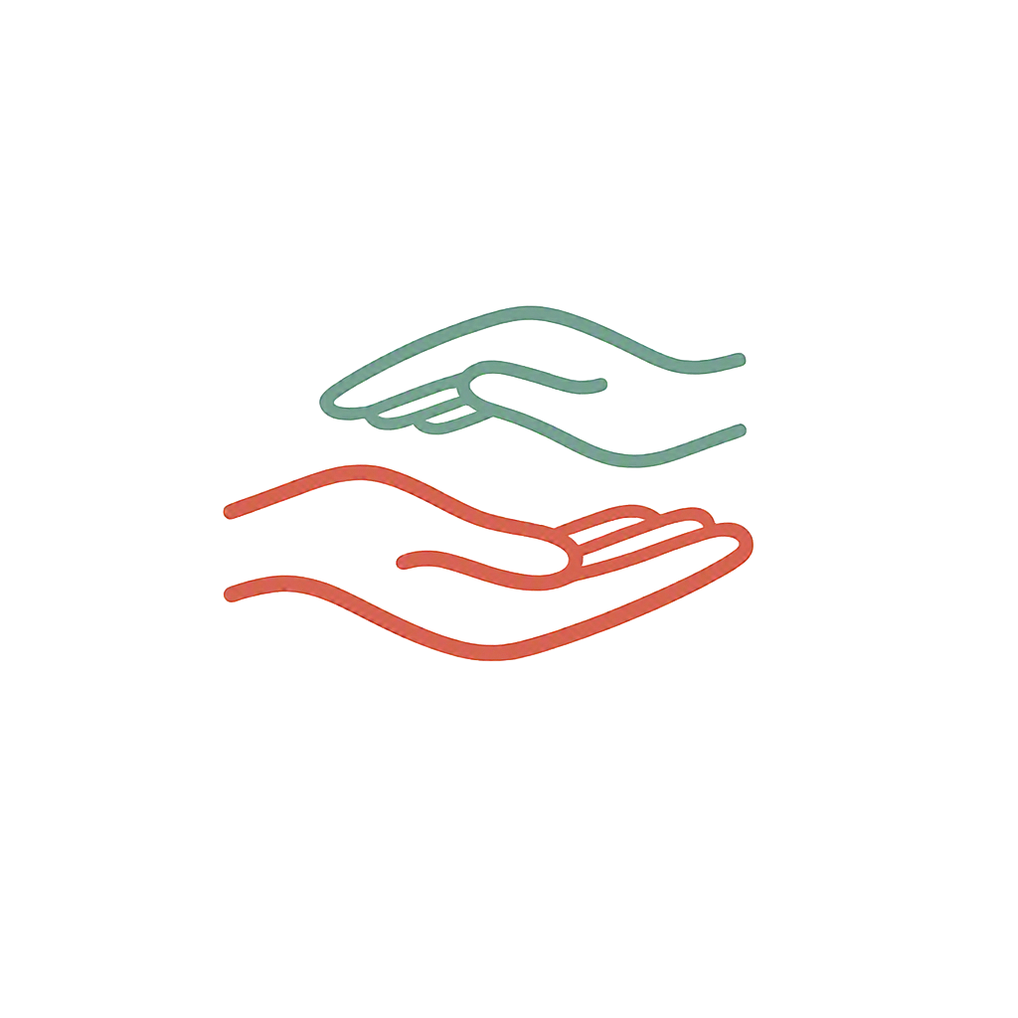
What WRAP Is
A self-designed, self-managed wellness plan created by Mary Ellen Copeland — the person decides everything in it.
Wellness Toolbox
Daily Maintenance
Triggers & Signs
Support & Action
A personal list of simple things that help you feel better.
What I'm like when well, and what keeps me that way.
Early warning signals and what to do about them.
Who I want involved and what helps in tough times.
Notes:
• WRAP is a wellness tool, not a treatment program.
• Person-owned: no clinician writes it for them.
• Five key concepts: hope, personal responsibility, education, self-advocacy, support.
• Nothing here requires admitting a problem first.

Slide 4
Why WRAP Fits Precontemplation
It asks about wellness, not illness
The person is fully in charge
Starting with 'what helps you feel good' bypasses the need to admit a problem.
Self-directed by design, so it doesn't trigger the usual push-back against advice.
It builds awareness quietly
It restores hope after setbacks
Naming triggers and early warning signs raises insight without confrontation.
Small, doable actions rebuild confidence that change is even possible.
Notes:
• Key message: WRAP meets the person where they already are.
• Wellness language is non-threatening — no label required.
• Autonomy lowers defensiveness; that's the whole point at this stage.
• Insight builds gradually, which is how precontemplation shifts.

Slide 5
Start Here: The Wellness Toolbox
The lowest-pressure entry point into WRAP for someone not seeking change.
1
Ask what already works
"What do you do on a good day?" No problem talk needed.
2
Write it down together
Music, walks, a shower, calling a friend, sleep, food.
3
Notice the difference
Gently connect: good days have more of these in them.
4
Leave it with them
It's their list. No follow-up demand, no commitment asked.
Notes:
• The toolbox needs no diagnosis, goal, or admission.
• Start from strengths and existing coping, not deficits.
• Keep it short — five items is a success.
• Hand it over and let go; ownership is the intervention.

Slide 6
How to Introduce It Without Pressure
DO
AVOID
Lead with curiosity and open questions
Offer WRAP as an option, never a requirement
Affirm autonomy: "It's completely your call"
Share a peer's story rather than instructions
Let one page be enough for now
Presenting the full WRAP binder up front
Setting goals or deadlines they didn't ask for
Warning them about consequences
Correcting their view of their own situation
Treating a "no" as the end of the conversation
Notes:
• Tone matters more than content at this stage.
• Pair with motivational interviewing: express empathy, roll with resistance.
• Righting reflex — the urge to fix — is the biggest risk here.
• A 'no' today keeps the door open for later.

Slide 7
What Progress Looks Like Here
Success is not a completed plan — it is a small shift in openness.
Talks about wellness
Keeps the list
Asks one question
Comes back
Willing to name what a good day feels like.
Holds on to a toolbox page without being asked to use it.
Curiosity about how it worked for someone else.
Stays in contact — the relationship is the foundation.
Movement toward contemplation is the goal — not a finished WRAP.
Notes:
• Reset expectations for staff: the plan is not the metric.
• Watch for engagement signals, not compliance.
• Document small openings; they compound over time.
• Moving to contemplation is a real, reportable outcome.

Slide 8
Key Takeaways
WRAP starts with wellness, so it works before someone admits a problem.
Its self-directed design protects autonomy and lowers defensiveness.
Begin with the Wellness Toolbox — the smallest, safest entry point.
Offer, never require; a "no" keeps the door open.
Progress here means openness and connection, not a finished plan.
Meet people where they are — and leave a door open.
Notes:
• Recap the five points quickly.
• Reinforce: relationship first, plan second.
• Invite staff to try one toolbox conversation this week.
• Offer to share blank WRAP toolbox pages.

Slide 9
In Summary: How WRAP Helps Here
At precontemplation, WRAP's value is not the plan itself — it is what the process quietly builds.
Lowers Defensiveness
Rebuilds Hope
Grows Self-Awareness
Strengthens Connection
Wellness language and full self-direction remove the pressure to admit a problem.
Naming what already helps counters demoralization from past setbacks.
Noticing triggers and good days builds insight without confrontation.
A shared, no-demand tool keeps the relationship and the door open.
Together these shift a person from "not me" toward "maybe someday" — the first real move in recovery.
Notes:
• Close by naming the payoff: WRAP works even before readiness.
• Four benefits: less defensiveness, renewed hope, self-awareness, connection.
• None of them require the person to admit a problem.
• The win at this stage is movement toward "maybe someday."

