Slide 1
Peer Case Managers and Their Role in Fostering Self-Sufficiency
Supporting independence through community-centered strategies
Notes:
---
This presentation explores the vital role of peer case managers in promoting self-sufficiency. We will discuss their unique approach, the meaning of self-sufficiency within human services, effective strategies they use, and the impact of their work on clients and communities.

Slide 2
Agenda Overview
Understanding Peer Case Management
The Concept of Self-Sufficiency in Case Management
Strategies Peer Case Managers Use to Promote Self-Sufficiency
Impact and Outcomes of Peer Case Management
Notes:
We will cover four main sections: understanding peer case management, the concept of self-sufficiency, strategies used by peer case managers to promote self-sufficiency, and the impact and outcomes of peer case management.

Slide 3
Understanding Peer Case Management
Notes:
Peer case management is a distinct approach that leverages lived experience to support clients. This section examines what peer case managers do, how they differ from traditional case managers, and the core principles guiding peer support.

Slide 4

Definition and Scope of Peer Case Managers
Personal Experience
  Peer case managers have lived experience with recovery or overcoming challenges.
Client Support
  They provide guidance, insights, and foster trust with clients effectively.
Unique Role
  Their experience allows them to connect in ways traditional professionals may not.
Notes:
---
Peer case managers are individuals who have personal experience with recovery or overcoming challenges. They support clients by providing guidance, sharing insights, and fostering trust in ways traditional professionals may not.
Image source: Microsoft 365 content library

Slide 5

Key Differences From Traditional Case Management
Focus on Shared Experience
  Peer case managers leverage shared experiences to build trust and foster mutual understanding with clients.
Promotion of Empathy
  This approach encourages deeper empathy between case managers and clients, enhancing support quality.
Client Empowerment
  Peer case management empowers clients by reducing stigma and encouraging active participation in their care.
Notes:
---
Unlike traditional case managers, peer case managers emphasize shared experience and mutual understanding. This approach promotes empathy, reduces stigma, and encourages client empowerment.
Image source: Microsoft 365 content library

Slide 6

Core Principles of Peer Support
Respect
  Respect forms the foundation of peer support, ensuring all voices are valued equally in the community.
Shared Responsibility
  Shared responsibility promotes collective ownership and accountability among peers for mutual growth.
Mutual Empowerment
  Mutual empowerment encourages peers to uplift each other, fostering hope and resilience together.
Notes:
---
Peer support is built on respect, shared responsibility, and mutual empowerment. These principles create a collaborative environment that fosters hope and resilience.
Image source: Microsoft 365 content library

Slide 7
The Concept of Self-Sufficiency in Case Management
Notes:
Self-sufficiency is a key goal in human services, focusing on individuals' ability to meet their own needs. This section explores what self-sufficiency entails, the critical skills and resources required, and common barriers clients face.

Slide 8
What Self-Sufficiency Means in Human Services
Managing Daily Living
Self-sufficiency involves independently handling everyday tasks and personal responsibilities effectively.
Maintaining Employment
Sustaining steady employment is a critical aspect of being self-sufficient in human services.
Accessing Resources
Self-sufficient individuals can obtain necessary resources without relying on continuous external support.
Notes:
---
Self-sufficiency refers to the capacity to independently manage daily living, maintain employment, and access necessary resources without ongoing external assistance.
Image source: Microsoft 365 content library

Slide 9
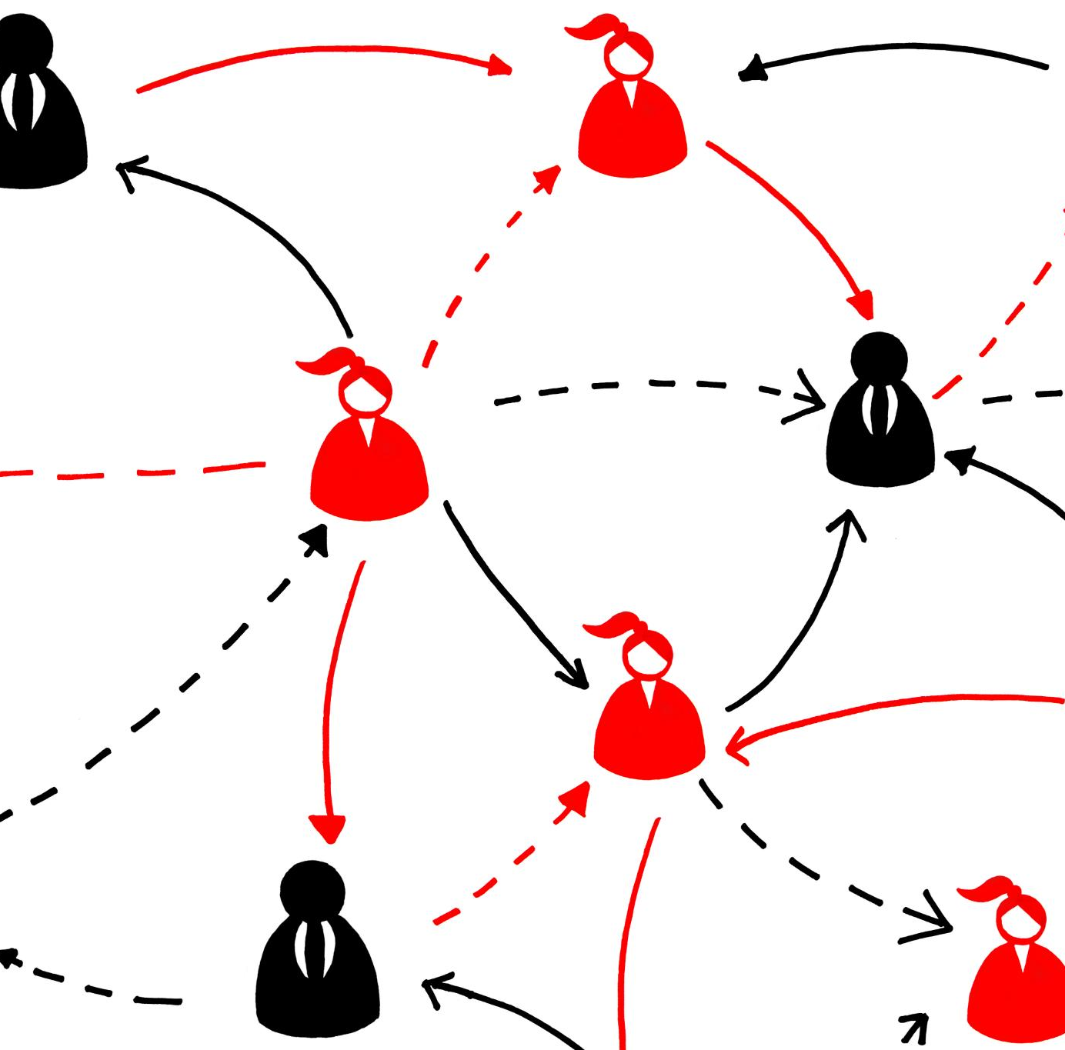
Skills and Resources Essential for Self-Sufficiency
Essential Skills
  Problem-solving, financial literacy, and communication are crucial skills for achieving self-sufficiency and independence.
Vital Resources
  Access to housing, education, and social support networks provides the foundation necessary for sustaining independence.
Notes:
---
Key skills include problem-solving, financial literacy, and communication, while resources such as housing, education, and social support networks are vital for sustaining independence.
Image source: Microsoft 365 content library

Slide 10

Barriers to Achieving Self-Sufficiency
Limited Access to Resources
  Clients frequently struggle due to insufficient access to essential resources necessary for achieving independence.
Mental Health Challenges
  Mental health issues can create significant obstacles that impede clients from progressing toward self-sufficiency.
Systemic Issues
  Broader systemic problems often create structural barriers that limit opportunities for achieving independence.
Notes:
---
Clients often face obstacles like limited access to resources, mental health challenges, and systemic issues that can hinder their journey toward independence.
Image source: Microsoft 365 content library

Slide 11
Strategies Peer Case Managers Use to Promote Self-Sufficiency
Notes:
Peer case managers employ a variety of effective strategies to empower clients. This section highlights three key methods: empowerment and motivational interviewing, resource navigation and advocacy, and goal-setting with action planning.

Slide 12

Empowerment and Motivational Interviewing
Building Client Confidence
  Motivational interviewing helps enhance clients' confidence to initiate and sustain change in their lives.
Encouraging Readiness to Change
  Peer case managers foster clients’ readiness by exploring ambivalence and enhancing motivation to change.
Promoting Self-Directed Growth
  Motivational interviewing encourages clients to set their own goals and commit to personal growth pathways.
Notes:
---
By fostering clients’ confidence and readiness to change, peer case managers use motivational interviewing to encourage self-directed growth and commitment to goals.
Image source: Microsoft 365 content library

Slide 13

Resource Navigation and Advocacy
Client Resource Identification
  Peer case managers help clients recognize available vital services and resources to support their needs effectively.
Accessing Services Support
  They assist clients in navigating complex systems to gain access to essential services and overcome obstacles.
Advocacy for Barriers Removal
  Peer case managers advocate on behalf of clients to remove systemic barriers toward self-sufficiency.
Notes:
---
Peer case managers assist clients in identifying, accessing, and advocating for vital services and resources, helping to overcome systemic barriers to self-sufficiency.
Image source: Microsoft 365 content library

Slide 14

Goal-Setting and Action Planning
Collaborative Goal Setting
  Working together with clients ensures goals are realistic and aligned with their needs.
Actionable Planning
  Breaking down large objectives into manageable steps facilitates steady progress and success.
Notes:
---
They work collaboratively with clients to set realistic goals and develop actionable plans, breaking down larger objectives into manageable steps to ensure progress.
Image source: Microsoft 365 content library

Slide 15
Impact and Outcomes of Peer Case Management
Notes:
The final section reviews evidence of peer case management's effectiveness, including client success stories, data demonstrating improved self-sufficiency, and challenges that remain for further development.

Slide 16

Success Stories and Client Perspectives
Increased Confidence
  Clients report a significant boost in self-confidence after support from peer case managers.
Improved Coping Skills
  Peer support helps clients develop better strategies to manage life's challenges effectively.
Enhanced Independence
  Clients achieve greater independence and autonomy through collaborative case management.
Notes:
---
Clients often express increased confidence, improved coping skills, and enhanced independence after working with peer case managers, highlighting the personal impact of this approach.
Image source: Microsoft 365 content library

Slide 17

Data and Evidence of Improved Self-Sufficiency
Employment Rate Improvement
  Peer case management significantly boosts employment rates among participants over time.
Housing Stability Gains
  Participants experience increased housing stability due to effective peer case management support.
Reduced Emergency Services Use
  There is a measurable reduction in reliance on emergency services among those managed by peers.
Notes:
---
Research indicates peer case management leads to measurable improvements in employment rates, housing stability, and reduced reliance on emergency services among participants.
Image source: Microsoft 365 content library

Slide 18

Challenges and Areas for Improvement
Funding Limitations
  Limited financial resources hinder the ability to expand and improve services effectively.
Role Clarity
  Unclear roles create confusion, reducing efficiency and effectiveness in service delivery.
Service Integration
  Integrating new approaches into traditional systems remains complex and requires ongoing efforts.
Notes:
---
Despite successes, challenges include funding limitations, role clarity, and integration into traditional service systems, which require ongoing attention to optimize outcomes.
Image source: Microsoft 365 content library

Slide 19
Conclusion
Critical Role of Peer Case Managers
Peer case managers are vital in fostering self-sufficiency through support and guidance based on lived experience.
Unique Approach Combining Experience and Strategy
They blend personal experience with professional methods to effectively empower clients.
Empowering Clients
Their approach helps clients overcome barriers and build fulfilling, independent lives.
Notes:
Peer case managers play a crucial role in fostering self-sufficiency by combining lived experience with professional strategies. Their unique approach empowers clients to overcome barriers and build fulfilling, independent lives.

