Slide 1
Motivational Interviewing: Empowering Change Through Collaborative Conversation
Techniques to inspire and support personal transformation
Notes:
---
This presentation explores motivational interviewing, a client-centered approach designed to evoke and strengthen motivation for change. We will cover its foundations, key techniques, applications across various contexts, and address challenges and best practices.

Slide 2
Discussion Outline
Foundations of Motivational Interviewing
Key Techniques and Strategies
Applications in Different Contexts
Challenges and Best Practices
Notes:
Our discussion includes the foundations of motivational interviewing, essential techniques and strategies, applications in healthcare, addiction, and counseling settings, and concludes with challenges and best practices for effective use.

Slide 3
Foundations of Motivational Interviewing
Notes:
Understanding the roots and philosophy of motivational interviewing is essential to apply it effectively. This section covers its definition, origins, and core guiding principles.

Slide 4

Definition and Purpose of Motivational Interviewing
Collaborative Conversation
  Motivational interviewing involves working together to foster open, supportive dialogue that encourages personal growth.
Strengthening Motivation
  This method aims to enhance an individual's intrinsic motivation to initiate and sustain positive changes.
Resolving Ambivalence
  Motivational interviewing helps explore and address conflicting feelings about change to achieve commitment.
Notes:
---
Motivational interviewing is a collaborative conversational method aimed at strengthening a person’s motivation and commitment to change by exploring and resolving ambivalence.
Image source: Microsoft 365 content library

Slide 5

Historical Development and Origins
Origins in Addiction Treatment
  Motivational interviewing was initially developed in the 1980s to address addiction treatment effectively.
Expansion to Behavioral Change
  The technique has been adapted to various fields involving behavioral change beyond addiction.
Notes:
---
Developed in the 1980s by William R. Miller and Stephen Rollnick, motivational interviewing emerged from addiction treatment and has since been adapted to many behavioral change fields.
Image source: Microsoft 365 content library

Slide 6

Core Principles and Philosophy
Collaboration
  Motivational interviewing relies on a collaborative partnership between the counselor and client.
Evocation
  The approach draws out the client’s own motivations and strengths for change.
Autonomy Support
  Respecting the client’s autonomy is fundamental, supporting their freedom to choose.
Compassion
  Compassion and empathy are essential to create a respectful and safe space for clients.
Notes:
---
Motivational interviewing is grounded in principles such as collaboration, evocation, autonomy support, and compassion, emphasizing respect for the client’s perspective and choice.
Image source: Microsoft 365 content library

Slide 7
Key Techniques and Strategies
Notes:
This section highlights the spirit of motivational interviewing, the OARS communication techniques, and how to recognize and respond to client language that indicates readiness or resistance to change.

Slide 8

The Spirit of Motivational Interviewing: Partnership, Acceptance, Compassion, and Evocation
Collaborative Partnership
  Motivational interviewing fosters a cooperative partnership between counselor and client to support change.
Acceptance of Autonomy
  Respecting client autonomy empowers individuals to take ownership of their decisions and changes.
Empathetic Compassion
  Empathy and compassion create a safe, supportive environment for clients to express themselves freely.
Evoking Motivation
  The approach draws out clients’ internal motivations, inspiring readiness for positive change.
Notes:
---
The approach centers on a collaborative partnership, acceptance of the client's autonomy, empathetic compassion, and evoking the client's own motivations for change.
Image source: Microsoft 365 content library

Slide 9

OARS Framework: Open Questions, Affirmations, Reflective Listening, and Summaries
Open Questions
  Open questions encourage clients to share more information and explore their thoughts freely.
Affirmations
  Affirmations recognize client strengths to boost confidence and build rapport.
Reflective Listening
  Reflective listening involves paraphrasing client statements to demonstrate understanding.
Summaries
  Summaries recap discussions to clarify and confirm shared understanding.
Notes:
---
OARS is a set of communication techniques used to engage clients, build rapport, and facilitate exploration: asking open questions, affirming strengths, reflecting meaning, and summarizing discussions.
Image source: Microsoft 365 content library

Slide 10

Recognizing and Responding to Change Talk and Sustain Talk
Understanding Change Talk
  Change talk includes client statements expressing desire, ability, reasons, or need to change behaviors.
Recognizing Sustain Talk
  Sustain talk reflects client resistance or reasons for maintaining current behavior and status quo.
Effective Conversation Guidance
  Distinguishing between change talk and sustain talk helps guide client conversations toward positive outcomes.
Notes:
---
Identifying client statements about desire, ability, reasons, and need for change (change talk) versus resistance or reasons to maintain status quo (sustain talk) is essential for guiding conversations effectively.
Image source: Microsoft 365 content library

Slide 11
Applications in Different Contexts
Notes:
Motivational interviewing is versatile and used in many settings including healthcare, addiction treatment, and mental health counseling to support behavior change and improve outcomes.

Slide 12

Motivational Interviewing in Healthcare Settings
Encouraging Medication Adherence
  Motivational interviewing helps patients understand the importance of taking medications as prescribed for better health outcomes.
Promoting Lifestyle Changes
  This technique supports patients in making positive lifestyle changes such as improved diet and increased physical activity.
Managing Chronic Diseases
  Motivational interviewing assists patients in managing chronic diseases through sustained motivation and behavior change.
Notes:
---
Healthcare providers use motivational interviewing to encourage healthy behaviors such as medication adherence, lifestyle changes, and chronic disease management.
Image source: Microsoft 365 content library

Slide 13

Use in Addiction and Substance Abuse Treatment
Core Role in Treatment
  The approach is fundamental in addiction recovery, guiding clients to overcome ambivalence and embrace change.
Non-Confrontational Method
  It uses a gentle, empowering approach that respects client autonomy and encourages commitment to recovery.
Notes:
---
It remains a cornerstone in addiction treatment by helping clients resolve ambivalence and commit to recovery through a non-confrontational and empowering approach.
Image source: Microsoft 365 content library

Slide 14
Implementation in Counseling and Mental Health
Motivational Interviewing Approach
Motivational interviewing helps clients explore and resolve ambivalence toward change in a supportive setting.
Fostering Intrinsic Motivation
This approach empowers clients to find their own motivation to achieve therapeutic goals effectively.
Strengthening Commitment
Motivational interviewing enhances clients’ commitment to positive behavioral changes and goal attainment.
Notes:
---
In counseling, motivational interviewing supports clients dealing with diverse issues by fostering intrinsic motivation and strengthening commitment to therapeutic goals.
Image source: Microsoft 365 content library

Slide 15
Challenges and Best Practices
Notes:
While effective, motivational interviewing faces challenges such as client resistance and practitioner skill levels. This section discusses common barriers and strategies to enhance practice.

Slide 16
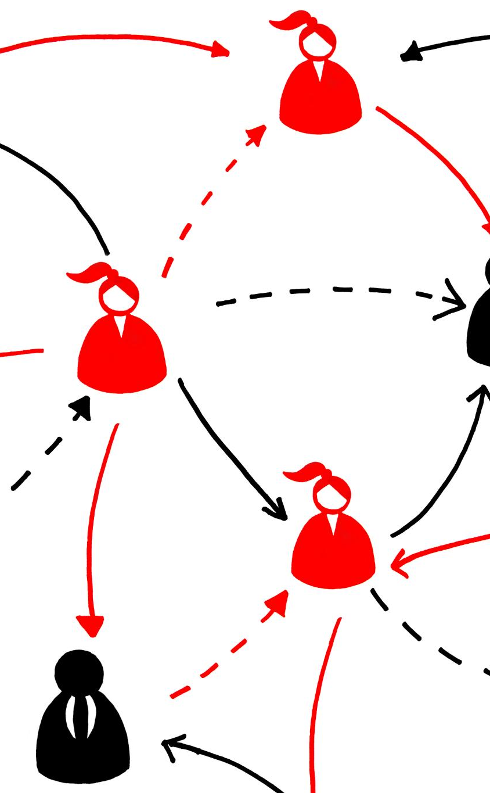
Common Barriers to Effective Motivational Interviewing
Practitioner Impatience
  Impatience from practitioners can disrupt the flow of motivational interviewing and reduce client openness.
Directive Approaches
  Using directive approaches can hinder collaboration by limiting client autonomy and engagement.
Lack of Training
  Insufficient training in motivational interviewing techniques can reduce effectiveness and client trust.
Client Mistrust or Ambivalence
  Client mistrust or ambivalence can create resistance and reduce the effectiveness of motivational interviewing.
Notes:
---
Barriers include practitioner impatience, directive approaches, lack of training, and client mistrust or ambivalence that can hinder collaborative engagement.
Image source: Microsoft 365 content library

Slide 17

Tips for Building Rapport and Maintaining Engagement
Empathetic Listening
  Actively listening with empathy helps build trust and makes clients feel understood and valued.
Respecting Autonomy
  Acknowledging and respecting clients' independence fosters mutual respect and encourages engagement.
Non-Judgmental Stance
  Maintaining a non-judgmental attitude ensures a safe environment for open communication and sustained engagement.
Notes:
---
Establishing trust through empathetic listening, respecting autonomy, and maintaining a non-judgmental stance are key to sustaining client engagement.
Image source: Microsoft 365 content library

Slide 18
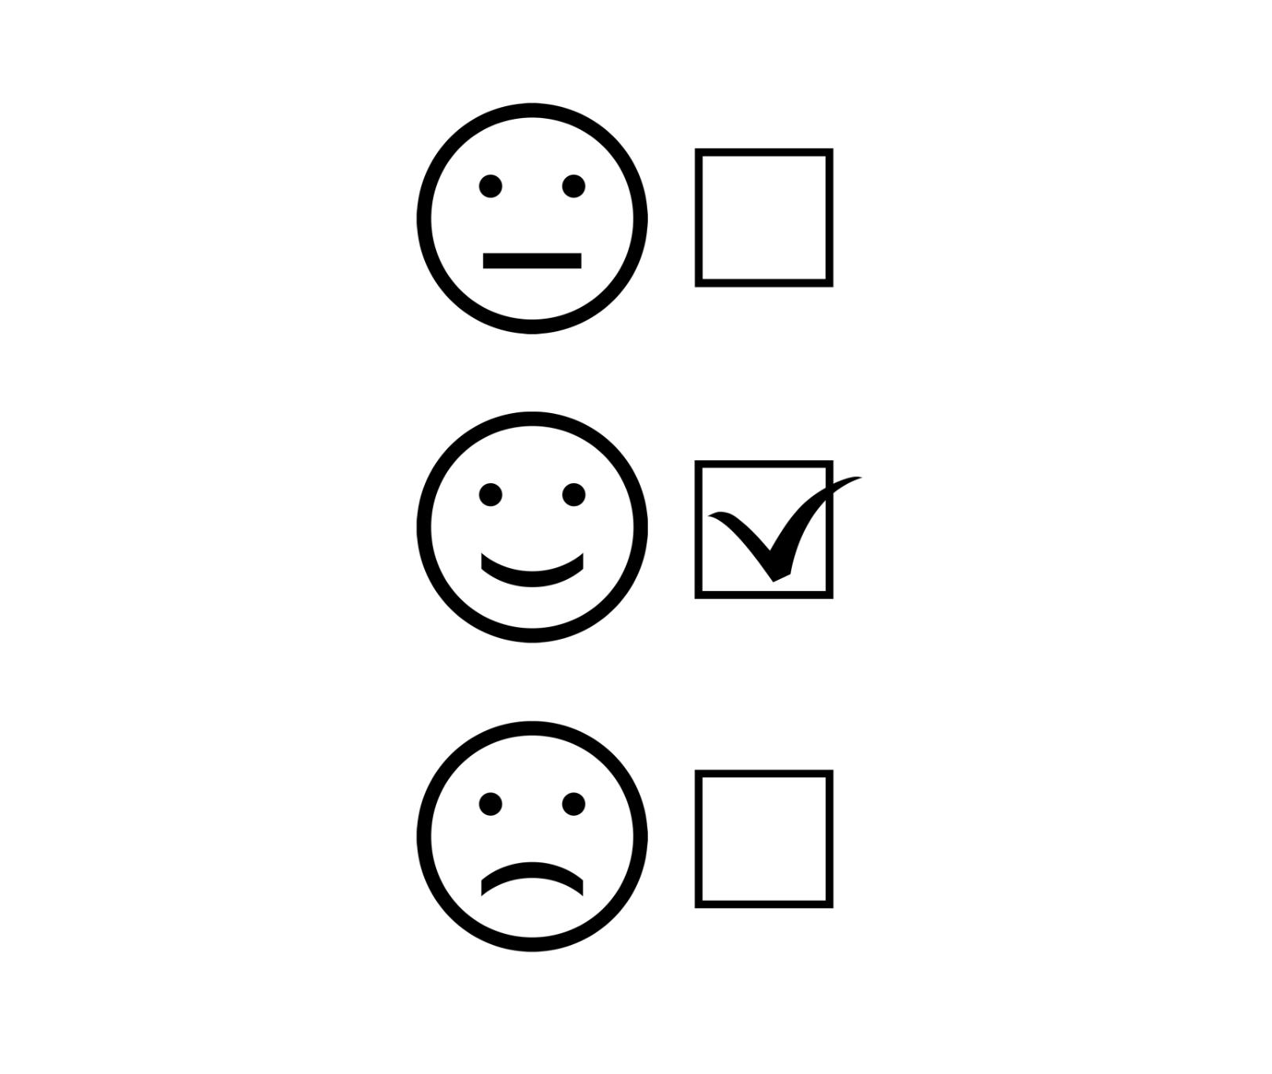
Evaluating Effectiveness and Outcomes
Client Progress Measurement
  Effectiveness is assessed by tracking client progress throughout the intervention or service period.
Behavioral Change Assessment
  Observing and evaluating changes in client behavior helps determine the impact of the intervention.
Feedback and Supervision
  Continuous feedback from clients and supervision of practitioners ensures quality and ongoing improvement.
Practitioner Self-Assessment
  Practitioners engage in self-assessment to reflect on their effectiveness and areas for growth.
Notes:
---
Effectiveness is measured through client progress, behavioral changes, and feedback, complemented by continuous practitioner self-assessment and supervision.
Image source: Microsoft 365 content library

Slide 19
Conclusion
Empowering Clients
Motivational interviewing empowers clients to achieve meaningful personal change through respectful dialogue.
Evidence-Based Approach
This approach is backed by research showing effectiveness in diverse fields and settings.
Wide Application
Mastering motivational interviewing enhances outcomes in healthcare, counseling, and beyond.
Notes:
Motivational interviewing is a powerful, evidence-based approach that empowers clients to make meaningful change through collaborative and respectful conversation. Mastery of its principles and techniques can enhance outcomes across many fields.

