Slide 1
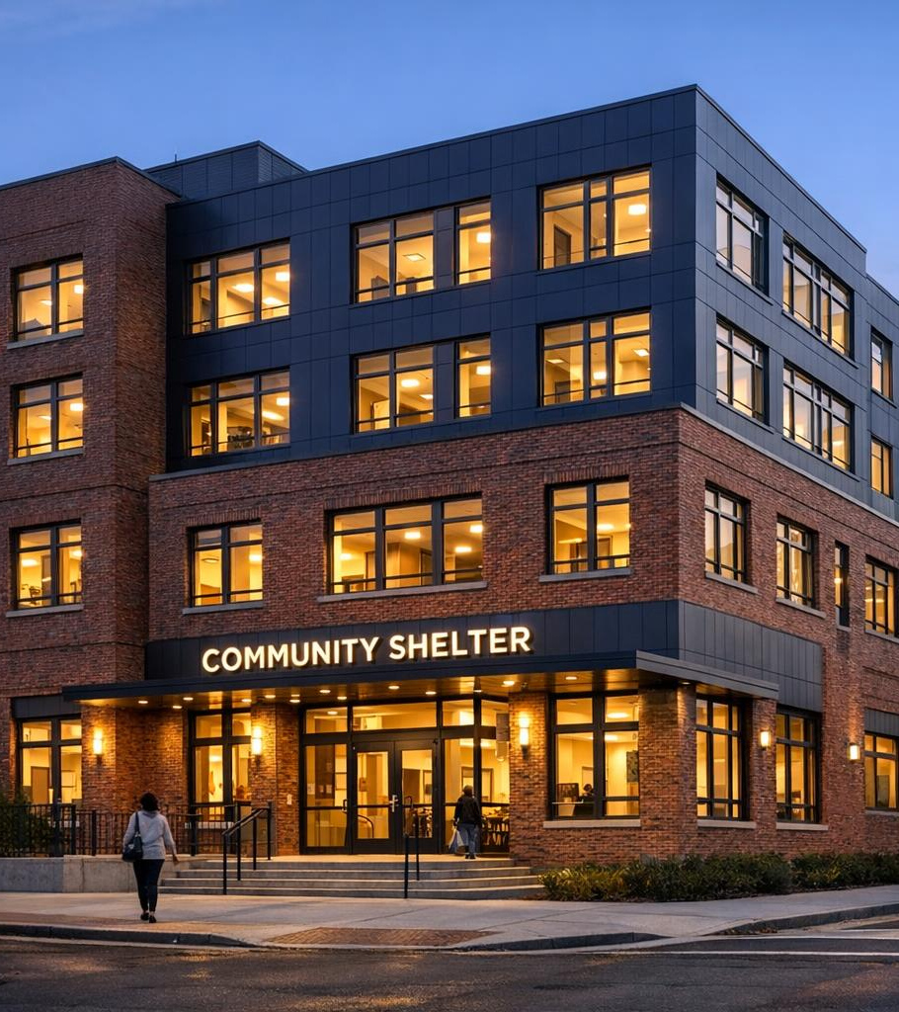
CATHOLIC CHARITIES OF THE ARCHDIOCESE OF WASHINGTON
801 East Men's Shelter
A Beacon of Hope on the St. Elizabeths East Campus
Safe shelter, dignified services, and pathways to housing for men experiencing homelessness in Washington, D.C.
Notes:
Welcome and thank attendees. Introduce 801 East Men's Shelter as a flagship program of Catholic Charities of the Archdiocese of Washington, operated on the historic St. Elizabeths East campus in Ward 8. Frame the session: we will cover mission, history, services, and how partners and volunteers can get involved.

Slide 2
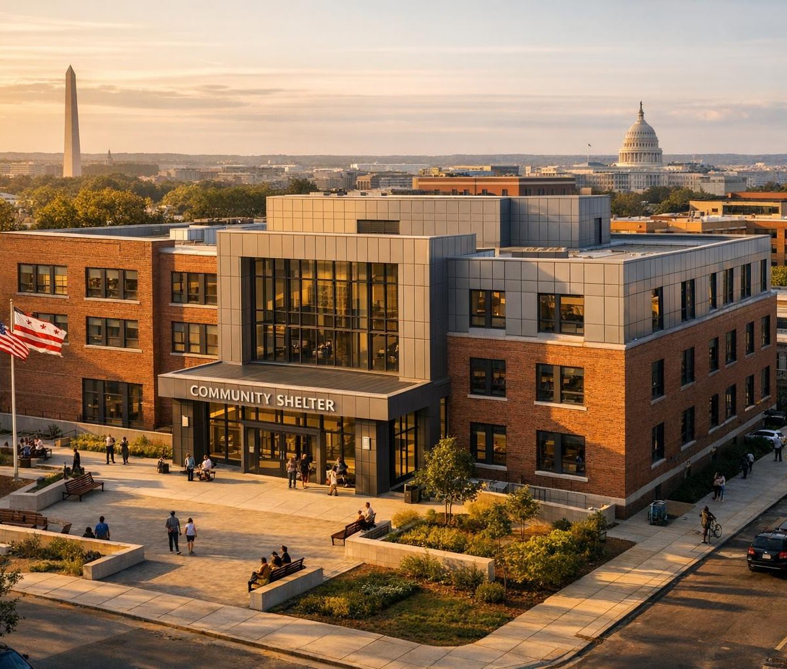
AT A GLANCE
A flagship low-barrier shelter for men in D.C.
396
85,600
Beds nightly
Square feet
$56M
2022
Construction investment
New facility opened
Ward 8 · St. Elizabeths East Campus — open every night of the year.
Catholic Charities of the Archdiocese of Washington | 801 East Men's Shelter
2 / 15
Notes:
Set the scale of the program with four key numbers. Emphasize that 396 beds run nightly, year-round, with capacity to expand during hypothermia season. The new 85,600 sq ft facility opened in January 2022 as a $56 million District investment under Mayor Bowser's Homeward DC plan.

Slide 3

OUR MISSION
Help that empowers. Hope that lasts.
Catholic Charities is the social ministry outreach of the Archdiocese of Washington — and the largest private social service provider in the D.C. region.
Dignity
Affirm and support the dignity of every human life — without exception.
Service
Strengthen families and serve the poor and most vulnerable in our community.
Empowerment
Offer help that empowers individuals to move from crisis to stability.
Catholic Charities of the Archdiocese of Washington | 801 East Men's Shelter
3 / 15
Notes:
Ground the audience in the parent organization's mission. Catholic Charities was founded in 1928 and serves everyone who comes for help, regardless of race, religion, orientation, or status. Three pillars frame our work at 801 East: dignity, service, and empowerment.

Slide 4
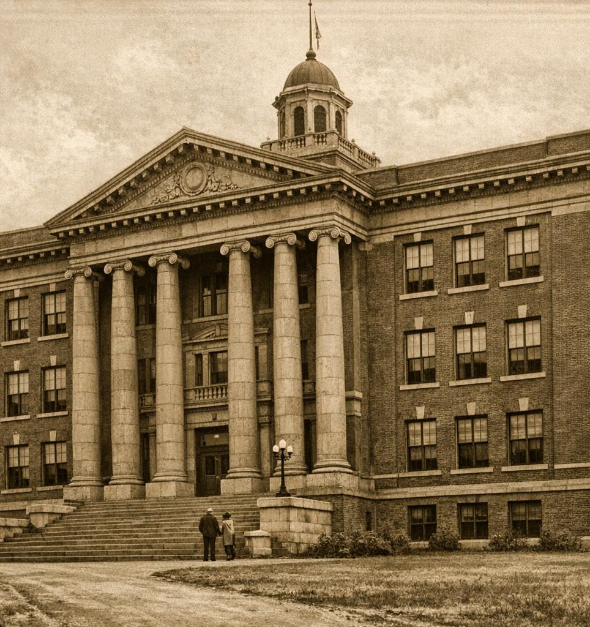
OUR HISTORY
From legacy shelter to flagship facility
Legacy
The original 801 East operated for years as a low-barrier shelter for men in Southeast D.C., on the St. Elizabeths campus.
2015
Mayor Bowser launches Homeward DC — a strategic plan to make homelessness rare, brief, and non-recurring.
2019–2020
Wiencek + Associates leads design; Coakley & Williams and Blue Skye begin construction adjacent to the historic 1884 dry barn.
Jan 2022
The new 396-bed shelter opens as the District's first major shelter redevelopment — LEED Gold certified.
Catholic Charities of the Archdiocese of Washington | 801 East Men's Shelter
4 / 15
Notes:
Walk through the arc of how 801 East evolved. The legacy shelter served men in Southeast D.C. for years. With the launch of Homeward DC in 2015, the District committed to modernizing its shelter system. After several years of design and construction, the new facility opened in January 2022 — notably, members of the Goodfellas Team, former residents of the old shelter, were hired to help build the new one.

Slide 5
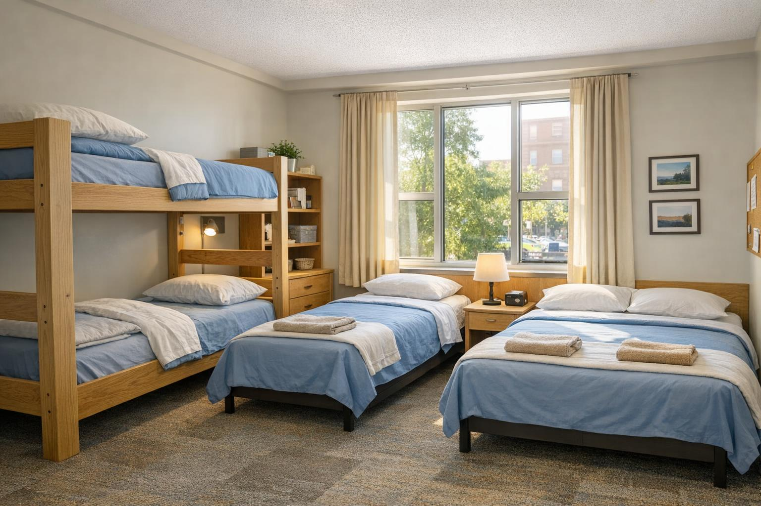
THE NEW FACILITY
A purpose-built home for dignity
Beacon of hope
Illuminated stair towers visible across the campus.
Honoring history
Adjacent to the 1884 dry barn, the last in the District.
Engineering feat
Structural system spans directly over the WMATA Green Line tunnel.
85,600 sq ft · LEED Gold
Local artistry
Three wings separate low-barrier, workforce, and senior/medical client groups.
Interior common areas showcase work by D.C. artists.
Catholic Charities of the Archdiocese of Washington | 801 East Men's Shelter
5 / 15
Notes:
Highlight that the new building was intentionally designed around the dignity of the men served. The three-wing layout separates client groups so each receives appropriate care. Note the building's historic context — it sits next to the 1884 dry barn — and the unusual engineering challenge of spanning the WMATA Green Line. LEED Gold reflects the District's sustainability commitment.

Slide 6
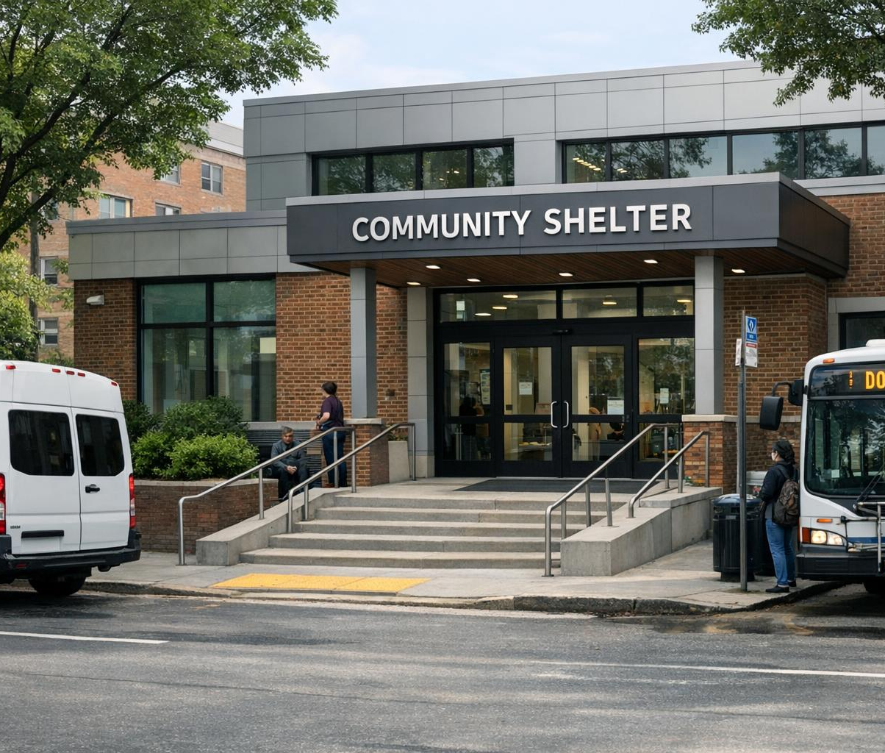
LOCATION & ACCESS
Where to find us — and how to get here
ADDRESS
801 East Building, 2700 Martin Luther King Jr. Ave. SE, Washington, DC 20032
Ward 8 · St. Elizabeths East Campus · Hours: 5 p.m. – 9 a.m. daily, year-round
Daily shuttle service to and from downtown D.C., several times per day.
D.C. Shelter Hotline
1-800-535-7252
Walk-up intake welcomed — no referral required.
Catholic Charities of the Archdiocese of Washington | 801 East Men's Shelter
6 / 15
Notes:
Make sure attendees can locate the shelter and refer clients. Shelter hours run overnight and extend during hypothermia or extreme weather alerts. The free shuttle is an underappreciated asset — it connects men to jobs, day programs, and downtown services. The D.C. Shelter Hotline is the fastest way to request a bed.

Slide 7
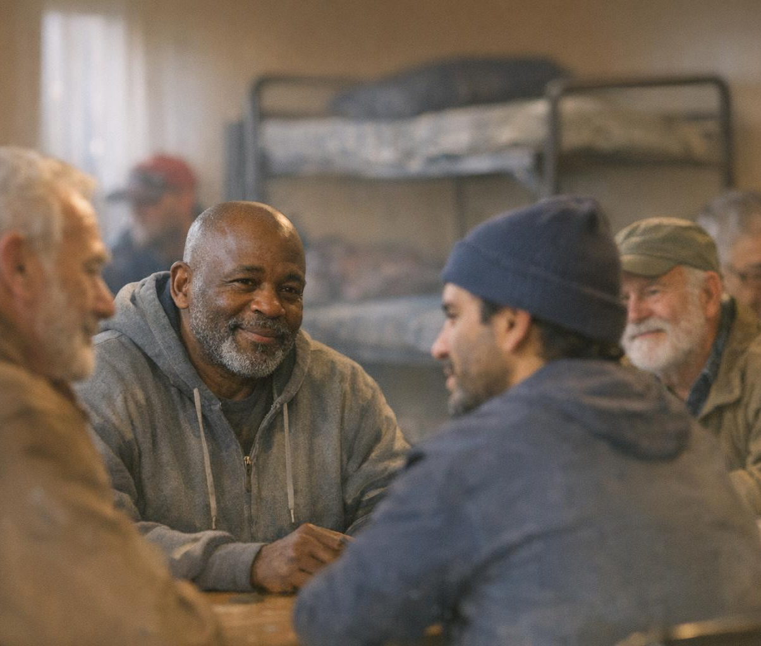
WHO WE SERVE
Open to any man, every night of the year
Open to any man, 18+, every night of the year — four overlapping populations under one roof.
01
Overnight low-barrier
Men needing safe shelter, a hot meal, and a shower nightly.
02
Working men
Dedicated work-bed program for men holding employment.
03
Seniors
Beds and supports tailored for older adults.
04
Medical respite
Beds reserved for men recovering from illness or surgery.
Catholic Charities of the Archdiocese of Washington | 801 East Men's Shelter
7 / 15
Notes:
Underscore that 'low barrier' means no ID requirements, no sobriety requirements — just walk-up access. We serve four distinct populations under one roof, which lets us right-size supports for each group. This separation was a deliberate design choice, not an afterthought.

Slide 8
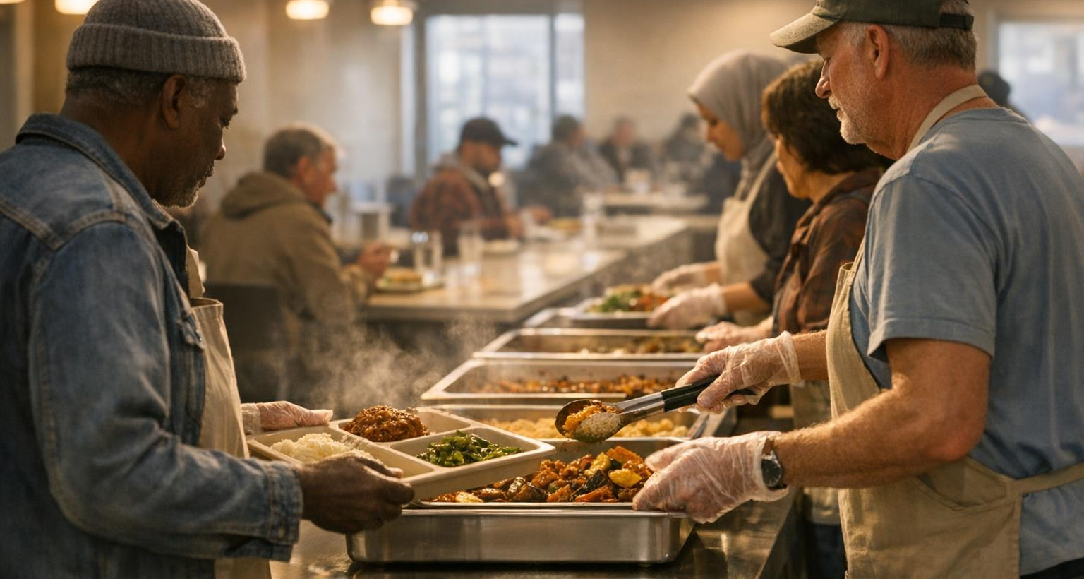
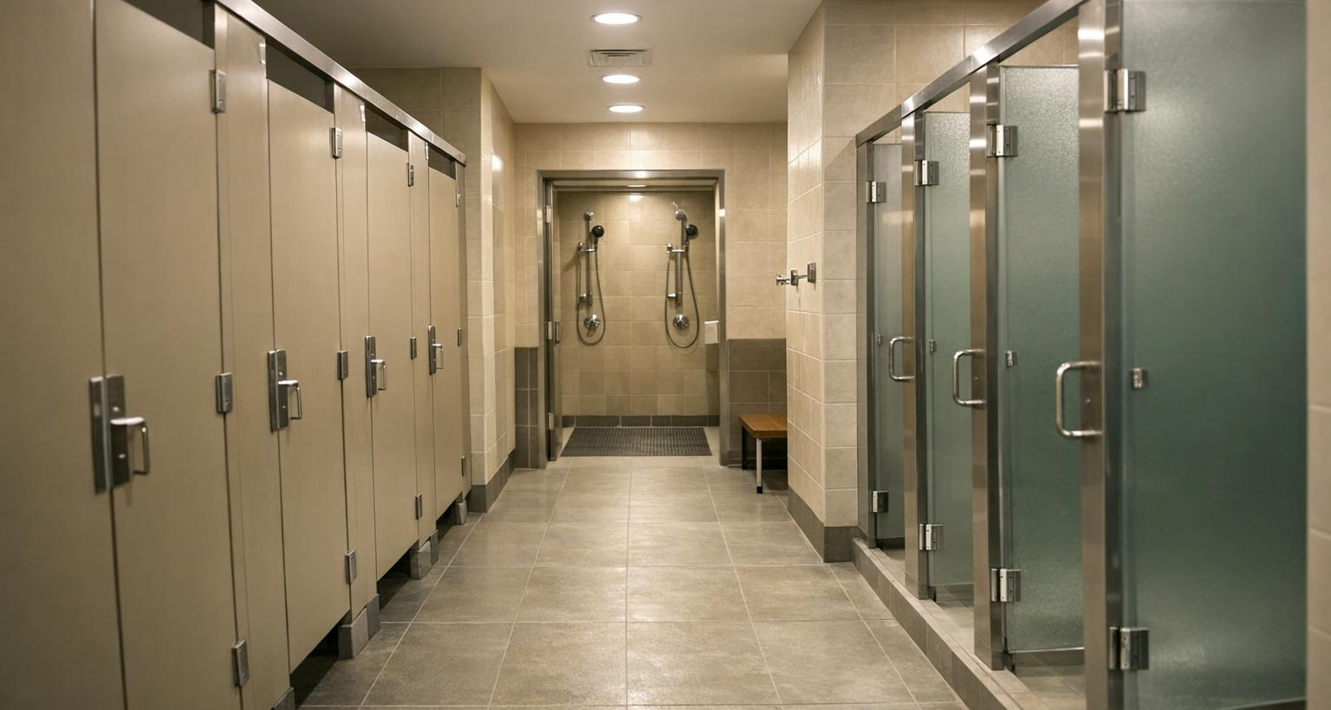
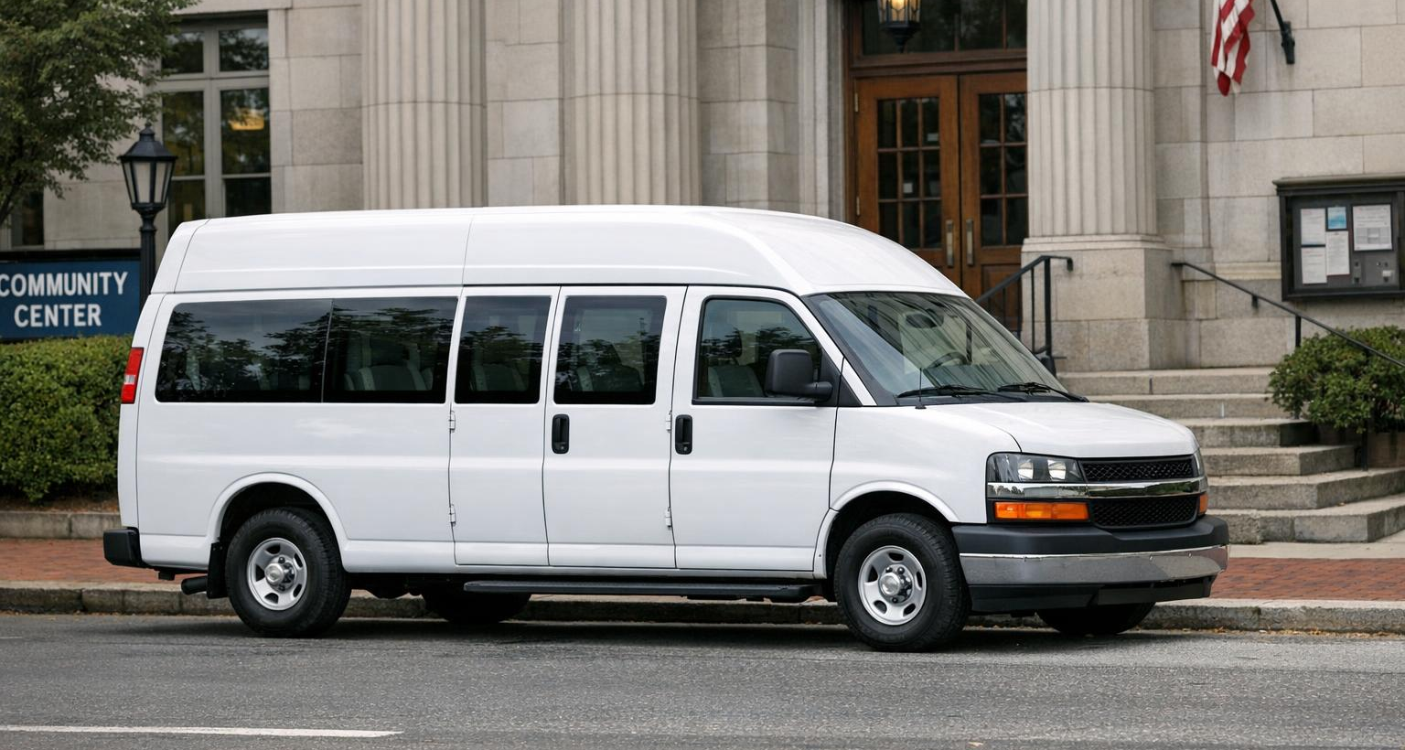
EVERY NIGHT, WE PROVIDE
Core shelter services
Safe overnight bed
Hot dinner
Showers & restrooms
396 beds nightly, year-round.
A nutritious meal each evening.
Clean facilities every resident can use.
Case management
Behavioral health
Transportation
Housing-focused case managers chart a path forward.
On-site behavioral health and harm-reduction supports.
Free shuttle to and from downtown D.C.
Catholic Charities of the Archdiocese of Washington | 801 East Men's Shelter
8 / 15
Notes:
These six services form the daily backbone of the shelter. Every resident gets a bed, a hot meal, and access to showers — and from that foundation, case managers begin the housing-focused conversation. Behavioral health and harm-reduction supports meet men where they are, without preconditions.

Slide 9

SPECIALIZED PROGRAMS
Beyond a bed for the night
Work Bed Program
Dedicated beds for men with jobs — protected sleep schedules and storage to support employment stability.
Senior Program
Tailored beds and on-site supports for older adults whose needs differ from the general shelter population.
Medical Respite
Beds reserved for men recovering from illness, surgery, or hospitalization — bridging care and stable housing.
Culinary Training
On-site culinary training builds practical kitchen skills and pathways into food-service employment.
Catholic Charities of the Archdiocese of Washington | 801 East Men's Shelter
9 / 15
Notes:
Walk through how the shelter goes beyond an overnight bed. The work-bed program protects sleep for employed men. The senior and medical-respite programs recognize that homelessness presents differently across populations. The culinary training program turns the on-site commercial kitchen into a workforce development engine.

Slide 10
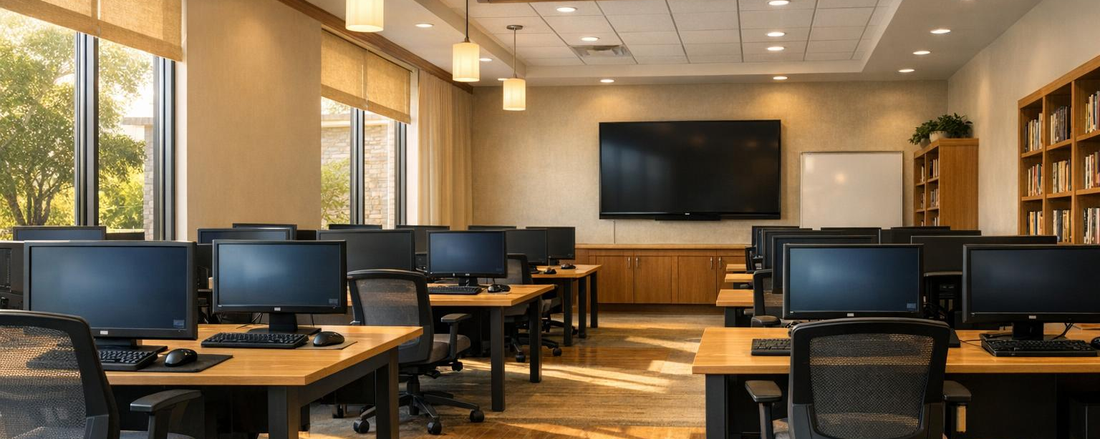
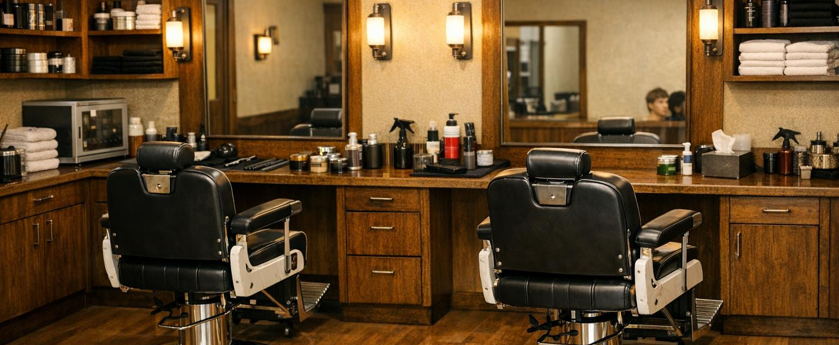
DAYTIME SERVICES CENTER
One-stop access during the day
Services once scattered across the city now sit under one roof — easier to reach for the men we serve.
Health clinic — on-site medical care
Computer lab — job search & benefits
Teaching barbershop — free haircuts
Mail room — a stable mailing address
Laundry facility for residents
Clothing boutique at no cost
Catholic Charities of the Archdiocese of Washington | 801 East Men's Shelter
10 / 15
Notes:
Emphasize that the Daytime Services Center is a major equity advance — vulnerable residents no longer need to navigate across the city to reach basic services. Mention that the barbershop and culinary kitchen double as workforce-training environments, building skills alongside service delivery.

Slide 11
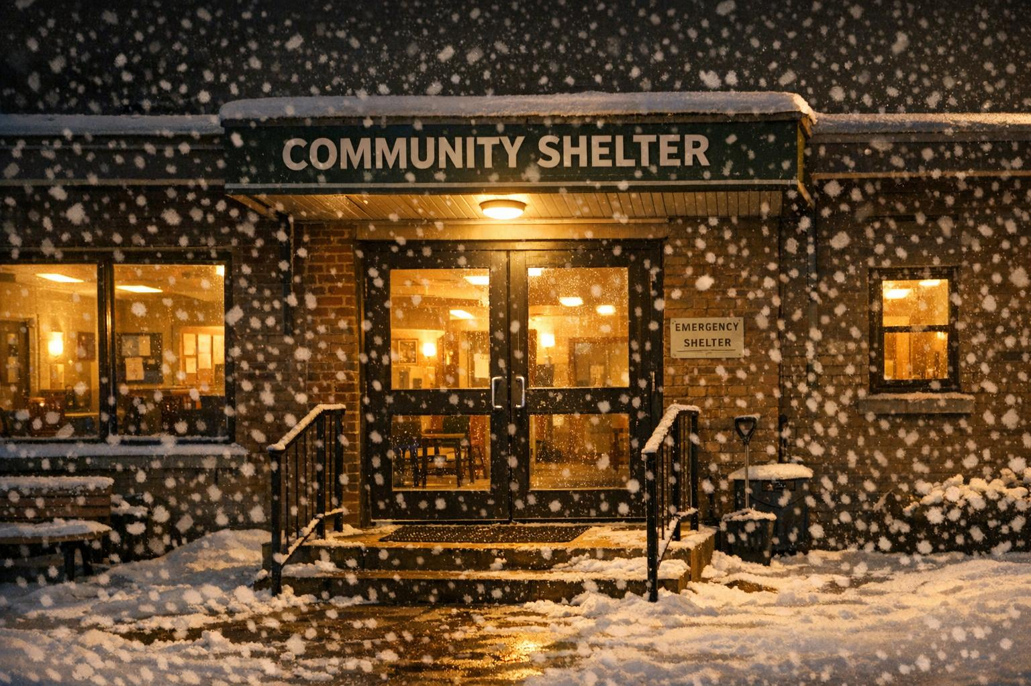
HYPOTHERMIA RESPONSE
Open doors when D.C. needs them most
Designated hypothermia shelter
An official site under the D.C. hypothermia alert system from November through March.
Extended hours
Shelter hours stretch beyond overnight when D.C. issues special weather alerts.
Surge capacity
Nov – Mar · +150 emergency beds
Surge capacity activates when the District issues weather alerts.
The building was designed so additional emergency beds can be stood up quickly.
Catholic Charities of the Archdiocese of Washington | 801 East Men's Shelter
11 / 15
Notes:
Hypothermia season is the most life-critical period of our calendar. Between November and March, 801 East functions as a designated hypothermia shelter, adding up to 150 emergency beds and extending hours during alerts. Staff coordinate closely with D.C. government on activations.

Slide 12
DESIGN PHILOSOPHY
A beacon of hope, by design
“This is going to demonstrate smaller, dignified, better services. People can get back on their feet and get the housing and the second chances that they deserve.”
— Mayor Muriel Bowser, January 2022 ribbon-cutting
AWARD
AWARD
AWARD
USGBC National Capital Region
ABC Excellence in Construction
AIA Potomac Valley Merit Award
Catholic Charities of the Archdiocese of Washington | 801 East Men's Shelter
12 / 15
Notes:
Take a moment to talk about design as dignity. The architects designed illuminated stair towers as 'beacons of hope' visible across the campus. Local artists were commissioned for interior common areas. The building has received multiple regional awards for architecture and construction, and it has been featured at the Living Futures and Greenbuild conferences.

Slide 13

PARTNERS
Built and operated together
OPERATOR
FUNDER
Catholic Charities of the Archdiocese of Washington
D.C. Department of Human Services
DEVELOPER
ARCHITECT
D.C. Department of General Services
Wiencek + Associates Architects + Planners
CONSTRUCTION
WORKFORCE
Coakley & Williams + Blue Skye (Design-Build)
Goodfellas Team — former residents hired to build the new shelter
Catholic Charities of the Archdiocese of Washington | 801 East Men's Shelter
13 / 15
Notes:
Recognize the public-private partnership that made the shelter possible. The District funded and developed the project; Catholic Charities operates the shelter day-to-day. Architects and contractors collaborated closely with current and former residents on design. The Goodfellas Team — men who lived in the previous shelter — were hired and trained to help build the new one, a powerful story to share.

Slide 14
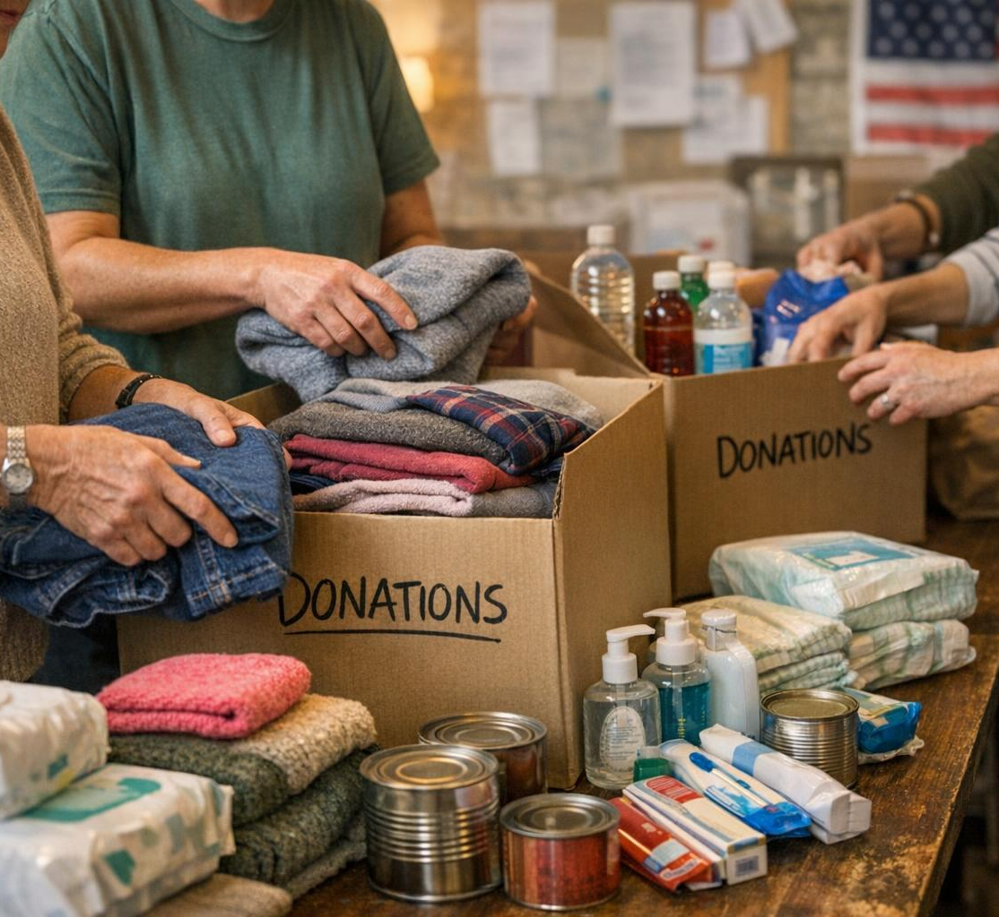
GET INVOLVED
Three ways to make a difference
01
VOLUNTEER
Help serve meals, sort donations, and support special events at 801 East.
volunteer@cc-dc.org
02
DONATE
Fund meals, case management, and housing supports for the men we serve.
catholiccharitiesdc.org/donate
03
PARTNER
Employers and congregations can sponsor work beds or host hiring days.
Connect with our development team
Catholic Charities of the Archdiocese of Washington | 801 East Men's Shelter
14 / 15
Notes:
Close the substantive content with concrete actions. Volunteer roles range from one-time meal service to ongoing case-management support. Financial gifts directly fund shelter operations. Partner organizations can sponsor work-bed slots, host hiring events, or contribute in-kind goods such as clothing for the boutique.

Slide 15

THANK YOU
Help us help those in need.
ADDRESS
PROGRAM LINE
D.C. SHELTER HOTLINE
ONLINE
801 East Building
2700 Martin Luther King Jr. Ave. SE
Washington, DC 20032
(202) 561-4014
1-800-535-7252
catholiccharitiesdc.org
Catholic Charities of the Archdiocese of Washington
Catholic Charities of the Archdiocese of Washington | 801 East Men's Shelter
15 / 15
Notes:
Close with gratitude and clear paths to engage. The shelter program line connects callers to staff during business hours. The D.C. Shelter Hotline is the right number for anyone needing a bed tonight or anyone trying to refer a client. Encourage attendees to follow up with the volunteer manager at volunteer@cc-dc.org.

