Slide 1
Peer Case Managers: Enhancing Collaboration and Coordination in Care
Improving healthcare outcomes through teamwork and management
Notes:
---
This presentation explores the important role of peer case managers in healthcare. We will examine how they enhance collaboration and coordination, improving care outcomes for clients through effective teamwork and strategic management.

Slide 2
Agenda Highlights
Understanding the Role of Peer Case Managers
Importance of Collaboration in Peer Case Management
Coordination Strategies for Peer Case Managers
Challenges and Best Practices in Collaboration and Coordination
Notes:
We will cover the role and responsibilities of peer case managers, the significance of collaboration, strategies for coordination, and the challenges along with best practices in the field.

Slide 3
Understanding the Role of Peer Case Managers
Notes:
Peer case managers bring unique perspectives and skills rooted in lived experience. This section will define their role and highlight how they differ from traditional case managers.

Slide 4

Definition and Key Responsibilities
Support and Advocacy
  Peer case managers use their recovery experience to provide empathetic support and advocate for clients' needs effectively.
Care Planning
  They are responsible for creating and managing personalized care plans that address each client's unique needs.
Client Engagement
  Engaging clients actively to build trust and facilitate progress in their recovery journey is a core responsibility.
Resource Linkage
  Connecting clients with community resources and services supports their recovery and overall well-being.
Notes:
---
Peer case managers provide support, advocacy, and guidance to clients by leveraging their own recovery experience. Their responsibilities include care planning, client engagement, and resource linkage.
Image source: Microsoft 365 content library

Slide 5
Differences From Traditional Case Managers
Empathy Through Shared Experience
Peer case managers build empathy by sharing similar experiences with clients, creating stronger emotional connections.
Enhanced Client Trust
Trust is fostered when clients relate to case managers who understand their challenges firsthand.
Improved Client Engagement
Peer support motivates clients to actively participate in their care and recovery process.
Notes:
---
Unlike traditional case managers, peer case managers foster empathy and trust through shared experiences, enhancing client rapport and motivation to engage in care.
Image source: Microsoft 365 content library

Slide 6
Importance of Collaboration in Peer Case Management
Notes:
Collaboration is essential for delivering holistic care. This section focuses on building teams, establishing rapport, and sharing resources effectively among stakeholders.

Slide 7

Building Effective Interdisciplinary Teams
Interdisciplinary Collaboration
  Effective case management depends on collaboration among professionals from diverse disciplines.
Comprehensive Client Care
  Diverse expertise ensures holistic and comprehensive care tailored to client needs.
Shared Decision-Making
  Teams promote shared decision-making to improve outcomes and client engagement.
Notes:
---
Successful peer case management relies on interdisciplinary teams where diverse expertise supports comprehensive client care and promotes shared decision-making.
Image source: Microsoft 365 content library

Slide 8

Establishing Trust and Rapport with Clients
Building Trust
  Peer case managers develop trust to foster client engagement and openness for effective care.
Enhancing Client Engagement
  Strong rapport encourages clients to actively participate in their care process.
Improving Care Outcomes
  Trusting relationships lead to better health results and client satisfaction.
Notes:
---
Peer case managers excel in creating trusting relationships with clients, which increases engagement, openness, and ultimately better care outcomes.
Image source: Microsoft 365 content library

Slide 9
Facilitating Resource Sharing Among Stakeholders
Enhanced Service Accessibility
Sharing resources among stakeholders improves access to services for clients in a timely manner.
Improved Efficiency
Coordinated resource sharing streamlines processes and increases operational efficiency among stakeholders.
Timely Client Support
Effective collaboration ensures clients receive appropriate support without delays or gaps.
Notes:
---
Coordinated sharing of resources enhances service accessibility and efficiency, ensuring clients receive timely and appropriate support.
Image source: Microsoft 365 content library

Slide 10
Coordination Strategies for Peer Case Managers
Notes:
Effective coordination supports smooth care transitions and communication. This section outlines practical strategies used by peer case managers.

Slide 11
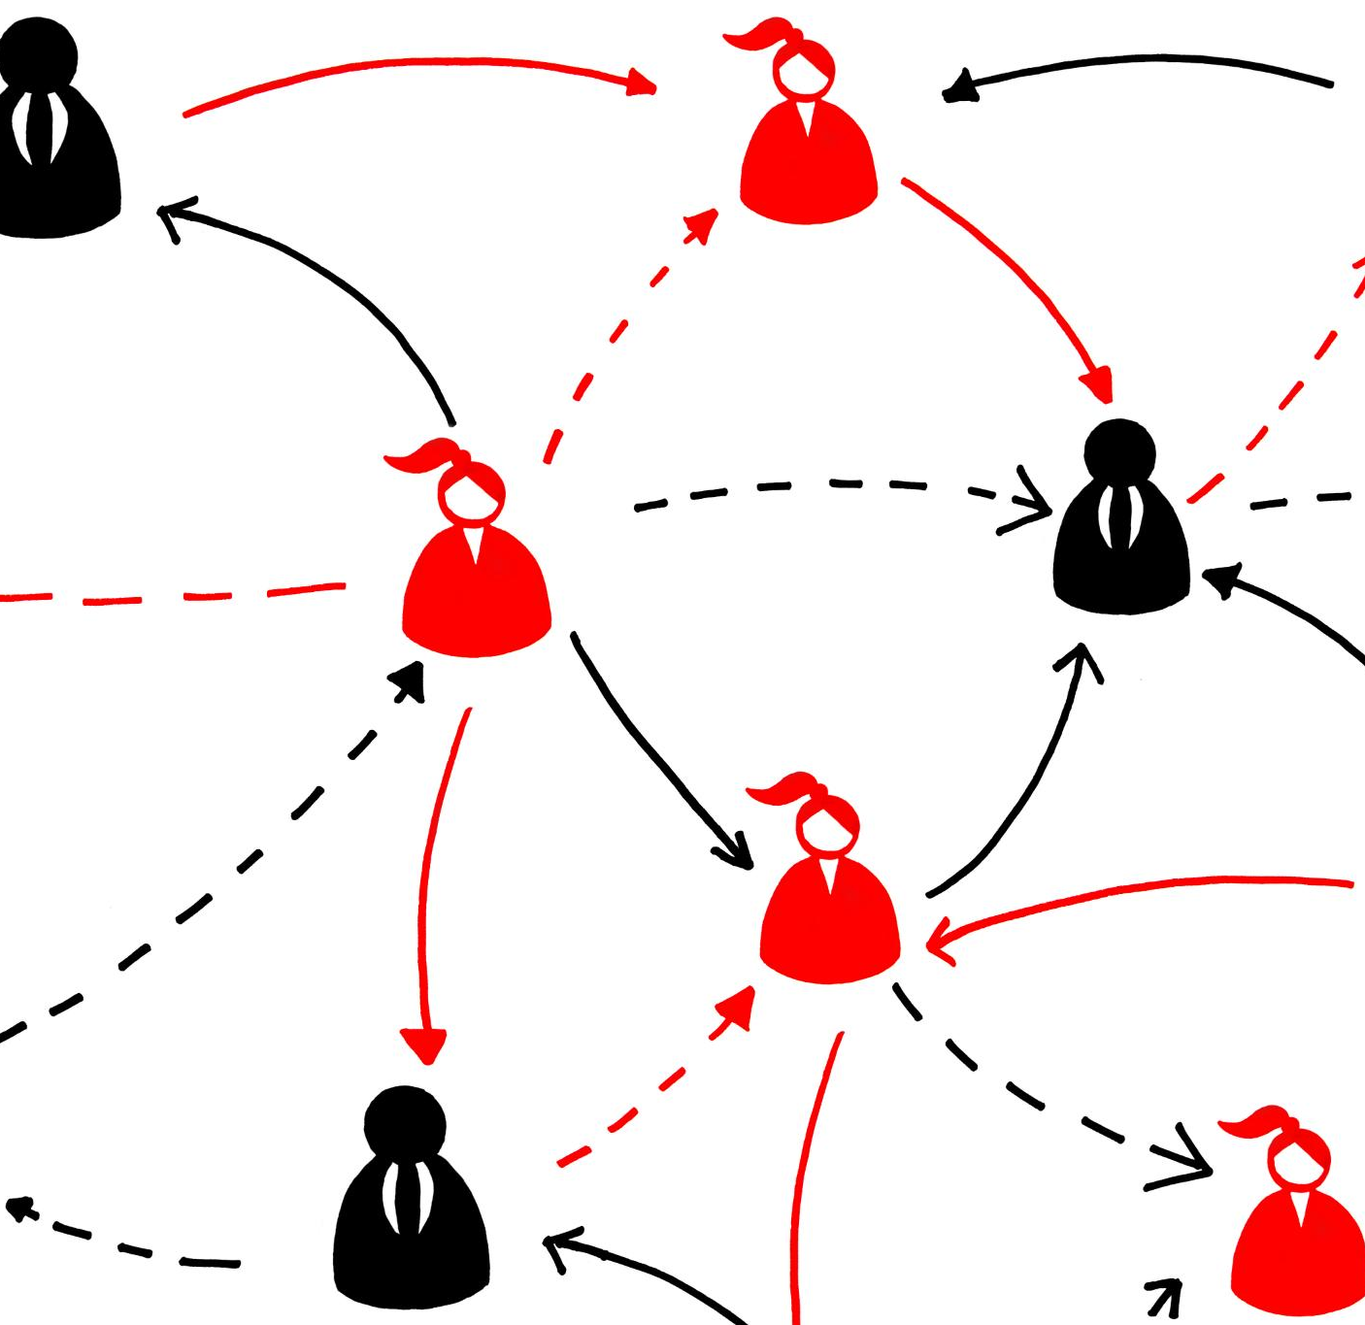
Streamlining Communication Channels
Clear Communication Importance
  Clear communication avoids misunderstandings and ensures everyone is on the same page.
Consistent Messaging
  Consistent communication promotes trust and smooth coordination among teams and clients.
Notes:
---
Clear and consistent communication among team members and clients prevents gaps in care and promotes shared understanding.
Image source: Microsoft 365 content library

Slide 12

Managing Care Transitions and Referrals
Seamless Care Transitions
  Peer case managers help ensure smooth transitions between different healthcare settings for patients.
Timely Appropriate Referrals
  Referrals made by case managers are timely and suitable to meet individual client healthcare needs.
Notes:
---
Peer case managers facilitate seamless transitions between care settings and ensure referrals are appropriate and timely to meet client needs.
Image source: Microsoft 365 content library

Slide 13

Ensuring Continuity of Care
Ongoing Support Importance
  Continuous support ensures client needs are consistently met over time, improving care outcomes.
Monitoring Client Needs
  Regular monitoring allows timely adjustments to care plans based on changing client conditions.
Preventing Care Disruptions
  Maintaining seamless care flow avoids interruptions that could negatively affect client health.
Notes:
---
Maintaining ongoing support and monitoring helps address changing client needs and prevents care disruptions.
Image source: Microsoft 365 content library

Slide 14
Challenges and Best Practices in Collaboration and Coordination
Notes:
This section discusses common barriers peer case managers face and highlights best practices to optimize collaboration and coordination.

Slide 15

Overcoming Barriers to Teamwork
Role Clarity
  Clear definition of roles helps prevent misunderstandings and improves team efficiency.
Effective Communication
  Bridging communication gaps is essential for smooth teamwork and project success.
Mutual Respect
  Fostering respect among team members builds trust and collaboration.
Training and Protocols
  Training and clear protocols equip teams to handle challenges effectively.
Notes:
---
Challenges such as role misunderstandings and communication gaps can be mitigated through training, clear protocols, and fostering mutual respect.
Image source: Microsoft 365 content library

Slide 16

Utilizing Technology for Enhanced Coordination
Shared Digital Records
  Shared digital records enable seamless access to patient information among care team members, enhancing collaboration.
Communication Platforms
  Communication platforms facilitate real-time messaging and updates, improving coordination and decision-making within care teams.
Notes:
---
Technology tools like shared records and communication platforms improve information flow and coordination efficiency among care teams.
Image source: Microsoft 365 content library

Slide 17

Promoting Ongoing Professional Development
Continuous Education Importance
  Ongoing learning helps professionals update their skills and stay current with industry standards.
Peer Support Benefits
  Collaboration among peers enhances knowledge sharing and fosters professional growth.
Staying Informed of Best Practices
  Regular updates ensure case managers apply the most effective methods in their work.
Notes:
---
Continuous education and peer support strengthen skills, enhance collaboration, and keep peer case managers informed of best practices.
Image source: Microsoft 365 content library

Slide 18
Conclusion
Role of Peer Case Managers
Peer case managers improve care by fostering collaboration and coordination among care providers.
Embracing Best Practices
Adopting best practices helps overcome challenges and enhances client outcomes effectively.
Strengthening Care Teams
Strong care teams result from effective collaboration and improved coordination among members.
Notes:
Peer case managers play a vital role in improving care through collaboration and coordination. Embracing best practices and overcoming challenges can lead to better client outcomes and stronger care teams.

