Slide 1
WRAP Seminar I: Developing a Wellness Recovery Action Plan
Session VI
Crisis Planning

Slide 2
Crisis Planning
The next section of the WRAP is the Crisis Plan.
In spite of your best planning and assertive action, you may find yourself in a crisis situation where others will need to take over responsibility for your care.
You may feel as though you are totally out of control.
281

Slide 3
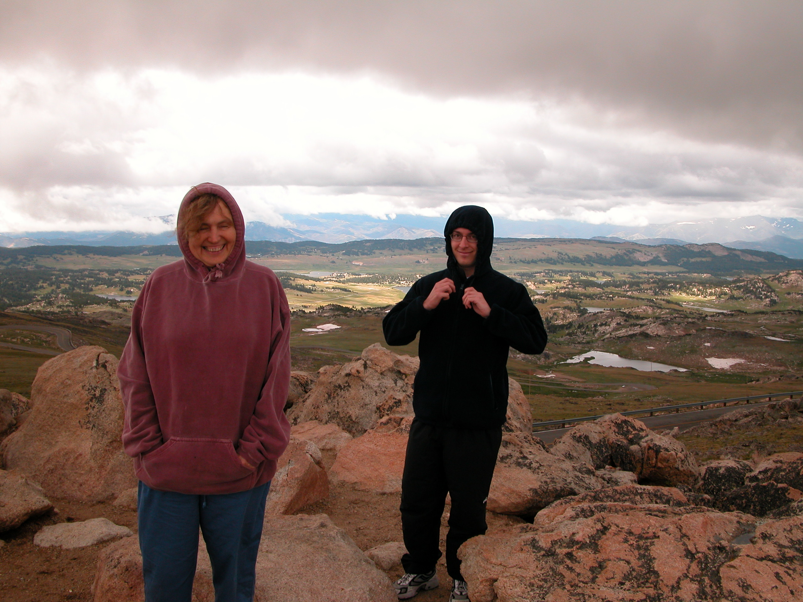
Crisis Planning
Write your Crisis Plan when you are well. Your plan will instruct others about how to care for you when you are not well.
It keeps you in control even when it seems like things are out of control.
282

Slide 4
Crisis Planning
Others will know what to do, saving everyone time and frustration, while insuring that your needs will be met.
Develop this plan slowly when you are feeling well.
283

Slide 5
Crisis Planning
On the fifth tab write “Crisis Plan.” Insert quite a few sheets of lined paper or use a form.
This part of WRAP is different from other parts of the plan because you will give it to others so they have it when needed.
The Crisis Plan has 9 parts.
284

Slide 6
Crisis Planning
It Includes:
  What you are like when you are well
  Indicators that others need to “take over”
  Who “takes over” and who doesn’t
285

Slide 7
Crisis Planning
  Information on your Health Care Contacts and Medications
  Acceptable and Unacceptable Treatments
  Home/Community Care/Respite Plan
286

Slide 8
Crisis Planning
  Acceptable and Unacceptable Hospital Facilities
  Things others can do that would help
  Things other might do that would make you feel worse
287

Slide 9
Crisis Planning
  A list of chores and tasks for others
  Indicators that the plan is no longer needed
  Signatures of key people
288

Slide 10
Crisis Planning Part 1:
“What I’m Like When I’m
Feeling Well”
Describe what you are like when you are feeling well, as a reference point for people who may not have met you before.
(You can copy this from the first part of the first section of WRAP.)
289

Slide 11
Crisis Planning Part 1:
“What I’m Like When I’m Feeling Well”
Examples:
Bright Industrious
Outgoing Withdrawn
Humorous Active
Athletic Talkative
Reasonable Energetic
Responsible Dramatic
290

Slide 12
Crisis Planning Part 1:
“What I’m Like When I’m Feeling Well”
Examples:
Introverted Content
Compulsive Calm
Cheerful Quiet
Boisterous Reserved
Happy Curious
Optimistic Competent
291

Slide 13

Crisis Planning Part 2: Signs that Supporters Need to Take Over
List those signs that indicate to others that they need to take over responsibility for your care and make decisions on your behalf.
292

Slide 14
Crisis Planning Part 2: Signs that Supporters Need to Take Over
Examples:
  Uncontrollable pacing, unable to stay still
  Inability to stop compulsive behaviors
  Catatonic/unmoving for long periods of time
  Neglecting personal hygiene (# of days?)
  Not cooking or doing any housework (days?)
293

Slide 15
Crisis Planning Part 2: Signs that Supporters Need to Take Over
Examples:
  Not understanding what people are saying
  Self destructive, abusive or violent behavior
  Criminal activities
  Destroying property
  Substance abuse
  Threatening suicide or acting suicidal
  Not getting out of bed at all, refusing to eat
294

Slide 16
Crisis Planning Part 3: Supporters
List at least 5 people you want to take over for you. You can include family members, friends and/or care providers.
Ask the people you choose if it is OK for you to include them on this list.
Tell them what would be involved. Show them a copy of your plan.
295

Slide 17
Crisis Planning Part 3: Supporters
If they say they can do it, GREAT! If not, they can still be a good friend.
Peers often provide this support for each other.
You may want to set up a meeting with your supporters so they know each other and to discuss your plan.
296

Slide 18
Crisis Planning Part 3: Supporters
Include a list of people you do not want to be involved in decision making or care.
You can also write why you do not want them involved.
Also describe how you want supporters to settle disputes if they disagree.
297

Slide 19
Crisis Planning Part 4: Medication
Provide the following information:
  Names and Phone Numbers of your Physician and Pharmacy
  Your Insurance Company Name, Phone Number, and ID Numbers
  All Allergies
  Medications and Health Care preparations you are currently using, why you are using them, dosage and when you take them
298

Slide 20
Crisis Planning Part 4: Medication
Medications you would prefer to use if medications (or additional medications) become necessary and why you would choose them
Medications that would be acceptable to you if medications became necessary, and why you would choose them
Medications that should be avoided and why
299

Slide 21
Crisis Planning Part 5: Treatments
List those treatments you would like and those that you would want to avoid.
Include “alternative” therapies that have helped as well as those that have not been helpful.
300

Slide 22
Crisis Planning Part 6:
Home/Community Care/
Respite Center
Hospitalization is often not the best option.
Develop a carefully devised plan so that you can stay at home or in the community and still get the care you need.
In order to do this, find out what resources are available in your community.
301

Slide 23

Crisis Planning Part 7: Treatment Facilities
List those treatment facilities where you would prefer to be hospitalized if that became necessary, and those you wish to avoid.
302

Slide 24
Peer Support
Peer Support may be hard for you if you have difficulty trusting others.
To overcome this, you may need to decide that Peer Support is a risk you are willing to take.
400

Slide 25
Peer Support
Begin by taking very small steps, gradually expanding your circle of Peer Supporters:
  Start by sharing more openly with one person you know very well.
  When you feel ready, choose another person with whom you are willing to share.
401

Slide 26
Peer Support
  A next step might be going to a peer center or support group.
  Gradually share more openly with people in the group.
  If you become uncomfortable with a person or a group, choose others to be your Peer Supporters.
402

Slide 27
Peer Support & Communication
Using “I” statements can be helpful.
Talk about what is true for you without assuming anything about the other person.
403

Slide 28

Peer Support & Communication
If you want to know how the other person feels or what they want, ask them.
404

Slide 29
Peer Support & Communication
Examples of “I” Statements:
  I feel scared.
  I feel lonely.
  I feel anxious.
405

Slide 30
Peer Support & Communication
  I feel great.
  I am going to change jobs.
406

Slide 31
Peer Support & Communication
  I want to know how you feel.
  I am going to spend the evening alone.
  I would like to pay for your lunch.
407

Slide 32
Peer Support & Communication
  I care about you.
  List other possible “I” statements.
408

Slide 33
Peer Support & Communication
Listening Guidelines
Listen closely to what the other person is saying.
Let the other person know you are paying close attention through eye contact, body language, and occasional brief comments.
409

Slide 34
Peer Support & Communication
Avoid thinking about what your response is going
to be while the person is talking.
410

Slide 35
Peer Support & Communication
If a person is sharing something intense and personal, don’t do something else at the same time that would be distracting, or share an “I can top that” story.
Don’t interrupt others when they are speaking.
411

Slide 36
Peer Support & Communication
Be realistic about how much time you can spend listening, and let the other person know when you begin talking how much time you have.
Avoid giving others advice unless they ask for it – Just Listen.
412

Slide 37
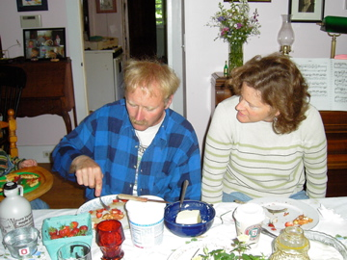
Peer Support & Communication
What the other person is saying may be important to them even if it doesn’t seem important to you.
413

Slide 38
Peer Support & Communication
414
Others may need to share the details of hard times or difficult experiences over and over until they have “gotten it out of their system”.
You can help by listening to the same story again and again, reassuring them by telling them it is OK to do this.

Slide 39
Peer Support & Communication
Let the other person know if you are uncomfortable with what they are sharing.
How would you like to be supported if you were having a hard time in a crisis?
415

Slide 40
Peer Support & Communication
Would you be able to accept unusual behavior if it was helpful to the other person and not hurting anyone?
Would you be able to accept the other person’s reality, even if it was different from yours?
416

Slide 41
Peer Support & Communication
What are some helpful things a peer could say to you when you are having a hard time?
(“How can I help you?”, “What happened?”, or “What do you need?”)
417

Slide 42
Peer Support & Communication
What are some things that a supporter might do that would not be helpful?
(asking the person if they have taken their medications, telling them to stay still, sit down or quiet down, threatening them, diagnosing them)
418

Slide 43
Peer Support & Communication
Do you think you could support someone who was having a very hard time?
419

Slide 44
Peer Support & Boundaries
Boundaries, or limits, are personal rules (often unspoken) that you and others have about things like:
  The amount of time spent together
  Where time is spent
  Time and quantity of phone calls
420

Slide 45
Peer Support & Boundaries
  Amount of support given
  Advice
  Connection with family
  Amount of physical touch
  Spending time together during hard times or
  a crisis
421

Slide 46
Peer Support & Boundaries
Can you think of anything else you might need to set boundaries around in a Peer Support relationship?
422

Slide 47

Peer Support & Boundaries
To keep your Peer Support relationships strong, understand and respect each other’s boundaries.
423

Slide 48
Peer Support & Boundaries
Feelings inside yourself will tell you what kind of boundaries you need and want with others.
You may have different boundaries with different people.
424

Slide 49

Peer Support & Boundaries
Body language gives you clues about a person’s boundaries.
425

Slide 50
Peer Support & Boundaries
It can tell you things like:
  Do or don’t come any closer to me
  Do or don’t touch me
  Do or don’t talk to me
  Do or don’t disturb me
  Do or don’t share a deeper level of intimacy with me
426

Slide 51
Peer Support & Boundaries
Sometimes you may not be able to say what it is about the body language that gives you a message.
427

Slide 52
Peer Support & Boundaries
It is not necessary to put the feelings into words or to take action based on your feelings.
428

Slide 53
Peer Support & Relationship “Spoilers”
  Sarcasm, put downs
  Dragging up the past
  Labels
  Negative comparisons, badmouthing others
429

Slide 54
Peer Support & Relationship “Spoilers”
  Threats, taunting, ridicule
  Judgmental “You” messages
  Rudeness
  Breaking confidentiality
  One person doing all the talking
430

Slide 55
Peer Support & Relationship “Spoilers”
  Violation of boundaries
  “Know it all” behavior
  Wanting you to be only their friend
  Flirting with your partner
431

Slide 56
Peer Support & Relationship “Spoilers”
  Controlling behavior
  Not wanting to be seen with you in public places
  Clinging or very needy behavior
  Inappropriate sexual talk
432

Slide 57
Peer Support
You may be able to resolve difficult issues with a Peer Supporter by:
  Doing a Reality Check –
  Asking yourself what is really happening and deciding on solutions that will work for both of you.
433

Slide 58
Peer Support
  Talking to the other person using “I” statements.
  Working together to develop a plan for resolving the situation that includes the steps each of you are going to take and when you are going to take them.
  Being clear about comfort levels and boundaries.
434

Slide 59

Peer Support
  Discussing the situation with supporters like friends and counselors.
435

Slide 60
Peer Support
If Peer Supporters are coming to your home, make them feel welcome and comfortable by:
  Focusing your full attention on them.
  Turning off the television, radio, or music when you are sharing or involved in an activity together, or have quiet music playing in the background.
436

Slide 61
Peer Support
  Ask other family members to be friendly and welcoming but not too intrusive.
  Avoid discussion of personal matters with family members while friends are there.
437

Slide 62

Peer Support
  Reduce distractions by turning off your phone and letting the answering machine pick up the messages.
438

Slide 63
Peer Support
  It’s always nice to pick up clutter before friends arrive.
  If friends arrive before you have had a chance to do that, or if they stop by unexpectedly, don’t apologize and don’t worry about it.
  Enjoy their visit!
439

