Slide 1
WRAP Seminar I: Developing a Wellness Recovery Action Plan
Session I
Introduction to Key Concepts
&
WRAP

Slide 2


Mental Health Recovery
Including:
Wellness Recovery Action Planning®
WRAP®
Mary Ellen Copeland, PhD

Slide 3
There are Four Parts to the study of Mental Health Recovery:
1. Key Recovery Concepts…
    Hope
    Personal Responsibility
    Education
    Self Advocacy
    Support
  …and Issues That Need Attention:
    Getting Good Health Care
    Medication Management
2
Notes:
3

Slide 4
There are Four Parts to the study of Mental Health Recovery:
2. Wellness Toolbox
3. Wellness Recovery Action Planning
4. Recovery Topics:
  Building Self-Esteem
  Changing Negative Thoughts to Positive Ones
  Peer Support
  Work Related Issues
  Trauma Recovery
  Suicide Prevention
3

Slide 5
Mental Health Recovery
Additional Issues:
      Living Space
      Lifestyle
      Motivation
This workshop and the concepts, skills and strategies you learn while in this workshop are complementary to your health care treatment program.
They are not a replacement for your treatment program.
4

Slide 6
Mental Health Recovery
Never stop taking medications without careful consideration and without getting the advice of your physician and other supporters.
Never abruptly stop taking any medication. There are protocols which must be followed for safely stopping or changing medications.
5

Slide 7

Key Recovery Concepts
Hope
Personal Responsibility
Education
Self-Advocacy
Support
6

Slide 8
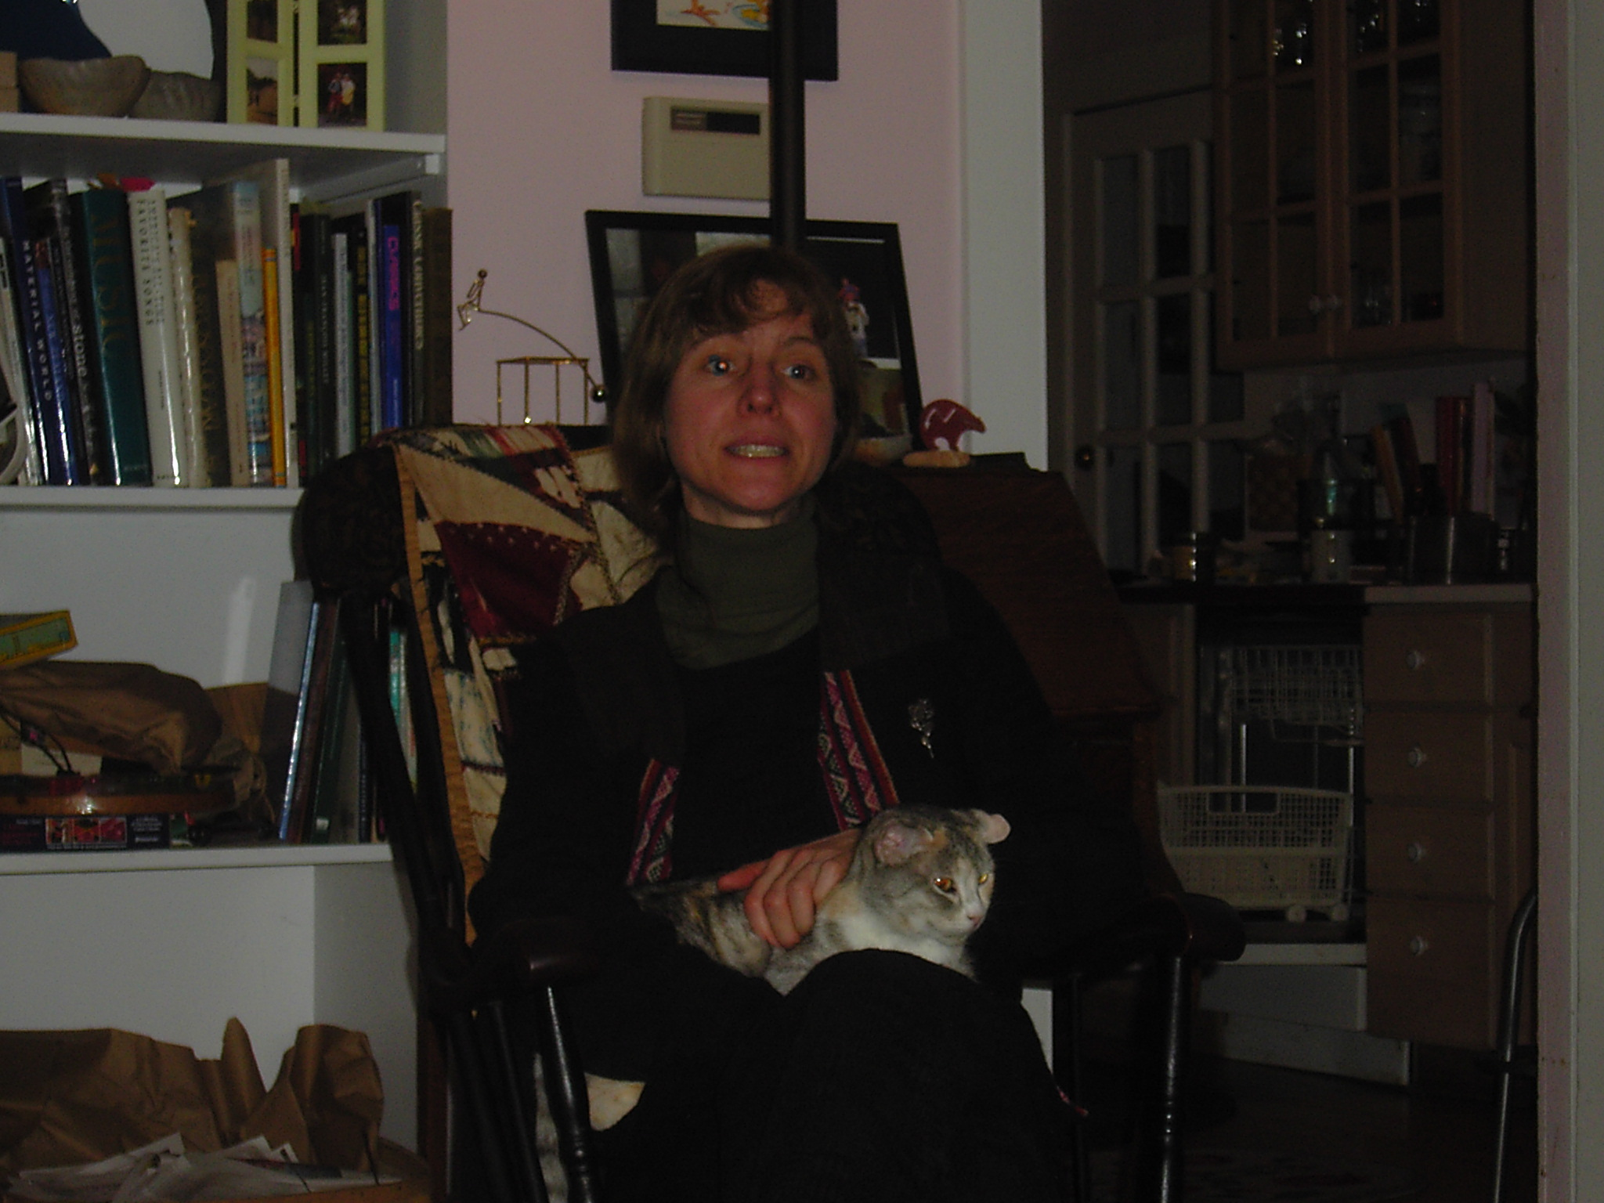
There is Much to Hope For!
You can get well and stay well for long periods of time!
7

Slide 9
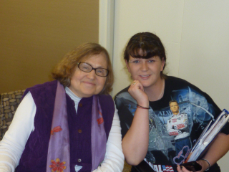
There is Much to Hope For!
You can work toward and meet your goals!
You can lead a happy and productive life!
8

Slide 10

There is Much to Hope For!
You don’t need, nor will you benefit from, dire predictions about your future.
9

Slide 11
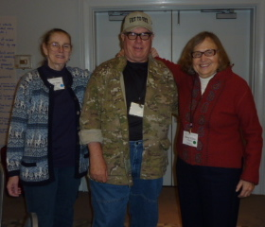
There is Much to Hope For!
Your supporters and care providers need to:
encourage you,
help you to feel better,
assist and support you
in staying well.
10

Slide 12
Personal Responsibility
You are the expert on yourself!
You know what you want and need!
It is up to you to take personal responsibility for your own wellness and your own life!
11

Slide 13
Personal Responsibility
Sometimes this means taking back control that you have lost in the past.
Those of us who take back this responsibility achieve the highest levels of:
Wellness, Happiness, and Life Satisfaction.
12

Slide 14
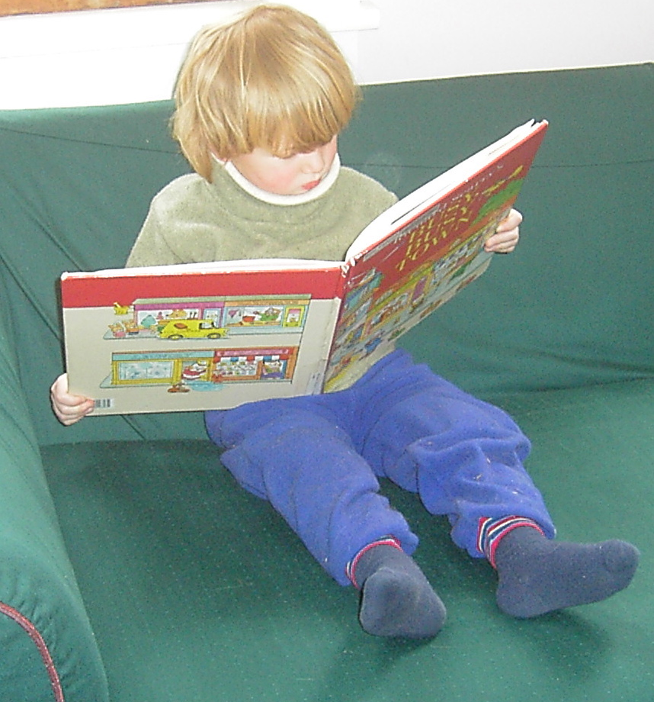
Education
Learn all you can about yourself so you can make good decisions about:
                Treatment
                Lifestyle
                Career
                Relationships
                Living Space
                Leisure Time Activities
                All Aspects of Your Life
13

Slide 15
Education
You can educate yourself by:
  Attending workshops, lectures and support groups
  Reviewing educational resources (articles, books, newsletters, CDs and DVDs)
  Contacting mental health organizations
14

Slide 16
Education
  Talking to others who have similar experiences and to those who have expertise in this field
  Checking mental health sites on the Internet
  Considering all perspectives and deciding which ones feel right to you
15

Slide 17
Education
Go to www.mentalhealthrecovery.com
for free educational articles and information, lists of resources and organizations, recovery stories, and mental health recovery and WRAP resources you can purchase including books, CDs and DVDs.
16

Slide 18
Self-Advocacy
Become a strong advocate for yourself.
This means:
  “Going for it” with courage, persistence and determination;
  expressing yourself clearly and calmly until you get what you need for yourself.
17

Slide 19
Personal Bill of Rights
1. I have the right to ask for what I want.
2. I have the right to say no to
requests or demands I cannot meet.
3. I have the right to change my mind.
4. I have the right to make mistakes and don’t have to be perfect.
20

Slide 20
Personal Bill of Rights
5. I have the right to follow my own values
and standards.
6. I have the right to express all of my feelings,
both positive and negative, in a manner that
will not harm others.
7. I have the right to say no to anything when I
feel I am not ready, it is unsafe, or it violates
my values.
21

Slide 21
Personal Bill of Rights
8. I have the right to determine my own priorities.
9. I have the right not to be responsible for others’
behavior, actions, feelings or problems.
10. I have the right to expect honesty from others.
22

Slide 22
Personal Bill of Rights
I have the right to feel angry and to express my anger in a responsible manner.
12. I have the right to be uniquely myself.
13. I have the right to feel scared and say, “I’m afraid.”
14. I have the right to say, “I don’t know.”
23

Slide 23
Personal Bill of Rights
15. I have the right to make decisions based on my feelings, beliefs and values.
16. I have the right to my own reality.
17. I have the right to my own need for personal space and time.
18. I have the right to be playful and frivolous.
24

Slide 24
Personal Bill of Rights
19. I have the right to be healthy.
20. I have the right to be in a non-abusive environment.
21. I have the right to change and grow.
22. I have the right to be treated with dignity and respect.
25

Slide 25
Personal Bill of Rights
23. I have the right to have my needs and wants respected by others.
24. I have the right to a fulfilling sex life.
I have the right to be happy.
Adapted from the Anxiety and Phobia Workbook, Edmund J. Bourne, PhD., New Harbinger: Oakland, CA, 1990
26

Slide 26
Self-Advocacy
    Believe in yourself
    Know your rights and insist that they are respected (see the following Bill of Rights)
18

Slide 27
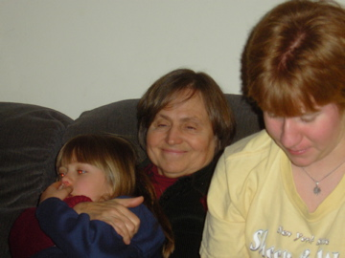
Developing & Keeping a Strong Support System
Support from family, friends, and care providers is definitely helpful. Being effectively supported will help you feel better and enrich your life.
You will benefit from having at least five good friends or supporters you can call on when you need or want …
27

Slide 28
Developing & Keeping a Strong Support System
  Someone to talk to
  Companionship
  To have a good time
  Help in figuring things out and making decisions
  Someone to take over for you and keep you safe when you can’t take care of yourself
28

Slide 29
Supporters Are People Who:
  Care about you
  Empathize with you
  Affirm and validate you and your experience
  Accept you as you are
  Listen to you and share with you
29

Slide 30
Supporters Are People Who:
  Advocate for you
  Enjoy sharing fun and interesting activities with you
  Make decisions for you when you can’t do this for yourself
  Are willing to follow your predetermined plans
30

Slide 31
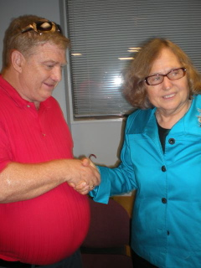
The most valuable thing a supporter can do for you (or you can do for them) is to
LISTEN
Supporters
31

Slide 32
A good supporter knows that unasked advice, criticism and judgments won’t help and will probably make the other person feel worse.
Supporters
32

Slide 33
You May Feel Isolated & Lonely.
Many People Do.
To change this you may need to make some changes in the way you do things.
33

Slide 34
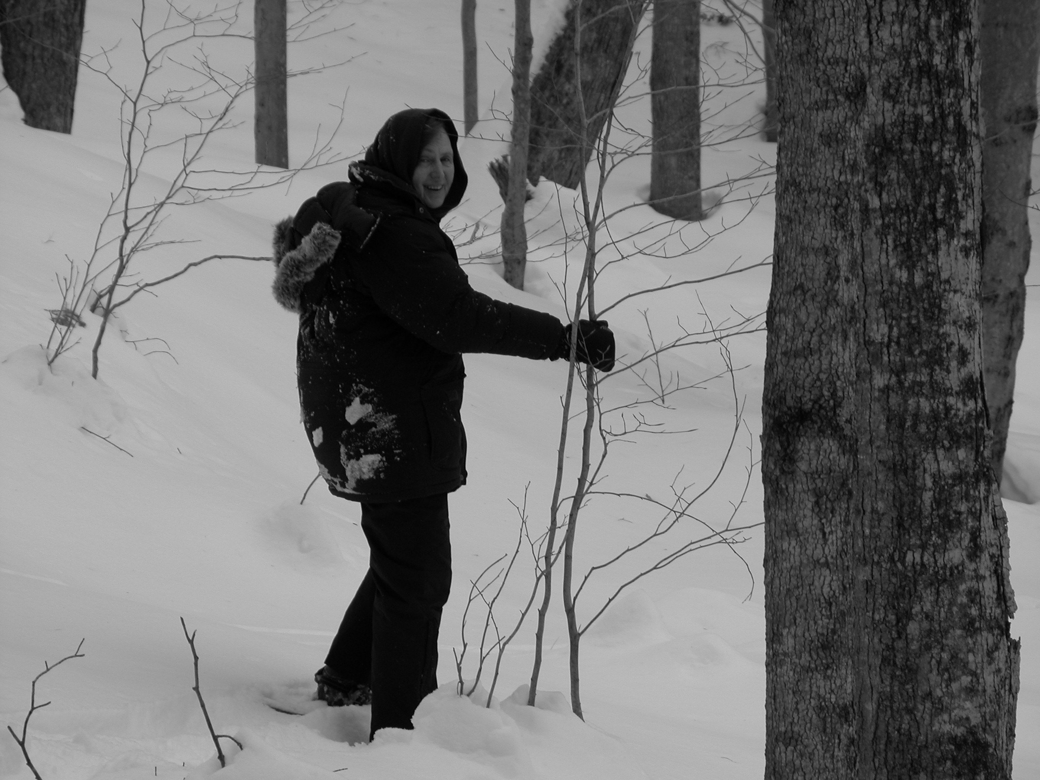
One reason that you may feel isolated and lonely is low self-esteem.
This may make you feel that others won’t like you. It can affect your ability to make and keep friends.
You May Feel Isolated & Lonely
34

Slide 35
You May Feel Isolated & Lonely
You can work on raising your self-esteem by understanding that you are a wonderful, unique, very special person who has a great deal of value.
35

Slide 36
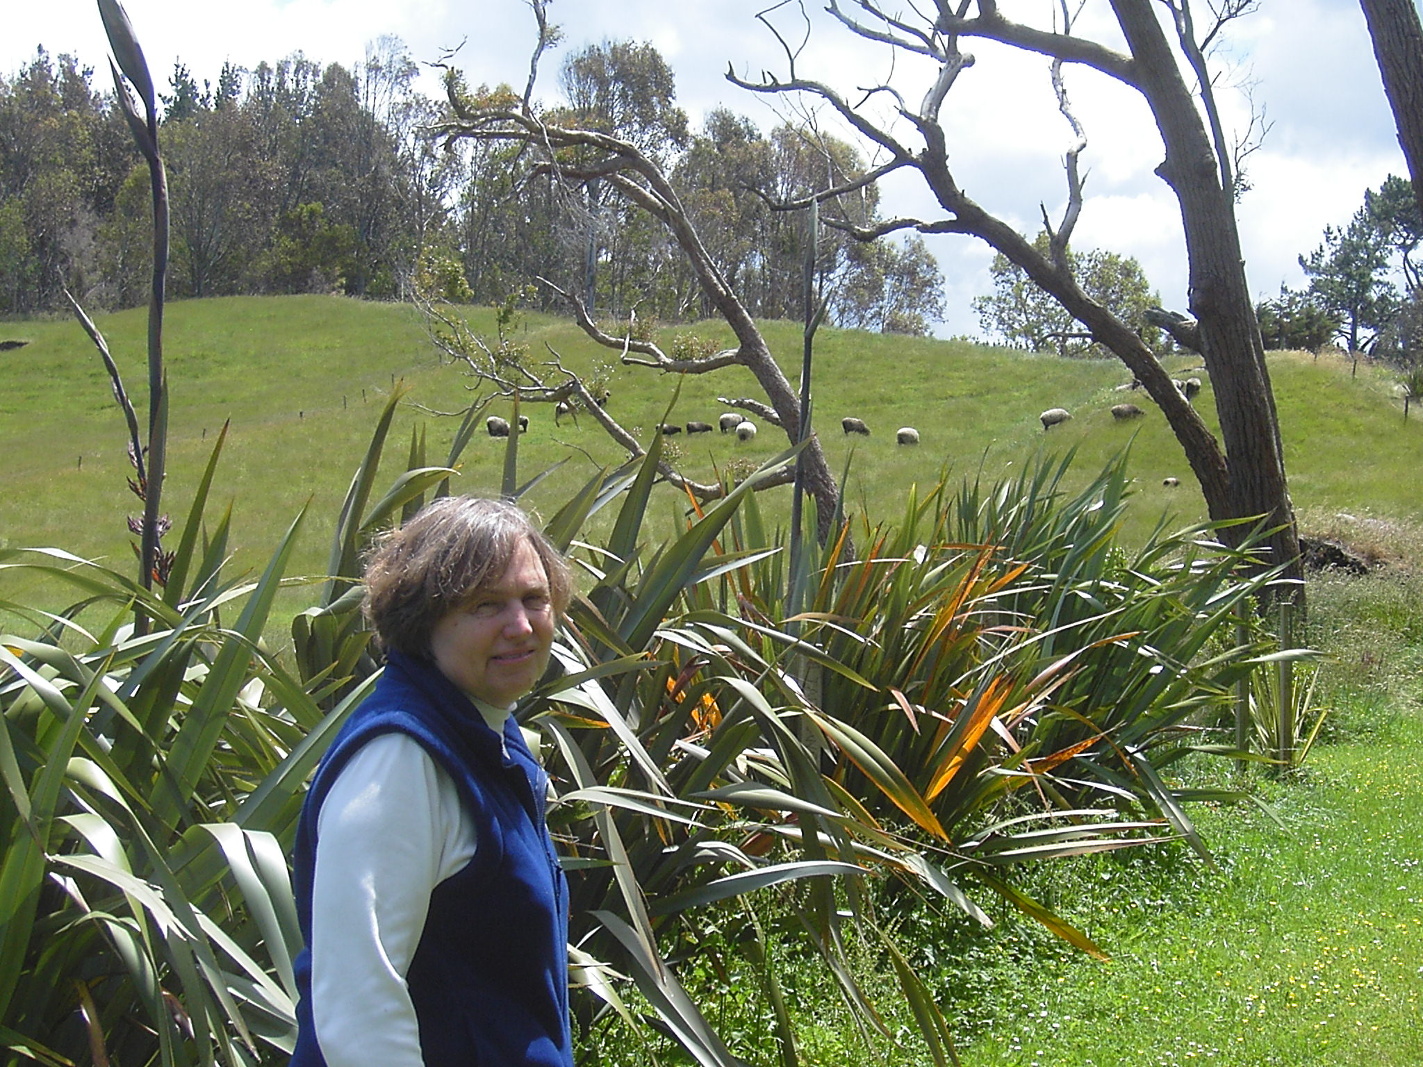
You can learn more about raising your self-esteem, changing negative thoughts about yourself to positive ones and activities to help you to feel better about yourself.
You May Feel Isolated & Lonely
36

Slide 37
You May Feel Isolated & Lonely
Self-help books, counseling, peer counseling, support groups, using a Wellness Recovery Action Plan® and taking steps toward your goals will help.
37

Slide 38
Another reason that you may feel isolated and lonely is because others choose to stay away from you because they feel that you are unreliable and unpredictable.
You May Feel Isolated & Lonely
38

Slide 39
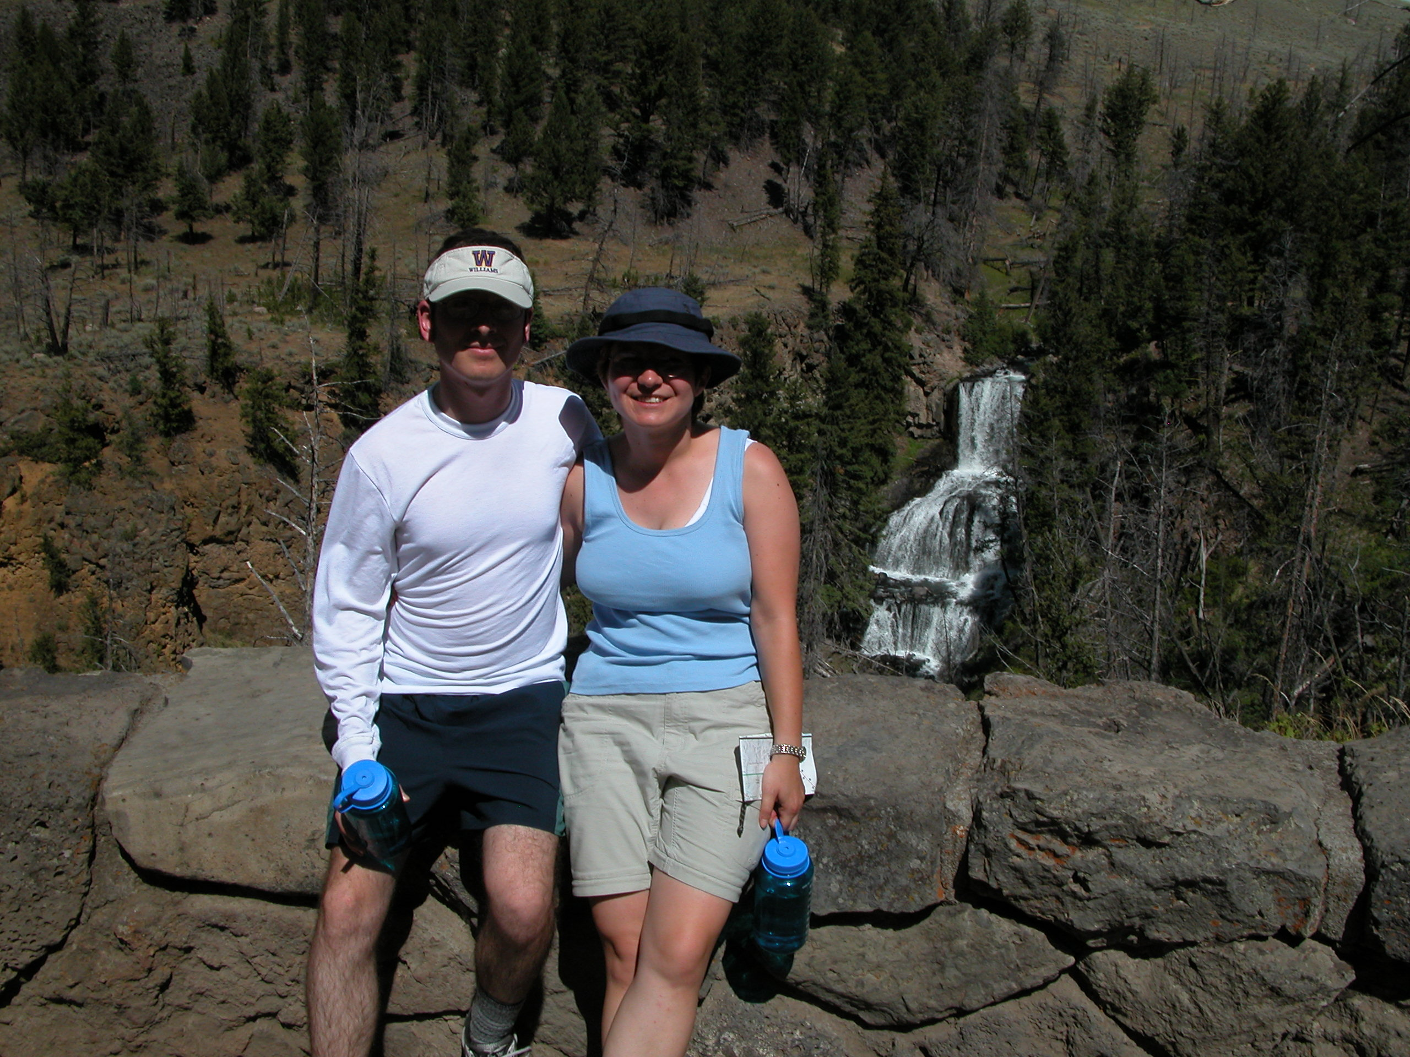
They are more likely to remain supportive if you are taking good care of yourself and doing those things you know you need to do to keep yourself well.
39

Slide 40
If you sometimes behave in ways that are uncomfortable or embarrassing to others, they may choose to stay away from you, worsening your feelings of loneliness.
You May Feel Isolated & Lonely
40

Slide 41
You may want to take a risk and ask your supporters if they notice things you do that may be “turning off” possible supporters. Then you can work on doing things differently.
You May Feel Isolated & Lonely
41

Slide 42
Counseling, peer counseling and self-help books can help you change your habits so that others will be more comfortable spending time with you.
You May Feel Isolated & Lonely
42

Slide 43
You may be isolated and lonely because others feel that you are too needy and dependent.
This could be “wearing them down” or making them feel overwhelmed.
43

Slide 44
It may be keeping them from doing the things they want to do. They may decide to stay away from you. It really hurts when this happens.
You May Feel Isolated & Lonely
44

Slide 45
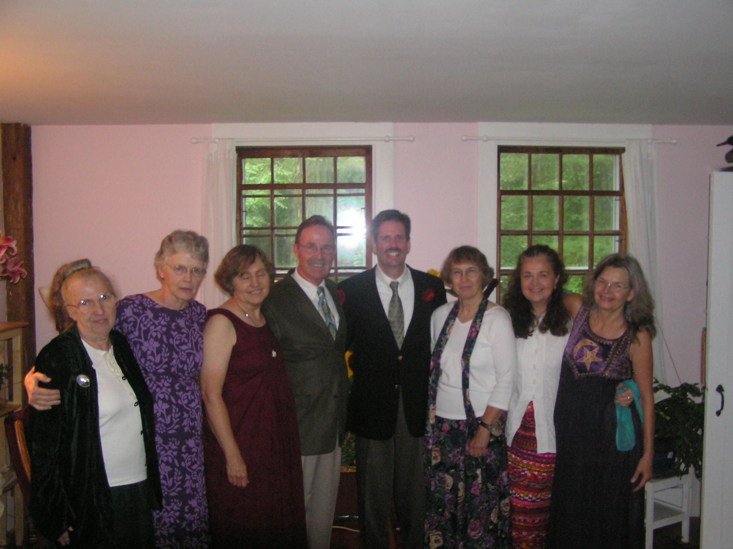
It will help if you have several friends, rather than just one or two people you depend on.
45

Slide 46
Avoid asking too much of any one person, taking up too much of their time, calling them too often, or insisting they spend time with you.
You May Feel Isolated & Lonely
46

Slide 47
Respect others’ boundaries.
If you have 5 supporters, no one gets worn out.
47

Slide 48
You May Feel Isolated & Lonely
Be sure you are supportive of your friends and supporters, giving them plenty of your help, time and attention.
Be there for them as much as they are there for you.
48

Slide 49
Five Steps in Developing a Strong Support System
Become an active member of a support group.
Support groups provide an opportunity to be with people who have similar problems – people who understand and can be mutually supportive.
49

Slide 50

They are a wonderful place to make new and lasting friendships. They counteract social isolation.
50

Slide 51
Developing & Keeping a Strong Support System
Support from family, friends, and care providers is definitely helpful. Being effectively supported will help you feel better and enrich your life.
You will benefit from having at least five good friends or supporters you can call on when you need or want …
27

Slide 52
Developing & Keeping a Strong Support System
  Someone to talk to
  Companionship
  To have a good time
  Help in figuring things out and making decisions
  Someone to take over for you and keep you safe when you can’t take care of yourself
28

Slide 53
Supporters Are People Who:
  Care about you
  Empathize with you
  Affirm and validate you and your experience
  Accept you as you are
  Listen to you and share with you
29

Slide 54
Supporters Are People Who:
  Advocate for you
  Enjoy sharing fun and interesting activities with you
  Make decisions for you when you can’t do this for yourself
  Are willing to follow your predetermined plans
30

Slide 55
The most valuable thing a supporter can do for you (or you can do for them) is to
LISTEN
Supporters
31

Slide 56
A good supporter knows that unasked advice, criticism and judgments won’t help and will probably make the other person feel worse.
Supporters
32

Slide 57
You May Feel Isolated & Lonely.
Many People Do.
To change this you may need to make some changes in the way you do things.
33

Slide 58
One reason that you may feel isolated and lonely is low self-esteem.
This may make you feel that others won’t like you. It can affect your ability to make and keep friends.
You May Feel Isolated & Lonely
34

Slide 59
You May Feel Isolated & Lonely
You can work on raising your self-esteem by understanding that you are a wonderful, unique, very special person who has a great deal of value.
35

Slide 60
You can learn more about raising your self-esteem, changing negative thoughts about yourself to positive ones and activities to help you to feel better about yourself.
You May Feel Isolated & Lonely
36

Slide 61
You May Feel Isolated & Lonely
Self-help books, counseling, peer counseling, support groups, using a Wellness Recovery Action Plan® and taking steps toward your goals will help.
37

Slide 62
Another reason that you may feel isolated and lonely is because others choose to stay away from you because they feel that you are unreliable and unpredictable.
You May Feel Isolated & Lonely
38

Slide 63
They are more likely to remain supportive if you are taking good care of yourself and doing those things you know you need to do to keep yourself well.
39

Slide 64
If you sometimes behave in ways that are uncomfortable or embarrassing to others, they may choose to stay away from you, worsening your feelings of loneliness.
You May Feel Isolated & Lonely
40

Slide 65
You may want to take a risk and ask your supporters if they notice things you do that may be “turning off” possible supporters. Then you can work on doing things differently.
You May Feel Isolated & Lonely
41

Slide 66
Counseling, peer counseling and self-help books can help you change your habits so that others will be more comfortable spending time with you.
You May Feel Isolated & Lonely
42

Slide 67
You may be isolated and lonely because others feel that you are too needy and dependent.
This could be “wearing them down” or making them feel overwhelmed.
43

Slide 68
It may be keeping them from doing the things they want to do. They may decide to stay away from you. It really hurts when this happens.
You May Feel Isolated & Lonely
44

Slide 69
It will help if you have several friends, rather than just one or two people you depend on.
45

Slide 70
Avoid asking too much of any one person, taking up too much of their time, calling them too often, or insisting they spend time with you.
You May Feel Isolated & Lonely
46

Slide 71
Respect others’ boundaries.
If you have 5 supporters, no one gets worn out.
47

Slide 72
You May Feel Isolated & Lonely
Be sure you are supportive of your friends and supporters, giving them plenty of your help, time and attention.
Be there for them as much as they are there for you.
48

Slide 73
Five Steps in Developing a Strong Support System
Become an active member of a support group.
Support groups provide an opportunity to be with people who have similar problems – people who understand and can be mutually supportive.
49

Slide 74
They are a wonderful place to make new and lasting friendships. They counteract social isolation.
50

Slide 75
Basic Support Group Rules
…assure you that you can feel comfortable in the support group.
The most common ones are:
No criticism or judging
  Sharing is optional
  Participants choose what they will talk about
  Attendance is optional
51

Slide 76
Basic Support Group Rules
Groups often develop other rules that help
people in the group feel comfortable and safe.
Everything discussed at the meetings and who
attends these meetings is strictly confidential.
52

Slide 77
Participate in community activities, special interest groups or church groups.
The hardest part is going the first time. Give yourself a pat on the back or some reward for getting there.
Five Steps in Developing a Strong Support System
53

Slide 78
If you see the same person several times, you might suggest an activity of interest to both of you.
If you enjoy being with this person, and they are willing, you could get together again.
It may become a friendship.
Five Steps in Developing a Strong Support System
54

Slide 79

Check your newspaper and community access television and listen to the radio for announcements of activities and events which interest you.
55

Slide 80
Volunteer!
Find a worthy organization that needs help and lend a hand. It is an excellent way to meet new people while doing something nice for someone else—and building your self esteem.
Many communities have an organization that coordinates volunteer opportunities.
Five Steps in Developing a Strong Support System
56

Slide 81
Keep in touch with friends and acquaintances.
Make regular phone calls, send e-mail, notes and cards. Help them out whenever you can.
Always have a time scheduled for your next
“get together.”
Five Steps in Developing a Strong Support System
57

Slide 82
Five Steps in Developing a Strong Support System
Make mutual support a priority!
Be there for others as much as they are there for you.
If your supporters are not asking as much of you as you are asking of them, treat them to lunch or some other fun activity, or do them a needed favor.
58

Slide 83

Make a commitment to establish and keep regular contact with members of your support team, even when things are going well.
Five Steps in Developing a Strong Support System
59

Slide 84
WRAP®
Wellness
Recovery
Action
Plan®
Mary Ellen Copeland, PhD
219

Slide 85
WRAP Includes:
Wellness Toolbox
Daily Maintenance Plan
Triggers and Action Plan
Early Warning Signs and Action Plan
When Things are Breaking Down and Action Plan
Crisis Planning
Post Crisis Planning
220

Slide 86
Wellness Recovery Action Plan
Was developed by a group of people who had been dealing with difficult feelings and behaviors for many years
People working to feel better and get on with their lives
221

Slide 87
WRAP Will:
Help you stay as well as possible
Help you keep track of difficult feelings and behaviors, and develop action plans to help you feel better
222

Slide 88
WRAP Will:
Tell others what to do for you when you feel so badly you can’t make decisions, take care of yourself and keep yourself safe.

Slide 89
You Can Use WRAP
As a tool to help insure your success if you are planning changes in your life, like:
    Getting a Job
    Changing Jobs

Slide 90
You Can Use WRAP
  Increasing your Work Hours
  Taking on More Responsibilities
  Getting More Education or Training
  Leaving Supported Housing

Slide 91
You Can Use WRAP
  Moving
  Beginning or Leaving a Relationship
  Working on Relationship Issues
  Having a Child
226

Slide 92
You Can Use WRAP
To Address Other Life Issues like:
    Chronic or Acute Illness
    Addictions
    Breaking Bad Habits
    Losing Weight
    Trying Out New Interests
    Caring for Ill or Elderly Family Member
227

Slide 93
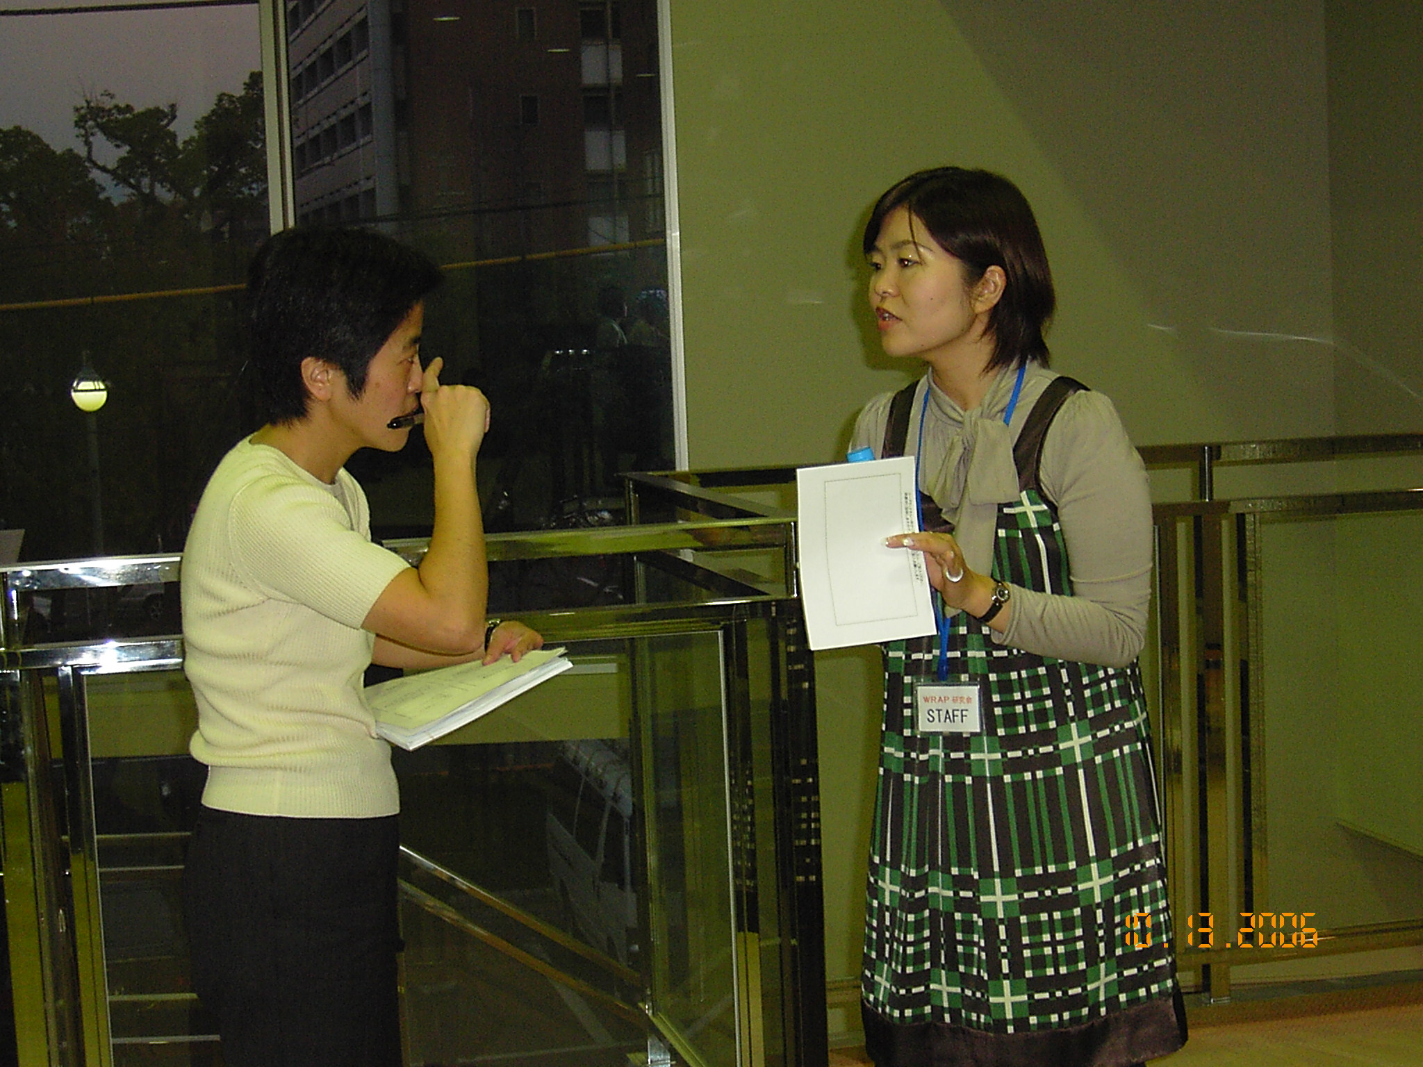
WRAP
You could develop a separate WRAP to deal with each of these issues or you could include these issues in one WRAP.
228

Slide 94
WRAP
There is only one person who can write your WRAP-
YOU!
You and only you decide:
  If you want to write a WRAP
  How much time it takes you to do it
  When you want to do it
  Which parts you want to do
229

Slide 95
WRAP
You and only you decide:
  Who you want, if anyone, to help you with it
  How you use it
  Who you show it to
  Where you keep it
  Who, if anyone, has copies of your
  Crisis Plan
230

Slide 96


WRAP
You may want to develop your WRAP in a three ring binder with filler paper and a set of five tabs.
However, you can develop your WRAP using any paper or notebook style.
231

Slide 97

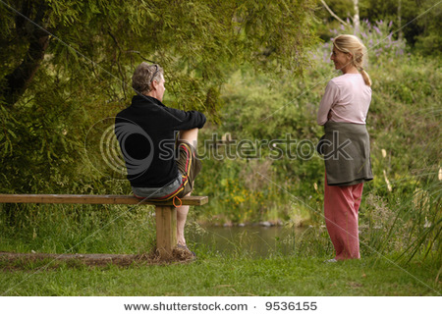
WRAP
You could develop it on your computer or even on a tape recorder.
You may want to ask a friend to support you as you work on your WRAP.
232

