Slide 1

LOW BARRIER SHELTER · WORK BED PROGRAM
When Guests Thrive,
Staff Do Too
How the Wellness Recovery Action Plan (WRAP) makes shifts calmer, safer, and more rewarding for shelter staff.
A staff briefing · June 2026
Notes:
Welcome. This short briefing is about a simple idea: when guests in the Work Bed Program use WRAP, our jobs as staff get easier. WRAP is a self-directed wellness plan guests build for themselves. We'll walk through what it is and the concrete ways it benefits us on shift, the guests, and the program as a whole.

Slide 2

START HERE
Two programs, one shared goal
THE WORK BED PROGRAM
WELLNESS RECOVERY ACTION PLAN (WRAP)
A reserved bed for guests who are working or actively looking for work — the stability to keep a job while getting back on their feet.
A self-made plan a guest writes for themselves — spotting what keeps them well and what to do when things get hard.
Early starts and steady sleep schedules
Keeping a job depends on consistency
Staff help protect that routine
Daily wellness routine and toolbox
Triggers and early warning signs
A crisis plan: who to call, what helps
Notes:
Quick context. The Work Bed Program reserves a bed for guests who are working or job-hunting, so consistency really matters to them. WRAP is a wellness plan a guest writes for themselves: their daily routine, their triggers and early warning signs, and a crisis plan that spells out who to call and what helps. The key word is self-directed — the guest owns it, and that's exactly why it takes pressure off us.

Slide 3
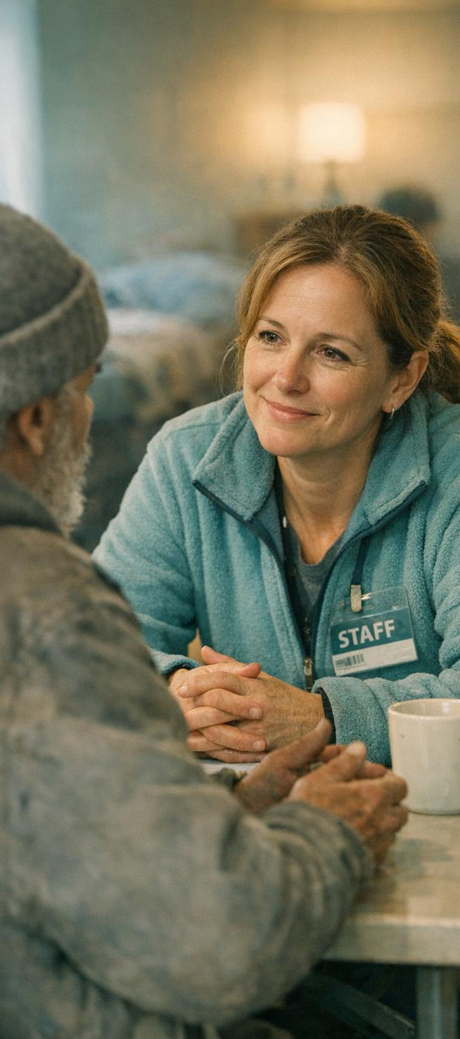
BENEFIT FOR STAFF
Calmer shifts, safer spaces
1
2
3
Fewer crises to manage
No more guesswork
A clear crisis plan
Guests catch their own early warning signs and reach for coping tools before things boil over — so we spend far less of the shift on de-escalation.
A guest can tell us their triggers and what actually helps. We respond with confidence instead of trying to read the situation cold.
When a hard moment hits, the plan already names who to call and what the guest wants — less scrambling, safer outcomes for everyone in the room.
Notes:
Here's what this looks like for us on shift. First, fewer crises — guests notice their own warning signs and use their toolbox before a situation escalates, which cuts down our de-escalation time. Second, no guesswork — they can tell us their triggers and what helps, so we're not reading the room blind. Third, the crisis plan does the heavy lifting in a hard moment: it already says who to call and what the guest wants, so we act fast and safely.

Slide 4

BENEFIT THROUGH THE GUEST
Guests who steer their own day
A
B
C
Ownership, not dependence
Routines that protect the job
A shared language
Guests make their own wellness calls instead of looking to staff for every decision — freeing us to support rather than direct.
Daily plans keep sleep, wake-ups, and work departures steady. Smoother mornings for them mean smoother mornings for us.
When guests name how they're doing, handoffs between staff get clearer and trust grows on both sides of the desk.
Notes:
A lot of the benefit to us comes through the guest. When guests own their wellness, they're not leaning on staff for every small decision — we get to support instead of direct. Their daily routine keeps sleep and work departures steady, so mornings run smoother for everyone. And because guests can put words to how they're doing, our handoffs between staff are clearer and trust builds on both sides.

Slide 5

BENEFIT FOR THE PROGRAM
A steadier shelter overall
Longer
Fewer
Stronger
Bed & job retention
Incidents & disruptions
Shelter culture
Stable guests keep their work beds and their jobs longer, so beds turn over less and placements actually stick.
Calmer guests mean fewer late-night escalations and fewer incident reports to write up at the end of a shift.
A shared wellness language builds a calmer, more trusting environment — the kind of place staff want to work.
Notes:
Zoom out to the program level. Guests who are well keep their work beds and their jobs longer, so placements stick and beds turn over less often. Calmer guests mean fewer late-night escalations and fewer incident reports for us to write up. And over time, a shared wellness language makes the whole shelter calmer and more trusting — which is exactly the kind of environment we all want to work in.

Slide 6

THE BOTTOM LINE
From constant response to steady support
When guests use WRAP, our shifts shift too — away from putting out fires and toward the kind of support that actually helps people move forward.
HOW WE CAN HELP IT STICK
Ask guests what's in their plan — and respect it
Protect the routines that keep their job safe
Use their own words back to them in tough moments
Notes:
The bottom line: when guests use WRAP, our role shifts from constantly responding to crises toward steady, forward-looking support. We can help it stick in three simple ways — ask guests what's in their plan and respect it, protect the routines that keep their job safe, and reflect their own words back to them in hard moments. Small habits from us, big payoff for everyone on shift.

