Slide 1
Peer Case Managers: Building and Sustaining Resilience in Support Roles
Exploring resilience strategies for effective support roles
Notes:
---
This presentation explores the vital role of peer case managers in healthcare and social support, focusing on how they build and maintain resilience while supporting others.

Slide 2
Meeting Program
Understanding the Role of Peer Case Managers
Defining and Exploring Resilience
Strategies for Fostering Resilience Among Peer Case Managers
Real-World Examples and Stories of Resilience
Notes:
We will cover the role of peer case managers, core concepts of resilience in support roles, strategies to foster resilience, and real-world examples illustrating resilience in action.

Slide 3
Understanding the Role of Peer Case Managers
Notes:
Peer case managers bring unique lived experiences to their roles, offering essential support within healthcare and social systems. This section outlines their responsibilities and significance.

Slide 4
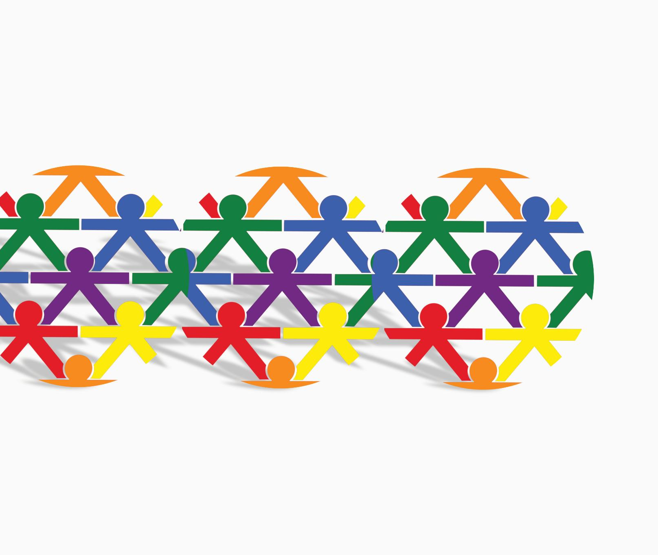
Definition and Responsibilities of Peer Case Managers
Role of Peer Case Managers
  Peer case managers use personal experience to guide and support clients facing similar life challenges.
Care Coordination
  They coordinate care by connecting clients with necessary health and social services efficiently.
Emotional Support
  Providing empathetic emotional support is a key responsibility to help clients manage their challenges.
Resource Navigation
  Peer case managers assist clients in navigating and accessing community resources and services.
Notes:
---
Peer case managers are individuals with lived experience who provide guidance, advocacy, and support to clients facing similar challenges. Their responsibilities include care coordination, emotional support, and resource navigation.
Image source: Microsoft 365 content library

Slide 5

Unique Perspectives and Lived Experience
Building Trust
  Personal experiences help peer case managers establish trust with clients through shared understanding.
Fostering Empathy
  Lived experience enables peer case managers to empathize deeply with clients’ challenges and emotions.
Enhancing Credibility
  Clients view peer case managers as credible due to their authentic life experiences and relatable insights.
Notes:
---
Their personal experiences allow peer case managers to build trust, empathy, and credibility with clients, creating a bridge between professional services and client needs.
Image source: Microsoft 365 content library

Slide 6

Importance in Healthcare and Social Support Systems
Promoting Patient Engagement
  Peer case managers encourage active patient participation which improves healthcare outcomes and satisfaction.
Reducing Stigma
  They help reduce stigma by fostering open communication and acceptance within healthcare environments.
Enhancing Culturally Sensitive Care
  Peer case managers provide culturally sensitive care tailored to diverse patient needs in social support systems.
Notes:
---
Peer case managers play a critical role in improving outcomes by promoting engagement, reducing stigma, and enhancing culturally sensitive care within healthcare and social support frameworks.
Image source: Microsoft 365 content library

Slide 7
Defining and Exploring Resilience
Notes:
Resilience is a key attribute for peer case managers, enabling them to cope with workplace challenges and sustain their supportive roles effectively.

Slide 8
Core Concepts of Resilience
Adaptability
Resilience involves adapting effectively to changing circumstances and challenges.
Emotional Strength
Emotional strength helps individuals manage stress and maintain well-being.
Recovery from Adversity
Resilience enables quick recovery and sustained effectiveness after difficulties.
Notes:
---
Resilience encompasses adaptability, emotional strength, and the ability to recover from adversity, allowing individuals to maintain well-being and effectiveness under stress.
Image source: Microsoft 365 content library

Slide 9

Relevance of Resilience in Peer Support Roles
Emotional Demands
  Peer support roles involve high emotional demands that require strong coping mechanisms to manage stress effectively.
Importance of Resilience
  Resilience helps peer supporters maintain their well-being and continue providing compassionate care despite challenges.
Notes:
---
Given the emotional demands and potential triggers in peer support work, resilience is essential for maintaining personal health and providing consistent, compassionate care.
Image source: Microsoft 365 content library

Slide 10

Challenges that Require Resilience
Secondary Trauma Impact
  Peer case managers often experience secondary trauma, affecting their emotional well-being and requiring coping strategies.
Burnout Challenges
  Burnout from high workload and emotional strain demands resilience and self-care among peer case managers.
Boundary Complexities
  Managing boundaries with clients can be complex and requires resilience to maintain professional relationships.
Systemic Barriers
  Systemic barriers create obstacles that challenge peer case managers' effectiveness and require resilience to overcome.
Notes:
---
Peer case managers face challenges such as secondary trauma, burnout, boundary complexities, and systemic barriers, all of which necessitate strong resilience skills.
Image source: Microsoft 365 content library

Slide 11
Strategies for Fostering Resilience Among Peer Case Managers
Notes:
This section discusses effective approaches to enhance resilience, supporting peer case managers in sustaining their vital roles.

Slide 12

Self-Care Practices and Boundary Setting
Importance of Self-Care
  Self-care routines are essential for maintaining mental and emotional health in demanding roles.
Setting Clear Boundaries
  Establishing boundaries helps prevent burnout and ensures sustainable work performance.
Benefits for Peer Case Managers
  Self-care and boundaries support peer case managers’ well-being and job effectiveness.
Notes:
---
Implementing self-care routines and clear boundaries helps prevent burnout and maintain mental and emotional well-being among peer case managers.
Image source: Microsoft 365 content library

Slide 13

Peer Support Networks and Supervision
Supportive Supervision
  Providing guidance and oversight enhances learning and builds resilience through constructive feedback and encouragement.
Peer Networks
  Peer connections create a community for shared experiences, emotional support, and collaborative problem solving.
Community and Resilience
  A strong community fosters resilience by promoting shared learning and emotional support among members.
Notes:
---
Access to supportive supervision and peer networks fosters a sense of community, shared learning, and emotional support critical for resilience.
Image source: Microsoft 365 content library

Slide 14

Ongoing Training and Professional Development
Skill Enhancement
  Ongoing training helps peer case managers improve their professional skills and adapt to new challenges effectively.
Coping Strategies
  Professional development equips case managers with coping strategies to manage stress and workplace challenges successfully.
Empowerment and Growth
  Continued education empowers peer case managers to grow professionally and navigate complex situations confidently.
Notes:
---
Continued education enhances skills and coping strategies, empowering peer case managers to navigate challenges and grow professionally.
Image source: Microsoft 365 content library

Slide 15
Real-World Examples and Stories of Resilience
Notes:
Examining real cases highlights how resilience helps peer case managers overcome adversity and thrive in their supportive roles.

Slide 16

Case Studies of Overcoming Adversity
Resilient Peer Support
  Peer case managers demonstrate resilience by effectively supporting each other through difficult circumstances.
Navigating Challenges
  Successful navigation of personal and professional challenges is achieved through collaborative problem solving and determination.
Notes:
---
Illustrative case studies show peer case managers successfully navigating personal and professional challenges through resilience and support.
Image source: Microsoft 365 content library

Slide 17

Success Stories From Peer Case Managers
Resilience Impact
  Resilience greatly influences career longevity by helping peer case managers overcome challenges and stay committed.
Client Relationships
  Strong client relationships develop through trust and empathy fostered by peer case managers’ personal experiences.
Personal Growth
  Peer case managers experience personal growth by reflecting on experiences and learning from client interactions.
Notes:
---
Personal narratives reveal the impact of resilience on career longevity, client relationships, and personal growth within peer support roles.
Image source: Microsoft 365 content library

Slide 18

Lessons Learned and Best Practices
Self-Care Importance
  Prioritizing self-care helps peer case managers maintain mental and physical well-being to sustain resilience.
Community Support
  Building a strong community provides emotional support and shared strength among peer case managers.
Ongoing Learning
  Continuous education and skill development empower peer case managers to adapt and grow professionally.
Notes:
---
Key takeaways emphasize the importance of self-care, community, and ongoing learning as pillars to sustain resilience among peer case managers.
Image source: Microsoft 365 content library

Slide 19
Conclusion
Importance of Resilience
Resilience enables peer case managers to handle challenges and maintain their well-being effectively.
Effective Support Strategies
Using proven strategies helps peer case managers provide meaningful assistance to others.
Learning from Experience
Real-life experiences offer valuable lessons for continuous improvement in peer management.
Notes:
Resilience is foundational for peer case managers to effectively support others and sustain their own well-being. By embracing proven strategies and learning from real experiences, they can continue making a meaningful difference.

