Slide 1

Wellness Recovery Action Plan for Work-Related Issues
Enhancing mental wellness in the workplace
Notes:
---
This presentation focuses on the Wellness Recovery Action Plan (WRAP) and its application in addressing work-related issues. We will explore how WRAP can be utilized to improve mental wellness in the workplace.

Slide 2

Agenda Items
Understanding WRAP (Wellness Recovery Action Plan)
Identifying Work-Related Stress and Challenges
Creating a WRAP for Work
Implementing WRAP in the Workplace
Long-Term Benefits of WRAP for Employees and Organizations
Notes:
In this presentation, we will cover the fundamentals of WRAP, identify common work-related stressors, and outline how to create and implement a WRAP tailored for the workplace. We will also discuss the long-term benefits of adopting WRAP for both employees and organizations.

Slide 3
Understanding WRAP (Wellness Recovery Action Plan)
Notes:
WRAP is a self-directed wellness tool designed to help individuals manage their emotional and mental health. It empowers individuals to develop their own plans for recovery and wellness.

Slide 4

Introduction to WRAP
Developed by Peers
  WRAP was created by individuals with lived experience of mental health challenges, emphasizing peer support and shared understanding.
Structured Approach
  The WRAP plan offers a systematic framework that helps individuals identify and achieve their personal wellness goals effectively.
Achieving Wellness Goals
  WRAP guides individuals in creating personalized strategies for managing their mental health and improving overall well-being.
Notes:
WRAP was developed by individuals who have experienced mental health challenges and is based on their shared experiences. The plan provides a structured approach to assist individuals in achieving their wellness goals.

Slide 5

Key Components of WRAP
Wellness Toolbox
  The wellness toolbox includes various strategies and resources that individuals can use to support their mental health and well-being.
Daily Maintenance Plan
  A daily maintenance plan outlines the specific actions and practices individuals can incorporate into their routine to sustain wellness.
Triggers Identification
  Identifying personal triggers helps individuals recognize stressors and plan effective coping strategies to manage their responses.
Emergency Plans
  Emergency plans provide a clear outline of actions to take during crises to ensure safety and recovery.
Notes:
WRAP consists of several key components, including a wellness toolbox, daily maintenance plan, triggers identification, and emergency plans. These components work together to support individuals in maintaining their wellness.

Slide 6

Benefits of Implementing WRAP
Increased Self-Awareness
  Implementing WRAP encourages individuals to develop a deeper understanding of their thoughts and feelings, leading to improved self-awareness.
Improved Coping Strategies
  WRAP helps individuals learn and practice effective coping strategies to manage stress and mental health challenges more effectively.
Recognizing Early Warning Signs
  Implementing WRAP enhances the ability to identify early signs of stress or mental health issues, allowing for timely interventions.
Proactive Mental Wellness
  WRAP promotes a proactive approach to maintaining mental wellness, encouraging regular self-check-ins and mental health practices.
Notes:
Implementing WRAP can lead to increased self-awareness, improved coping strategies, and the ability to recognize early warning signs of stress or mental health issues. It fosters a proactive approach to maintaining mental wellness.

Slide 7
Identifying Work-Related Stress and Challenges
Notes:
Recognizing the sources of work-related stress is essential to effectively use WRAP. Identifying stressors can empower employees to take action and mitigate their effects.

Slide 8

Common Sources of Work-Related Stress
Tight Deadlines
  Tight deadlines create pressure, leading to increased anxiety and stress among employees to meet expectations.
Heavy Workloads
  Heavy workloads can overwhelm employees, causing fatigue and reducing workplace efficiency and morale.
Lack of Support
  A lack of support from colleagues or management can exacerbate stress, making it difficult to cope with challenges.
Interpersonal Conflicts
  Interpersonal conflicts among coworkers can lead to a toxic work environment, increasing overall stress levels.
Notes:
Common sources of work-related stress include tight deadlines, heavy workloads, lack of support, and interpersonal conflicts. Understanding these stressors is the first step in managing them effectively.

Slide 9

Signs and Symptoms of Stress
Irritability
  Irritability is a common sign of work-related stress, affecting relationships and workplace dynamics.
Fatigue
  Chronic fatigue is another symptom, often resulting from prolonged stress and affecting productivity.
Difficulty Concentrating
  Stress can lead to difficulty concentrating, impacting decision-making and problem-solving abilities.
Changes in Sleep Patterns
  Changes in sleep patterns, whether insomnia or oversleeping, can indicate work-related stress.
Notes:
Signs of work-related stress may include irritability, fatigue, difficulty concentrating, and changes in sleep patterns. Recognizing these symptoms is crucial for early intervention.

Slide 10

Impact of Stress on Productivity and Well-Being
Decreased Job Performance
  Work-related stress can lead to decreased job performance, affecting both individual and team outcomes.
Burnout Risk
  High levels of stress can result in burnout, where employees feel exhausted and disengaged from their work.
Overall Well-Being
  Stress negatively impacts employees' overall well-being, including mental health, job satisfaction, and work-life balance.
Notes:
Work-related stress can significantly affect productivity, leading to decreased job performance and burnout. It also impacts employees' overall well-being and satisfaction with their work environment.

Slide 11
Creating a WRAP for Work
Notes:
Creating a WRAP tailored for the workplace involves customizing action plans based on individual needs and stressors. A personal wellness toolkit is essential for effective implementation.

Slide 12
Personal Wellness Toolkit
Mindfulness Practices
Mindfulness practices include techniques such as meditation and deep breathing to enhance mental clarity and reduce stress.
Relaxation Techniques
Relaxation techniques can help individuals unwind and relieve tension, such as progressive muscle relaxation or guided imagery.
Self-Care Activities
Self-care activities encompass a variety of practices that promote physical, emotional, and mental well-being, like journaling or taking baths.
Notes:
A personal wellness toolkit includes strategies and resources that individuals can use to manage stress and promote well-being. It may contain mindfulness practices, relaxation techniques, and self-care activities.

Slide 13

Developing Action Plans for Common Stressors
Identifying Triggers
  Recognizing common workplace stressors is the first step in developing effective action plans.
Outlining Steps
  Create clear, actionable steps to manage stress triggers when they occur, ensuring a prompt response.
Minimizing Impact
  Implementing these plans effectively can significantly reduce the negative impact of stress on employees.
Notes:
It's important to develop specific action plans for common workplace stressors. This involves identifying triggers and outlining steps to take when they arise to minimize their impact.

Slide 14
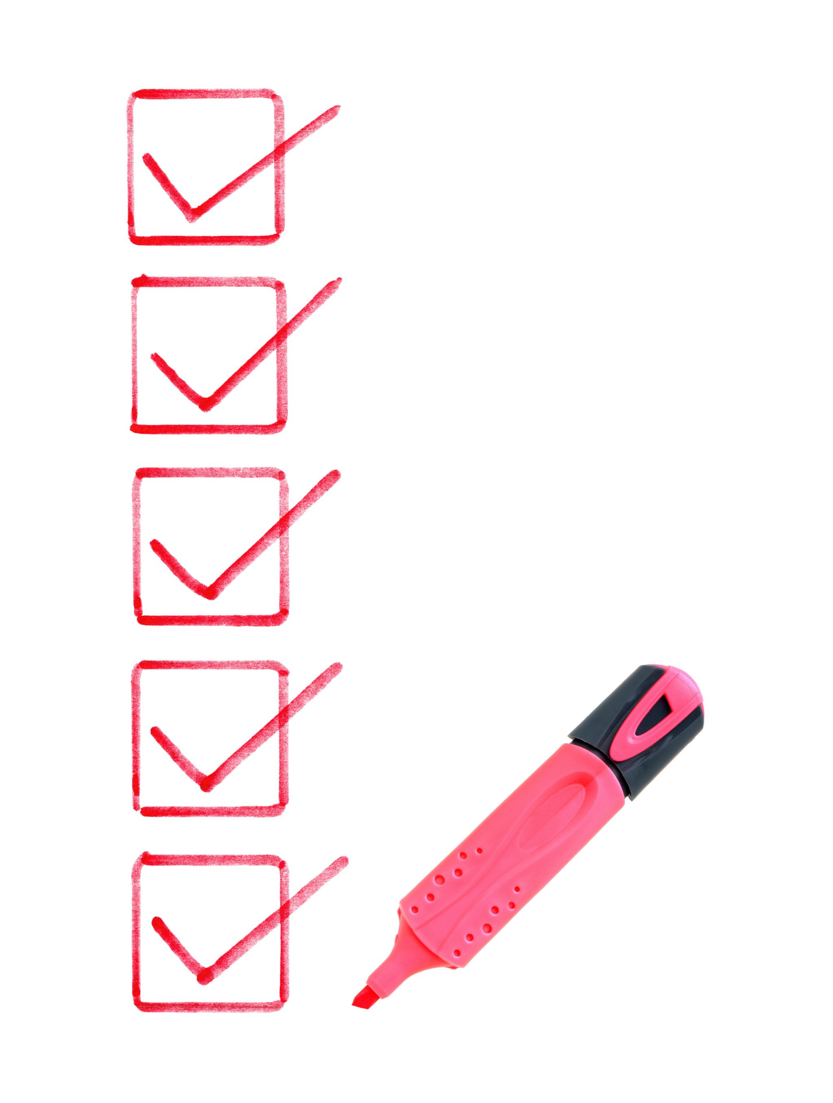
Setting Realistic Goals and Monitoring Progress
Importance of Realistic Goals
  Setting realistic goals is crucial for achieving success in wellness programs. It helps individuals focus on attainable targets.
Monitoring Progress
  Regularly tracking progress allows individuals to remain accountable for their wellness journey. This fosters motivation and commitment.
Adjusting Plans
  Adjusting plans based on progress ensures that wellness strategies remain effective and aligned with individual needs.
Notes:
Setting realistic wellness goals is key to a successful WRAP. Regularly monitoring progress helps individuals stay accountable and adjust their plans as needed to ensure ongoing effectiveness.

Slide 15
Implementing WRAP in the Workplace
Notes:
Implementation of WRAP within the workplace requires collaboration and support from both employers and employees. A supportive environment fosters successful implementation of wellness strategies.

Slide 16

Engaging with Employers and Colleagues
Importance of Engagement
  Engagement from employers and colleagues is essential for the successful implementation of WRAP initiatives, fostering a supportive environment.
Open Communication
  Encouraging open communication among team members can help in raising awareness and promoting wellness initiatives effectively.
Collaboration for Success
  Collaborative efforts among colleagues can significantly enhance the support for wellness initiatives, leading to a healthier workplace.
Notes:
Engagement from employers and colleagues is vital for a successful WRAP implementation. Open communication and collaborative efforts can enhance awareness and support wellness initiatives.

Slide 17

Creating a Supportive Work Environment
Employee Well-being
  A supportive work environment promotes employee well-being, leading to higher job satisfaction and productivity.
Open Dialogue
  Encouraging open dialogue about mental health helps create a safe space for employees to express their concerns.
Culture of Support
  Fostering a culture of understanding and support can significantly enhance team dynamics and collaboration.
Notes:
A supportive work environment is essential for employee well-being. This includes providing resources, encouraging open dialogue about mental health, and fostering a culture of understanding and support.

Slide 18

Policies and Practices to Promote Wellness
Flexible Work Schedules
  Implementing flexible work schedules allows employees to balance their personal and professional lives, enhancing overall well-being.
Mental Health Days
  Offering mental health days encourages employees to take time off for self-care, reducing stress and burnout.
Access to Counseling Services
  Providing access to counseling services supports employees' mental health and helps them navigate personal challenges effectively.
Notes:
Organizations should establish policies and practices that promote wellness, such as flexible work schedules, mental health days, and access to counseling services. These initiatives help create a healthy workplace.

Slide 19
Long-Term Benefits of WRAP for Employees and Organizations
Notes:
The long-term implementation of WRAP can benefit both employees and organizations. Improved mental wellness leads to enhanced productivity and satisfaction, creating a positive work atmosphere.

Slide 20
Improved Employee Well-Being
Empowerment Through WRAP
Implementing WRAP encourages employees to take control of their mental health and well-being, leading to greater job satisfaction.
Mental Health Control
WRAP provides employees with tools and strategies to manage their mental health, fostering resilience and self-care.
Positive Work Environment
A focus on well-being leads to a healthier workplace culture, improving collaboration and team dynamics.
Notes:
Implementing WRAP can lead to significant improvements in employee well-being, fostering a sense of empowerment and control over their mental health.

Slide 21
Enhanced Productivity and Job Satisfaction
Employee Well-Being
Improving employee well-being is essential for fostering a supportive and productive work environment.
Increased Engagement
Employees who feel supported are more engaged and contribute positively to the workplace culture.
Motivation at Work
Mental health support leads to higher motivation levels, resulting in improved productivity and job satisfaction.
Notes:
As employee well-being improves, so does productivity and job satisfaction. Employees who feel supported and mentally healthy are more engaged and motivated at work.

Slide 22

Reduced Absenteeism and Turnover Rates
Promoting Mental Wellness
  Organizations that focus on mental wellness initiatives can significantly improve employee morale and productivity.
Reduced Absenteeism
  Implementing programs that support mental health can lead to fewer sick days and increased attendance at work.
Lower Turnover Rates
  Supporting mental wellness can create a more stable workforce, reducing the costs associated with high turnover rates.
Notes:
By promoting mental wellness through WRAP, organizations can experience reduced absenteeism and lower turnover rates. This ultimately leads to a more stable and effective workforce.

Slide 23
Conclusion
Powerful Management Tool
The Wellness Recovery Action Plan (WRAP) is essential for effectively managing work-related issues and mental wellness.
Benefits for Employees
Implementing WRAP can lead to improved mental health and well-being among employees, enhancing their productivity.
Organizational Advantages
Organizations that embrace WRAP can experience better workplace culture, reduced absenteeism, and increased performance.
Notes:
The Wellness Recovery Action Plan is a powerful tool for managing work-related issues and promoting mental wellness in the workplace. By implementing WRAP, both employees and organizations can reap significant benefits.

