Slide 1
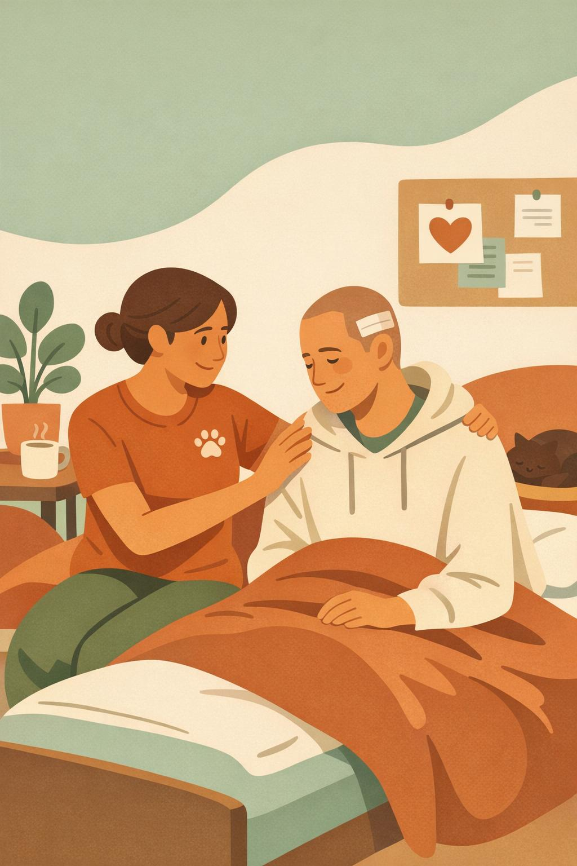
STAFF BRIEFING · MEDICAL RESPITE PROGRAM
When Guests Use WRAP, Staff Benefit Too
How the Wellness Recovery Action Plan supports Low Barrier Shelter staff working alongside the Medical Respite Program.
A shared, person-centered approach to wellness, safety, and care
Notes:
Welcome. This briefing explains, in plain terms, how it helps frontline shelter staff when guests in the Medical Respite Program build and use a Wellness Recovery Action Plan, or WRAP. The short version: WRAP is a self-directed wellness tool guests own, and when guests manage their own wellness, staff spend less time reacting to crises and more time supporting recovery. We'll cover what WRAP is, how it fits our setting, and the concrete day-to-day benefits for staff.

Slide 2
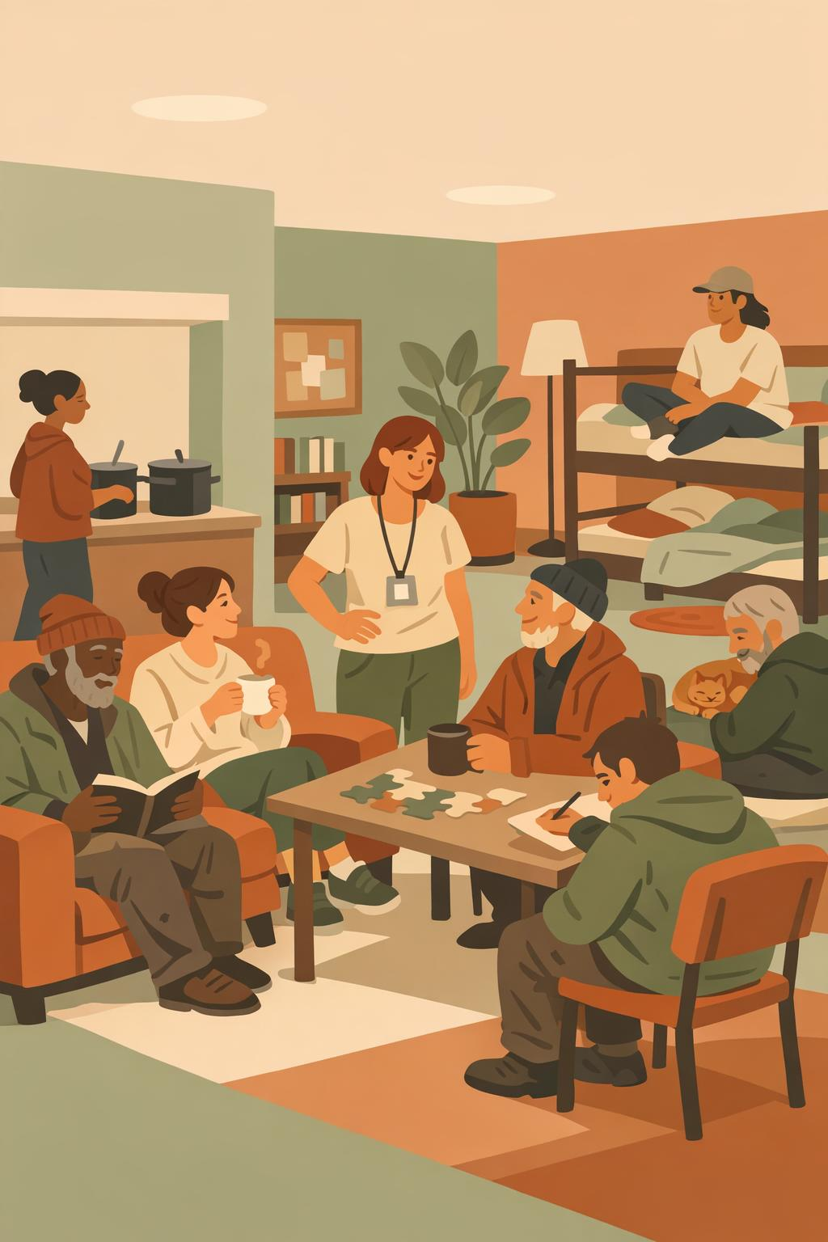
THE CONTEXT
Complex needs, high-pressure shifts
Guests recovering in medical respite often carry overlapping medical, mental health, and substance use needs — raising the stakes and the workload on every shift.
1
Layered needs
2
Reactive days
Illness, injury, behavioral health, and social needs at once.
Without a plan, staff absorb crises as they happen.
3
Strain & turnover
4
A better way
Constant crisis response drives stress and burnout.
A tool guests own shifts work from reacting to supporting.
Notes:
Set the scene. The people we serve in medical respite are recovering from acute illness or injury and frequently live with mental health conditions and substance use needs at the same time. In a low barrier setting we meet people where they are, which is the right thing to do, but it also means staff handle a lot of unpredictability. When the day is purely reactive, stress builds and burnout follows. The premise of this briefing is simple: giving guests a wellness tool they own changes the dynamic for staff, too.

Slide 3
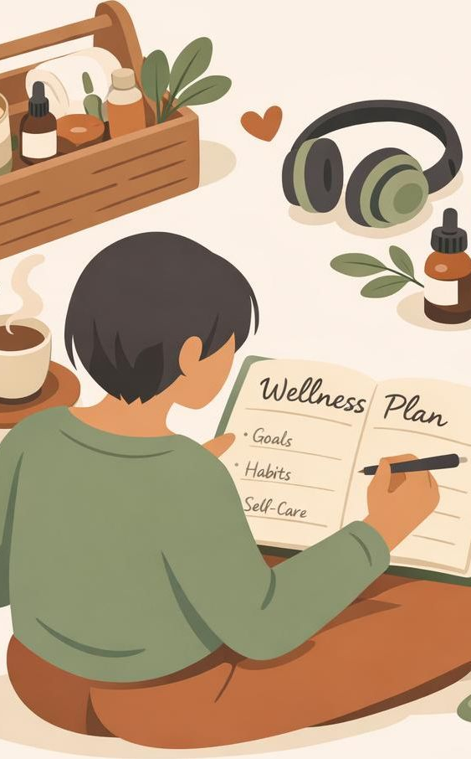
WHAT IS WRAP?
A wellness plan the guest owns
The Wellness Recovery Action Plan is an evidence-based, voluntary, self-directed process (recognized by SAMHSA in 2010). Guests build their own plan around five key concepts:
Hope — Belief that recovery is possible
Personal responsibility — Owning one's own wellness
Education — Learning what helps and what hurts
Self-advocacy — Voicing needs clearly
Support — Giving and receiving help
Notes:
Here's WRAP in a nutshell. It's an evidence-based self-management tool developed by people in recovery and recognized by SAMHSA as an evidence-based practice in 2010. Two things matter most for staff to understand. First, it's voluntary and self-directed — the guest decides what goes in it and who sees it. Second, it's built around five key concepts: hope, personal responsibility, education, self-advocacy, and support. Those concepts naturally move a guest toward managing their own wellness, which is exactly what eases the load on staff.

Slide 4
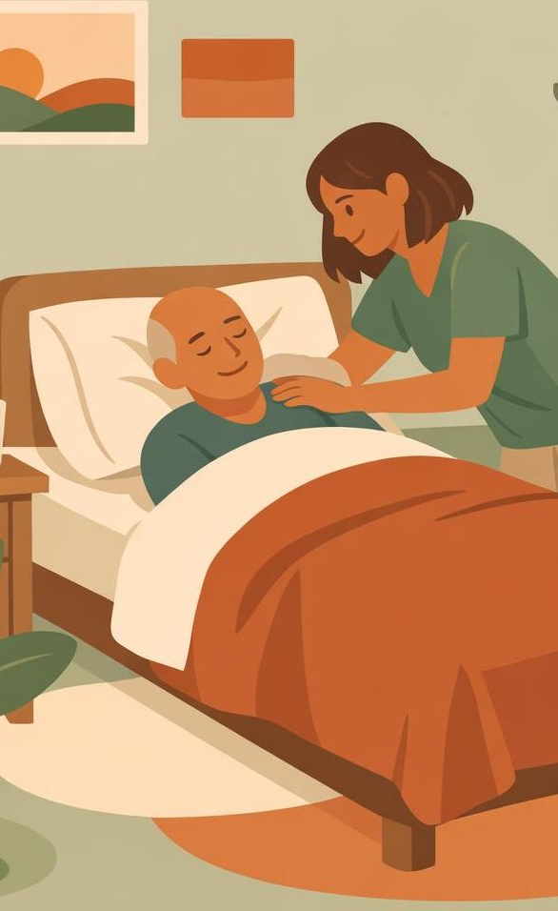
OUR SETTING
Two models, one shared goal
Medical Respite Program
Short-term, post-hospital recuperative care — a safe place to rest and heal with medical oversight, reducing readmissions and ER visits.
Low Barrier Shelter
Meets people where they are: no sobriety, ID, or strict-curfew requirements. Harm reduction keeps people engaged in care.
Where they meet: medically fragile guests need stability, yet the setting stays flexible — a self-management tool fits perfectly between the two.
Notes:
Quick grounding in our two models. Medical respite, also called recuperative care, gives people experiencing homelessness a safe place to recover after a hospital stay, with medical oversight and case management; it's been shown to cut readmissions and ER visits. The low barrier shelter model removes obstacles to entry and staying — no sobriety or ID requirements, flexible curfews, discharge only as a last resort. The tension staff feel is real: medically fragile guests need stability, but the setting is deliberately flexible. WRAP bridges that gap because it helps guests bring their own structure.

Slide 5

PROGRAM INTEGRATION
How WRAP plugs into respite care
WRAP is the guest's own plan; staff simply know it exists and honor it. It threads through moments that already happen each shift.
1
Intake & rest
Guest settles in; staff invite WRAP, never require it.
2
Daily plan
A daily wellness routine guides quieter, steadier days.
3
Early warning signs
Guest and staff spot trouble before it becomes a crisis.
4
Crisis plan
A pre-written plan tells staff how to help if things escalate.
Notes:
This slide answers the practical question: where does WRAP actually show up in our work? It's not a new program staff have to run. The guest owns the plan; our job is to know it exists and honor it. It threads through moments that already happen — settling in at intake, a daily wellness routine that makes days steadier, recognizing early warning signs together before things boil over, and a crisis plan the guest wrote in advance that tells us exactly how they want to be supported. Notice the progression: each step gives staff more foresight and less guesswork.

Slide 6
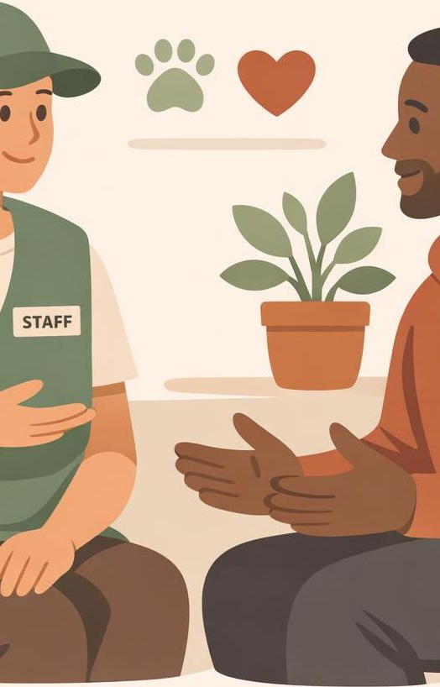
STAFF BENEFIT 01
Fewer crises — and easier de-escalation
1
Early warning signs
Guests name their own triggers and warning signs, so staff can step in before a situation escalates.
2
A ready-made roadmap
The crisis plan tells staff what calms this person and what to avoid — no guessing in the moment.
3
Calmer responses
De-escalation follows the guest's own preferences, which lands better and resolves faster.
Notes:
Now the benefits, starting with the one staff feel most: fewer crises and easier de-escalation. Because WRAP has guests identify their own triggers and early warning signs, problems surface earlier, while they're still small. And when tension does rise, the guest's crisis plan acts as a roadmap — it tells us what helps this specific person and what to avoid, so we're not guessing under pressure. De-escalation built on the guest's own stated preferences simply works better and resolves faster. That's fewer incidents and safer shifts.

Slide 7
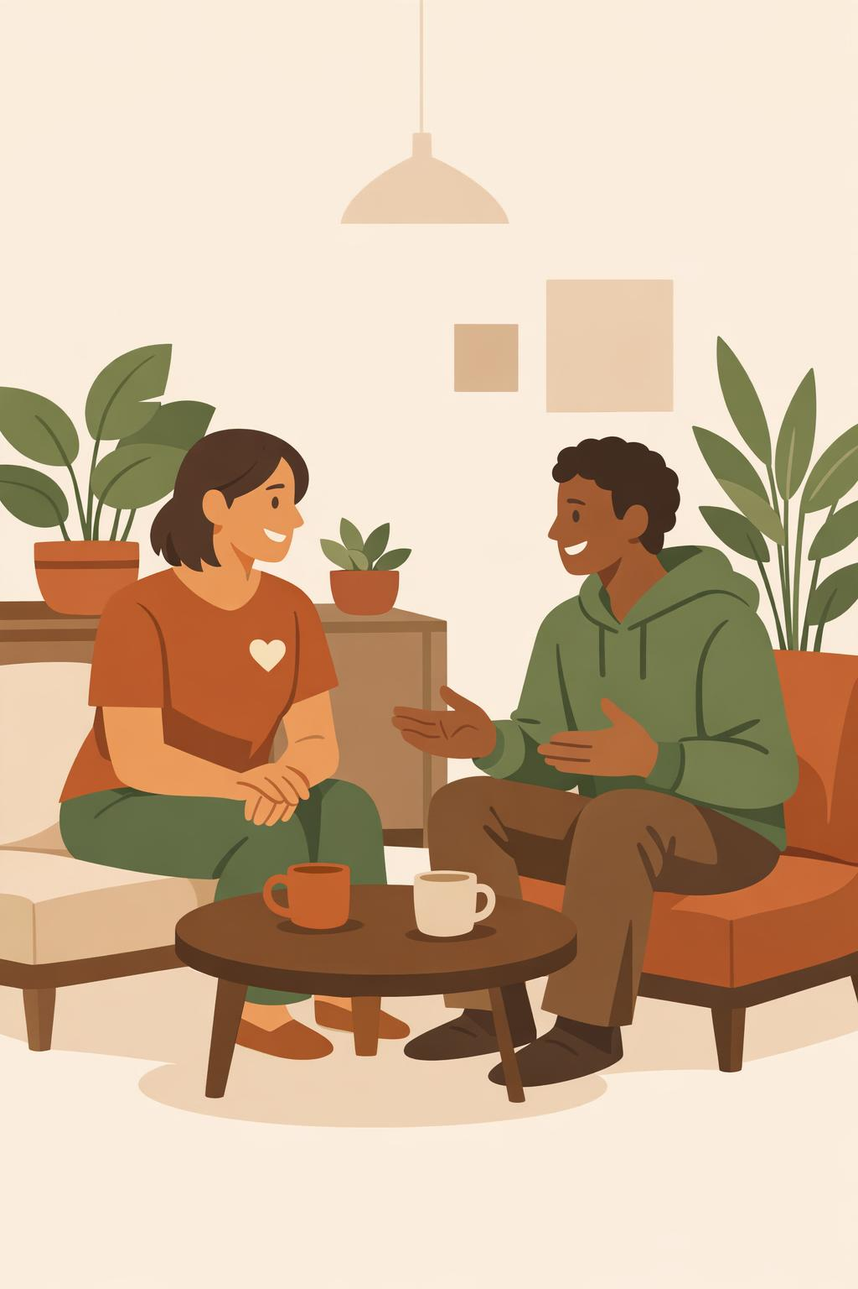
STAFF BENEFIT 02
A calmer space and stronger relationships
When guests engage their own wellness tools, the environment steadies — and the relationship shifts from enforcement to partnership.
1
Safer for everyone
Predictable routines and shared plans reduce conflict and protect guests and staff alike.
2
Trust, not enforcement
Honoring a guest's own plan builds rapport; staff become collaborators, not rule-keepers.
3
A common language
Hope, responsibility, and self-advocacy give both sides shared words for hard moments.
Notes:
The second benefit is a calmer environment and better relationships. When guests are actively using their own wellness routines, the floor steadies for everyone — predictable days mean less conflict, which is safer for guests and staff alike. Just as important, the relationship changes. Instead of being the person enforcing rules, staff become partners who help a guest carry out a plan the guest chose. And WRAP's shared vocabulary — hope, personal responsibility, self-advocacy — gives both sides the same words to use in tough moments. That partnership is what low barrier care is meant to feel like.

Slide 8
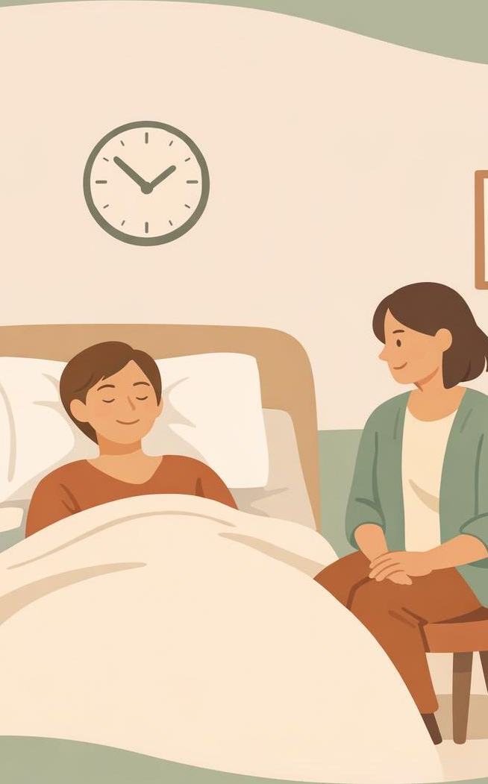
STAFF BENEFIT 03
Lighter workload, less burnout
Self-management shifts effort from staff to the guest — and constant crisis response is the biggest driver of frontline burnout.
From reacting to supporting
Less time absorbing emergencies, more on planned, proactive care.
Guests carry more of the load
Personal responsibility means staff aren't the sole engine of every guest's wellness.
Sustainable shifts
Fewer high-stress incidents protects staff energy, morale, and retention.
Notes:
Third benefit, and the one leadership cares about for retention: a lighter workload and less burnout. WRAP is built on personal responsibility, so the guest carries more of their own wellness work. That shifts staff effort away from constantly absorbing emergencies and toward planned, proactive support. Since relentless crisis response is the single biggest driver of frontline burnout, reducing those high-stress incidents directly protects staff energy, morale, and ultimately retention. Healthier staff mean more consistent care for guests — it compounds.

Slide 9
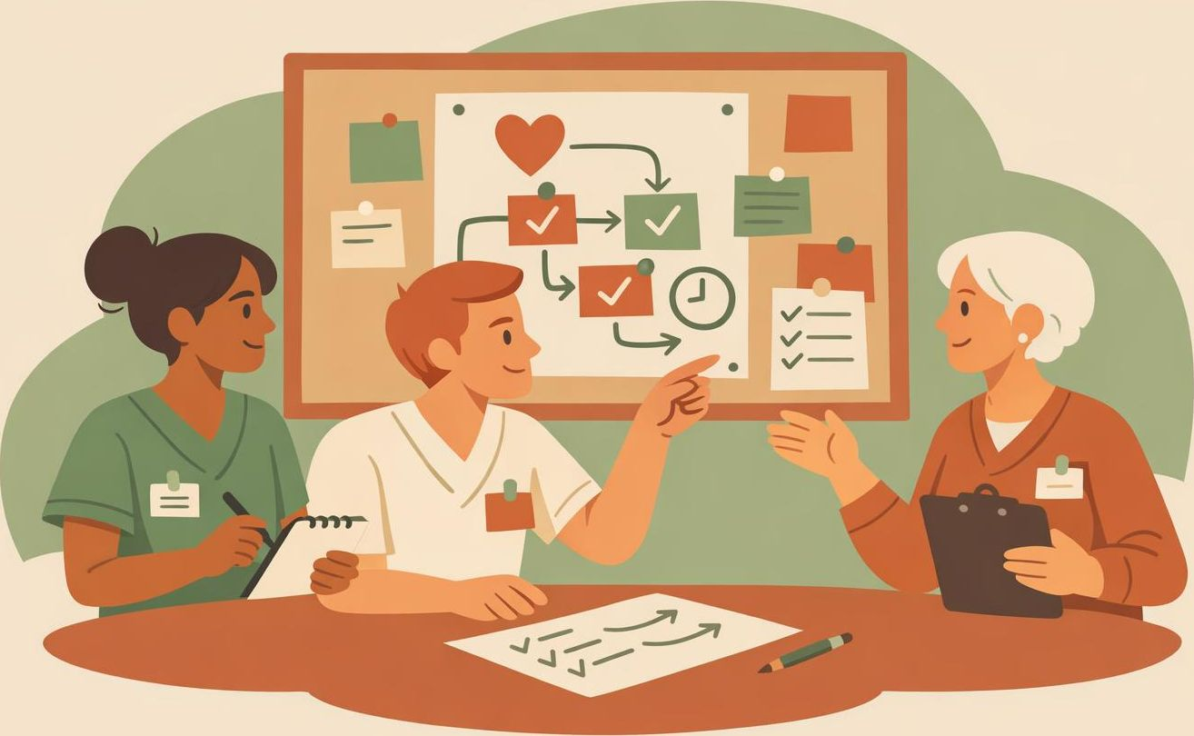
STAFF BENEFIT 04
Better care coordination and continuity
When a guest chooses to share their plan, it becomes a shared reference across the whole care team.
1
Continuity across shifts
New and night staff instantly know how this guest wants to be supported.
2
One aligned team
Shelter staff, nurses, and case managers work from the same playbook.
3
Smoother handoffs
The plan travels with the guest — into discharge, housing, and follow-up care.
Notes:
Fourth benefit: better coordination and continuity of care. WRAP is voluntary and private, but when a guest chooses to share their plan, it becomes a shared reference for the whole team. That's powerful in a setting with shift changes and many hands. Night staff and new hires instantly know how a guest wants to be supported; shelter staff, nurses, and case managers all work from the same playbook; and because the plan belongs to the guest, it travels with them into discharge, housing, and follow-up. Less is lost in the handoffs, which is safer and far less work to reconstruct.

Slide 10
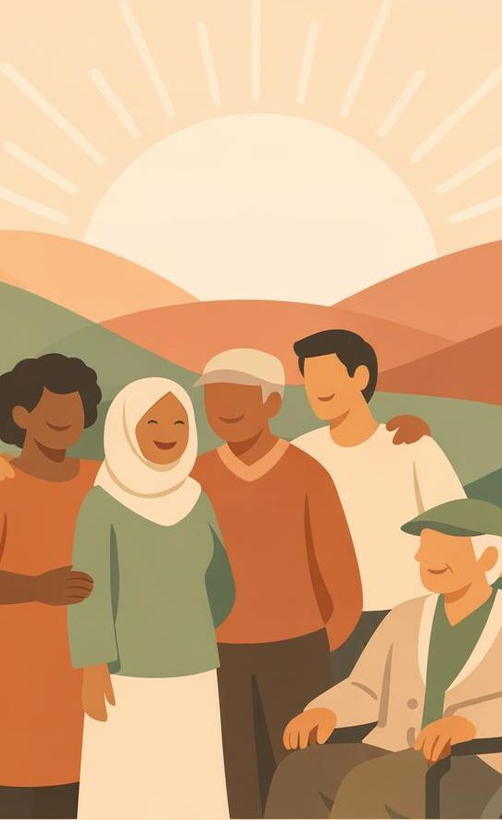
SHARED OUTCOMES
When guests do well, staff do well
WRAP's documented gains for guests translate directly into a steadier, more rewarding job for staff.
For Guests
For Staff
Increased hope and empowerment
Reduced anxiety and depression
Stronger self-advocacy and self-care
Better engagement in recovery
Fewer crises and safer shifts
Less reactive workload and burnout
Stronger, trust-based relationships
Coordinated, easier-to-sustain care
Notes:
Step back and see the whole picture. WRAP has documented, evidence-based gains for participants: more hope and empowerment, less anxiety and depression, stronger self-advocacy, and deeper engagement in their own recovery. Look at the staff column beside it — every guest gain has a staff payoff. A guest who is more engaged and self-advocating creates fewer crises, a lighter reactive load, more trusting relationships, and care that's easier to coordinate and sustain. This is the core message: guest wellness and staff wellbeing aren't a trade-off. They rise together.

Slide 11

THE BOTTOM LINE
A win for guests is a win for staff
WRAP is a voluntary plan guests own — staff honor it, not run it.
Self-management means fewer crises and easier de-escalation.
Lighter reactive workload protects staff from burnout.
Shared plans keep the whole care team aligned across shifts.
Notes:
To close, four takeaways. One: WRAP is a voluntary plan the guest owns — our job is to honor it, not administer it. Two: because guests self-manage, we see fewer crises and de-escalation gets easier. Three: a lighter reactive workload is real protection against burnout. Four: when guests share their plans, the whole care team stays aligned across every shift and handoff. The throughline is simple — supporting guests to use WRAP isn't extra work for staff, it's what makes the work more sustainable. A win for guests really is a win for staff.

Slide 12
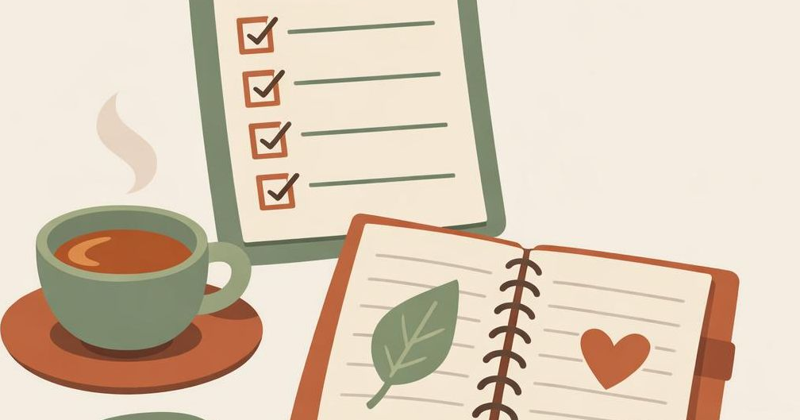
QUICK REFERENCE
WRAP at a glance
What WRAP is
Where it fits
Voluntary, self-directed plan the guest owns (SAMHSA, 2010).
Five concepts: Hope · Responsibility · Education · Self-advocacy · Support.
Bridges medically fragile needs with low-barrier flexibility.
Threads through intake, daily plan, warning signs, and crisis plan.
What staff gain
The staff role
Fewer crises and easier de-escalation.
Calmer space and trust-based relationships.
Lighter load, less burnout, better coordination.
Invite WRAP — never require it.
Know the plan exists and honor it.
Use it for smoother handoffs across shifts.
Bottom line: supporting WRAP isn't extra work — it's what makes the work more sustainable.
Notes:
Use this final slide as a one-page takeaway people can photograph or print. It recaps the whole briefing at a glance: what WRAP is — a voluntary, self-directed plan the guest owns, built on hope, personal responsibility, education, self-advocacy, and support; where it fits in our setting; the concrete gains for staff, from fewer crises to less burnout to better coordination; and the simple staff role, which is to invite it, honor it, and use it at handoffs. The bottom line stays the same: supporting guests to use WRAP isn't extra work, it's what makes the work more sustainable.

