Slide 1
Wellness Recovery Action Plan (WRAP)
Turning readiness into a plan at the Preparation stage of change
Notes:
Welcome — today we look at WRAP as a practical tool for the Preparation stage.
Preparation = the person has decided to change and is getting ready to act.
WRAP is self-created, self-managed, and evidence-based (Mary Ellen Copeland).
Goal: leave with a clear picture of how WRAP turns intention into a concrete plan.

Slide 2
The Preparation Stage of Change
The person is ready to act soon — usually within the next month
Motivation is present, but the how is still uncertain
Small first steps may already be happening (research, appointments, telling someone)
Key risks: vague goals, no plan for hard days, and going it alone
What helps most here: structure, specific actions, and a support network
Notes:
Preparation follows precontemplation and contemplation in the Stages of Change model.
The person is convinced change is needed and is planning the first concrete steps.
Ambivalence can still resurface — a plan protects against it.
Our job is not to persuade, but to help them build a workable plan they own.

Slide 3
What WRAP Is
A personal, written self-management plan the individual creates and owns
Built on five key concepts: hope, personal responsibility, education, self-advocacy, support
Starts with a Wellness Toolbox — the simple things that keep me well
Practical, plain-language, and updated as recovery progresses
Not a treatment plan and not written by a professional — it belongs to the person
Notes:
WRAP was developed by Mary Ellen Copeland with people in recovery.
Emphasize ownership — the person writes it in their own words.
Wellness Toolbox examples: sleep, walking, calling a friend, music, journaling.
It is designed to be used daily, not filed away.

Slide 4




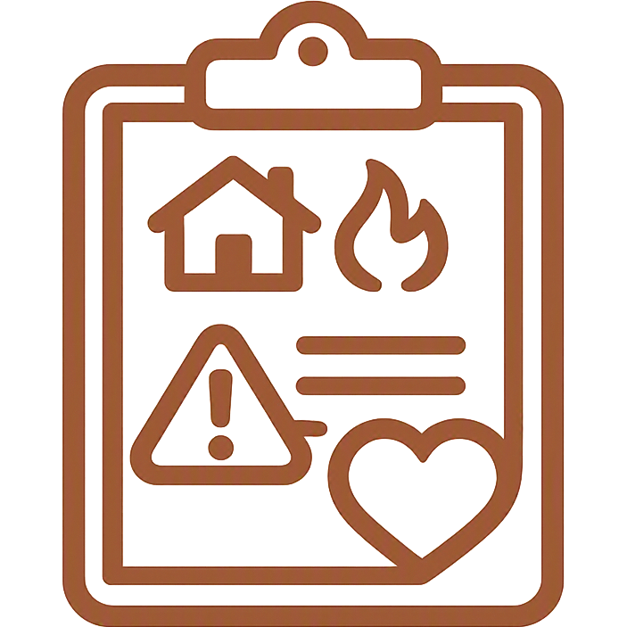

The Six Sections of a WRAP
Daily Maintenance
Triggers
Early Warning Signs
What I'm like when well and what I do each day to stay there.
External events that can set me back, plus my action plan for each.
Subtle internal shifts and the steps I take when I notice them.
Breaking Down
Crisis Plan
Post-Crisis Plan
Signs things are worsening, and stronger actions to take.
Who decides, who helps, and what care I want when I can't say.
How I return to routine, wellness, and responsibility afterward.
Notes:
Walk through each section briefly — the plan builds from everyday wellness to crisis and back.
Daily Maintenance is where Preparation-stage work usually starts.
The Crisis Plan is written while well, so it speaks for the person when they can't.
Each section pairs a warning with a specific action — that's what makes WRAP usable.

Slide 5
How WRAP Helps at the Preparation Stage
Converts I want to change into specific, written, doable actions
Breaks recovery into small daily steps that build early confidence
Identifies triggers and warning signs before they become a setback
Names supporters and their roles, so help is arranged in advance
Builds self-efficacy — the person is the author, not the patient
Creates a baseline to review, so progress becomes visible
Notes:
This is the core slide — link each bullet back to Preparation-stage needs.
Written commitment increases follow-through compared with intention alone.
Early wins in Daily Maintenance build momentum into the Action stage.
Planning for triggers now prevents the first setback from becoming a relapse.

Slide 6






Getting Started: First Steps
1. Build the Toolbox
2. Write Daily Maintenance
3. Map Triggers
List the simple, free things that reliably help you feel well.
Describe yourself when well and 3-5 things you'll do daily.
Name your top triggers and one action you'll take for each.
4. Recruit Supporters
5. Set a Review Date
6. Keep It Close
Ask specific people, and tell them exactly how to help.
Pick a day each month to update the plan as you learn.
Store it where you'll actually reach for it on a hard day.
Notes:
Encourage starting small — one section at a time beats a blank page.
Suggest a WRAP group or peer facilitator if one is available locally.
Supporters should be asked directly and given concrete instructions.
A review date turns WRAP into a living document rather than a one-off exercise.

Slide 7
Summary: How WRAP Benefits Recovery
WRAP gives structure to readiness.
It turns the decision to change into a written, personal plan of small daily actions, so a person leaving the Preparation stage knows exactly what to do first.
It strengthens recovery over time by:
Increasing self-awareness of triggers and early warning signs
Restoring a sense of control, hope, and personal responsibility
Reducing crises and shortening the time it takes to recover from them
Making support practical, specific, and arranged in advance
Sustaining momentum as the person moves into Action and Maintenance
Notes:
Close by restating the benefit: WRAP makes recovery concrete, personal, and repeatable.
Preparation is the ideal moment — motivation is high and the plan channels it.
Benefits compound: awareness, control, fewer crises, faster recovery, real support.
Invite one action today — start a Wellness Toolbox list.

