Slide 1

Wellness Recovery Action Plan (WRAP): A Path to Personal Well-Being
Empowering individuals through self-management techniques
Notes:
---
The Wellness Recovery Action Plan (WRAP) is a powerful self-management tool that promotes personal well-being and mental health recovery. This presentation will explore WRAP's core concepts, how to create your own WRAP, and the importance of support systems in the recovery journey.

Slide 2

Agenda Overview
Understanding WRAP
Creating Your WRAP
Taking Action: Crisis Plan and Post-Crisis Plan
Personal Experiences and Success Stories
Resources and Support
Notes:
In this presentation, we will begin by understanding WRAP, including its introduction, history, and core principles. Next, we will guide you on how to create your own WRAP, focusing on wellness tools and maintenance plans. We will also discuss creating crisis and post-crisis plans, sharing personal experiences, and conclude with available resources.

Slide 3
Understanding WRAP
Notes:
WRAP is designed to help individuals take control of their own recovery process. It is a structured approach to wellness that emphasizes personal responsibility and self-determination.

Slide 4

Introduction to WRAP
Self-Help Recovery System
  WRAP was developed by individuals with mental health challenges, emphasizing self-empowerment and personal recovery.
Focus on Wellness
  The WRAP system places a strong emphasis on wellness, encouraging individuals to prioritize their mental health.
Personalized Plans
  WRAP provides a framework for creating personalized plans that help individuals manage their mental health and promote overall well-being.
Notes:
WRAP is a self-help recovery system developed by individuals with mental health challenges. It focuses on wellness and provides a framework for creating personalized plans that promote well-being.

Slide 5
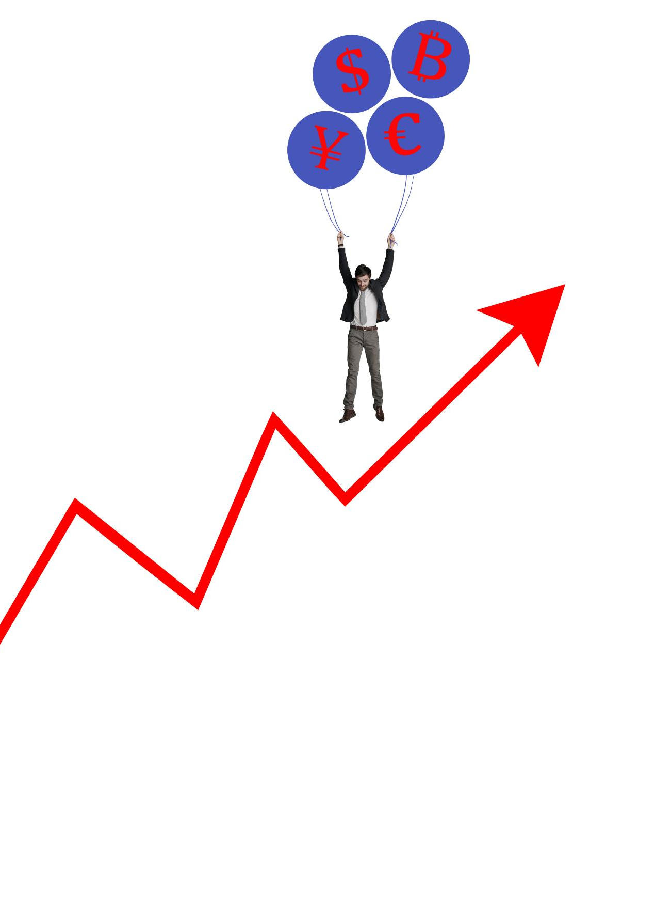
History and Development
Introduction to WRAP
  WRAP, or Wellness Recovery Action Plan, was developed in 1997, focusing on self-management strategies for recovery.
Global Adoption
  Since its inception, WRAP has been widely adopted across various recovery programs globally, showcasing its effectiveness.
Self-Management Emphasis
  WRAP emphasizes the importance of self-management in the recovery process, enabling individuals to take control of their lives.
Notes:
WRAP was first created in 1997 by Mary Ellen Copeland. It has since been adopted widely and has inspired many recovery programs around the world, emphasizing the importance of self-management and recovery.

Slide 6

Core Concepts and Principles
Hope
  Hope is essential in the recovery process, providing the motivation to create a fulfilling life.
Personal Responsibility
  Taking personal responsibility empowers individuals to make choices that support their recovery journey.
Education and Self-Advocacy
  Education enhances self-advocacy, enabling individuals to advocate for their needs and preferences.
Support Systems
  Support from peers and community members is vital in the recovery journey, fostering connection and encouragement.
Notes:
The core concepts of WRAP include hope, personal responsibility, education, self-advocacy, and support. These principles guide individuals in their recovery journey, helping them to create a life they want to live.

Slide 7
Creating Your WRAP
Notes:
Creating a WRAP is a personal and empowering process. It involves identifying what wellness means to you and the tools that can help you maintain it.

Slide 8

Identifying Wellness Tools
Mental Health Strategies
  Mental health strategies include mindfulness practices, meditation, and therapy that support emotional well-being.
Physical Health Practices
  Physical health practices involve regular exercise, balanced nutrition, and proper sleep to maintain overall wellness.
Support Systems
  Support systems include community groups, health professionals, and social networks that provide encouragement and assistance.
Notes:
Wellness tools are strategies and resources that help individuals stay well. These can include activities, practices, and support systems that promote mental and physical health.

Slide 9
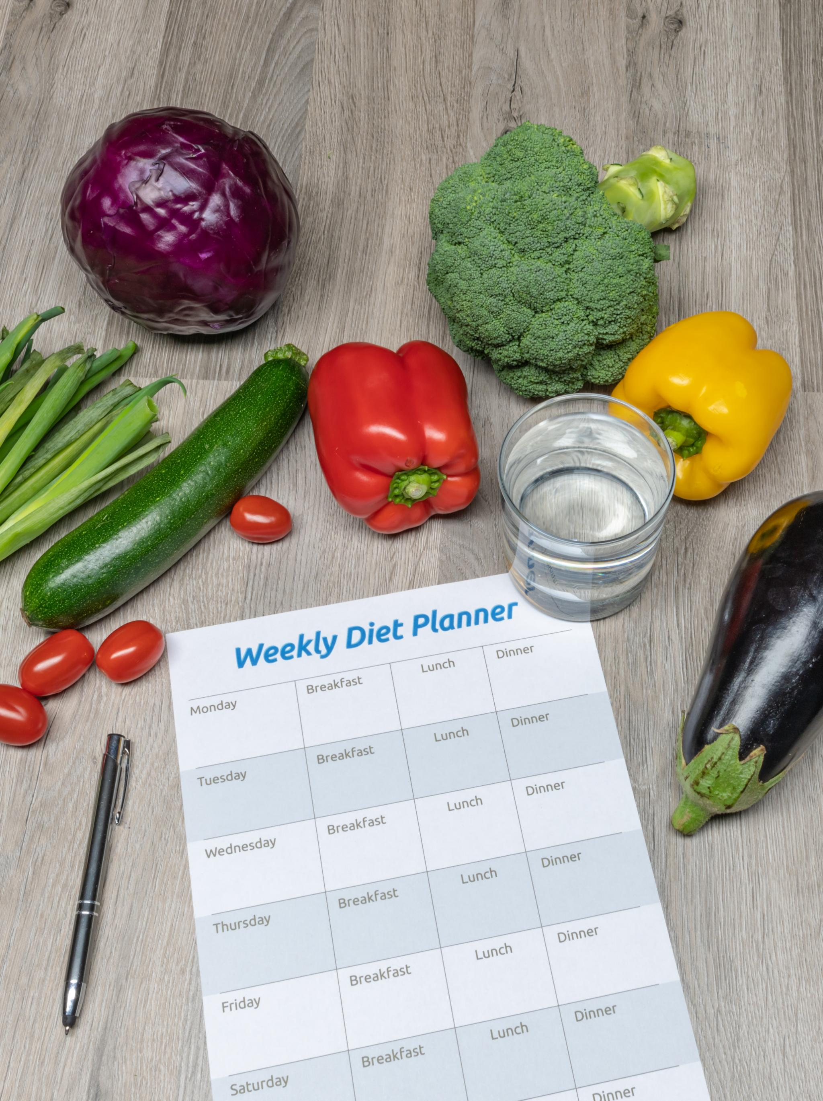
Developing a Daily Maintenance Plan
Importance of Daily Maintenance
  A daily maintenance plan is essential for maintaining mental wellness and ensuring self-care is prioritized.
Self-Care Activities
  Incorporating self-care activities into your daily routine helps to support mental health and overall well-being.
Prioritizing Mental Health
  A structured plan encourages prioritization of mental health, leading to a more balanced and fulfilling life.
Notes:
A daily maintenance plan is crucial for sustaining wellness. It outlines daily activities and practices that support your mental health, ensuring you prioritize self-care in your life.

Slide 10

Recognizing Early Warning Signs
Importance of Early Recognition
  Recognizing early warning signs of distress is crucial for effective wellness management through the WRAP process.
Understanding Triggers
  Being aware of your triggers can empower you to take proactive steps in managing your mental wellness and preventing crises.
Proactive Wellness Steps
  Taking proactive steps based on early identification can significantly enhance your overall well-being and resilience.
Notes:
Identifying early warning signs of distress is essential in WRAP. Being aware of your triggers can help you take proactive steps to manage your wellness effectively.

Slide 11
Taking Action: Crisis Plan and Post-Crisis Plan
Notes:
Having a crisis plan in place is a key aspect of WRAP, empowering individuals to act decisively and effectively during difficult times.

Slide 12

Creating a Crisis Plan
Identifying Triggers
  Recognize the situations or events that may lead to a crisis, allowing for proactive management and preparation.
Coping Strategies
  Develop effective coping strategies to manage stress and emotions during a crisis, ensuring a clearer mindset.
Emergency Contacts
  Compile a list of emergency contacts, including family, friends, and professionals, to reach out during a crisis.
Notes:
A crisis plan outlines specific steps to take when you're experiencing a crisis. It includes identifying triggers, coping strategies, and emergency contacts.

Slide 13
Implementing the Post-Crisis Plan
Reflection on Experience
Reflection is crucial in understanding the impact of the crisis and identifying personal and organizational lessons learned.
Steps for Recovery
Outlining clear steps for recovery helps individuals and organizations to regain stability and rebuild effectively after a crisis.
Implementing Changes
Implementing changes based on crisis experiences ensures improved responses and preparedness for future challenges.
Notes:
A post-crisis plan helps individuals reflect on their experience and outlines steps for recovery. It focuses on learning from the crisis and implementing changes to improve future responses.

Slide 14

Involving a Support Network
Importance of Support Networks
  A strong support network is essential for emotional well-being and resilience, especially during difficult moments in life.
Trust and Encouragement
  Involving trusted individuals provides encouragement and strengthens the bonds necessary for navigating challenges effectively.
Professional Guidance
  Incorporating professionals into your support network can offer valuable insights and assistance tailored to your needs.
Notes:
Having a support network is vital in WRAP. Involving trusted friends, family members, or professionals can provide encouragement, guidance, and assistance during challenging times.

Slide 15
Personal Experiences and Success Stories
Notes:
Hearing from others who have used WRAP can provide inspiration and hope. Personal success stories highlight the effectiveness of WRAP in achieving wellness.

Slide 16
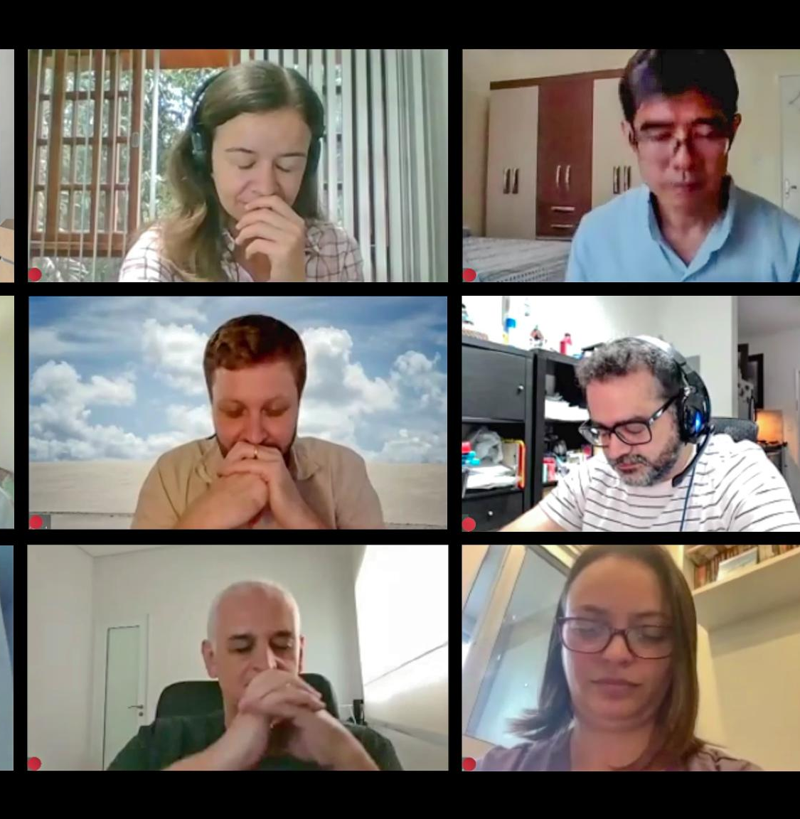
Case Studies and Testimonials
Successful Implementation of WRAP
  Real-life case studies show how individuals effectively implemented WRAP strategies, leading to significant positive changes in their lives.
Transformative Power of Personal Responsibility
  Testimonials highlight the importance of personal responsibility in the recovery process, showcasing how it fosters empowerment and growth.
Notes:
Real-life case studies demonstrate how individuals have successfully implemented WRAP in their lives. These testimonials illustrate the transformative power of personal responsibility in recovery.

Slide 17

Overcoming Challenges
Facing Recovery Challenges
  Individuals often encounter various challenges during their recovery journey, which can be discouraging.
Importance of Sharing Stories
  Sharing personal stories of overcoming challenges can inspire and motivate others in their own recovery processes.
Motivation to Persist
  Hearing about others' successes can provide hope and encouragement to persist through tough times.
Notes:
Many individuals face challenges during their recovery journey. Sharing stories of overcoming these obstacles can motivate others to persist in their WRAP process.

Slide 18

Long-Term Benefits and Personal Growth
Enhanced Self-Awareness
  Implementing WRAP fosters a deeper understanding of oneself, leading to improved decision-making and emotional regulation.
Improved Mental Health
  Individuals who implement WRAP often experience better mental health, reduced anxiety, and increased resilience.
Personal Growth
  Engaging with WRAP promotes personal growth, helping individuals to set and achieve meaningful life goals.
Sense of Control
  WRAP empowers individuals, giving them a greater sense of control over their lives and choices.
Notes:
The long-term benefits of implementing WRAP include enhanced self-awareness, improved mental health, and personal growth. Individuals often report a greater sense of control over their lives.

Slide 19
Resources and Support
Notes:
Numerous resources are available for individuals interested in WRAP. Finding support and educational materials can enhance the effectiveness of the WRAP process.

Slide 20
Finding WRAP Facilitators
Importance of Connection
Establishing connections with trained WRAP facilitators is crucial for effective guidance and support.
Navigating the WRAP Process
Facilitators assist individuals in navigating the WRAP process, ensuring they understand each step.
Personalized Plans Development
Facilitators help individuals develop personalized WRAP plans tailored to their unique needs.
Notes:
Connecting with trained WRAP facilitators can provide guidance and support. They can help individuals navigate the WRAP process and develop their personalized plans.

Slide 21

Accessing Educational Materials
Diverse Learning Resources
  There is a wide range of educational materials available, from traditional textbooks to interactive online resources.
Online Educational Platforms
  Numerous online platforms offer structured courses and materials that can enhance understanding of WRAP implementation.
Books and Publications
  Books and publications provide in-depth knowledge and comprehensive insights into WRAP and its practices.
Notes:
A variety of educational materials, including books and online resources, are available to help individuals learn more about WRAP and its implementation.

Slide 22

Connecting with Support Groups
Sense of Community
  Support groups offer individuals a sense of belonging and connection through shared experiences and challenges.
Fostering Recovery
  Connecting with others through programs like WRAP encourages healing and promotes a positive recovery journey.
Notes:
Support groups can provide a sense of community and shared experience. Connecting with others using WRAP fosters a supportive environment for recovery.

Slide 23
Conclusion
Empowerment through WRAP
The Wellness Recovery Action Plan empowers individuals to take control of their well-being and recovery journey.
Personalized Wellness Plans
Creating personalized plans helps individuals focus on their unique needs and goals for a healthier life.
Utilizing Resources
Utilizing available resources effectively can significantly enhance an individual's path to recovery and well-being.
Notes:
In conclusion, the Wellness Recovery Action Plan (WRAP) is an empowering tool that promotes personal well-being and recovery. By understanding WRAP, creating personalized plans, and utilizing available resources, individuals can take significant steps toward a fulfilling and healthy life.

