Slide 1

Wellness Recovery Action Plan: Essential Recovery Topics
Explore key strategies for wellness and recovery.
Notes:
---
The Wellness Recovery Action Plan (WRAP) is a structured system for developing wellness and recovery strategies. This presentation will explore essential topics related to WRAP, including its principles, toolbox development, daily maintenance planning, identifying triggers, and crisis planning.

Slide 2
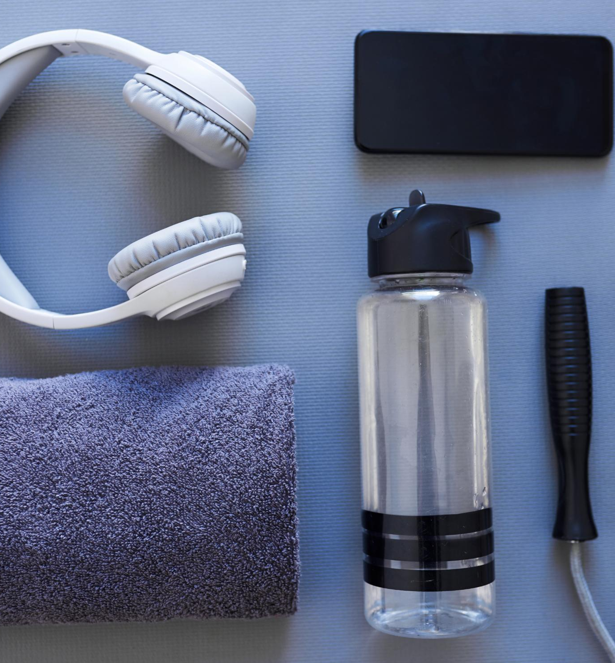
Agenda Items
Introduction to Wellness Recovery Action Plan (WRAP)
Developing a Wellness Toolbox
Creating a Daily Maintenance Plan
Identifying Triggers and Early Warning Signs
Crisis Planning and Post-Crisis Reflection
Notes:
This presentation will start with an introduction to WRAP, explaining its definition, principles, and benefits. We will then discuss how to develop a wellness toolbox and create a daily maintenance plan. Following that, we will learn about identifying triggers and early warning signs, and finally, we will cover crisis planning and post-crisis reflection.

Slide 3
Introduction to Wellness Recovery Action Plan (WRAP)
Notes:
Understanding the fundamentals of WRAP is crucial for effective recovery. This section will cover the core concepts that guide individuals in their wellness journey.

Slide 4
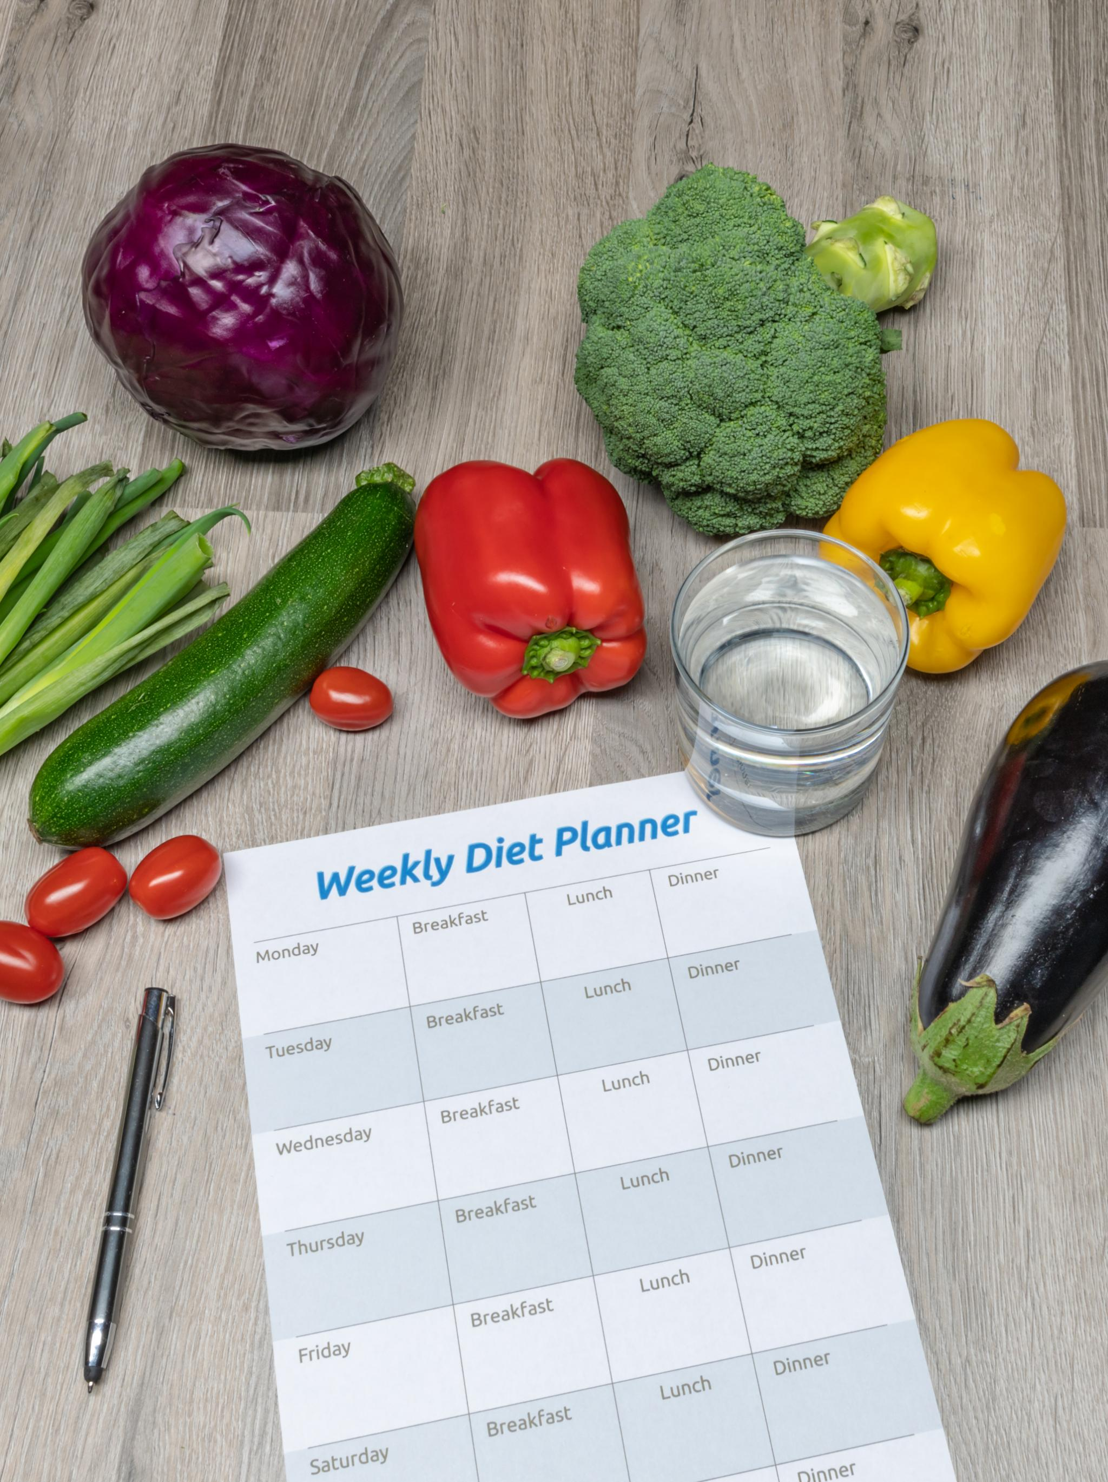
What Is WRAP?
Definition of WRAP
  WRAP is an acronym for Wellness Recovery Action Plan, a tool designed for personal wellness.
Self-Directed Tool
  WRAP empowers individuals to take charge of their wellness journey through self-directed strategies and goals.
Personalized Strategies
  The plan encourages the development of personalized strategies tailored to each individual's needs and preferences.
Notes:
WRAP stands for Wellness Recovery Action Plan. It is a self-directed tool that helps individuals take control of their wellness and recovery process through the development of personalized strategies.

Slide 5

The Principles and Values of WRAP
Principles of WRAP
  WRAP is founded on essential principles that promote hope, personal responsibility, and education to enhance individual wellness.
Empowerment through Education
  Education is a fundamental value of WRAP that empowers individuals to make informed choices regarding their wellness and recovery.
Self-Advocacy and Support
  Self-advocacy is crucial in WRAP, allowing individuals to seek support and make choices that align with their wellness goals.
Notes:
WRAP is built on principles such as hope, personal responsibility, education, self-advocacy, and support. These values empower individuals to make informed choices about their wellness.

Slide 6

Benefits of Using WRAP
Improved Self-Awareness
  WRAP encourages individuals to reflect on their thoughts and emotions, leading to greater self-awareness and understanding.
Enhanced Coping Strategies
  Using WRAP helps individuals develop effective coping strategies to manage stress and challenges in a healthy way.
Proactive Wellness Management
  WRAP promotes a proactive approach to managing mental health, empowering individuals to take charge of their wellness.
Notes:
Using WRAP can lead to improved self-awareness, enhanced coping strategies, and a clearer understanding of personal wellness needs. It promotes a proactive approach to managing mental health.

Slide 7
Developing a Wellness Toolbox
Notes:
A wellness toolbox is essential for maintaining mental health. This section focuses on identifying and utilizing tools that promote well-being.

Slide 8
Identifying Personal Wellness Tools
Exercise for Wellness
Engaging in regular physical activity is crucial for maintaining physical and mental health, promoting overall well-being.
Meditation Practices
Meditation provides a peaceful space to center thoughts and relieve stress, enhancing emotional balance and clarity.
Creative Outlets
Engaging in creative activities allows for self-expression and can significantly boost mental health and happiness.
Notes:
Personal wellness tools can include activities, practices, and resources that help individuals feel balanced and centered. Examples include exercise, meditation, and creative outlets.

Slide 9
Practical Strategies for Day-to-Day Wellness
Establishing Routines
Creating consistent daily routines can significantly improve your physical and mental wellness by providing structure to your day.
Engaging in Hobbies
Incorporating hobbies into your daily life can serve as a stress reliever and enhance overall happiness and satisfaction.
Fulfilling Activities
Participating in enjoyable and fulfilling activities is essential for maintaining wellness and improving quality of life.
Notes:
Implementing practical strategies, such as establishing routines or engaging in hobbies, can enhance daily wellness. It’s important to incorporate enjoyable and fulfilling activities into daily life.

Slide 10

Building Resilience and Coping Mechanisms
Importance of Resilience
  Resilience is crucial for overcoming challenges and adapting to stressors in life, promoting mental well-being.
Adaptive Coping Mechanisms
  Adaptive coping mechanisms help individuals manage stress effectively and promote positive mental health outcomes.
Maladaptive Coping Mechanisms
  Maladaptive coping strategies can lead to increased stress and negative mental health impacts, often exacerbating challenges.
Notes:
Building resilience involves developing skills to bounce back from challenges. Coping mechanisms, whether adaptive or maladaptive, can greatly impact one's ability to manage stress.

Slide 11
Creating a Daily Maintenance Plan
Notes:
A daily maintenance plan helps individuals outline their wellness routines. This section focuses on establishing and personalizing these routines to promote consistency.

Slide 12

Establishing Routine Activities for Wellness
Importance of Exercise
  Incorporating regular exercise into your routine enhances physical health and boosts mental well-being, leading to a healthier lifestyle.
Mindfulness Practices
  Mindfulness practices, like meditation and deep breathing, can reduce stress and enhance emotional regulation, contributing to overall wellness.
Self-Check-Ins
  Regular check-ins with oneself promote self-awareness and mental clarity, enabling proactive management of emotional health.
Notes:
Routine activities can include exercise, mindfulness practices, and regular check-ins with oneself. Consistency in these activities can foster a greater sense of stability.

Slide 13
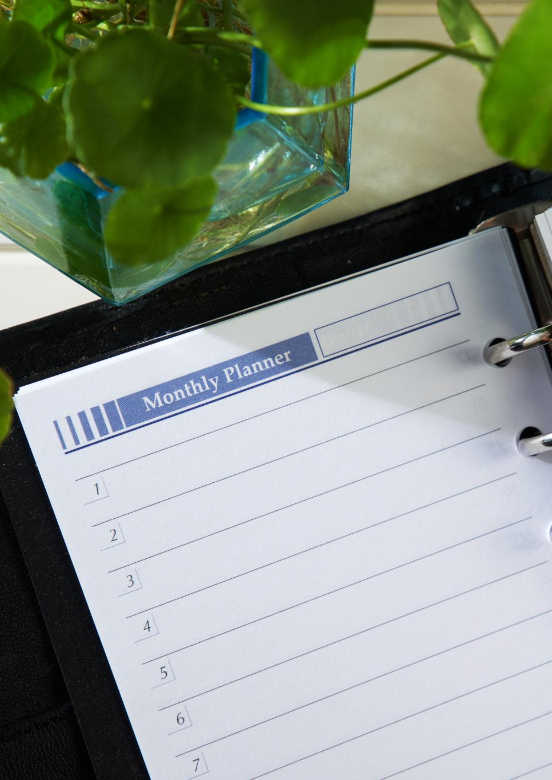
Personalizing Your Daily Maintenance Plan
Importance of Personalization
  Personalizing your maintenance plan helps in aligning it with individual preferences and lifestyles for better adherence.
Tailoring to Individual Needs
  Each person's needs are unique; adjusting maintenance tasks accordingly ensures effectiveness and sustainability.
Sustainable Practices
  Incorporating sustainable practices into your daily plan leads to long-term benefits for both individuals and the environment.
Notes:
Personalization is key to a successful daily maintenance plan. Individuals should tailor their plans according to their preferences, needs, and lifestyles to ensure sustainability.

Slide 14

Monitoring Daily Wellness and Making Adjustments
Regular Wellness Assessment
  Regularly assessing your wellness helps to identify effective practices and areas that need improvement.
Making Adjustments
  Making adjustments to your daily routines can enhance wellness by integrating new strategies that better suit your needs.
New Wellness Strategies
  Exploring new wellness strategies can provide fresh insights and boost overall health and well-being.
Notes:
Regularly assessing one's wellness can help identify what works and what doesn’t. Adjustments may include changing routines or trying new wellness strategies.

Slide 15
Identifying Triggers and Early Warning Signs
Notes:
Recognizing triggers and early warning signs is essential for proactive wellness management. This section will guide individuals through this identification process.

Slide 16
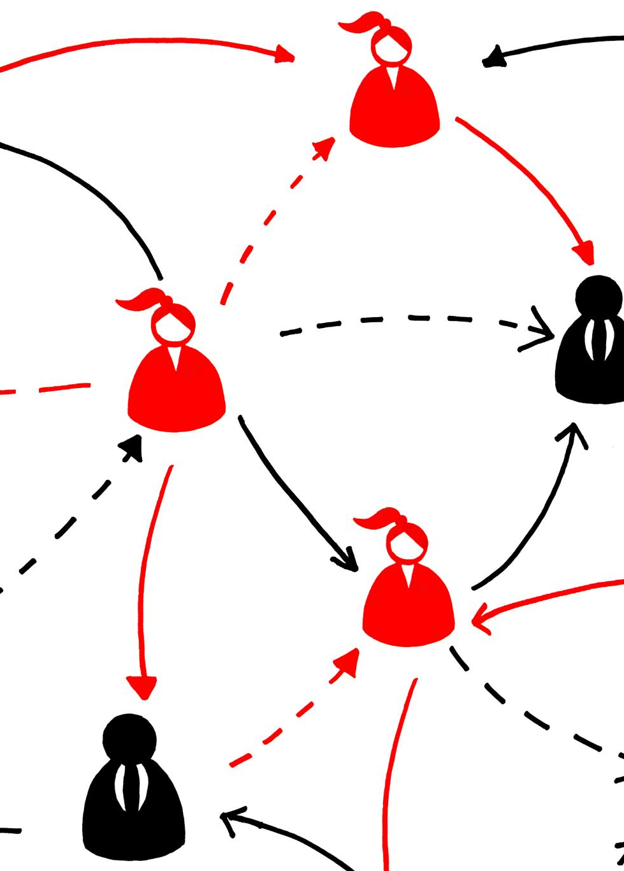
Recognizing Potential Triggers
Personalized Triggers
  Triggers can differ significantly among individuals, influenced by personal experiences and environments.
Identifying Triggers
  Recognizing specific environments, interactions, or stressors can be the first step in managing reactions effectively.
Coping Strategies
  Developing coping strategies based on identified triggers can enhance emotional well-being and resilience.
Notes:
Triggers can vary from person to person and may include specific environments, interactions, or stressors. Identifying these can help in developing coping strategies.

Slide 17
Developing a List of Early Warning Signs
Understanding Early Warning Signs
Early warning signs are critical indicators that signify a potential decline in an individual's wellness.
Personalized Action Plan
Creating a personalized list of early warning signs empowers individuals to act proactively and avoid crises.
Importance of Awareness
Being aware of these signs allows individuals to maintain wellness and seek help when necessary.
Notes:
Early warning signs are indicators that may suggest a decline in wellness. Having a personalized list can help individuals take action before crises occur.

Slide 18
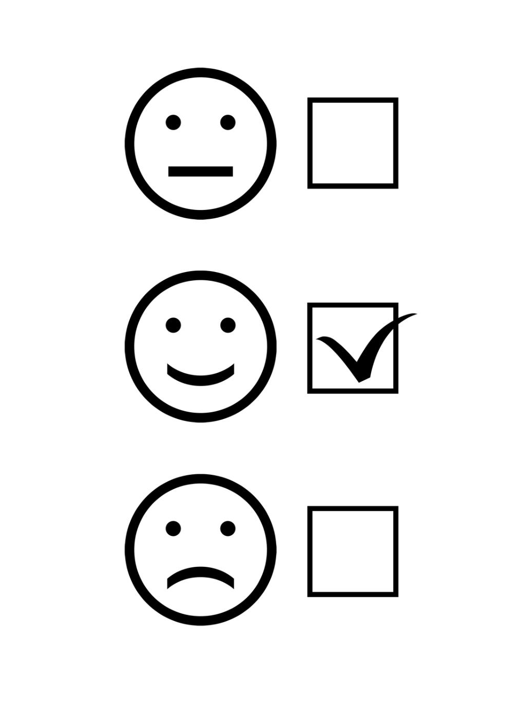
Creating Action Plans for Triggers and Warning Signs
Understanding Triggers
  Identifying triggers is crucial for developing effective action plans to manage wellness. Awareness can prevent negative responses.
Early Warning Signs
  Recognizing early warning signs helps individuals take proactive measures to address potential issues before they escalate.
Developing Strategies
  Creating tailored strategies helps individuals respond effectively to triggers and maintain their wellness journey.
Notes:
Developing action plans involves strategies and responses that individuals can use when they encounter triggers or early warning signs, ensuring they stay on track with their wellness.

Slide 19
Crisis Planning and Post-Crisis Reflection
Notes:
Crisis planning is crucial for managing potential mental health crises. This section will discuss creating a crisis plan and learning from experiences.

Slide 20
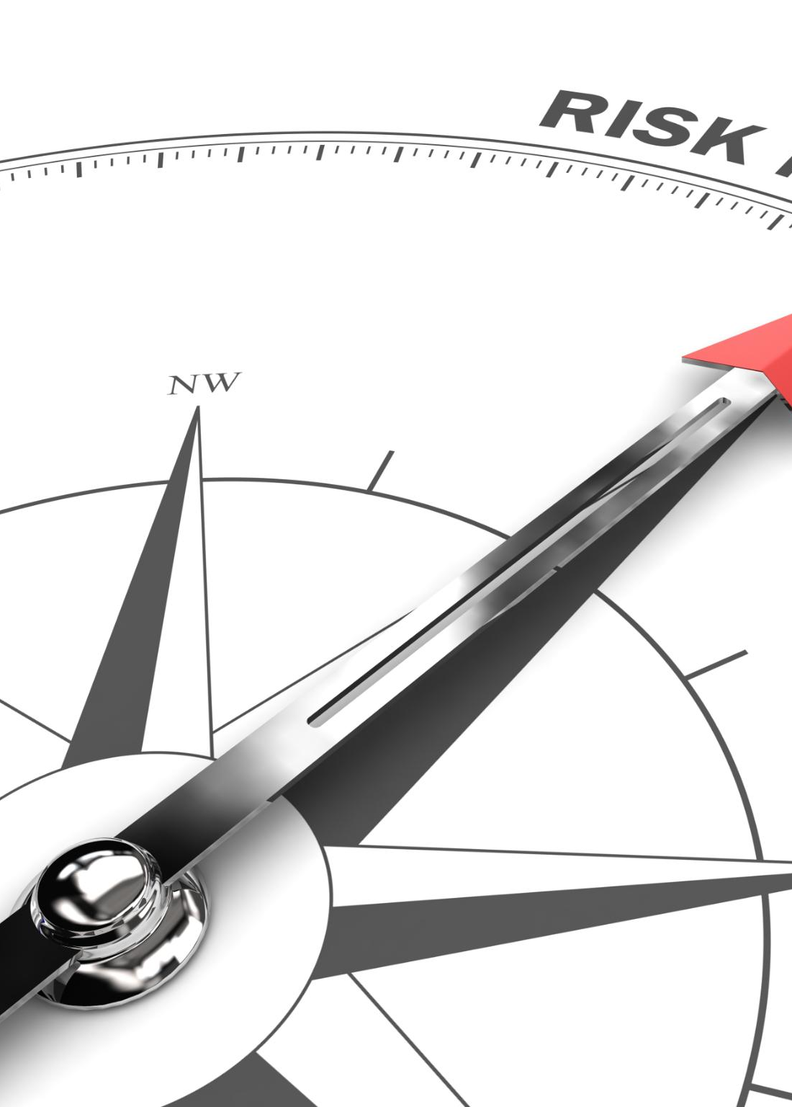
Creating a Crisis Plan
Importance of a Crisis Plan
  A crisis plan is essential for navigating difficult situations effectively and ensuring safety.
Emergency Contacts
  Including emergency contacts in your crisis plan helps ensure quick access to support during a crisis.
Coping Strategies
  Effective coping strategies outlined in the plan can support mental well-being during crises.
Notes:
A crisis plan outlines steps to take when experiencing a crisis, including emergency contacts and coping strategies. It serves as a vital resource during difficult times.

Slide 21

Identifying Supporters and Resources in Crisis
Role of Supporters
  Supporters like friends and family play a vital role in providing emotional and practical assistance during a crisis.
Professional Help
  Professionals such as counselors and therapists can offer expert guidance and support for recovery during challenging times.
Seeking Help
  Knowing where to seek help enhances recovery efforts and ensures access to necessary resources during crises.
Notes:
Identifying supporters—friends, family, or professionals—can provide crucial assistance during a crisis. Knowing where to seek help enhances recovery efforts.

Slide 22

Reflecting and Learning From Crisis Experiences
Opportunity for Growth
  Post-crisis reflection allows individuals to identify lessons learned and gain insights for future challenges.
Preparing for Future Challenges
  Reflecting on past experiences equips individuals with strategies to better handle future crises and challenges.
Refining Wellness Plans
  Learning from previous experiences helps individuals enhance their wellness plans for improved resilience.
Notes:
Post-crisis reflection is an opportunity for growth. Individuals can learn from their experiences to better prepare for future challenges and refine their wellness plans.

Slide 23
Conclusion
Understanding WRAP
The Wellness Recovery Action Plan (WRAP) helps individuals gain insight into their mental health needs and wellness.
Personalized Tools
Developing personalized tools within WRAP allows individuals to manage their wellness effectively and foster resilience.
Crisis Planning
Planning for crises is essential in WRAP, enabling individuals to navigate challenges and maintain their overall mental health.
Notes:
The Wellness Recovery Action Plan is a vital framework for managing wellness and recovery. By understanding WRAP, developing personalized tools, and planning for crises, individuals can enhance their overall mental health and resilience.

