Slide 1
Self Care: Nurturing Well-Being in Everyday Life
Building sustainable routines for balanced healthy living
Notes:
---
This presentation explores the essential role of self care in maintaining overall well-being. We will cover the definitions, practices, challenges, and strategies to help you build sustainable self care routines for a balanced and healthy life.

Slide 2
Agenda Highlights
Understanding Self Care
Physical Self Care Practices
Mental and Emotional Self Care Strategies
Barriers to Effective Self Care
Building a Sustainable Self Care Routine
Notes:
We will begin by understanding the concept of self care and its importance. Then, we delve into physical and mental self care practices, discuss common barriers, and conclude with guidance on building a sustainable self care routine.

Slide 3
Understanding Self Care
Notes:
Self care encompasses activities and practices individuals engage in to maintain and enhance their health and well-being. It has evolved over time and plays a critical role in supporting both mental and physical health.

Slide 4
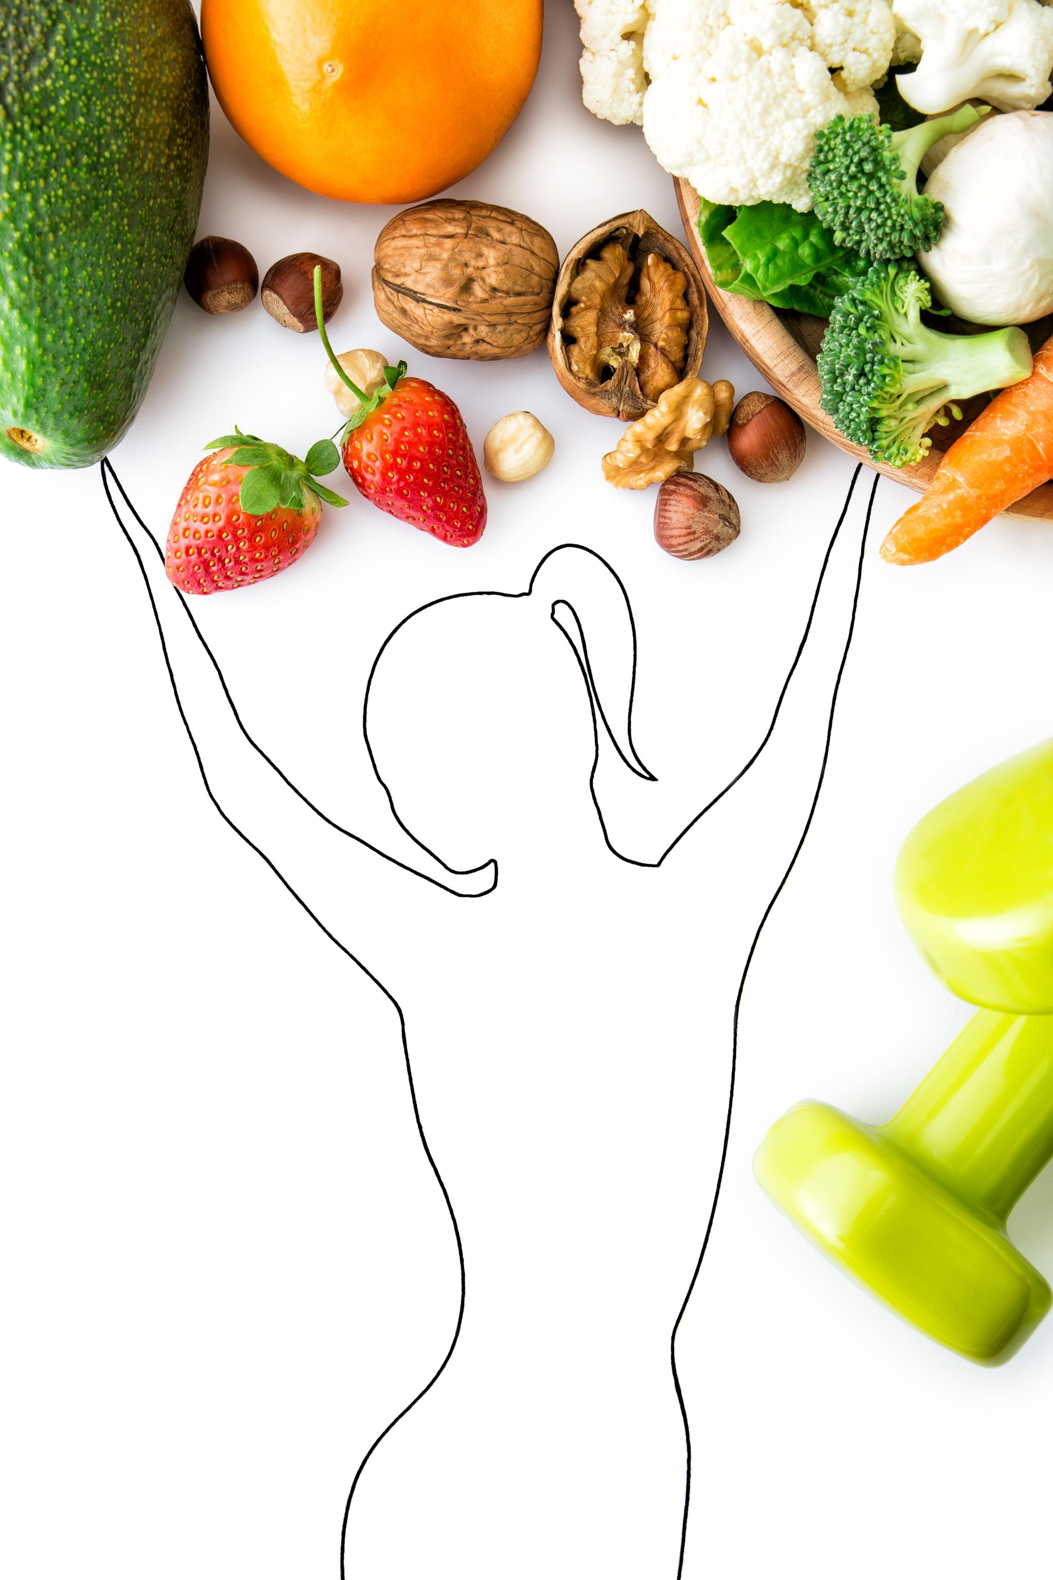
Definition and Key Concepts of Self Care
Deliberate Health Actions
  Self care involves intentional actions aimed at maintaining or improving personal health.
Preventive Measures
  It includes preventive steps to avoid illness and promote long-term wellness.
Physical and Emotional Management
  Self care covers managing both physical needs and emotional well-being proactively.
Notes:
---
Self care refers to deliberate actions to preserve or improve one’s health. It includes preventive measures, daily habits, and proactive management of physical and emotional needs.
Image source: Microsoft 365 content library

Slide 5

Historical Perspectives on Self Care
Traditional Medicine Origins
  Self care originated from traditional medicine and cultural rituals practiced over centuries worldwide.
Modern Psychological Emphasis
  Contemporary psychology highlights self care as essential for mental well-being and overall health management.
Notes:
---
Historically, self care practices have roots in traditional medicine and cultural rituals. Over time, modern psychology and healthcare have emphasized its importance as a vital component of health management.
Image source: Microsoft 365 content library

Slide 6

Importance for Mental and Physical Health
Stress Reduction
  Effective self-care practices help reduce stress and promote relaxation for better health.
Illness Prevention
  Self-care prevents illness by supporting the immune system through healthy habits.
Mental and Emotional Balance
  Self-care supports mental clarity and emotional balance for improved wellbeing.
Physical Vitality
  Maintaining self-care enhances physical vitality and overall quality of life.
Notes:
---
Effective self care reduces stress, prevents illness, and improves resilience. It supports mental clarity, emotional balance, and physical vitality, enhancing overall quality of life.
Image source: Microsoft 365 content library

Slide 7
Physical Self Care Practices
Notes:
Physical self care focuses on maintaining bodily health through nutrition, activity, and rest. These foundational practices build strength and energy for daily life.

Slide 8
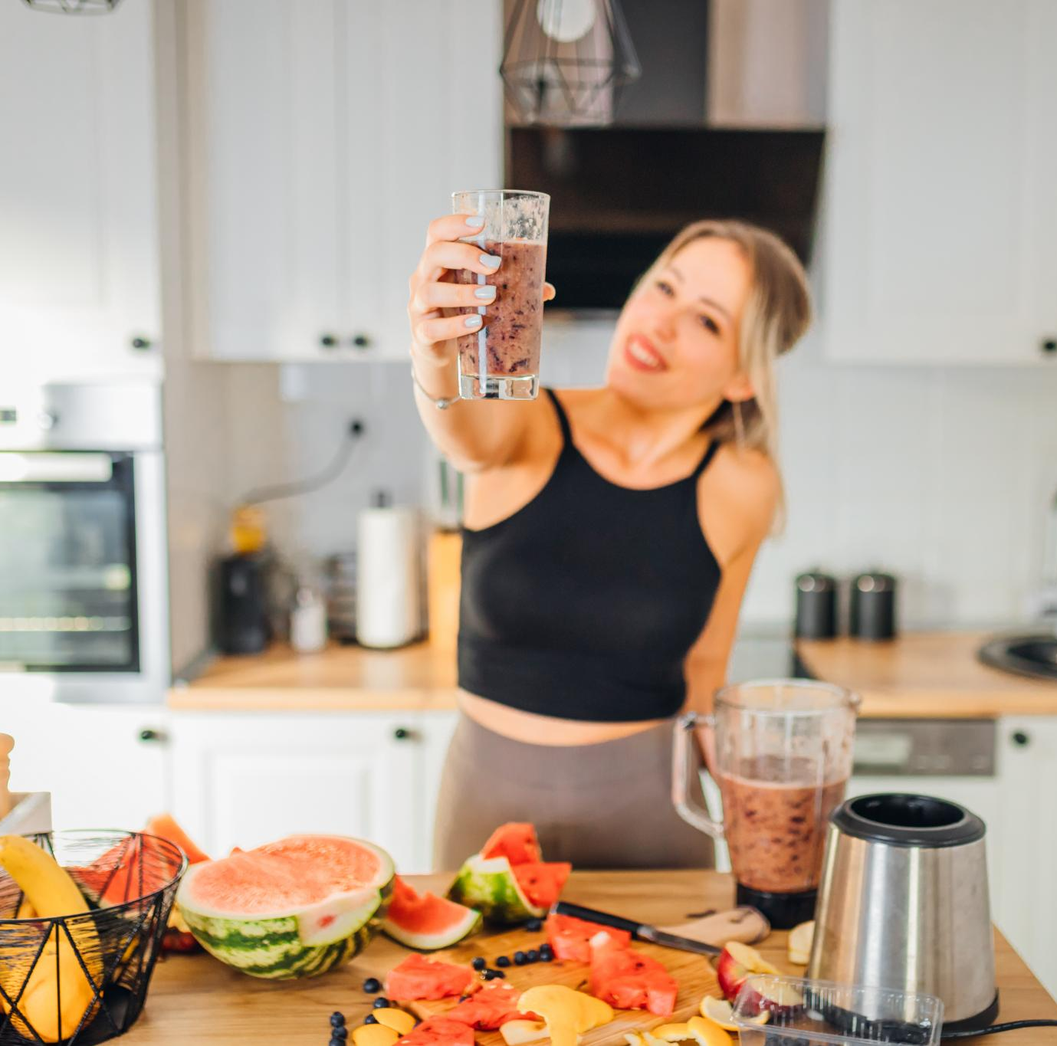
Nutrition and Healthy Eating Habits
Balanced Nutrition
  Balanced nutrition provides essential nutrients that fuel both the body and mind effectively.
Importance of Hydration
  Proper hydration supports overall health and aids in energy and mood regulation throughout the day.
Mindful Eating
  Mindful eating encourages awareness and appreciation of food, supporting better digestion and immunity.
Notes:
---
Balanced nutrition fuels the body and mind. Emphasizing whole foods, hydration, and mindful eating supports energy, immunity, and mood regulation.
Image source: Microsoft 365 content library

Slide 9

Exercise and Movement
Cardiovascular Health Benefits
  Regular exercise improves heart function and circulation, reducing the risk of cardiovascular diseases.
Flexibility Enhancement
  Physical activity increases flexibility, improving range of motion and reducing injury risks.
Mental Well-being
  Movement boosts mood and reduces stress through the release of endorphins and other chemicals.
Enjoyable Movement
  Finding fun and enjoyable ways to exercise helps maintain consistency for long-term health benefits.
Notes:
---
Regular physical activity enhances cardiovascular health, flexibility, and mental well-being. Finding enjoyable ways to move encourages consistency and long-term benefits.
Image source: Microsoft 365 content library

Slide 10

Sleep Hygiene and Rest
Importance of Quality Sleep
  Quality sleep supports cognitive functions like memory and concentration and aids physical recovery processes.
Establishing Sleep Routines
  Consistent sleep routines help regulate the body's internal clock and improve sleep quality over time.
Optimizing Sleep Environment
  Creating a comfortable, quiet, and dark environment enhances the chances of restful and restorative sleep.
Notes:
---
Quality sleep is essential for cognitive function and physical recovery. Establishing routines and optimizing the sleep environment promote restful and restorative sleep.
Image source: Microsoft 365 content library

Slide 11
Mental and Emotional Self Care Strategies
Notes:
Mental and emotional self care involves managing stress, cultivating mindfulness, and creating supportive environments to maintain psychological well-being.

Slide 12
Stress Management and Relaxation Techniques
Deep Breathing
Deep breathing exercises help lower stress levels by slowing the heart rate and promoting relaxation.
Muscle Relaxation
Progressive muscle relaxation reduces tension by systematically tensing and relaxing muscle groups.
Engaging in Hobbies
Participating in enjoyable hobbies helps distract from stress and promotes a sense of calm and happiness.
Notes:
---
Techniques such as deep breathing, progressive muscle relaxation, and engaging in hobbies help reduce stress and promote calmness.
Image source: Microsoft 365 content library

Slide 13

Mindfulness and Meditation
Enhances Awareness
  Mindfulness practice increases present moment awareness and helps focus attention effectively.
Regulates Emotions
  Meditation helps in managing emotions by promoting calmness and reducing emotional reactivity.
Reduces Anxiety
  Regular practice decreases anxiety levels and promotes relaxation and mental clarity.
Notes:
---
Practicing mindfulness and meditation enhances awareness and presence, helping to regulate emotions and reduce anxiety.
Image source: Microsoft 365 content library

Slide 14

Seeking Support and Setting Boundaries
Importance of Social Connections
  Strong social bonds provide emotional support and improve overall mental well-being.
Healthy Boundary Setting
  Setting personal boundaries protects emotional energy and prevents burnout.
Fostering Resilience
  Combining support and boundaries strengthens resilience to emotional challenges.
Notes:
---
Building strong social connections and learning to set healthy boundaries protect emotional energy and foster resilience.
Image source: Microsoft 365 content library

Slide 15
Barriers to Effective Self Care
Notes:
Many face challenges that hinder self care, including societal pressures, cultural expectations, and personal misconceptions. Recognizing these barriers is the first step toward overcoming them.

Slide 16
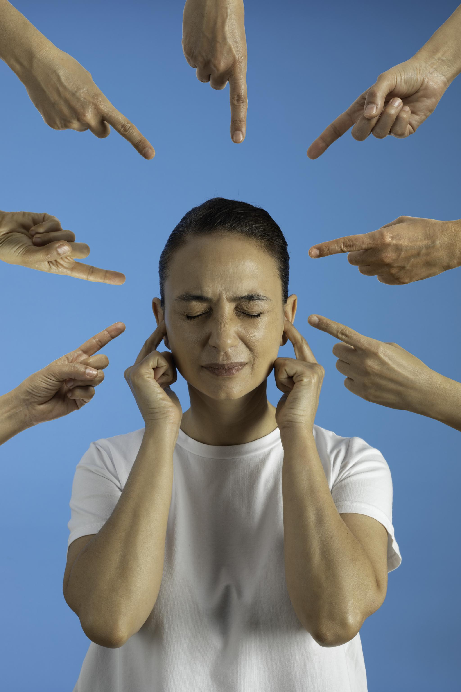
Societal and Cultural Challenges
Cultural Norms Influence
  Cultural norms often shape beliefs about self care, sometimes discouraging personal well-being practices.
Societal Expectations
  Societal demands can impose unrealistic expectations, making self care seem selfish or unnecessary.
Guilt and Stigma
  Many experience guilt or stigma when prioritizing self care due to ingrained societal attitudes.
Notes:
---
Cultural norms and societal demands can create unrealistic expectations, guilt, or stigma around prioritizing self care.
Image source: Microsoft 365 content library

Slide 17

Personal Obstacles and Misconceptions
Lack of Time
  Many individuals struggle to find time for self-care due to busy schedules and competing priorities.
Low Motivation
  A lack of motivation often hinders people from engaging in regular self-care practices.
Misconception of Self-Care
  Some view self-care as selfish, not realizing it is necessary for mental and physical well-being.
Notes:
---
Common personal challenges include lack of time, motivation, or misunderstanding self care as selfish rather than necessary.
Image source: Microsoft 365 content library

Slide 18

Strategies for Overcoming Barriers
Reframe Self Care
  View self care as an essential part of life, not a luxury or optional task.
Seek Community Support
  Engage with supportive communities to share experiences and encourage each other.
Integrate Small Practices
  Gradually add small self-care routines into daily life for sustainable habits.
Notes:
---
Practical strategies include reframing self care as essential, seeking community support, and gradually integrating small practices into daily life.
Image source: Microsoft 365 content library

Slide 19
Building a Sustainable Self Care Routine
Notes:
Creating lasting self care habits requires realistic planning, personalization, and consistent reflection to maintain motivation and adapt to changing needs.

Slide 20
Setting Realistic Goals
Achievable Goals
Setting achievable goals helps maintain steady progress without overwhelming yourself.
Specific Goal Setting
Specific goals provide clear direction and make progress measurable and motivating.
Preventing Burnout
Realistic goals prevent burnout and ensure self-care remains manageable and rewarding.
Notes:
---
Setting achievable and specific goals ensures steady progress and prevents burnout, making self care manageable and rewarding.
Image source: Microsoft 365 content library

Slide 21

Adapting Practices to Individual Needs
Personalized Self Care
  Self care should be tailored to individual preferences to maximize its benefits and personal satisfaction.
Lifestyle Integration
  Adapting self care practices to fit one’s lifestyle ensures consistency and long-term effectiveness.
Circumstance Consideration
  Considering personal circumstances helps in selecting appropriate and practical self care methods.
Notes:
---
Self care is personal; adapting practices to fit individual preferences, lifestyle, and circumstances increases effectiveness and satisfaction.
Image source: Microsoft 365 content library

Slide 22

Tracking Progress and Maintaining Motivation
Progress Monitoring Tools
  Using journals or apps enables consistent tracking of progress and helps identify growth areas.
Celebrating Successes
  Recognizing and celebrating milestones reinforces motivation and encourages continuation of positive habits.
Notes:
---
Monitoring progress through journals or apps and celebrating successes help sustain motivation and reinforce positive habits.
Image source: Microsoft 365 content library

Slide 23
Conclusion
Importance of Self Care
Self care nurtures mental, emotional, and physical health, improving overall well-being and quality of life.
Effective Self Care Strategies
Embracing strategies like mindfulness, rest, and healthy habits supports a consistent and fulfilling self care routine.
Overcoming Self Care Barriers
Identifying and overcoming obstacles helps maintain a sustainable routine that enriches everyday life.
Notes:
Self care is a vital practice for nurturing mental, emotional, and physical well-being. By understanding its importance, embracing effective strategies, and overcoming barriers, anyone can build a sustainable routine that enriches everyday life.

