Slide 1

Wellness Recovery Action Plan (WRAP) Wellness Toolbox: Building Resilience and Well-Being
Strategies for improving mental health and resilience
Notes:
---
The Wellness Recovery Action Plan (WRAP) offers structured support for individuals seeking to enhance their mental well-being. In this presentation, we will explore WRAP and its Wellness Toolbox, which plays a crucial role in building resilience and fostering overall well-being.

Slide 2
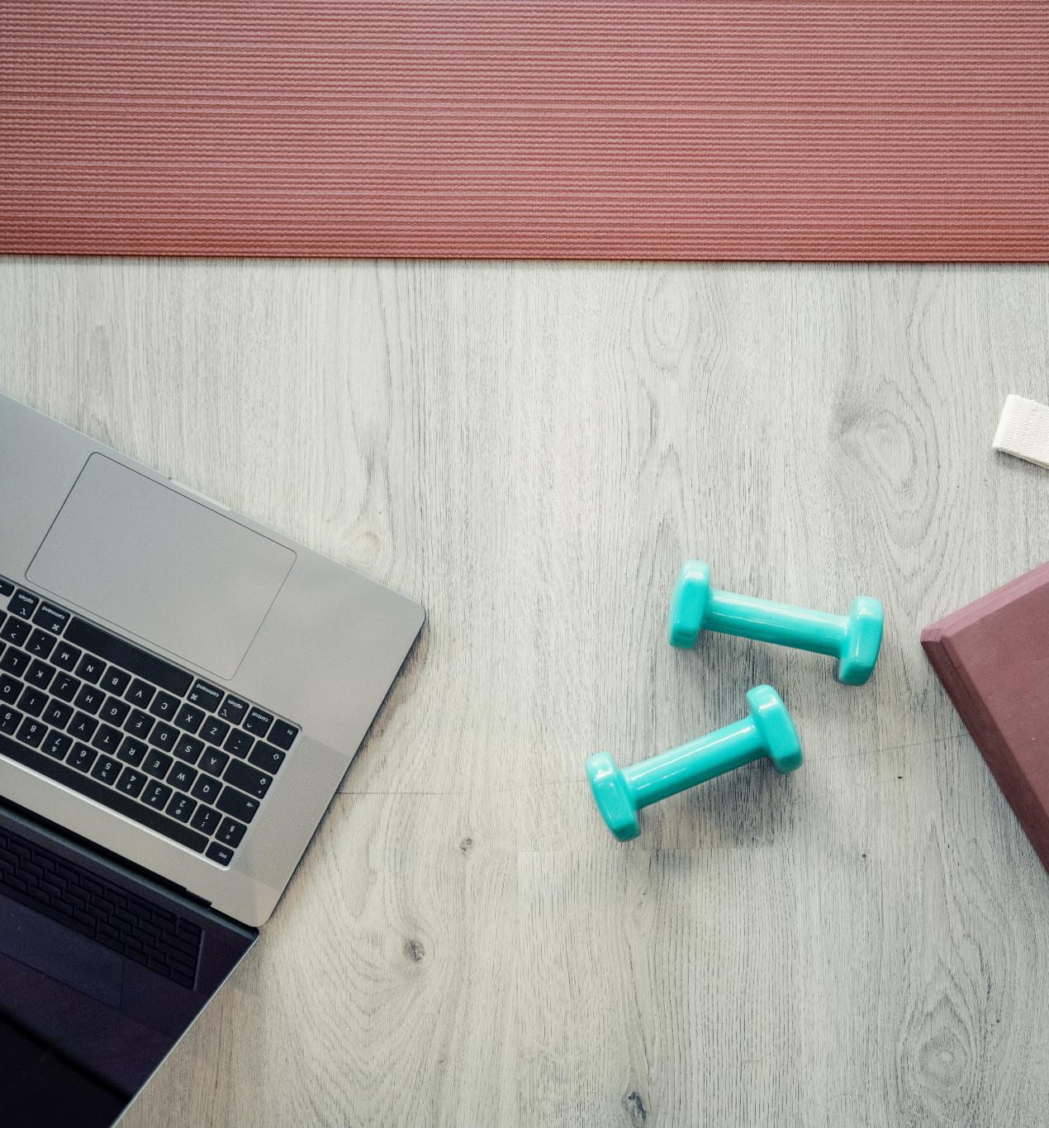
Agenda Items
Introduction to WRAP
Understanding the Wellness Toolbox
Creating Your Personal Wellness Toolbox
Utilizing Your Wellness Toolbox
Sharing and Expanding Your Toolbox
Notes:
We will begin with an introduction to WRAP, covering its history, principles, and benefits in mental health recovery. Next, we will dive into the Wellness Toolbox, exploring its purpose and how to identify effective wellness tools. We will then discuss creating a personal toolbox, utilizing those tools in daily life, and finally, sharing and enhancing your toolbox with others.

Slide 3
Introduction to WRAP
Notes:
The Wellness Recovery Action Plan (WRAP) is a self-directed program that empowers individuals to take control of their mental health. This section will cover its historical context, core principles, and the advantages it provides in recovery.

Slide 4

History and Development of WRAP
Origins of WRAP
  WRAP was created in the 1990s to provide a structured framework for individuals seeking mental health recovery.
Evolution Over Time
  Since its inception, WRAP has evolved into a widely adopted tool utilized across various mental health settings.
Impact on Mental Health
  WRAP has significantly impacted the way mental health recovery is approached, emphasizing self-management and empowerment.
Notes:
WRAP was developed in the 1990s by Mary Ellen Copeland, who recognized the need for a structured approach to mental health recovery. It has evolved over the years, becoming a widely used tool in various mental health settings.

Slide 5

Core Principles and Philosophy
Personal Responsibility
  Personal responsibility is a key principle in WRAP, encouraging individuals to take charge of their own recovery process and decisions.
Self-Advocacy
  Self-advocacy empowers individuals to express their needs and desires, promoting active participation in their recovery journey.
Empowerment
  Empowerment is central to WRAP, helping individuals recognize and utilize their strengths and resources for effective recovery.
Notes:
WRAP is founded on principles such as personal responsibility, self-advocacy, and empowerment. These core tenets encourage individuals to take an active role in their recovery journey, utilizing their strengths and resources.

Slide 6

Benefits of WRAP in Mental Health Recovery
Enhanced Self-Awareness
  WRAP promotes enhanced self-awareness, helping individuals identify their needs and triggers effectively.
Symptom Reduction
  Participants using WRAP often experience a reduction in symptoms, leading to improved mental wellness.
Improved Quality of Life
  WRAP contributes to an overall better quality of life, fostering hope and a sense of purpose among participants.
Notes:
Utilizing WRAP has been shown to enhance self-awareness, reduce symptoms, and improve overall quality of life. Participants often report a greater sense of control and hope, leading to more effective recovery outcomes.

Slide 7
Understanding the Wellness Toolbox
Notes:
The Wellness Toolbox is a key component of WRAP, designed to provide individuals with tools and strategies to manage their mental health. This section will define the toolbox and discuss its purpose in recovery.

Slide 8
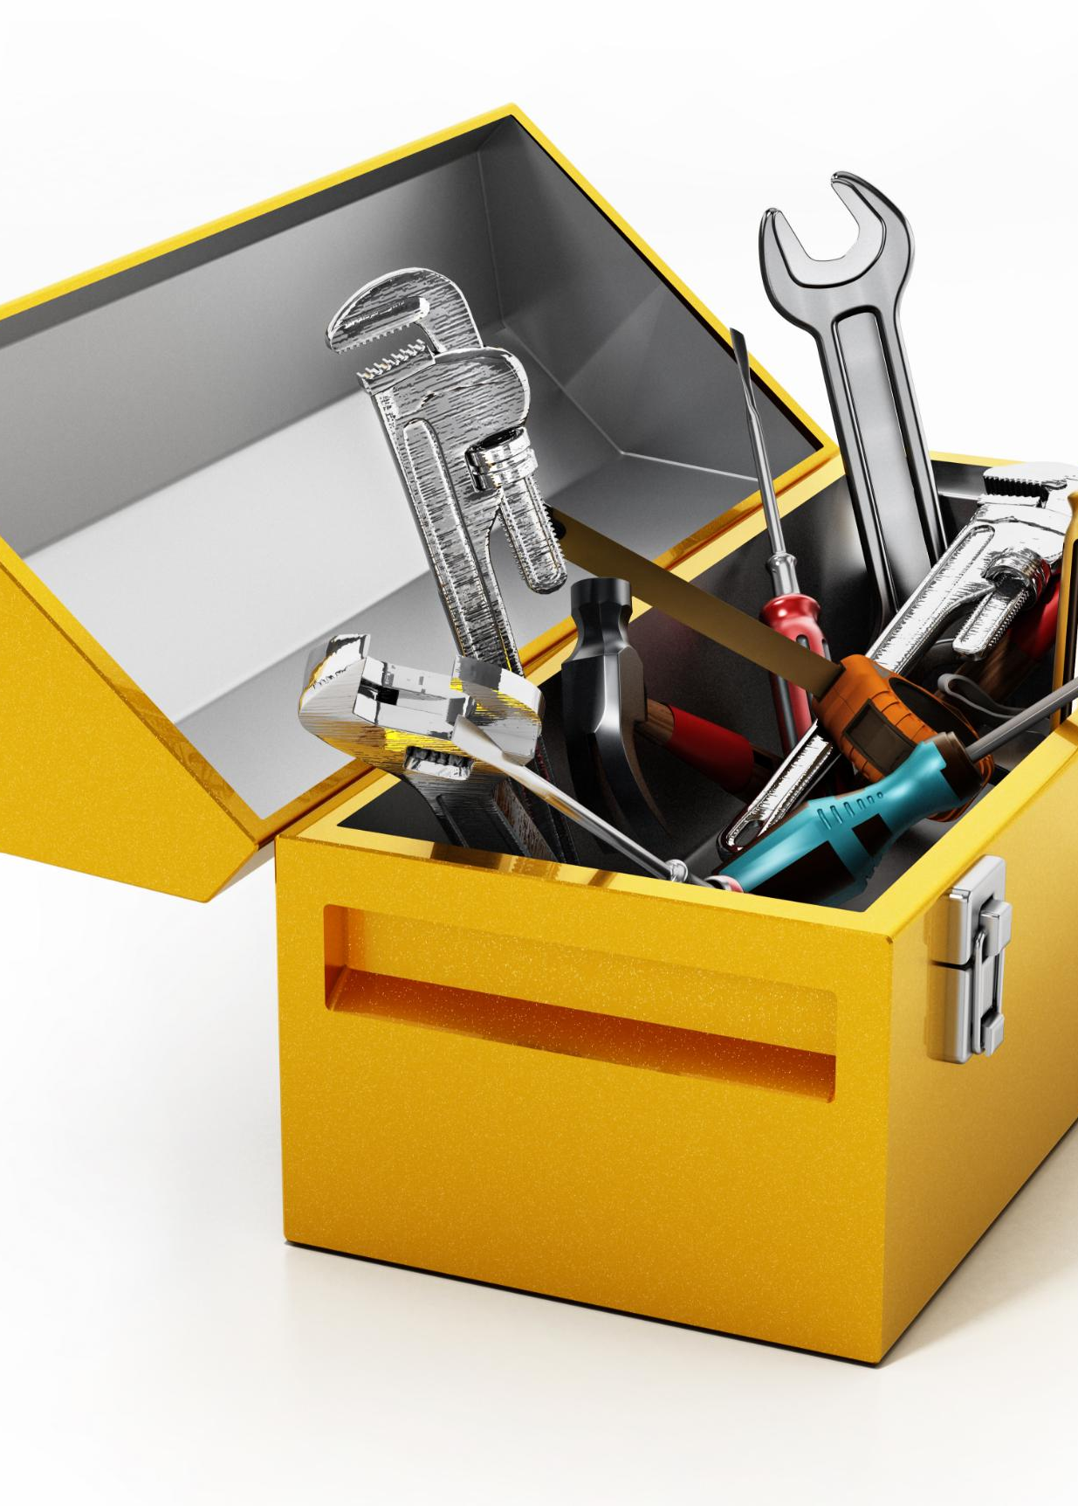
Definition and Purpose of the Wellness Toolbox
Personal Strategies for Well-being
  The Wellness Toolbox includes various personal strategies that individuals can tailor to enhance their mental and emotional health.
Combatting Stress
  The toolbox aims to provide effective methods to manage and reduce stress, enabling individuals to face adversity with resilience.
Empowerment through Resources
  The Wellness Toolbox empowers users by offering accessible resources that support their journey towards better well-being.
Notes:
The Wellness Toolbox is a collection of personal strategies and resources that individuals can use to maintain their well-being. Its purpose is to empower users to utilize effective methods to combat stress and adversity in their lives.

Slide 9
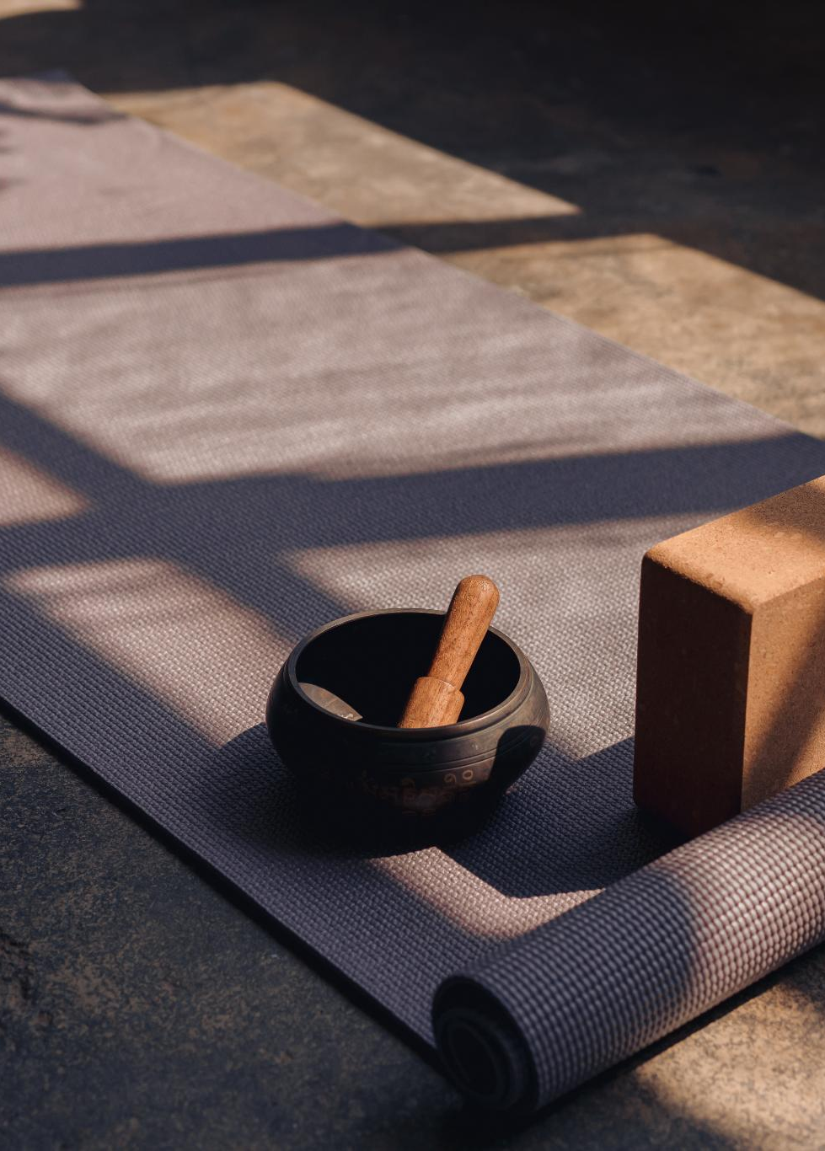
Identifying Personal Wellness Tools
Importance of Personal Wellness Tools
  Selecting personal wellness tools is essential for effective recovery and maintaining mental well-being.
Tailored to Individual Needs
  Wellness tools should be tailored to meet individual preferences and needs, enhancing their effectiveness in promoting well-being.
Activities and Practices
  Wellness tools can include activities like meditation, exercise, and creative practices that foster mental health.
Notes:
Recognizing and selecting personal wellness tools is crucial for effective recovery. Tools may include activities, practices, or resources that support mental well-being, tailored to individual needs.

Slide 10
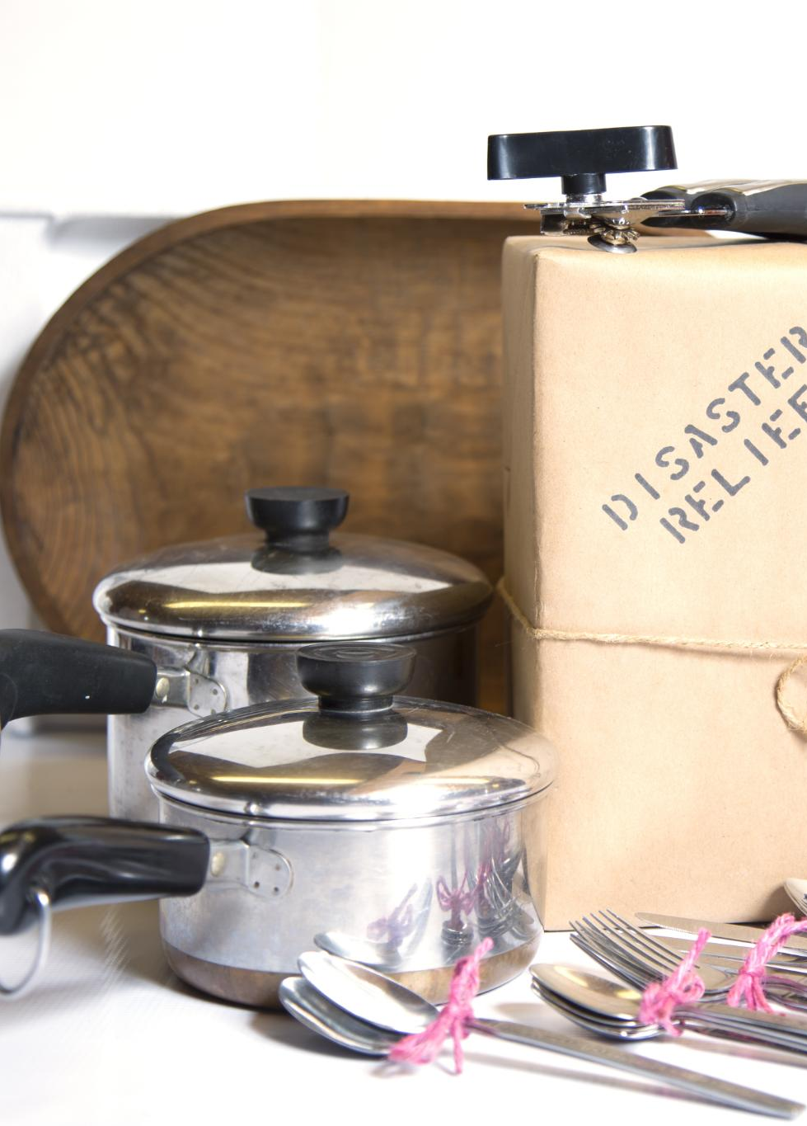
How the Toolbox Supports WRAP Goals
Practical Coping Strategies
  The Wellness Toolbox provides individuals with practical strategies to cope with life’s challenges effectively.
Promoting Resilience
  The Toolbox enhances resilience by equipping individuals with the necessary skills to bounce back from difficulties.
Balanced Lifestyle Support
  The Toolbox aligns with WRAP goals by helping individuals maintain a balanced lifestyle through proactive planning.
Notes:
The Wellness Toolbox complements WRAP goals by providing practical strategies for coping and resilience. It allows individuals to proactively address challenges and maintain a balanced lifestyle, aligning with WRAP's philosophy.

Slide 11
Creating Your Personal Wellness Toolbox
Notes:
Building a personalized Wellness Toolbox involves self-assessment and identifying needs. This section will guide you through the process of creating a toolbox that is uniquely effective for you.

Slide 12

Self-Assessment and Identifying Needs
Importance of Self-Assessment
  Conducting a self-assessment is essential to recognize your current wellness status and identify focus areas for improvement.
Identifying Specific Challenges
  Recognizing specific challenges is crucial in addressing wellness needs effectively and developing targeted strategies.
Choosing Appropriate Tools
  Once challenges are identified, selecting the right tools can significantly enhance your daily life and wellness journey.
Notes:
Start with a self-assessment to determine areas of focus for your wellness. Identify specific challenges you face and determine what tools could best address those needs in your daily life.

Slide 13

Examples of Effective Wellness Tools
Mindfulness Practices
  Mindfulness practices, such as meditation and deep breathing, can help reduce stress and enhance overall well-being.
Physical Activities
  Engaging in physical activities like walking, running, or yoga promotes physical health and boosts mental wellness.
Creative Outlets
  Creative outlets, such as painting or writing, allow for self-expression and can significantly enhance emotional well-being.
Social Support Networks
  Building social support networks with friends and family can provide emotional support and improve mental health.
Notes:
Examples of wellness tools can vary widely, including mindfulness practices, physical activities, creative outlets, and social support networks. These tools should resonate with your personal preferences and support your goals.

Slide 14
Organizing and Maintaining Your Toolbox
Importance of Organization
Keeping your Wellness Toolbox organized helps you easily access the tools you need for your well-being.
Regular Reviews
Regularly reviewing your toolbox ensures that your tools are effective and relevant to your current needs.
Adaptation to Needs
Adjust your tools based on changing circumstances to maintain their effectiveness in supporting your wellness journey.
Notes:
It’s essential to keep your Wellness Toolbox organized and up-to-date. Regularly review and adjust your tools to ensure they remain effective and relevant to your current situation and needs.

Slide 15
Utilizing Your Wellness Toolbox
Notes:
The next step is to integrate your wellness tools into your daily routine effectively. This section discusses how to adapt your tools for various situations and monitor their effectiveness.

Slide 16
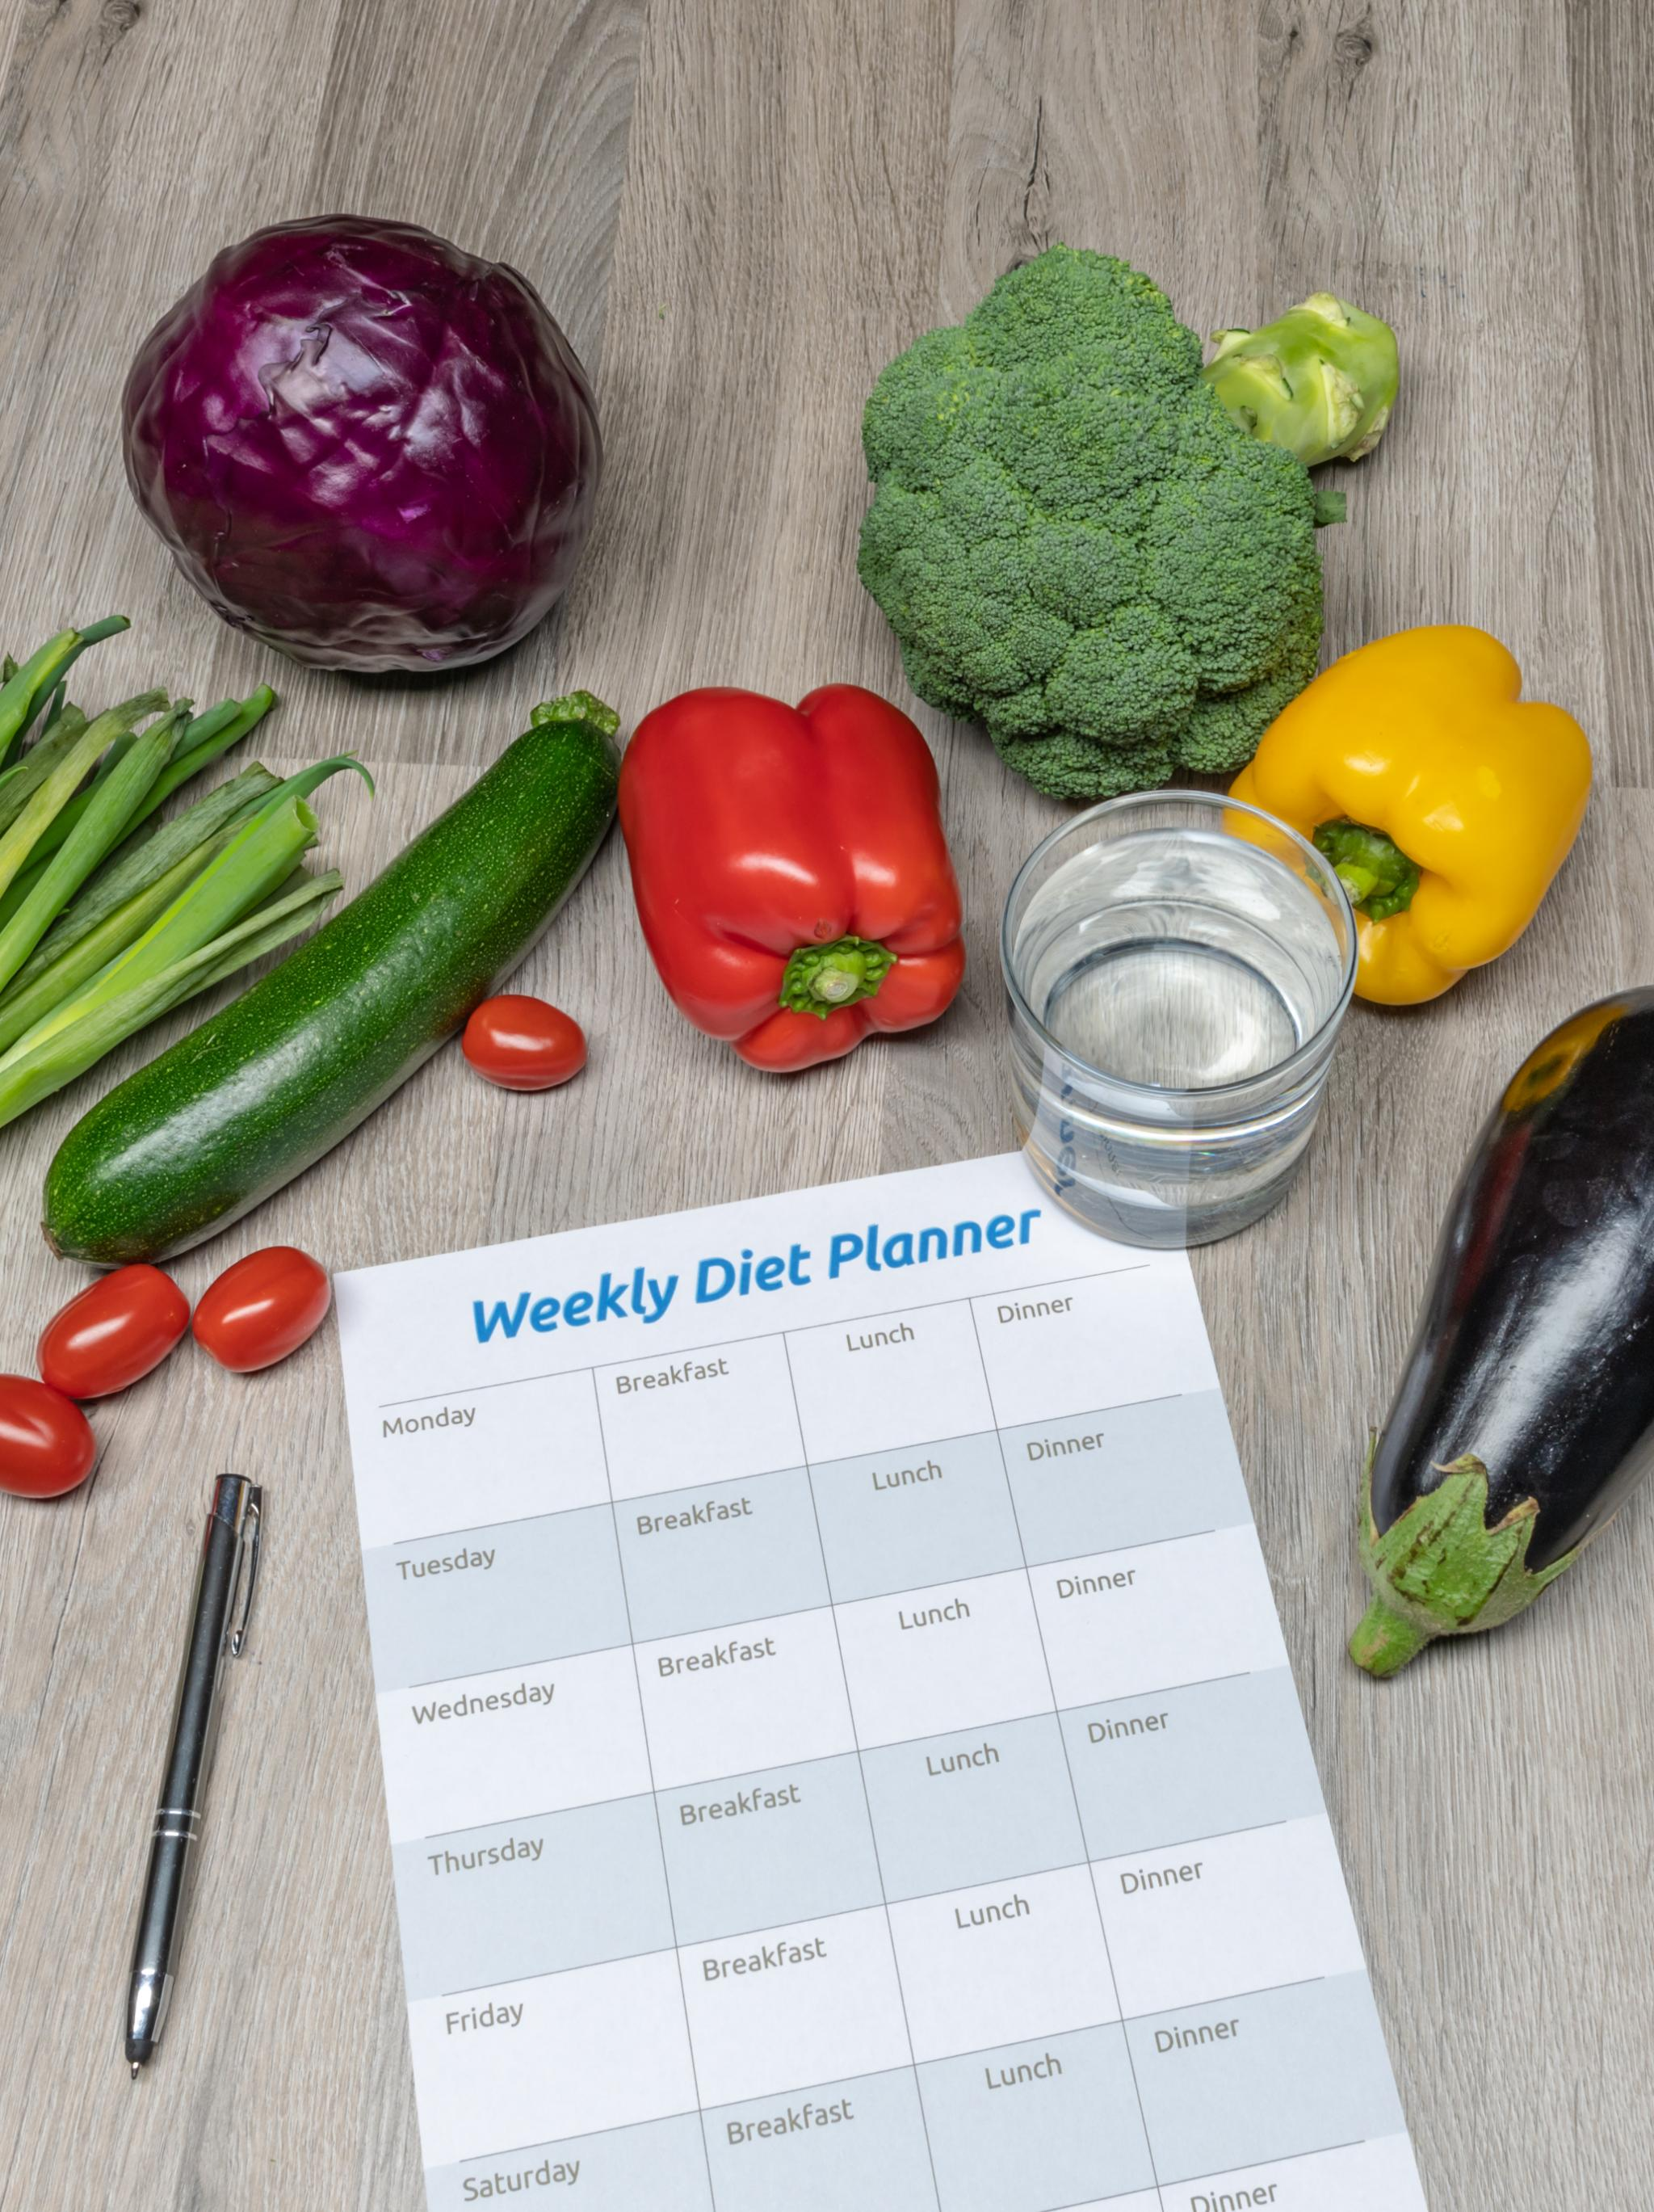
Incorporating Tools Into Daily Routines
Schedule Your Wellness Time
  Incorporate wellness tools into your daily routine by scheduling dedicated time for activities that promote well-being.
Morning Meditation
  Starting your day with morning meditation can help center your mind and enhance focus throughout the day.
Weekly Exercise Class
  Participating in a weekly exercise class fosters consistency and encourages a healthy lifestyle within your routine.
Notes:
Incorporate wellness tools into your everyday life by scheduling time for them. Whether it’s a morning meditation or a weekly exercise class, consistency is key to building resilience.

Slide 17

Adapting Tools for Different Situations
Flexibility in Tool Usage
  Being flexible with your tools allows you to approach challenges creatively and effectively, ensuring better outcomes.
Creative Problem Solving
  Creativity in adapting your tools can lead to innovative solutions for new challenges, enhancing your problem-solving skills.
Mental Health Responsiveness
  Adapting your toolbox ensures you can respond to your mental health needs, promoting overall well-being and resilience.
Notes:
Different situations may call for different tools. Learn to be flexible and creative in adapting your toolbox to address new challenges, ensuring that you remain responsive to your mental health needs.

Slide 18
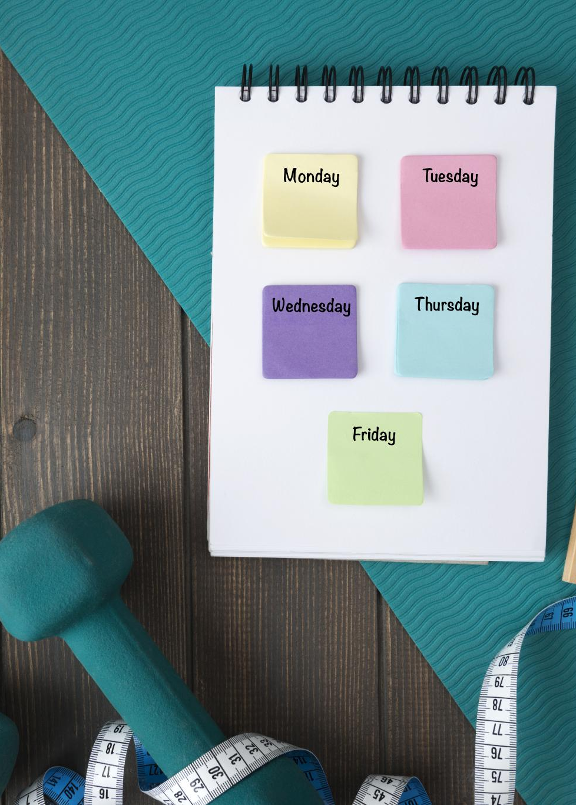
Monitoring Effectiveness and Making Adjustments
Assessing Wellness Tools
  Regularly monitor the effectiveness of the wellness tools you are using to ensure they meet your needs and expectations.
Making Necessary Adjustments
  If certain strategies are not yielding the desired results, be open to making changes or finding alternatives that better suit your well-being.
Enhancing Well-Being
  The goal is to enhance your overall well-being, so continuously evaluate and improve your strategies for optimal health.
Notes:
Regularly assess the effectiveness of your wellness tools. If something isn’t working as expected, don’t hesitate to adjust or replace it with a more fitting strategy to enhance your well-being.

Slide 19
Sharing and Expanding Your Toolbox
Notes:
Collaboration and sharing experiences with others can enhance your personal Wellness Toolbox. This section will cover how to learn from peers and professionals to further develop your toolkit.

Slide 20

Collaborating with Peers and Professionals
Engagement with Peers
  Engaging with peers allows for the exchange of valuable insights and experiences related to wellness tools and practices.
Professional Collaboration
  Collaboration with mental health professionals enhances the quality of ideas and approaches to wellness, promoting shared knowledge.
Supportive Environment
  Creating a supportive environment through collaboration encourages personal growth and learning among participants.
Notes:
Engage with peers and mental health professionals to exchange ideas about effective wellness tools. Collaboration fosters a supportive environment where everyone can learn and grow.

Slide 21

Learning From Others' Experiences
Gaining New Insights
  Listening to the experiences of others can lead to fresh ideas and perspectives that enhance personal growth and wellness.
Inspiration Through Stories
  Sharing personal stories can inspire others and create a supportive community focused on wellness and self-improvement.
Broadening Perspectives
  Exchanging strategies and experiences helps broaden one's perspective on wellness and enhances problem-solving abilities.
Notes:
Listening to the experiences of others can provide new insights and inspiration for your toolbox. Share stories and strategies to broaden your perspective on wellness.

Slide 22

Continuously Updating and Enhancing Your Toolbox
Dynamic Resource
  Your Wellness Toolbox is a dynamic resource that should reflect your personal growth and changing life circumstances.
Seek New Tools
  Regularly explore and seek out new tools and strategies that resonate with your current needs and preferences.
Personal Growth
  As you grow personally, your toolbox should evolve to include resources that support your development and well-being.
Notes:
Your Wellness Toolbox should be a dynamic resource, continuously evolving with your personal growth and changing circumstances. Regularly seek out new tools and strategies that resonate with you.

Slide 23
Conclusion
Wellness Recovery Action Plan
The Wellness Recovery Action Plan is a structured approach that helps individuals take control of their mental health recovery process.
Wellness Toolbox
The Wellness Toolbox comprises various strategies and tools that enhance individual resilience and promote overall well-being.
Enhancing Mental Health Recovery
Utilizing these resources can significantly improve the mental health recovery journey and support lasting wellness.
Notes:
The Wellness Recovery Action Plan and its associated Wellness Toolbox are invaluable for building resilience and promoting well-being. By understanding and utilizing these tools, individuals can enhance their mental health recovery journey and achieve lasting wellness.

