Slide 1

WRAP
IMPLEMENTATION GUIDE
WELLNESS
RECOVERY
ACTION PLAN
Implementing a Wellness Recovery Action Plan into a Low-Barrier Senior / Frail Bed Program
For shelter staff and frontline workers serving older adults experiencing homelessness.
A Staff Training Guide
Prepared June 2026
Notes:
Welcome staff to the training. This deck walks frontline workers through bringing WRAP — Mary Ellen Copeland's peer-developed wellness self-management process — into our senior and frail bed program. We'll cover what WRAP is, why it fits low-barrier shelter values, how we adapt it for older adults with mobility, cognitive, and behavioral health needs, and a phased plan for rollout. Set a warm, conversational tone.

Slide 2

WHY NOW
Older adults are the fastest-growing group in shelter
770K+
people experienced homelessness on a single night in 2024 — up roughly 18% from 2023.
1 in 5
are adults aged 55+; about 146,000 older adults experienced homelessness in 2024.
~93%
of shelter clients 55+ screened positive for dementia or mild cognitive impairment in a recent ASU study.
1.9x
higher dementia risk among people experiencing homelessness vs. the general population (Ontario data).
Source: HUD AHAR 2024, GAO, ASU Edson College, Alzheimer's & Dementia 2024.
WRAP in the Senior/Frail Bed Program
2 / 15
Notes:
Frame the population: seniors are showing up in shelter sicker, frailer, and with high rates of cognitive impairment. Traditional shelter design — bunk beds, strict curfews, sobriety rules — wasn't built for them. WRAP gives us a low-cost, peer-led tool to put residents in the driver's seat of their own wellness while we work on housing.

Slide 3
THE BASICS
What is the Wellness Recovery Action Plan?
A personalized, peer-developed wellness system
Developed in 1997 by Mary Ellen Copeland and peers in Vermont who had lived experience with serious mental illness.
SAMHSA-approved, evidence-based self-management process for mental and physical wellness.
Non-clinical language; participants design their own plan and can use it without a clinician.
Delivered in a group, peer-led format — typically 8 weekly sessions or a multi-day workshop.
“
Focuses on what is strong rather than what is wrong.
— WRAP guiding principle
WRAP in the Senior/Frail Bed Program
3 / 15
Notes:
Emphasize the strengths-based framing. WRAP doesn't diagnose or treat — it helps residents identify what keeps them well and what to do when things slide. This fits naturally with low-barrier and trauma-informed values: we meet residents where they are.

Slide 4

FOUNDATIONS
The five key concepts at the heart of WRAP
1
2
3
4
5
Hope
Personal Responsibility
Education
Self-Advocacy
Support
Belief that one can get well, stay well, and pursue a meaningful life.
Each person decides and takes the actions that support their own wellness.
Learning about one's experience supports informed choices and self-knowledge.
Expressing needs clearly to get the support one deserves.
Giving and receiving support strengthens recovery and quality of life.
WRAP in the Senior/Frail Bed Program
4 / 15
Notes:
These five concepts run through everything in WRAP. When introducing them to residents, give plain-language examples: hope might mean 'I want to see my grandkids again'; support might be a peer who checks on you at breakfast. Keep it concrete.

Slide 5

STRUCTURE
The six parts of every WRAP
01
Wellness Toolbox
02
Daily Maintenance Plan
03
Triggers + Action Plan
Simple, safe, low-cost activities that help — a walk, music, a phone call.
What I look like when well, plus daily habits that keep me there.
External events that throw me off and how I respond when they happen.
04
Early Warning Signs
05
When Things Break Down
06
Crisis + Post-Crisis Plan
Subtle internal shifts that signal trouble before it escalates.
Pre-crisis steps to regain footing before a full crisis.
Who decides, what helps, and how I return to wellness after.
WRAP in the Senior/Frail Bed Program
5 / 15
Notes:
Each section builds on the wellness toolbox. The toolbox is everything: residents identify free or low-cost activities — sit by the window, listen to gospel music, call a sister — and then use those same tools across every level of the plan.

Slide 6
PUTTING IT TO WORK
Wellness toolbox & daily plan — shelter examples
Wellness Toolbox examples
A senior resident's Daily Plan
Morning coffee in the day room
A short walk with a peer or staff
Calling a family member or chaplain
Listening to favorite music
Reading scripture or a familiar book
Knitting, puzzles, simple crafts
Sitting outside with the shelter dog
"When I'm well I'm chatty, I joke with staff, I eat breakfast."
Take medications with breakfast
Drink water — two cups by lunch
Sit in the day room for at least one hour
Check in with case manager
Lights out by 10 pm
WRAP in the Senior/Frail Bed Program
6 / 15
Notes:
Use these as conversation starters during one-on-ones. The point is not to hand a resident a worksheet — it's to listen for what already works for them and write it down so the whole team can support it. Staff should reference daily plans during shift handoffs.

Slide 7

CATCHING IT EARLY
Triggers and early warning signs in shelter life
Common triggers (external)
Early warning signs (internal)
Loud nights or roommate conflict
Anniversary of a loss
Missed medical appointment or new diagnosis
Housing application denied
Cold weather, pain flare, fall
Visit from estranged family
Skipping meals or hoarding food
Withdrawing from the day room
Sleeping much more or much less
Forgetting medications
Increased irritability or confusion
Talking about giving up
WRAP in the Senior/Frail Bed Program
7 / 15
Notes:
Staff observation is critical here. Many seniors won't volunteer that they're sliding. Train every shift to know each resident's early warning signs and the agreed action — extra cup of coffee with the peer specialist, a check-in with the nurse, a quieter bed assignment.

Slide 8

WHEN IT'S SERIOUS
Crisis planning and post-crisis recovery
Things Are Breaking Down
Resident is still aware but losing footing. Move to pre-arranged supports: peer check-ins, nurse visit, quieter sleeping area, medication review.
Crisis Plan
When the resident cannot make safe decisions. The plan names supporters, preferred hospitals, medications that help/don't, AHCD or guardianship status, and who to call.
Post-Crisis Plan
Re-entry to the shelter, gentler daily routine, follow-up appointments, peer reconnection, and review of the plan together.
WRAP's crisis plan functions like a self-directed advance directive — the resident's voice stays present even when they can't speak for themselves.
WRAP in the Senior/Frail Bed Program
8 / 15
Notes:
For frail seniors, the crisis plan is especially valuable. It captures what the resident wants before cognitive decline, delirium, or hospitalization takes their voice. Keep a paper copy with intake and an electronic copy in the case file.

Slide 9

OLDER-ADULT ADAPTATION
WRAP for Healthy Aging — what changes
AHP released WRAP for Healthy Aging in 2021 — built for adults 60+
"The definition of recovery — or wellness — has to change alongside our challenges." — Jane Winterling, WRAP co-originator
Shorter sessions
3–4 hours per day over 3 days vs. the original 8 weekly sessions.
Aging-relevant prompts
Loss, chronic illness, mobility changes, isolation, and grief — not careers.
Gentler pace
Slower delivery, larger print materials, more time for stories and reflection.
Wellness, not 'recovery'
Language reframed for people in late life, often recovering from physical change.
WRAP in the Senior/Frail Bed Program
9 / 15
Notes:
Use the Healthy Aging workbook for our group. The shorter format works better for residents who tire quickly, and the prompts already speak to loss and physical change rather than career goals. Materials are available through the AHP/WRAP bookstore.

Slide 10

OUR FOUNDATION
WRAP fits naturally into low-barrier shelter values
★
♥
✦
●
Housing First
Harm Reduction
Trauma-Informed
Person-Centered
Wellness work happens alongside housing, not as a prerequisite.
We welcome residents using substances; WRAP meets them where they are.
Strengths-based, voluntary, choice-driven — no power-over.
The resident is the author of their own plan, every time.
WRAP is voluntary. A resident can decline, walk away mid-group, or use only one section — that's the design.
WRAP in the Senior/Frail Bed Program
10 / 15
Notes:
Reinforce that nothing about WRAP requires sobriety, a diagnosis, ID, or even literacy. A peer can scribe for someone who can't write. This is essential — if staff treat the group like a mandatory program, it stops being WRAP.

Slide 11
POPULATION NEEDS
Adapting WRAP for frail and cognitively-impaired residents
Cognitive support
Physical accommodations
Behavioral health overlap
Screen with MoCA at intake; share results with the resident
Use plain-language prompts and large-print workbooks
Allow a peer or staff scribe; record audio versions
Repeat key sections each session — repetition is the plan
Chairs with arms, not benches; 60–75 minute sessions max
Schedule mid-morning, after meds and before fatigue
Quiet, accessible room — no stairs, good lighting
Snacks, water, and bathroom breaks built in
Co-occurring substance use is welcome; no exclusions
Coordinate with the nurse on medication side effects
Have a warm handoff to crisis services in the plan
Watch for delirium vs. dementia — different responses
WRAP in the Senior/Frail Bed Program
11 / 15
Notes:
These adaptations matter. The Arizona dementia screening study found roughly 93% of older shelter clients screened positive for MCI or dementia — so design WRAP groups assuming most participants will have some cognitive load. Repetition, simple language, and consistent facilitators are what make it stick.

Slide 12

THE PLAN
A 12-month implementation roadmap
Months 1–2
Months 2–4
Months 4–5
Lay the groundwork
Train the facilitators
Prepare materials
Leadership buy-in, board approval, identify champion, allocate budget.
Two staff/peers complete WRAP Seminar I, then Seminar II facilitator certification.
Order Healthy Aging workbooks, set up the meeting room, build the resident referral pathway.
Months 5–8
Months 8–10
Months 10–12
Pilot the first cohort
Embed in operations
Evaluate and iterate
8–10 residents, 3-day or weekly format, with a debrief after each session.
Wellness plans referenced in shift handoffs, case notes, and crisis response.
Review KPIs, gather resident feedback, plan cohort two, recertify facilitators.
WRAP in the Senior/Frail Bed Program
12 / 15
Notes:
This roadmap is conservative on purpose. Many shelters try to launch too fast and lose momentum when facilitator certification slips or workbooks don't arrive. A champion — usually the older adult case manager or a peer specialist — is the single biggest predictor of success.

Slide 13
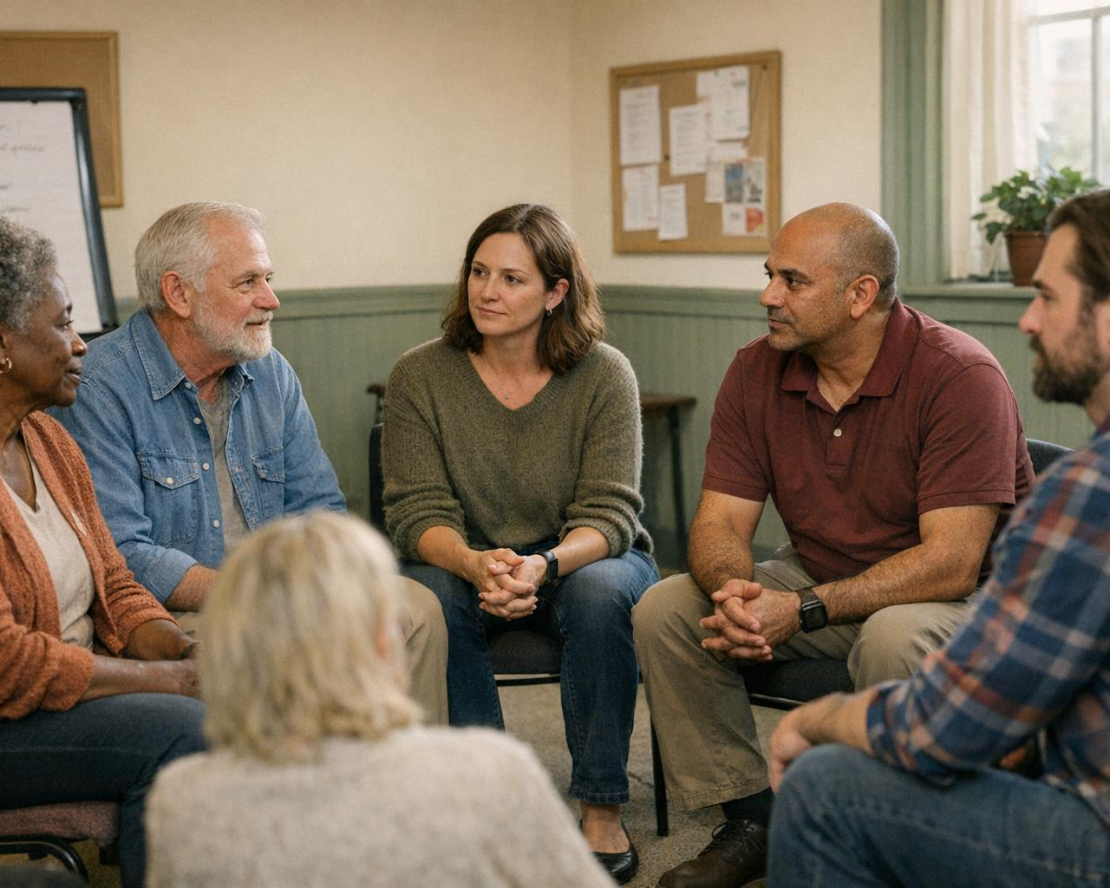
BUILDING CAPACITY
Staff training and facilitator certification
WRAP certification ladder
All shelter staff also need:
1
Seminar I
Trauma-informed care basics
Harm reduction & overdose response
Mental Health First Aid
Dementia / MoCA awareness
De-escalation & boundaries
How to read and use a WRAP
Build your own WRAP. 4 sessions × 4.5 hrs. ~$399 + materials.
2
Seminar II
Facilitator certification. 24–40 hrs in-person. ~$1,099. Recertify every 2–3 years.
3
Seminar III
Advanced Level Facilitator (ALF) — can train and certify other facilitators.
WRAP in the Senior/Frail Bed Program
13 / 15
Notes:
Two certified facilitators per cohort is the standard — one should ideally be a peer with lived experience. Budget for recertification every two years; failure to recertify means losing the ability to run groups under the WRAP name.

Slide 14

RESOURCES
Partners, budget, and funding sources
Key partners
Year-one sample budget
Local Area Agency on Aging (AAA)
Community mental health center
Federally Qualified Health Center / HCH
Peer recovery / certified peer specialist org
Adult Protective Services for high-risk cases
Hospice & palliative care providers
Facilitator training (2 staff)
$3,000
Healthy Aging workbooks (40)
$1,600
Peer specialist stipend
$8,000
Room setup, snacks, supplies
$1,400
Evaluation & data tools
$1,000
Total — Year 1
$15,000
Funding sources: SAMHSA block grants, CoC supplemental, ACL Title III-D, state aging budgets, local foundations.
WRAP in the Senior/Frail Bed Program
14 / 15
Notes:
These numbers are illustrative — adjust for local wages and group size. The biggest line item is staff time; build in protected hours rather than asking case managers to add WRAP on top of full caseloads. AAA partnerships often unlock Older Americans Act dollars.

Slide 15

MEASURING WHAT MATTERS
Outcomes, KPIs, and your next steps
Reach
Wellness
Stability
Housing
% of senior bed residents offered WRAP; cohort completion rate.
Pre/post hope scale, self-rated wellness, crisis frequency.
Bed retention days, fewer ER visits, reduced 911 calls.
Exits to permanent housing; days from intake to housing offer.
Your next three steps
Identify your WRAP champion this week — usually the older adult case manager or peer specialist.
Register two staff for the next Seminar I within 30 days.
Pick a pilot cohort of 8–10 senior residents and a target start date.
WRAP in the Senior/Frail Bed Program
15 / 15
Notes:
Close with the three actions, not abstractions. Ask the room: who will be our champion? Who is willing to attend Seminar I next month? Get verbal commitments before people leave. Evidence from Cook et al. (2011) and the 2019 meta-analysis shows WRAP reliably improves hope and self-perceived recovery — even if clinical symptom change is modest, that hope is what keeps frail seniors engaged with services.

